Slide 1
Jeopardy
COP 3502

Slide 2
BSTs & AVL Trees – Q1
Why would you use an AVL tree versus a Binary Search Tree?
  Faster Search/Insert/Delete in a balanced tree versus an unbalanced tree.
  In a balanced tree the Run-time of Search/Insert/Delete is O(log n)
    but if a branch becomes deep the Run-time approaches O(n).

Slide 3
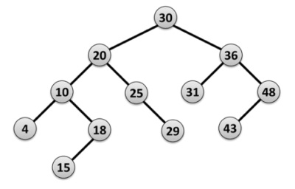
BSTs & AVL Trees – Q2
Show the state of the AVL tree after deleting node 48 and doing any necessary rebalancing:

Slide 4
BSTs & AVL Trees – Q2
Show the state of the AVL tree after deleting node 48 and doing any necessary rebalancing:
B
20
A
10
C
30
C
B
4
18
25
36
A
43
15
29
31
43

Slide 5
BSTs & AVL Trees – Q2
Show the state of the AVL tree after deleting node 48 and doing any necessary rebalancing:
B
20
A
10
C
30
4
18
25
36
15
29
31
43

Slide 6
BSTs & AVL Trees – Q3
What are the PreOrder, InOrder, and PostOrder traversals of the following Binary Tree?
PreOrder: 5,8,7,1,4,3,2,9,6
InOrder: 1,7,4,8,3,5,2,6,9
PostOrder: 1,4,7,3,8,6,9,2,5
5
8
2
7
3
9
1
4
6

Slide 7
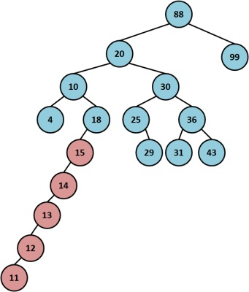
BSTs & AVL Trees – Q4
What is the height of the following tree?
  8

Slide 8
BSTs & AVL Trees – Q5
Write a recursive function to free the memory in a Binary Tree:
void FreeBST(node *root) {
if (root != NULL) {
FreeBST(root->left);
FreeBST(root->right);
free(root);
}
}

Slide 9
Hash Tables & Heaps – Q1
What index would 8 be inserted into in the following hash table using Quadratic Probing with the hash function x² + 7 % 13:
10
index | 0 | 1 | 2 | 3 | 4 | 5 | 6 | 7 | 8 | 9 | 10 | 11 | 12
val |  |  |  | 3 |  |  |  | 0 | 1 |  |  | 2

Slide 10
Hash Tables & Heaps – Q2
What is the purpose of a hash table?
  Very fast search, insert, and delete times: O(1) with a perfect hash function.

Slide 11
Hash Tables & Heaps – Q3
What are the two uses for Heaps given in class?
  Priority Queues and Heap Sort.

Slide 12
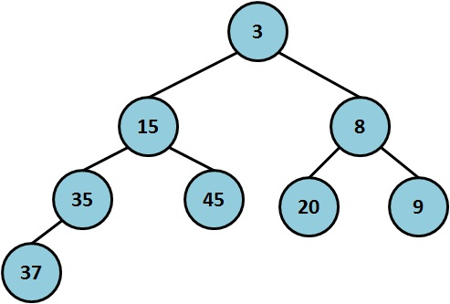
Hash Tables & Heaps – Q4
What is the resulting heap after Deleting the Minimum element from the following heap?

Slide 13
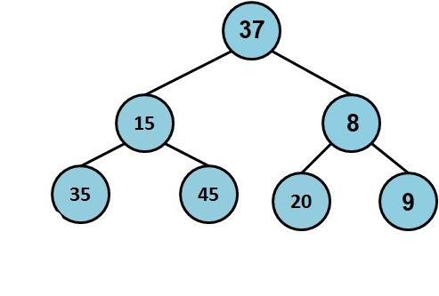
Hash Tables & Heaps – Q4
What is the resulting heap after Deleting the Minimum element from the following heap?
Percolate

Slide 14

Hash Tables & Heaps – Q4
What is the resulting heap after Deleting the Minimum element from the following heap?

Slide 15
Hash Tables & Heaps – Q5
Using Big-O notation, what is the run-time of:
  (a) Inserting 10 items into an initially empty binary heap
  (b) Inserting 10 items into a binary heap with n elements.
  O(1)
  O(log n)

Slide 16
Sorting – Q1
Fill in the table to show the resulting array after each pass in Bubble Sort:
Initial | 4 | 2 | 6 | 5 | 7 | 1 | 8 | 3
Sorted | 1 | 2 | 3 | 4 | 5 | 6 | 7 | 8

Slide 17
Sorting – Q1
Fill in the table to show the resulting array after each pass in Bubble Sort:
Initial | 4 | 2 | 6 | 5 | 7 | 1 | 8 | 3
 | 2 | 4 | 5 | 6 | 1 | 7 | 3 | 8
 | 2 | 4 | 5 | 1 | 6 | 3 | 7
 | 2 | 4 | 1 | 5 | 3 | 6
 | 2 | 1 | 4 | 3 | 5
 | 1 | 2 | 3 | 4
Sorted | 1 | 2 | 3 | 4 | 5 | 6 | 7 | 8

Slide 18
Sorting – Q2
Show the result of running Partition on the array below using the leftmost element as the pivot element. Show the array after each swap.
Initial | 4 | 2 | 6 | 5 | 7 | 1 | 8 | 3
Swap1
Swap2
Partitioned

Slide 19
Sorting – Q2
Show the result of running Partition on the array below using the leftmost element as the pivot element. Show the array after each swap.
Initial | 4 | 2 | 6 | 5 | 7 | 1 | 8 | 3
Swap1 | 4 | 2 | 3 |  |  |  |  | 6
Swap2 | 4 | 2 | 3 | 1 | 7 | 5 | 8 | 6
Partitioned | 1 | 2 | 3 | 4 | 7 | 5 | 8 | 6

Slide 20
Sorting – Q3
Fill in the table to show the array after each call to the Merge function in Merge Sort.
Initial | 5 | 2 | 6 | 4 | 7 | 1 | 8 | 3
Sorted | 1 | 2 | 3 | 4 | 5 | 6 | 7 | 8

Slide 21
Sorting – Q3
Fill in the table to show the array after each call to the Merge function in Merge Sort.
Initial | 5 | 2 | 6 | 4 | 7 | 1 | 8 | 3
 | 2 | 5 | 6 | 4 | 7 | 1 | 8 | 3
 | 2 | 5 | 4 | 6 | 7 | 1 | 8 | 3
 | 2 | 4 | 5 | 6 | 7 | 1 | 8 | 3
 | 2 | 4 | 5 | 6 | 1 | 7 | 8 | 3
 | 2 | 4 | 5 | 6 | 1 | 7 | 3 | 8
 | 2 | 4 | 5 | 6 | 1 | 3 | 7 | 8
Sorted | 1 | 2 | 3 | 4 | 5 | 6 | 7 | 8

Slide 22
Sorting – Q4
What is the Worst Case run-time of Insertion Sort, Selection Sort, and Bubble Sort respectively?
What is the Best Case of each?
  O(n²) , O(n²), O(n²)
  O(n) , O(n²) , O(n²)

Slide 23
Sorting – Q5
What is the Best Case and Worst Case for finding the kth smallest integer out of an unsorted array of n integers. (k <= n)
  Best Case: O(n) , Worst Case: O(n²)

Slide 24
Stacks & Queues – Q1
What is the acronym for describing the push and pop rules for Stacks and what does it stand for?
  LIFO – Last In, First Out.

Slide 25
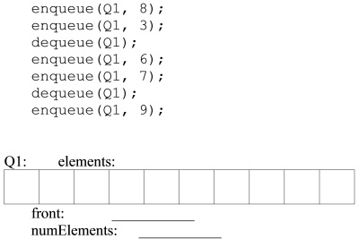
Stacks & Queues – Q2
Show the final contents of the Array-Implemented Queue, the index of front, and numElements – after running this code:

Slide 26
Stacks & Queues – Q2
Show the final contents of the Array-Implemented Queue, the index of front, and numElements – after running this code:
FRONT:
NUMELEMENTS:
-1
0
1
2
0
1
2
3
8
3
6
7
9

Slide 27
Stacks & Queues – Q3
What two implementations of Queue’s were used in HW #4? What was each one used for?
  Array implementation – Router
  Linked List implementation – each device’s request queue.

Slide 28
Stacks & Queues – Q4
What are the run-times of the following operations:
  Stacks: Push and Pop
  Queues: Enqueue and Dequeue
  O(1) for all

Slide 29
Stacks & Queues – Q5
Convert the following infix expression to postfix:
  ( A / ( B – C ) + D ) * ( E – F ) + G * H
  A B C – / D + E F – * G H * +

Slide 30
Algorithm Analysis – Q1
What is the Big-O run-time of deleting one node from an AVL tree with n nodes?
What is the Big-O run-time of deleting one node from an AVL tree with height h?
O(log n) and O(h)

Slide 31
Algorithm Analysis – Q2
What is the Big-O solution to the following recurrence relation?
  T(n) = 2T(n/2) + n, assume T(1) = 1
O(n log n)

Slide 32
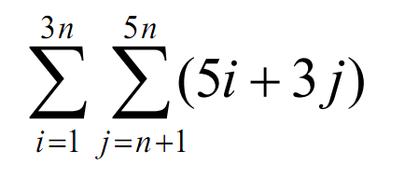
Algorithm Analysis – Q3
Determine a simplified closed-form solution for the following summation in terms of n:

Slide 33
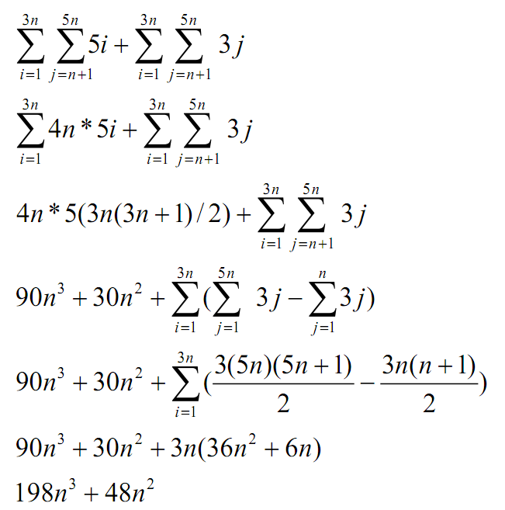
Algorithm Analysis – Q3
Determine a simplified closed-form solution for the following summation in terms of n:

Slide 34
Algorithm Analysis – Q4
What is the Big-O running time of the following segment of code, it terms of n.
int a = 1, b = n, sum = 0;
while (a < b) {
sum++;
a = a*2;
b = b/2;
}

Slide 35
Algorithm Analysis – Q4
What is the Big-O running time of the following segment of code, it terms of n.
Consider the ratio b/a.
The loop stops when this ration is 1. For each loop iteration the ratio decreases by a factor of 4. Let k be the number of loop iterations total. Then 1 = n/4^{k}. Solving we get k = log₄n. → O(log n)
int a = 1, b = n, sum = 0;
while (a < b) {
sum++;
a = a*2;
b = b/2;
}

Slide 36
Algorithm Analysis – Q5
If an O(n²) algorithm takes 40 ms to complete with an input size of n = 20,000, how much time will it take to complete on an input size of n = 50,000?
  c * n² = 40ms, c = 40/20,000² = 40 / 400,000
  40 / 400,000 * (50,000²) = 40 / 400,000 * (2,500,000)
  = 10 * 25 = 250 ms

Slide 37
Mixed Bag – Q1
Fill in the blanks of the following recursive sorting function, which of the sorting algorithms that we have seen so far does this resemble?:
void sort(int *values, int length) {
if (length > 1) {
int maxIndex = 0;
int i;
for (i=1; i<length; i++)
if ( ________(1)________ )
maxIndex = i ;
int temp = values[length-1];
values[length-1] = ____(2)___ ;
________(3)_______ = temp ;
______________(4)____________ ;
}

Slide 38
Mixed Bag – Q1
Fill in the blanks of the following recursive sorting function, which of the sorting algorithms that we have seen so far does this resemble?
  Selection sort.
void sort(int *values, int length) {
if (length > 1) {
int maxIndex = 0;
int i;
for (i=1; i<length; i++)
if ( values[i] > values[maxIndex] )
maxIndex = i ;
int temp = values[length-1];
values[length-1] = values[maxIndex];
values[maxIndex] = temp ;
sort(values, length – 1);
}

Slide 39
Mixed Bag – Q2
In a binary search of the array below, which elements in the array are checked (and in what order) when a search is conducted for the number 17?
47, 9, 22
Index | 0 | 1 | 2 | 3 | 4 | 5 | 6 | 7 | 8
Value | 2 | 9 | 22 | 25 | 47 | 59 | 61 | 66 | 93

Slide 40
Mixed Bag – Q3
Briefly explain what the function does AND what its return value means. (Using the typical tree node struct)
int mystery(struct node *root) {
int retVal;
if(root == NULL)
return 0;
retVal = mystery(root->left) +
mystery(root->right);
if(root->data % 2 == 1) {
root->data -= 1;
retVal ++;
}
return retVal;
}

Slide 41
Mixed Bag – Q3
• The function subtracts 1 from all nodes containing odd values
• The function returns the number of nodes altered by the function (# of odd nodes)
int mystery(struct node *root) {
int retVal;
if(root == NULL)
return 0;
retVal = mystery(root->left) +
mystery(root->right);
if(root->data % 2 == 1) {
root->data -= 1;
retVal ++;
}
return retVal;
}

Slide 42
Mixed Bag – Q4
Imagine using a linked list of digits to store an integer. For example, a list containing 3, 6, 2, and 1, in that order stores the number 3621. Write an iterative function which accepts a linear linked list num that stores a number in this fashion and returns the value of the number. You may assume the list stores digits only and contains 9 or fewer nodes.
struct node{
int data;
struct node *next;
};
int getValue(struct node* num) {
// Fill in code
}

Slide 43
Mixed Bag – Q4
Imagine using a linked list of digits to store an integer. For example, a list containing 3, 6, 2, and 1, in that order stores the number 3621. Write an iterative function which accepts a linear linked list num that stores a number in this fashion and returns the value of the number.
int getValue(struct node* num) {
int sum = 0;
while (num != NULL) {
sum = 10*sum + num->data;
num = num->next;
}
return sum;
}

Slide 44
Mixed Bag – Q5
What is the Big-O running time of the following segment of code, in terms of n.
The inner loop will run 0+2+4+…+ n times
Since we know 0+1+2+3+…+n = n(n+1)/2 = O(n²)
We would have about ½ of O(n²) = O(n²)
int i;
for (i=0; i<n; i+=2) {
for (j=i; j>0; j--)
printf(“%d”, j);
printf(“\n”);
}

