Slide 1
Graphs
COP 3502

Slide 2
Graphs
Train Lines
Daytona
Gainesville
Ocala
Deltona
Orlando
Melbourne
Lakeland
Tampa

Slide 3
Graphs
Southwest Flights in FL
Jax
Pan
Orl
Tpa
WPB
Naples
FTL

Slide 4
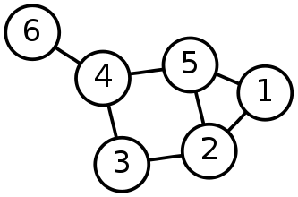
Graphs
Definition
A Graph G, is a
a set of vertices, V
AND
a set of edges, E
where each edge is associated with a pair of vertices.
We write: G = (V, E)
Vertex set V = {1, 2, 3, 4, 5, 6}
Edge set E = {{1,2}, {1,5}, {2,3},
{2,5}, {3,4}, {4,5}, {4,6}}.

Slide 5
Graphs
Undirected vs Directed
The following graph is UNDIRECTED
There is an edge between vertices 4 and 6, but there is no direction.
Vertex set V = {1, 2, 3, 4, 5, 6}
Edge set E = {{1,2}, {1,5}, {2,3},
{2,5}, {3,4}, {4,5}, {4,6}}.

Slide 6
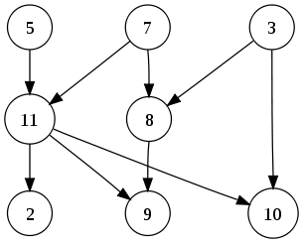
Graphs
Directed Graph:
Same as before, but where each edge is associated with an ordered pair of vertices.
Note: This graph does not have the edge (11,5), but it does have (5,11)
A labeled simple graph:
Vertex set V = {2,3,5,7,8,9,10,11}
Edge set E = {{3,8}, {3,10}, {5,11}, {7,8}, {7,11}, {8,9}, {11,2},{11,9},{11,10}}.

Slide 7
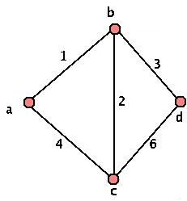
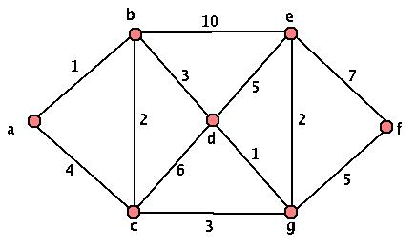
Graphs
Subgraph
Basically, to be a subgraph, all of the edges and vertices must be in the original graph.
Just a subset of the vertices and edges

Slide 8
Graphs
Simple Path
A path such that all vertices are distinct, except that the first and the last could be the same.
Simple Path – S T U V
S
T
V
U

Slide 9
Graphs
Cycle
A cycle is a path that starts and ends at the same point. For an undirected graph (such as below) the edges are distinct.
S T U S is a cycle
S
T
V
U

Slide 10
Graphs
Connected vs Unconnected
A connected graph is one where any pair of vertices in the graph is connected by at least one path.
S
T
S
T
V
U
V
U

Slide 11
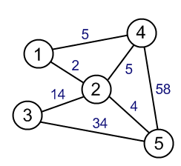
Graphs
Weighted Graph:
Same as above, but where each edge also has an associated real number with it, known as the edge weight.
Can be directed or undirected.
A labeled weighted graph:
Vertex set V = {1,2,3,4,5}

Slide 12
Graphs
Graph Storage
Adjacency Matrix
Adjacency List

Slide 13
Graph – Adjacency Matrix
Assume there are N vertices in a graph
Then you need an NxN matrix
A[0…N-1][0…N-1]
If vertex i and vertex j have an edge between them, A[i][j] = 1;
Otherwise, A[i][j] = 0
Note a vertex can have an edge back to itself (shown as a loop) where A[i][i] = 1, otherwise A[i][i] = 0

Slide 14
Adjacency Matrix - Undirected
 | S | T | U | V
S | 1 | 1 | 1 | 1
T | 1 | 0 | 1 | 0
U | 1 | 1 | 0 | 1
V | 1 | 0 | 1 | 0
S
T
 | S | T | U | V
S
T
U
V
V
U
Since this is an undirected graph, the adjacency matrix is symmetric
A directed graph may not have a symmetric adjacency matrix.

Slide 15
Adjacency Matrix - Directed
 | S | T | U | V
S | 1 | 1 | 1 | 1
T | 0 | 0 | 0 | 0
U | 0 | 1 | 0 | 0
V | 0 | 0 | 1 | 0
S
T
 | S | T | U | V
S
T
U
V
V
U
A directed graph may not have a symmetric adjacency matrix.
Note in this matrix the start is the row, and the end is the column.

Slide 16
Adjacency Matrix - Weighted
 | S | T | U | V
S | 1 | 1 | 1 | 1
T | 1 | 0 | 1 | 0
U | 1 | 1 | 0 | 1
V | 1 | 0 | 1 | 0
S
T
 | S | T | U | V
S
T
U
V
V
U
Since this is an undirected graph, the adjacency matrix is symmetric
A directed graph may not have a symmetric adjacency matrix.

Slide 17
Graph – Adjacency List
An array of linked lists
Where Array[i] holds the list of vertices that are adjacent to vertex i
0
0__
1__
2__
3 X
0
1
1
2
1_X
3
2
3
2_X

Slide 18
Graph – Adjacency List
Weighted Graph
Adjacency List - array of linked lists
Where Array[i] holds the list of vertices that are adjacent to vertex i
8
10
0
0 8_
1 10
2 5
3 4 X
0
1
1
4
5
12
2
1 12 X
3
2
15
3
2 15 X

Slide 19
Graph Traversals
Depth First Search
Breadth First Search

Slide 20
Graph Traversals
Depth First Search
The general "rule" used in searching a graph using a depth first search is to search down a path from a particular source vertex as far as you can go.
When you can go to farther, "backtrack" to the last vertex from which a different path could have been taken.
Continue in this fashion, attempting to go as deep as possible down each path until each node has been visited.
S
What is the DFS Traversal of the following
Graph starting from S? When you have a
choice between which vertex to search next
choose alphabetically.
S
T
T
W
W
V
V
U
U
S
U
T
W
V
R
R
R

Slide 21
Depth First Search
The general "rule" used in searching a graph using a depth first search is to search down a path from a particular source vertex as far as you can go.
When you can go to farther, "backtrack" to the last vertex from which a different path could have been taken.
Continue in this fashion, attempting to go as deep as possible down each path until each node has been visited.
The most difficult part of this algorithm is keeping track of what nodes have already been visited, so that the algorithm does not run ad infinitum. We can do this by labeling each visited node.

Slide 22
Graph Traversals
Breadth First Search
The idea in a breadth first search is opposite to a depth first search. Instead of searching down a single path until you can go no longer, you search all paths at an uniform depth from the source before moving onto deeper paths.
Once again, we'll need to mark both edges and vertices based on what has been visited.
S
What is the BFS Traversal of the following
Graph starting from S? When you have a
choice between which vertex to search next
choose alphabetically.
S
T
T
W
W
V
V
U
U
S
U
T
V
W
R
R
R

Slide 23
Breadth First Search
Instead of searching down a single path until you can go no longer, you search all paths at an uniform depth from the source before moving onto deeper paths. Once again, we'll need to mark both edges and vertices based on what has been visited.
In essence, we only want to explore one "unit" away from a searched node before we move to a different node to search from. All in all, we will be adding nodes to the back of a queue to be ones to searched from in the future.

Slide 24
Depth First Search
Output
List:
1
2
4
3
7
6
10
13
9
11
8
5
15
14
12
1
1
2
2
5
5
8
8
11
11
15
15
6
6
10
10
13
13
3
3
4
4
7
7
9
9
12
12
14
14
Start with 1
2,4,3
Stop at 3
Backtrack to 4, can we search?
7,6
Stop at 2
Backtrack to 6, can we search?
10,13
Stop at 13
Backtrack to 10,6,7
9, 11, 8, 5
Stop at 5
Backtrack to 8,11
15,14,12
STOP – All nodes are marked!!

Slide 25
Breadth First Search
1
1
2
2
5
5
8
8
11
11
15
15
6
6
10
10
13
13
3
3
4
4
7
7
9
9
12
12
14
14
L0: 1
L1: 2, 3
L2: 4,5,6,11
L3: 7,8,10,9,15
L4: 13,12,14
Final output: 1, 2, 3, 4, 5, 6, 11, 7, 8, 10, 9, 15, 13, 12, 14

Slide 26
Breadth First Search
The basic idea
we have successive rounds and continue with our rounds until no new vertices are visited on a round.
For each round, we look at each vertex connected to the vertex we came from.
And from this vertex we look at all possible connected vertices.
This leaves no vertex unvisited
because we continue to look for vertices until no new ones of a particular length are found.
If there are no paths of length 10 to a new vertex, surely there can be no paths of length 11 to a new vertex.
The algorithm also terminates since no path can be longer than the number of vertices in the graph.

Slide 27
Directed Graphs
Traversals
Both of the traversals DFS and BFS are essentially the same on a directed graph.
When you run the algorithms, you must simply pay attention to the direction of the edges.
Furthermore, you must keep in mind that you will only visit edges that are reachable from the source vertex.

Slide 28
Graph Traversal – Application
Mark and Sweep Algorithm for Garbage Collection
A mark bit is associated with each object created in a Java program.
It indicates if the object is live or not.
When the JVM notices that the memory heap is low, it suspends all threads, and clears all mark bits.
To garbage collect, we go through each live stack of current threads and mark all these objects as live.
Then we use a DFS to mark all objects reachable from these initial live objects. (In particular each object is viewed as a vertex and each reference as a directed edge.)
This completes marking all live objects.
Then we scan through the memory heap freeing all space that has NOT been marked.

Slide 29
Example Exam Questions
What is the DFS and BFS of the following Graph?
What is the adjacency matrix and adjacency list of the following Graph?

