Slide 1
Face Detection Using AdabooSt

Slide 2
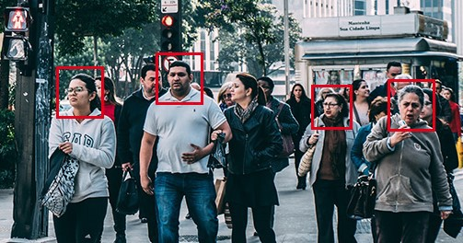
Find Faces

Slide 3
Find Faces
Image taken from: P. Viola and M. Jones. Robust real- time object detection. International Journal of Computer Vision, 57(2):137–154, 2004.

Slide 4
Some assumptionS to SIMPLIFY challenges
Restrict ourselves to near frontal views of the face
Assume limited range of illumination conditions
Assume little or no facial occlusions
Limited facial expressions

Slide 5
Why Adaboost
Adaboost is a technique that does the following:
Uses multiple (weak) classifiers – each based on different features
Combines these different (weak) classifiers into a single powerful (strong) classifier; that is what “boosting” means
ADABOOST stands for Adaptive Boosting

Slide 6
ADaboost
Early motivation was financial sector
So, we will introduce the ADABOOST concept with a Stock Market example

Slide 7
Imagine a Stock Market Application
In the investment field, many experts get paid for their stock market forecasts.
Suppose a Rich Person (RP) who would like to hire a small team of Experts.
The RP would like to have a team of size, say, 50.
The RP has access to the performance records of the 10,000 experts for the past 5 years (which is 1,000 days, since each year has 200 stock-trading days).
Performance is judged by this: The market opens at 9:30am EST each trading day. At 8:30am each expert announces whether s/he thinks the market will go UP that day or not.
Here, UP is defined as, perhaps, the Dow up by at least 20 points. At market close (typically, at 4pm), we know if each expert was right or not. Performance does not care about whether market went up or not, just cares about whether the expert called it correctly.

Slide 8
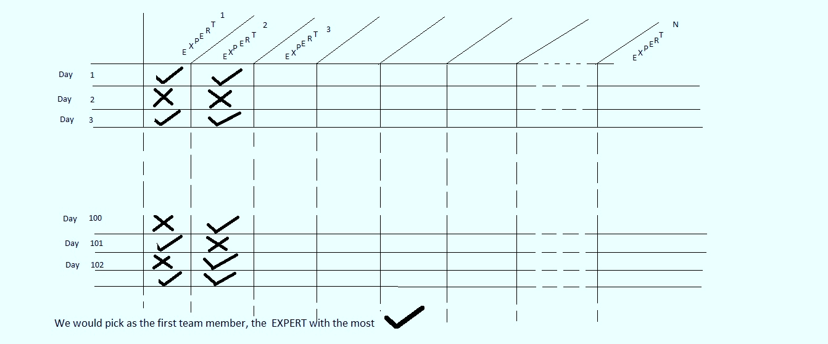
Imagine a Stock Market Application
So, our RP has access to a table that looks like this:

Slide 9
Picking the first member
It is a correct move to pick the first member as the one with the most correct forecasts

Slide 10
Picking the second member
So, what should our strategy be to pick the second team member?
Please spend a minute thinking about this and e-mail the instructor what you think.
We will pause here, while you finish this task.

Slide 11
Picking the second member
Most students and others generally think that the correct thing to do is to pick the expert who has the next highest correct score.
And that is what machine learning thinkers thought till Schapire (pronounced Sha-Pee-Ray) came along in about 1993, published in 1995.
Turns out the 2nd should be the expert who gets the most correct of the examples that the 1st expert got wrong!! i.e., complements the existing team

Slide 12
Picking the second member
Pick from the available pool of experts, the one who most complements the existing (selected) team
Note: each expert is assumed to be a Weak Expert, named so for being correct between 51% and somewhere in the 80’s or low-90’s percent of the time.
BOOSTING means picking a team of weak experts, so the team performance is strong (close to 99.9%).

Slide 13
Observations about Picking the team
Note: if an expert was worse than a Weak Expert, i.e., was correct less than 49% of the time, one would “force” it to be a weak expert by simply flipping its answers. So, if it said UP, the system would flip it to NOT-UP, and vice versa.
The only time one cannot benefit from the flip is if the expert is exactly at 50%. This is very rare, and these are discarded from the pool of experts.

Slide 14
Recap: Imagine a Stock Market Application
In the investment field, many experts get paid for their stock market forecasts.
Suppose a Rich Person (RP) who would like to hire a small team of Experts.
The RP would like to have a team of size, say, 50.
The RP has access to the performance records of the 10,000 experts for the past 5 years (which is 1,000 days, since each year has 200 stock-trading days).
Now, the actual problem can be stated fully: Once the team (of 50) is selected, its job is to look at a new day (8:30am) and make a forecast (we will deal later with how the team functions as a team, i.e.,how decisions will be made in a collaborative manner).
Realize that without that final task (to decide about a new day), the process would have been a waste of time. There is a Training Stage & a Testing Stage.

Slide 15
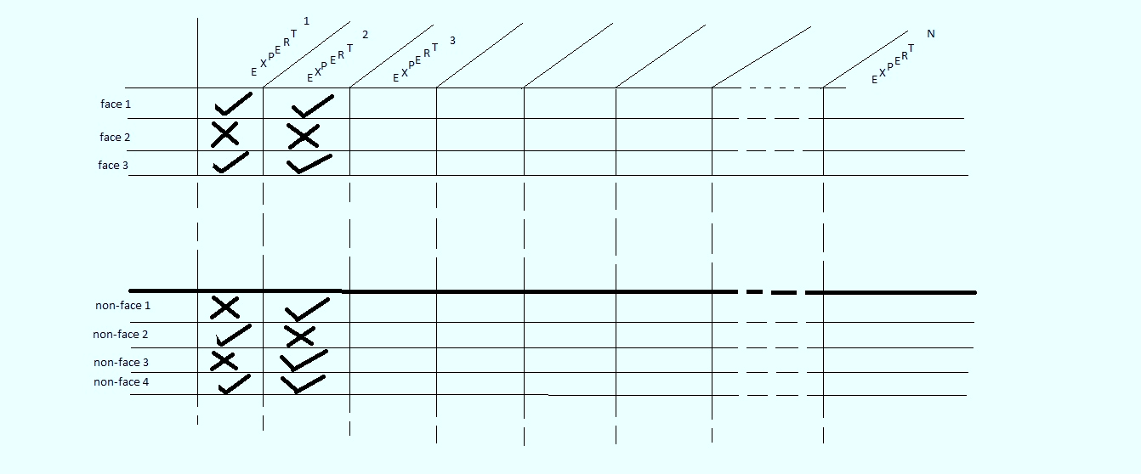
Now, do the vision problem
So, the problem can be phrased as: an expert is presented with a fixed-size picture, and needs to say if it is a face or not.

Slide 16
Now, do the vision problem
So, the problem can be phrased as: an expert is presented with a fixed-size picture, and needs to say if it is a face or not.
The ADABOOST approach to face detection was done by Viola and Jones around 2000/2001

Slide 17
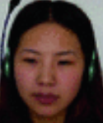
For Training Stage: Faces database
Get a stack of different faces.
Actually pics are in grey, not color,

Slide 18
For Training Stage: Non-Faces database
Put in cars, trees, furniture, scenery,
include half-faces, torso, limbs, etc.

Slide 19
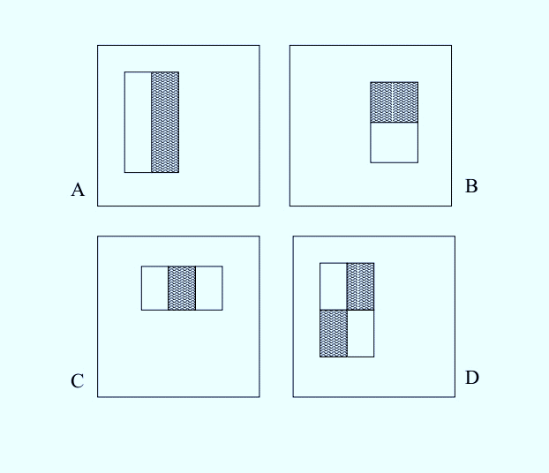
Start with A pattern from below
In the patterns above, the numbers in the region of the white bars are +1, the black bars have numbers of -1, and the surround background numbers have 0.
The size of each pattern is the same as the size of a training image, typically something like 50x50 pixels.

Slide 20
Start with A pattern from below
These are the 4 families of patterns. Each family has thousands of members, obtained from small variations of the basic shape.

Slide 21
Consider the number line
n
In all these plots of the number-line, the depiction of the y-axis is irrelevant, and is only included to indicate that at that position the numbers switch from negative to positive.

Slide 22
To Construct A single expert
Select a single specific pattern; it is a specific Convolution table made up of a combination of 0’s, +1’s, and -1’s.

Slide 23
Convolution of ONE pattern with first face
Our Convolution table has a combination of 0’s, +1’s, and -1’s.
Hence, a one-step convolution between the table and our first face is some integer between negative infinity and positive infinity. So, plot this resulting integer on the number line.

Slide 24
Bring in the second face, and more

Slide 25
Do all faces

Slide 26
Start putting the non-faces in

Slide 27
Put them both in

Slide 28
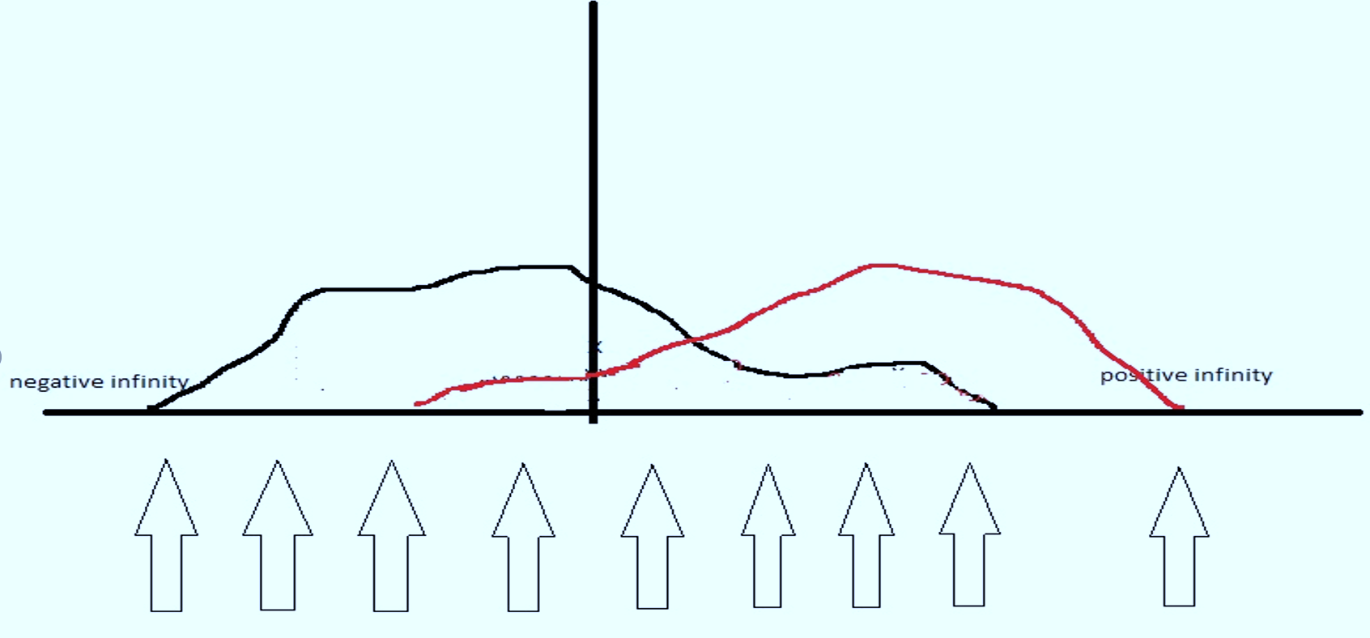
Start search for THRESHOLD
We consider a candidate Threshold (each arrow represents a possible Threshold). For it, we then ask:
Suppose we labeled its left-hand side as the realm of the negatives, and the right hand side as the realm of the positives; then what would be the error? i.e., given that polarity-sign label, how many example actual positives end up on its left, and how many actual negatives end up on its right, they constitute its error.

Slide 29
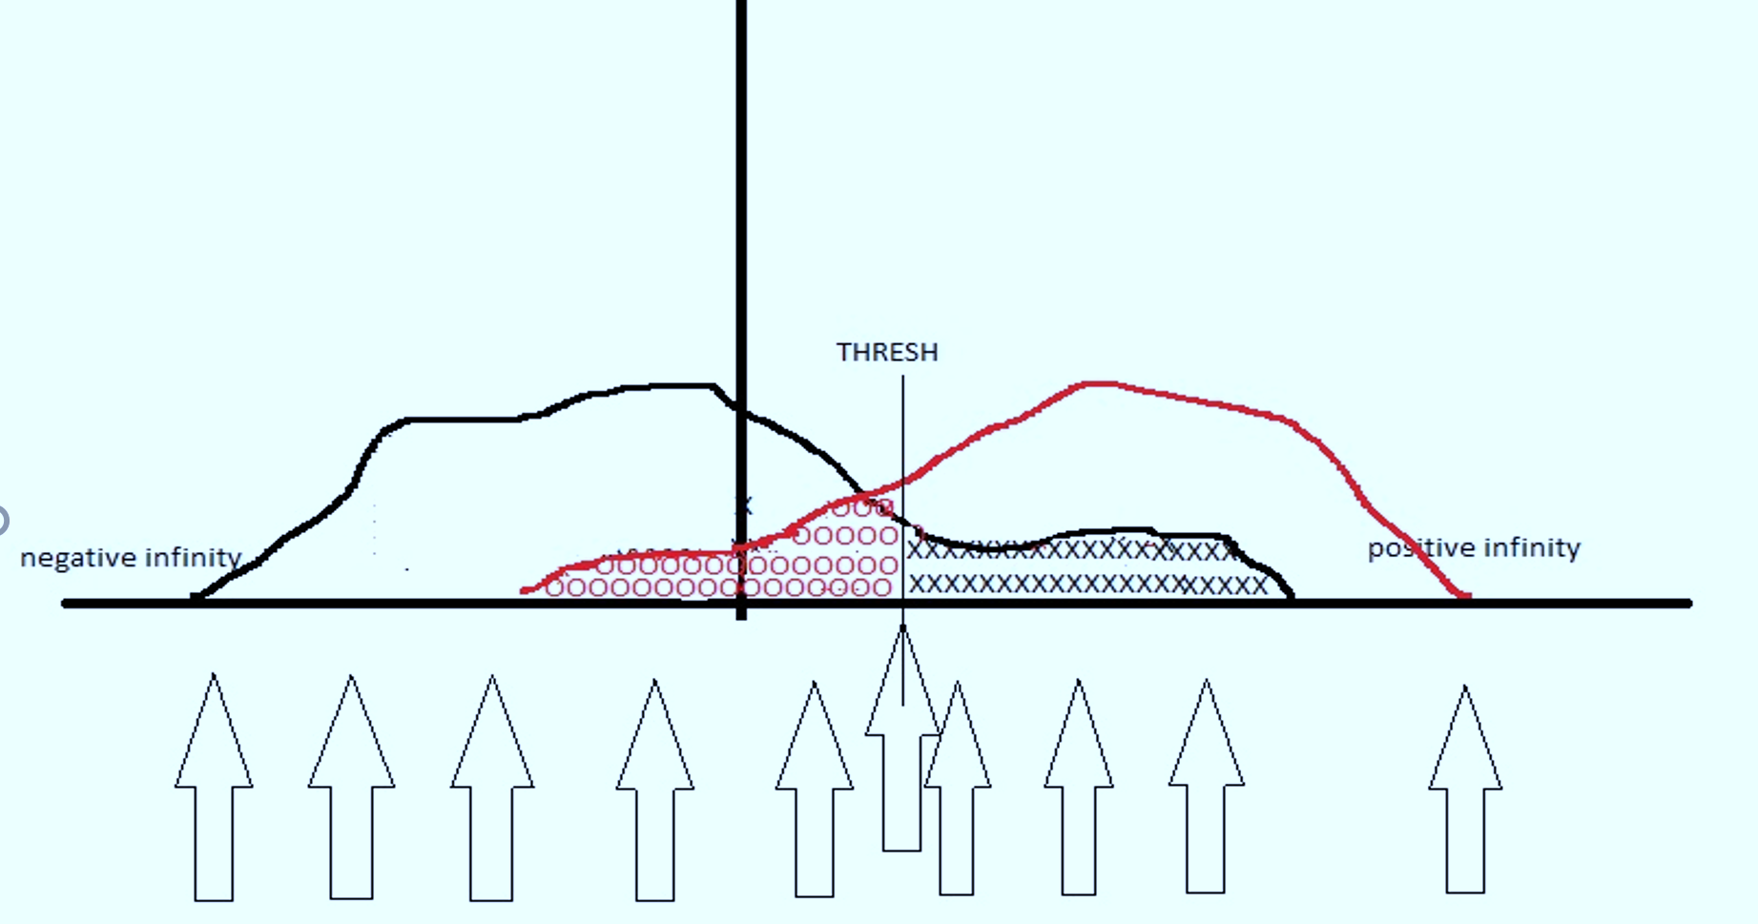
Find the best (i.e., lowest error)
Verify for yourself, that placements other than the one shown as best, would be worse.
We have shown coloring in the error for the best placement.
Now you color in the error for another choice, e.g., the arrow that is 4th from the left.

Slide 30
Find the best Threshold
So EXPERT is the original-pattern, plus THRESHOLD, plus Polarity

Slide 31
Two Extreme cases to BE AWARE OF
Both distributions are clearly separated
Both distributions exactly (or almost exactly) have overlap

Slide 32
Remember …
So, now we are able to explain how the earlier table is obtained. i.e., once we have all our experts created (many hundreds of thousands of them, why so many???),
we see how this table can be populated.

Slide 33
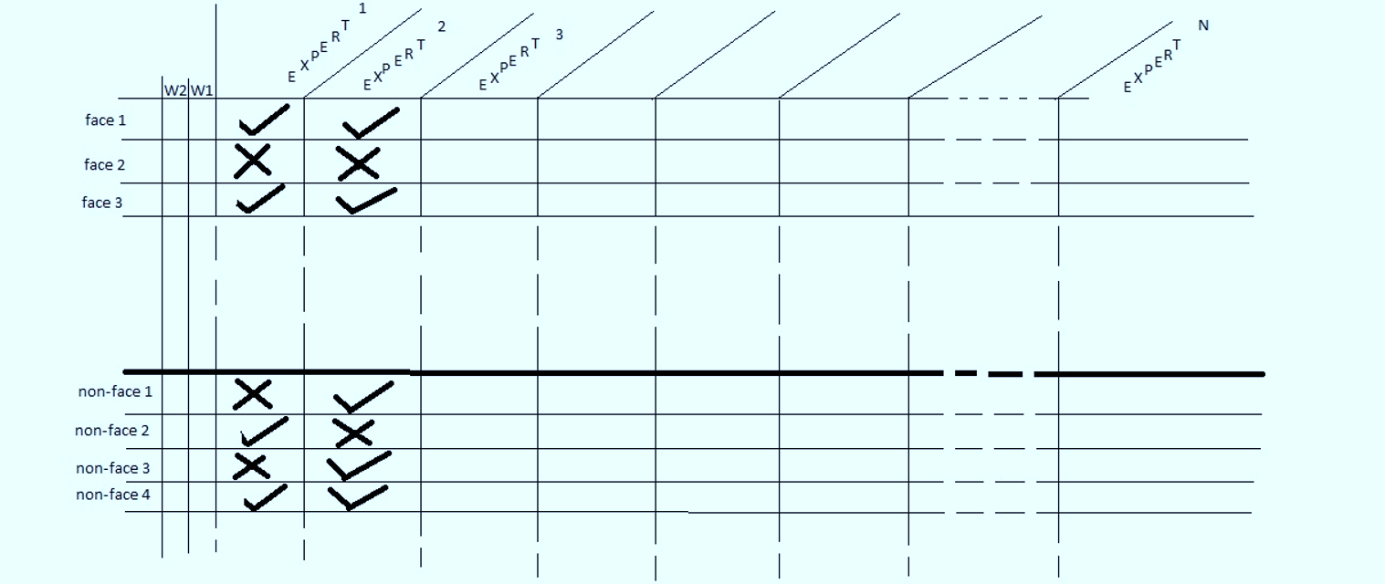
To facilitate selection, Add weights
The idea here is to not have to keep track of what experts are complementing others and so on, and instead to have a numerical algorithm to achieve the same goals. This is done using weights attached to each training example.
A training example is a member of our database. The weights will keep a history of how difficult an example is to be conquered (to be classified correctly).

Slide 34
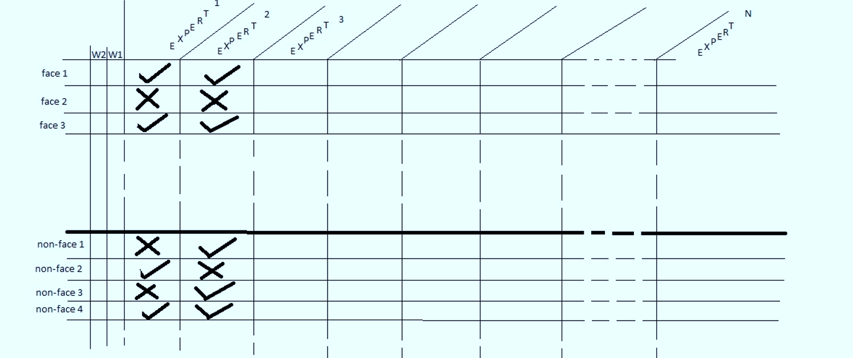
Using weights attached to examples
The basic idea is that with each selection of an expert, the weights of examples that are not yet conquered, their weights will grow. At time to select, add every expert’s error as the sum of the weights for the examples it has gotten wrong.
So, after many selections, say 45, if there are examples that are not yet conquered, their weights will be quite high so they will contribute high errors to the experts who get them wrong (which include the current team), but will contribute nothing to a fresh expert who has not been picked so far (because it gets fewer correct). So, now, it isits turn to be picked because it is conquering a really, really bad example (and hence it has a lower error).

Slide 35
Algorithm 1a
The Algorithm boxes shown in these slides are from the Viola Jones paper.

Slide 36
Algorithm 1b

Slide 37
Algorithm 1c

Slide 38
Adaboost Summary
Input is a set of training examples (X_{i}, y_{i}) i = 1 to m.
We are going to train a sequence of weak classifiers. Weak because not as strong as the final classifier.
The training examples will have weights, initially all equal.
At each step, we use the current weights, train a new classifier, and use its performance on the training data to produce new weights for the next step.
But we keep ALL the CHOSEN weak classifiers.
When it’s time for testing on a new feature vector, we will combine the results from all of the weak classifiers

Slide 39
Adaboost’s strong classifier
H (x) = α₁h₁(x) + α₂h₂ (x) + α₃h₃(x) +...
Sign of h_{i} ( x) decides to which class point x is assigned, by the i - th weak classifier.
Sign of H ( x) decides to which class point x is assigned, by the final strong classifier.
Typically, the designer makes H or h respond with 1 when they are reporting that the test sample is IN THE CLASS
The designer makes H and h respond with 0 when they are reporting that the test sample is NOT from the class.
Strong Classifier
Weight
Weak Classifier
Input Vector

Slide 40
So, let’s review how weights work

Slide 41
Include young faces in training

Slide 42
Two ways Time savings
First savings is from the Integral Image

Slide 43
Second WAY Time-SAVE: Exploit that faces are rare

