Slide 1
COP 4104 Human and Technology Interaction
Chapter 15
Usability Principles proposed by Jakob Nielsen
Heuristic Evaluation (Usability guidelines)

Slide 2
COP 4104 Human and Technology Interaction
Usability Principles proposed by Jakob Nielsen
Heuristic evaluation is a usability inspection method that was developed by Nielsen
and his colleagues.
In this method, experts are guided by a set of usability principles known as heuristics.
This heuristics evaluate whether user interface elements, such as:
Dialog boxes
Menus
Navigation structure
Online help
etc.
conform to tried and tested principles.

Slide 3
COP 4104 Human and Technology Interaction
Usability Principles proposed by Jakob Nielsen
The original set of heuristics identified by Nielsen and his colleagues was derive
Empirically from analysis of 249 usability problems in 1994.
        Visibility of System status.
        Match between system and the real world.
        User control and freedom.
        Consystency and standards.
        Error prevention.
        Recognition rather than recall.
        Flexibility and efficiency.
        Aesthetic and minimalist design.
        Help users recognize, diagnose, and recover from errors.
        Help and documentation.

Slide 4

COP 4104 Human and Technology Interaction
Usability Principles proposed by Jakob Nielsen
Visibility of system status:
The system should always keep users informed about what is going on,
through appropriate feedback within reasonable time.
searching database for matches

Slide 5
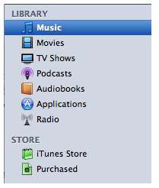
COP 4104 Human and Technology Interaction
Usability Principles proposed by Jakob Nielsen
Match between system and real world (METAPHOR):
The system should speak the users' language, with words, phrases and concepts
familiar to the user, rather than system-oriented terms. Follow real-world conventions,
making information appear in a natural and logical order.

Slide 6
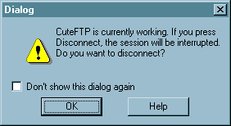
COP 4104 Human and Technology Interaction
Usability Principles proposed by Jakob Nielsen
        User control and freedom:
Users often choose system functions by mistake and will need a clearly marked
"emergency exit" to leave the unwanted state without having to go through an extended
dialogue. Support undo and redo.
Provide undo
Long operations should be cancelable
All dialogs should have a cancel button
Users should be able to explore interface without fear of being trapped in a corner.
Undo supports exploration

Slide 7
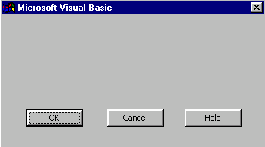
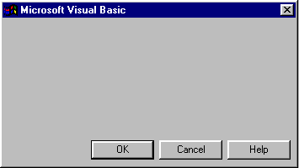
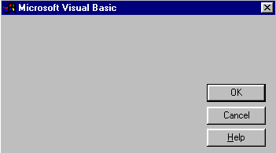
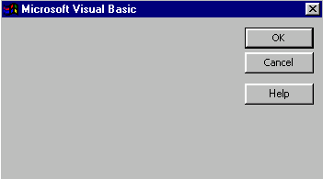
COP 4104 Human and Technology Interaction
Usability Principles proposed by Jakob Nielsen
        Consystency and standards:
Users should not have to wonder whether different words, situations, or actions mean
the same thing. Follow platform conventions.

Slide 8

COP 4104 Human and Technology Interaction
Usability Principles proposed by Jakob Nielsen
        Error prevention:
Even better than good error messages is a careful design which prevents a problem from
occurring in the first place. Either eliminate error-prone conditions or check for them
and present users with a confirmation option before they commit to the action.
Selection is less error-prone than typing
  But don’t go overboard…

Slide 9
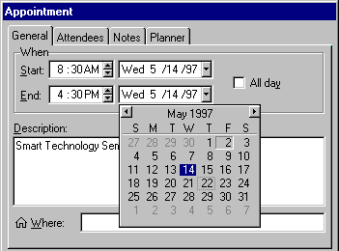
COP 4104 Human and Technology Interaction
Usability Principles proposed by Jakob Nielsen
        Recognition rather than recall:
Minimize the user's memory load by making objects, actions, and options visible. The user
should not have to remember information from one part of the dialogue to another.
Instructions for use of the system should be visible or easily retrievable whenever
appropriate.

Slide 10
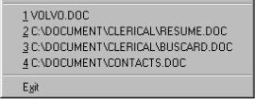
COP 4104 Human and Technology Interaction
Usability Principles proposed by Jakob Nielsen
        Flexibility and efficiency:
Accelerators -- unseen by the novice user -- may often speed up the interaction for the
expert user such that the system can cater to both inexperienced and experienced users.
Allow users to tailor frequent actions.
Provide easyly-learned shortcuts for frequent operations
  Keyboard accelerators
  Command abbreviations
  Styles
  Bookmarks
  History
Source: Interface Hall of Shame

Slide 11
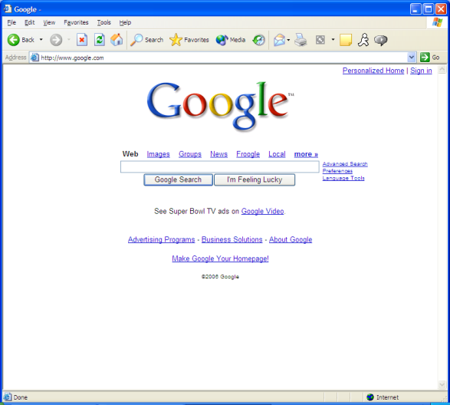
COP 4104 Human and Technology Interaction
Usability Principles proposed by Jakob Nielsen
        Aesthetic and minimalist design:
Dialogues should not contain information which is irrelevant or rarely needed.
Every extra unit of information in a dialogue competes with the relevant units of
information and diminishes their relative visibility.

Slide 12
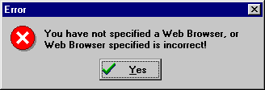
COP 4104 Human and Technology Interaction
Usability Principles proposed by Jakob Nielsen
        Help users recognize, diagnose, and recover from errors:
Error messages should be expressed in plain language (no codes), precisely indicate
the problem, and constructively suggest a solution.

Slide 13
COP 4104 Human and Technology Interaction
Usability Principles proposed by Jakob Nielsen
        Help and documentation:
Even though it is better if the system can be used without documentation, it may be
necessary to provide help and documentation. Any such information should be easy
to search, focused on the user's task, list concrete steps to be carried out, and not be
too large.
Users don’t read manuals
  Prefer to spend time working toward task goals, not learning about system
But manuals and online help are vital
  Usually when user is frustrated or in crisis
Help should be:
  Searchable
  Context-sensitive
  Task-oriented
  Concrete
  Short

Slide 14
COP 4104 Human and Technology Interaction
Usability Principles proposed by Jakob Nielsen
In a nutshell
Meet expectations
1. Match the real world
2. Consistency & standards
3. Help & documentation
User is the boss
4. User control & freedom
5. Visibility of system status
6. Flexibility & efficiency
Handle errors
7. Error prevention
8. Recognition, not recall
9. Error reporting, diagnosis, and recovery
Keep it simple
10. Aesthetic & minimalist design

Slide 15
COP 4104 Human and Technology Interaction
Chapter 15
Usability Principles proposed by Jakob Nielsen
Heuristic Evaluation (Usability guidelines)

