Slide 1
Vidja: A Simpler Video Chat Interface
By: Gregory Crain, Gregory Cook, Gregory Montague, Jonathan Shuttera

Slide 2
What is Vidja?
A very simple to use video chat web app
Designed by our group
Simple minimalist interface
Browser based - works on any PC or MAC web browser

Slide 3
Why Vidja?
Inspired by our Skype Usability analysis, Vidja strives to provide a quality interface based on both HCI principles and our own test results.

Slide 4
Design Choices
Aesthetic Minimalist interface
Clearly labeled options
Core video chat functionality - no frills
Flexible to users needs

Slide 5
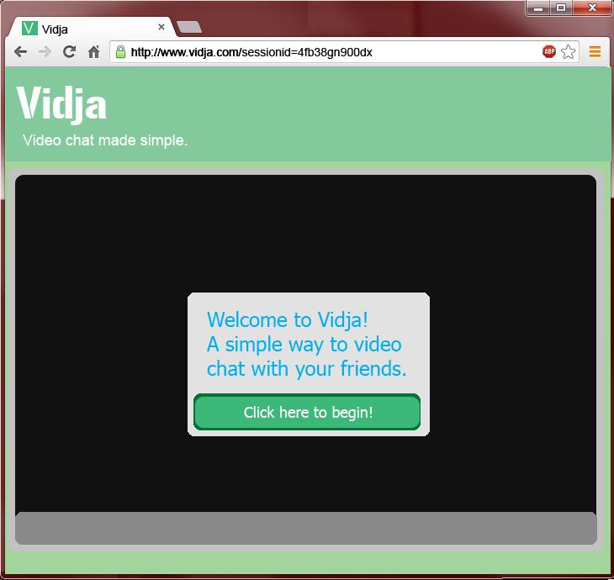

Slide 6
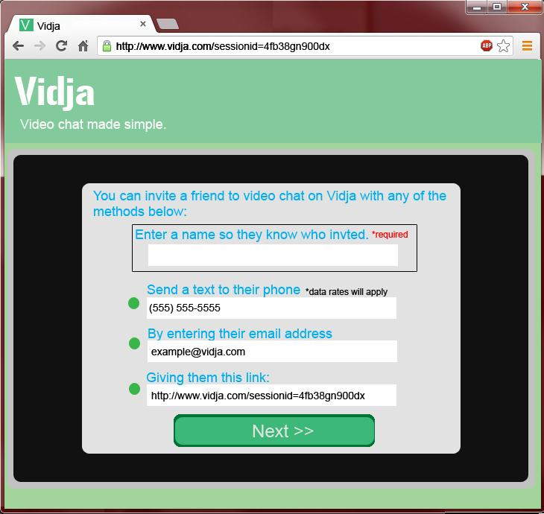

Slide 7
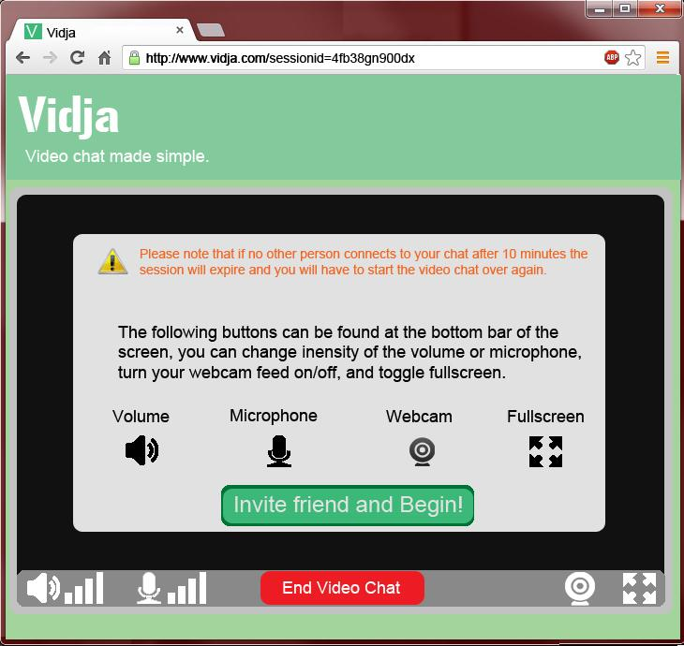

Slide 8
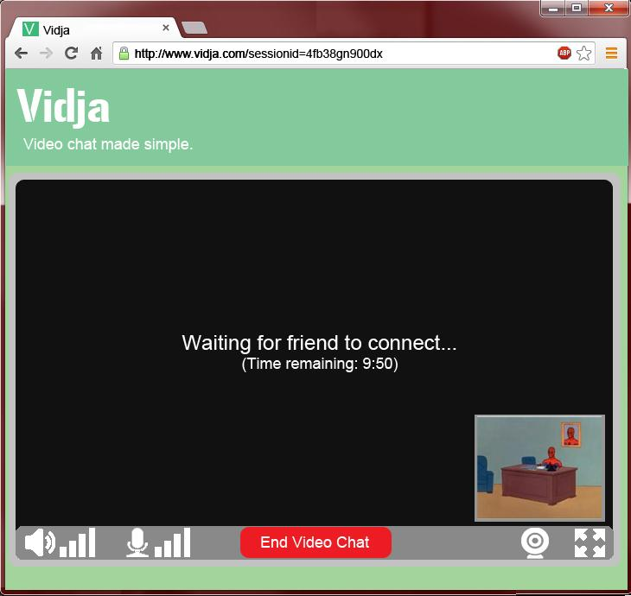

Slide 9
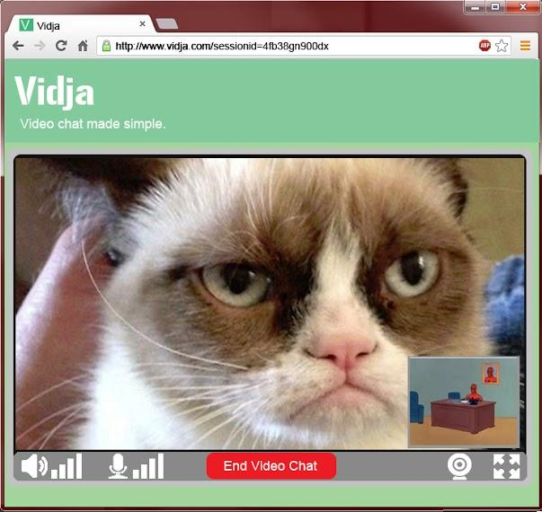

Slide 10
Goals of Testing
Is Vidja intuitive?
Is Vidja easy to use?
Does Vidja fulfill its user’s needs?
Is Vidja memorable in its use?

Slide 11
Participant Selection
Random Selection of 10 participants
Male and Female Participants
Age Range: 18 - 50+

Slide 12
Participant Demographics
Age
Gender
Education Level
Experience with similar services

Slide 13
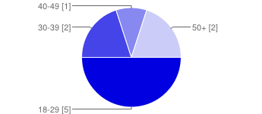
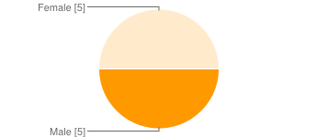
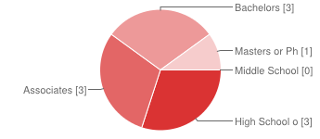
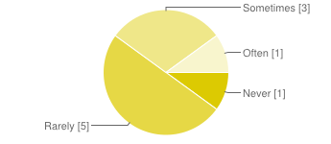
Participant Demographics
Age
Gender
Education Level
Video Chat Usage

Slide 14
Testing
Photo-based Simulation
Photos cover of every aspect of interface within testing boundaries
The user is instructed to point on the paper what they would click with the mouse and speak aloud what they would type

Slide 15
Tasks
Invite friend to video chat
Adjust the volume
Make it fullscreen
End the call

Slide 16
Post-test Questions
This portion of the post-test questions were administered on a likert scale ranging from 1-5, where 1 is very easy and 5 is very hard.
How difficult was it to invite a friend to a video chat?
How difficult was adjusting the volume?
How difficult was it to expand to full screen?
How difficult was it to end your chat session?

Slide 17
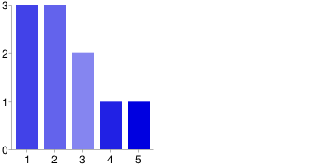
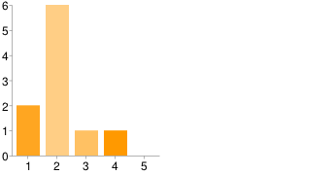
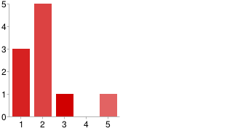
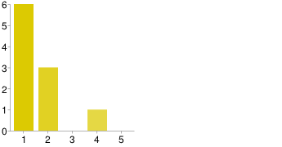
Testing Results
How difficult was it to invite a friend to chat?
How difficult was adjusting the volume?
How difficult was it to expand to full screen?
How difficult was it to end your chat session?

Slide 18
Post-test Questions
These post-test questions were administered with only binary responses, yes or no.
Was the Vidja homepage easy to navigate?
Would you use Vidja if were developed into a functioning service?
Were Vidja’s instructions easy to follow?

Slide 19
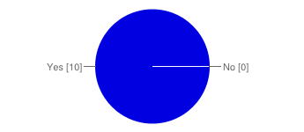
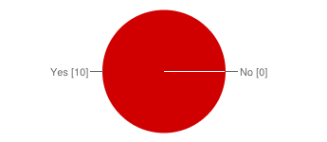
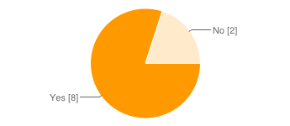
Testing Results
Was the Vidja homepage easy to navigate?
Were Vidja’s instructions easy to follow?
Would you use Vidja if it were developed into a functioning service?

Slide 20
Conclusions
Our testing yielded very positive results.
Our participants appreciated the the simplicity of Vidja’s design.
Overall, our participants rated the interface easy to use.

Slide 21
Conclusions
During our testing, we took note of some random comments from our users.
Some participants mentioned that some customizability might be nice.
A couple users asked why there wasn’t an option for just voice chat.

