Slide 1
Sub Shop Interface
Group 3: Jefferson Delgado, Allan Li, Thanh Tran, Antonio Whitehead

Slide 2
Brief Description of Interface
- Touchscreen interface for ordering at a sub shop
- Placed on multiple kiosks
- Select and remove ingredients from sandwich

Slide 3


Slide 4
Goals of the Interface
- Reduce errors in ordering
- Benefit deaf individuals and people with accents
- Improve throughput of orders

Slide 5
HCI Considerations
- Memorability: Relies on recognition over recall
- Learnability: Simple design allows for easy learning curve
- Effectiveness: Users get a better visual impression of
order
- Error handling: Easy to recover from mistakes

Slide 6
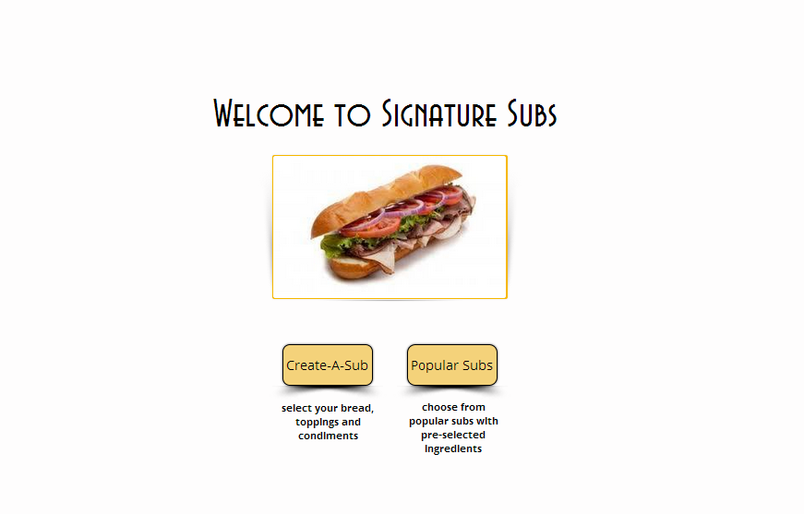

Slide 7
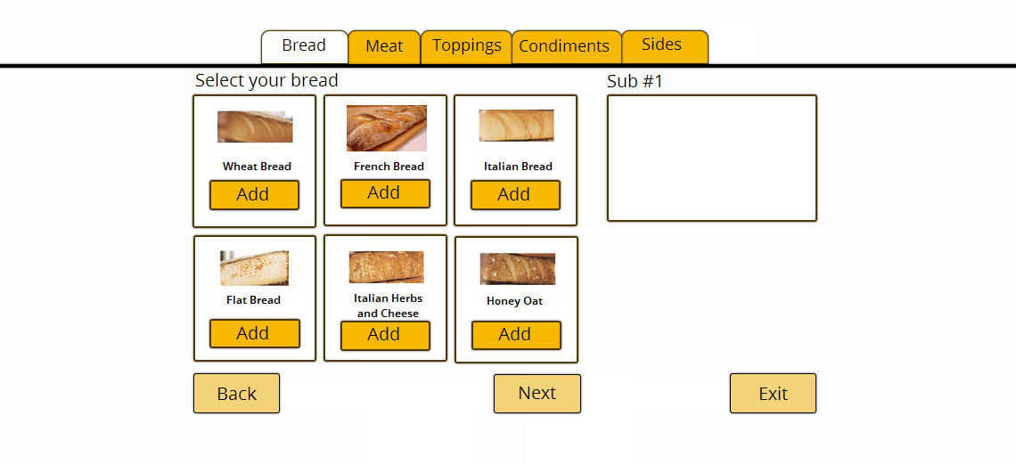

Slide 8
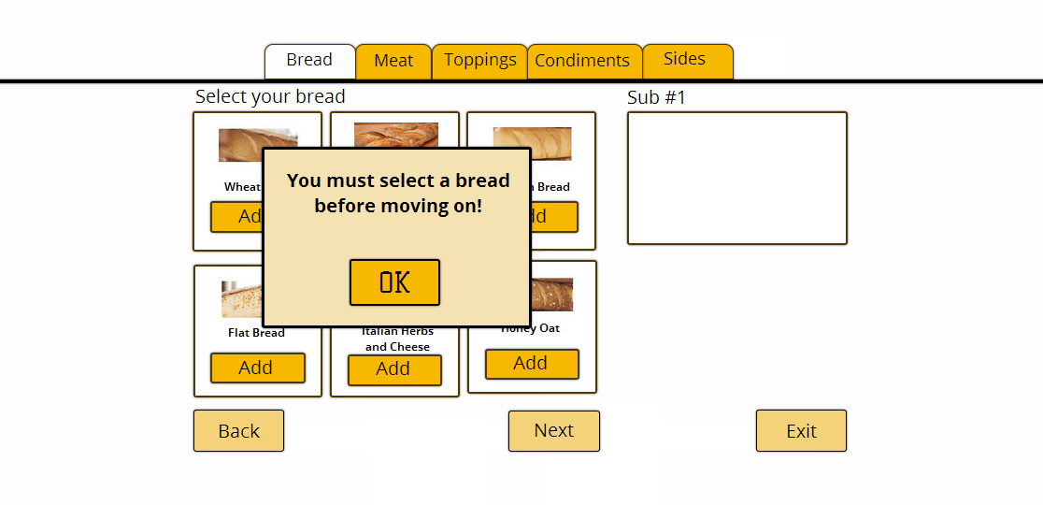

Slide 9
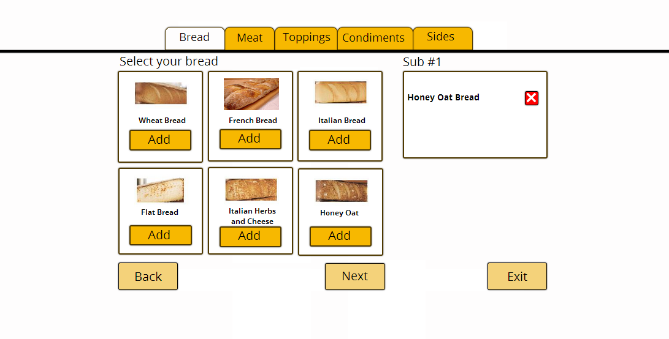

Slide 10
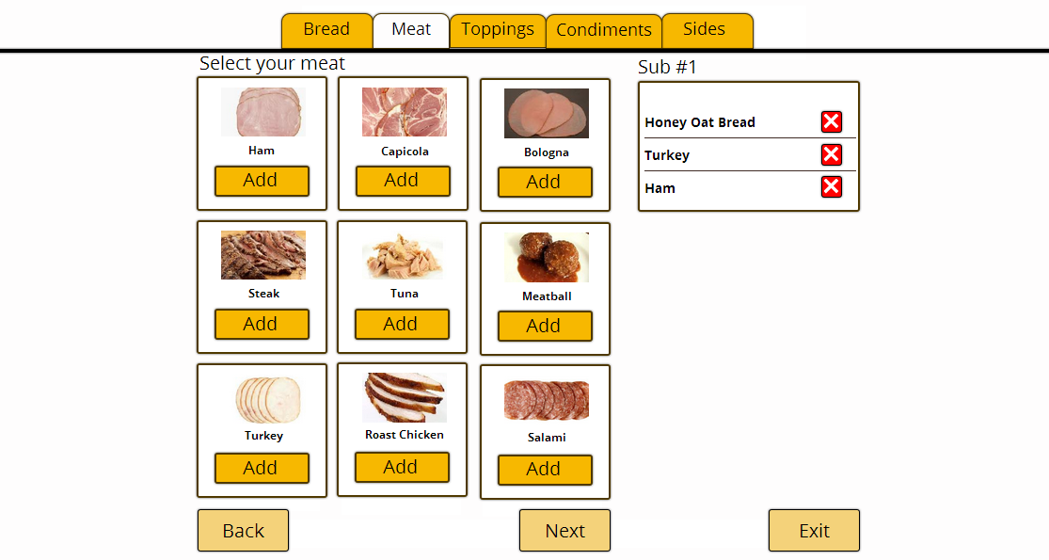

Slide 11
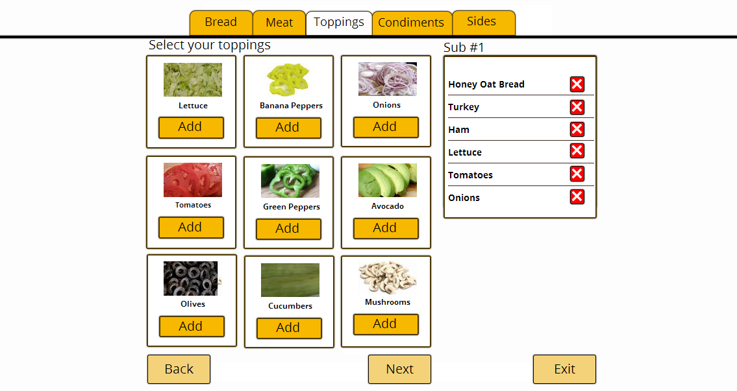

Slide 12
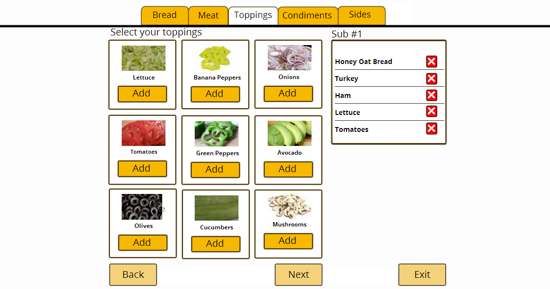

Slide 13
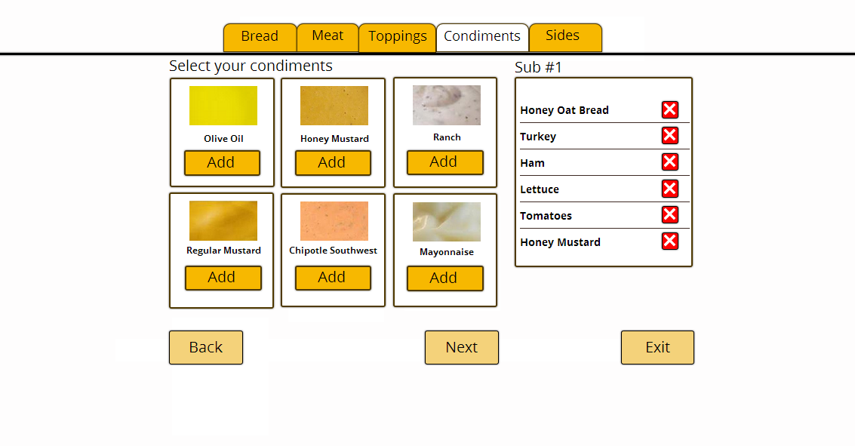

Slide 14
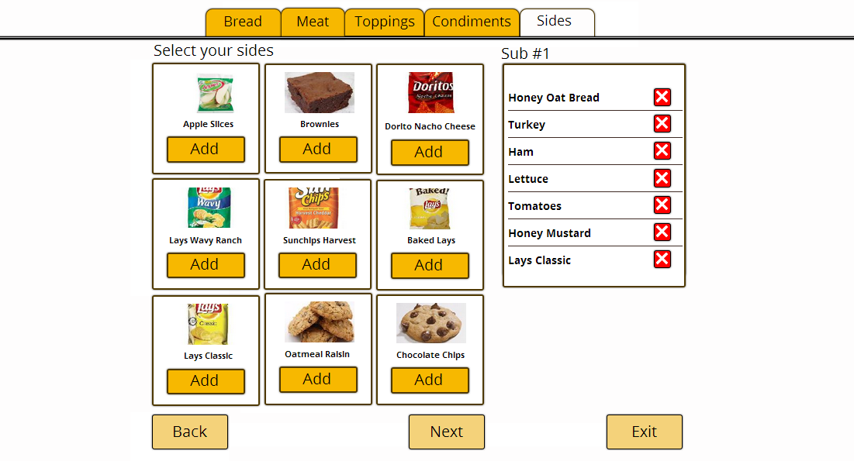

Slide 15
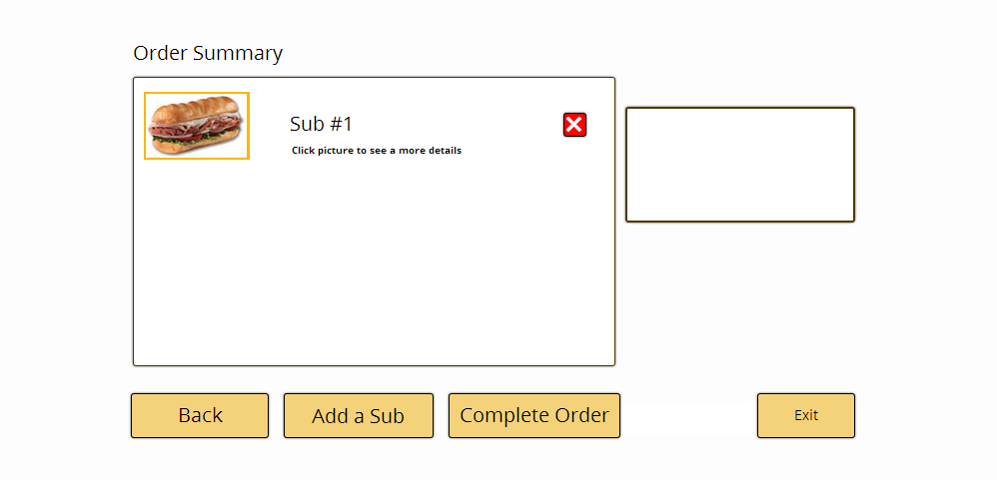

Slide 16
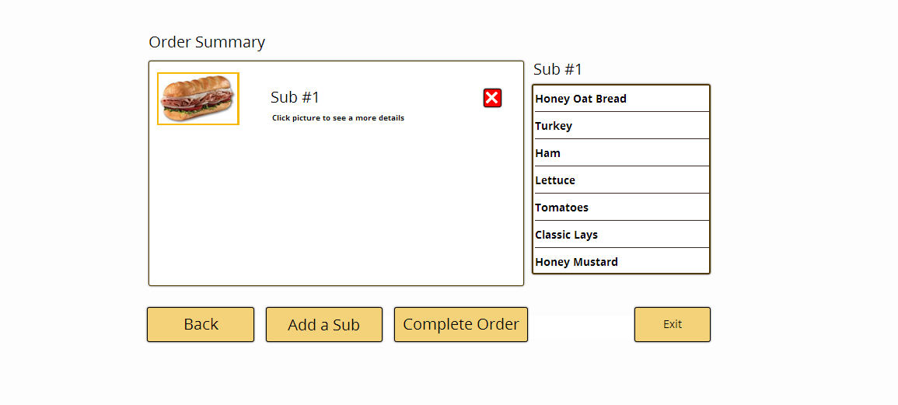

Slide 17
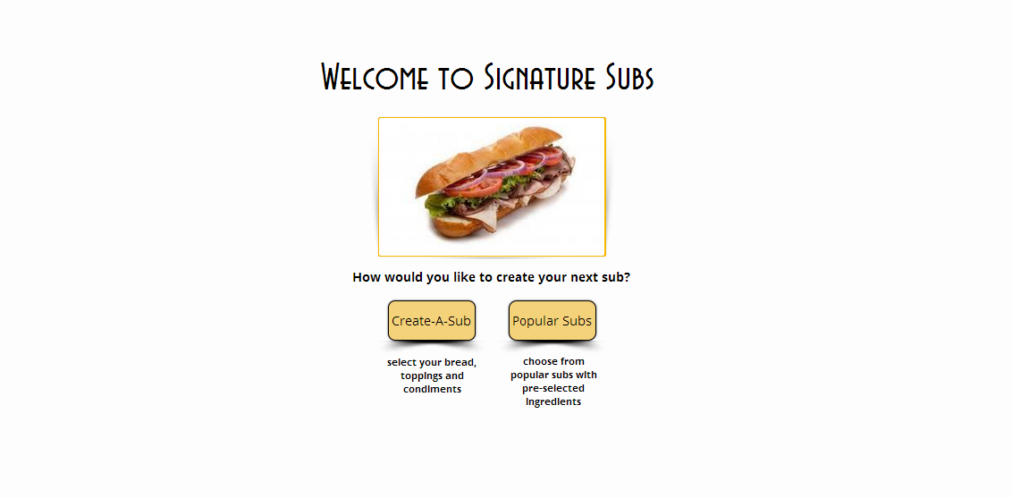

Slide 18
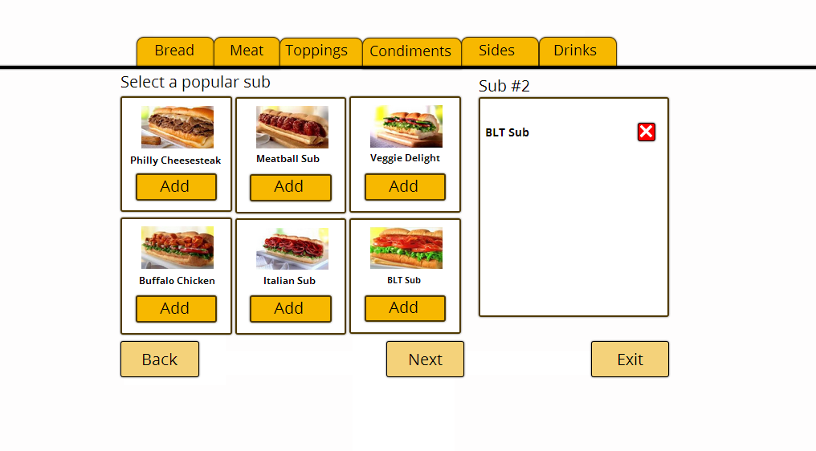

Slide 19
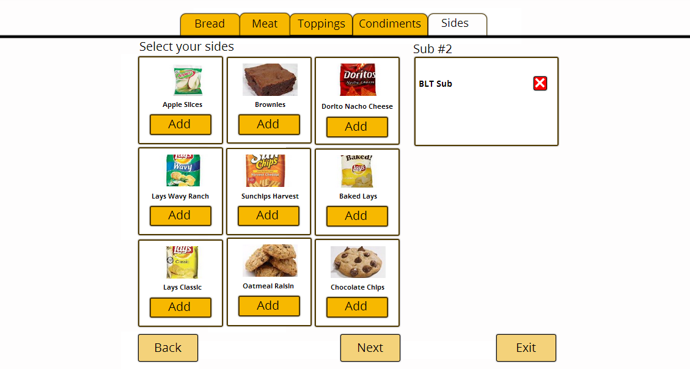

Slide 20
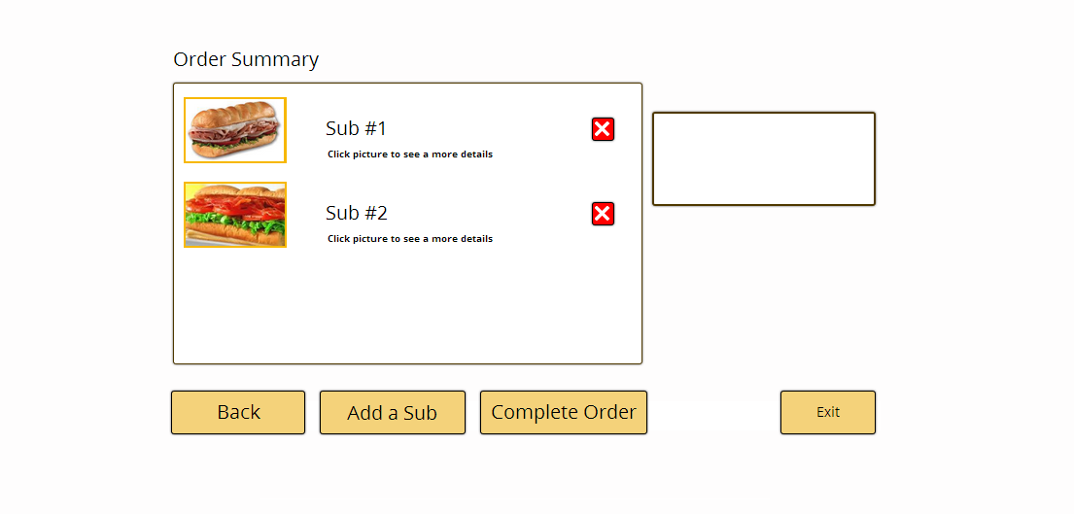

Slide 22
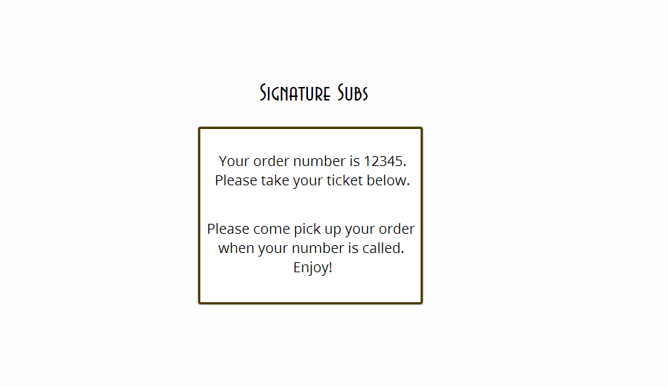

Slide 23
Pre-Test
- Use of Likert scale, differential semantics, etc.
- Gathered demographic information, comfortability with
touchscreens, etc.
- Helped to interpret the results obtained from testing

Slide 24
Pre-Test
- How old are you?
- What is your gender?
- Do you prefer touchscreen interfaces to physical buttons?
- Rate your people skills

Slide 25
Post-Test
- Gain information about the user’s experience
- Check whether their pre-test opinions changed

Slide 26
Post-Test
- Rate your experience with the system from 1-10
- Were you ever confused during the process?
- Did it take too long?
- Suggest any improvements

Slide 27
Suggested Improvements
- ’Back’ button added
- Sub details added at order summary page
- Bread option error recovery

Slide 28
Population
- 5 participants
- Randomly selected
- 4 between ages 18-24, 1 in 40+ range

Slide 29
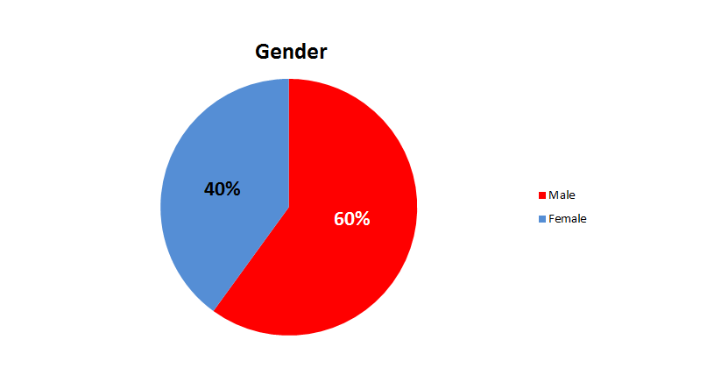
Population

Slide 30
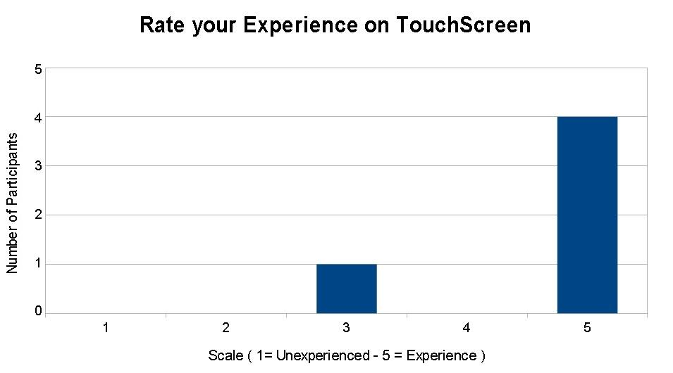
Results

Slide 31
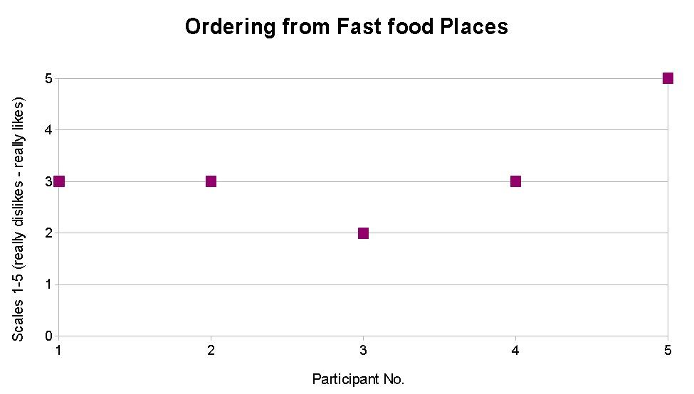
Results

Slide 32
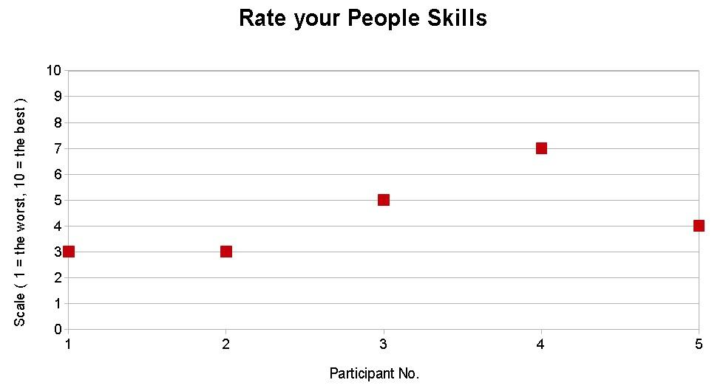
Results

Slide 33
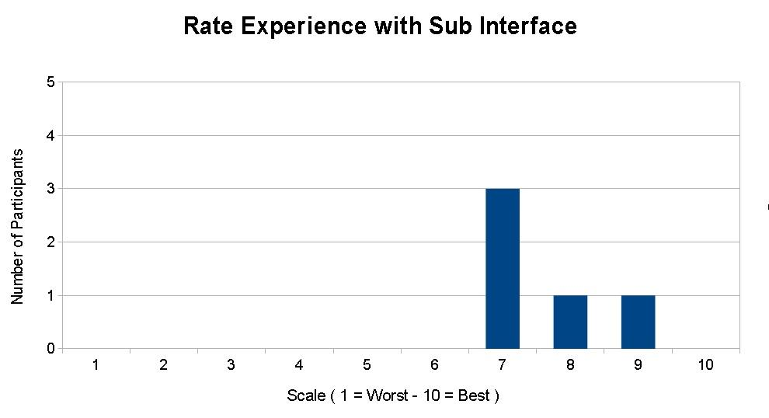
Results

Slide 34
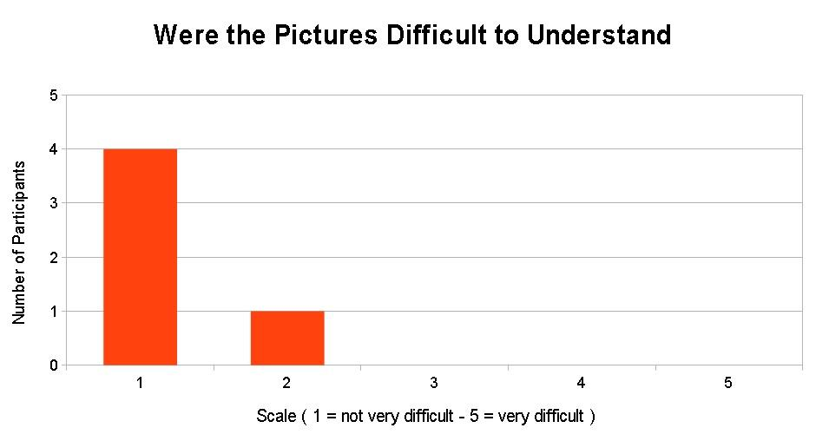
Results
[results graphs go here]

Slide 35
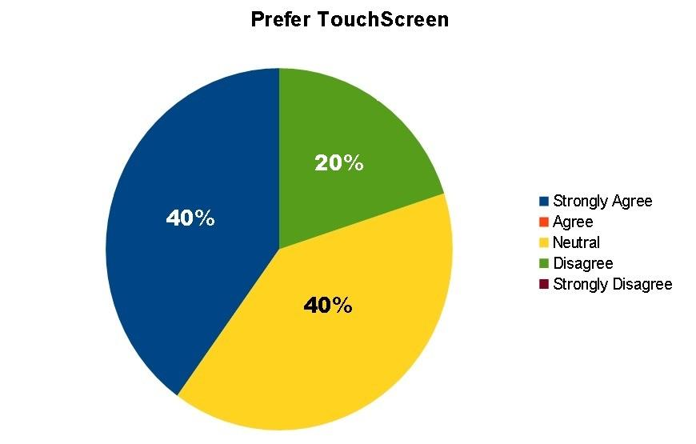
Results

Slide 36
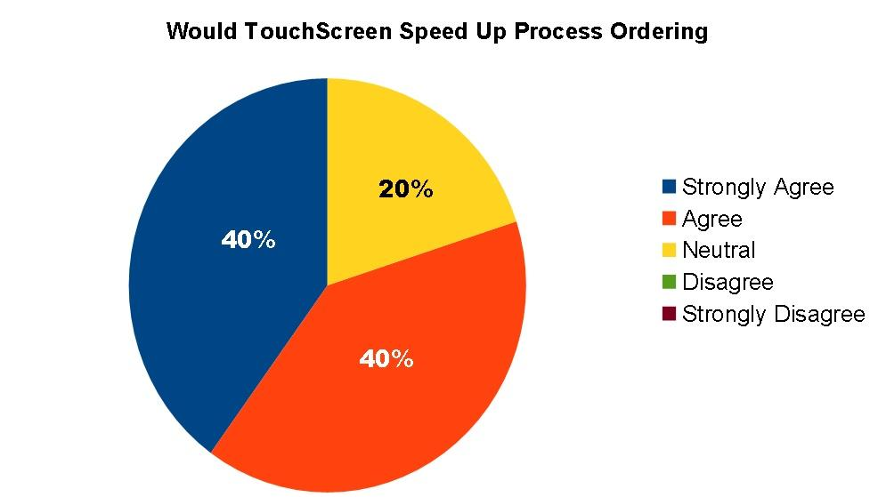
Results

Slide 37
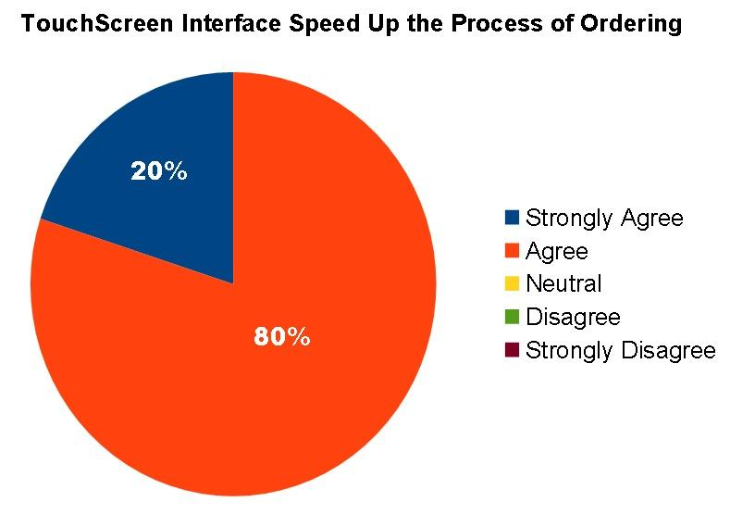
Results

Slide 38
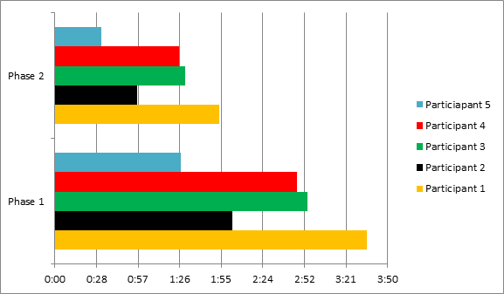
Results

Slide 39
Conclusion
- Makes the ordering process more productive
- Users generally satisfied with interface
- Minimal, functional design follows principles taught
throughout course

