Slide 1
Stock Ticker Lookup Interface
Daniel Allen
Dylan Rund
Dennis Lutchmen
David Morris

Slide 2
Introduction to Interface
Simple php program used to look up current stocks
Very simplistic Interface
Easy to figure out what to do

Slide 3
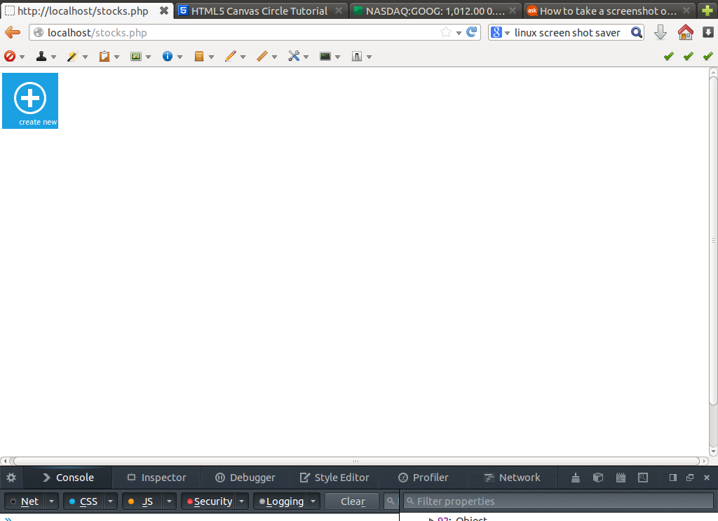

Slide 4
First Glance of Interface
Only one buttons
Draws users eye to button
Calming color
Giant plus sign
  International symbol for add

Slide 5
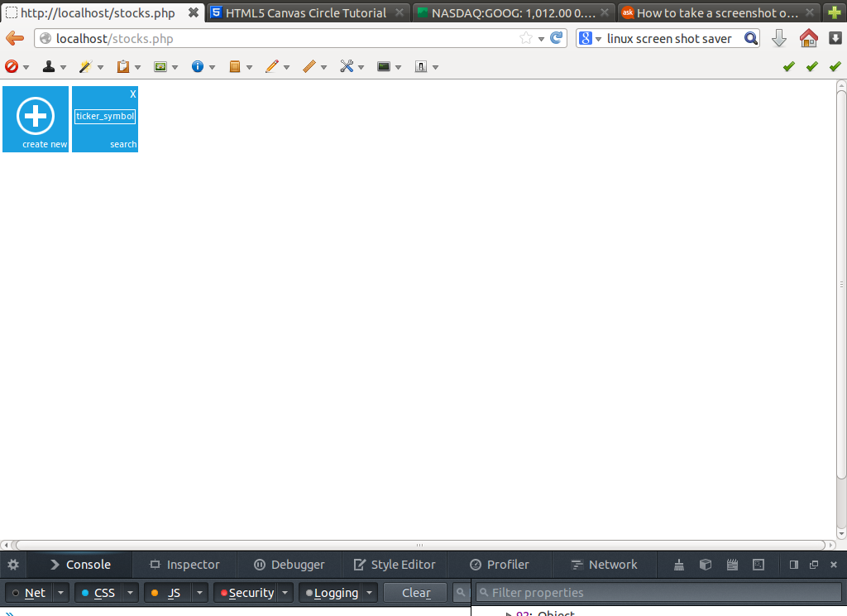

Slide 6
Clicking the plus
When the user clicks the plus sign a new blue box appears to the right
New stock tickers added to the bottom left
  2 Column design
  Prompts user for ticker symbol

Slide 7


Slide 8


Slide 9
Added new stock ticker
The new stock ticker is added when enter button is pressed
When clicked a line graph appears to the right
Shows stock market trends

Slide 10


Slide 11
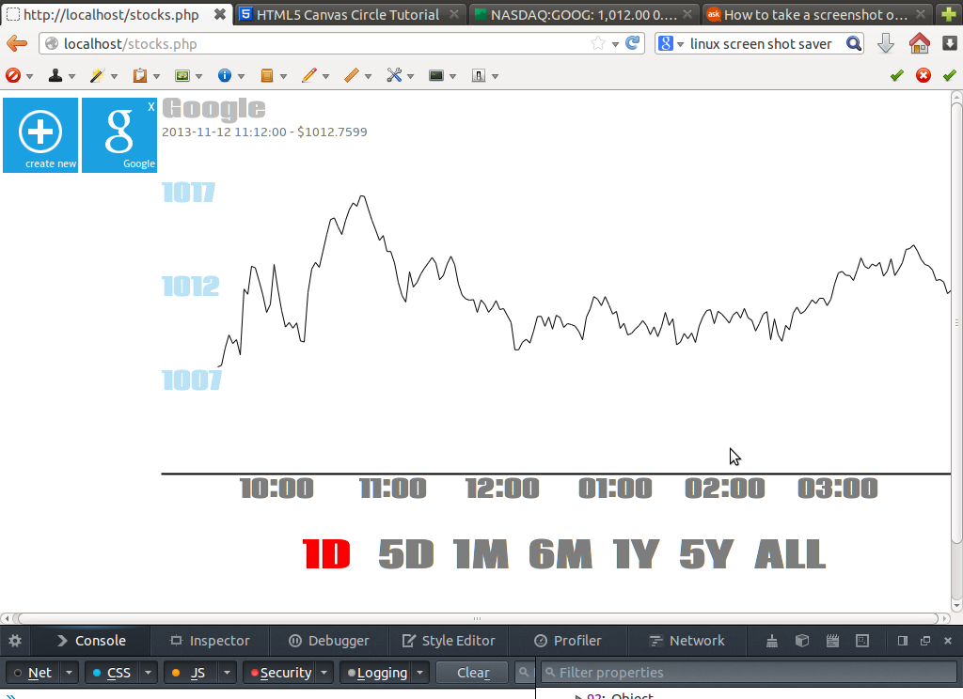

Slide 12
Stock Graph
The Market share is displayed
Line graphs x access can be changed
  Respect to predefined times

Slide 13
