Slide 1
www.RateMyPussy.UK
A feline picture rating website for the people of the United Kingdoms of England, Wales, Scotland, and Northern Ireland
By Dante Marone, Joe Pate, Diego Reano, and Jeremy Delorious

Slide 2
Main Page

Slide 3
Register

Slide 4
Login

Slide 5
Logged in

Slide 11
Category View

Slide 12
Profile View and Rating

Slide 13
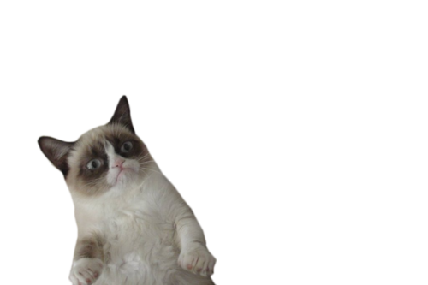
Demographic Data
7 Men to 3 Women
Ages 18 - 57
Mean of 26.7
Median of 23
Average 3.9 Hours of Internet Daily
Tend to prefer cute animals over not

Slide 14
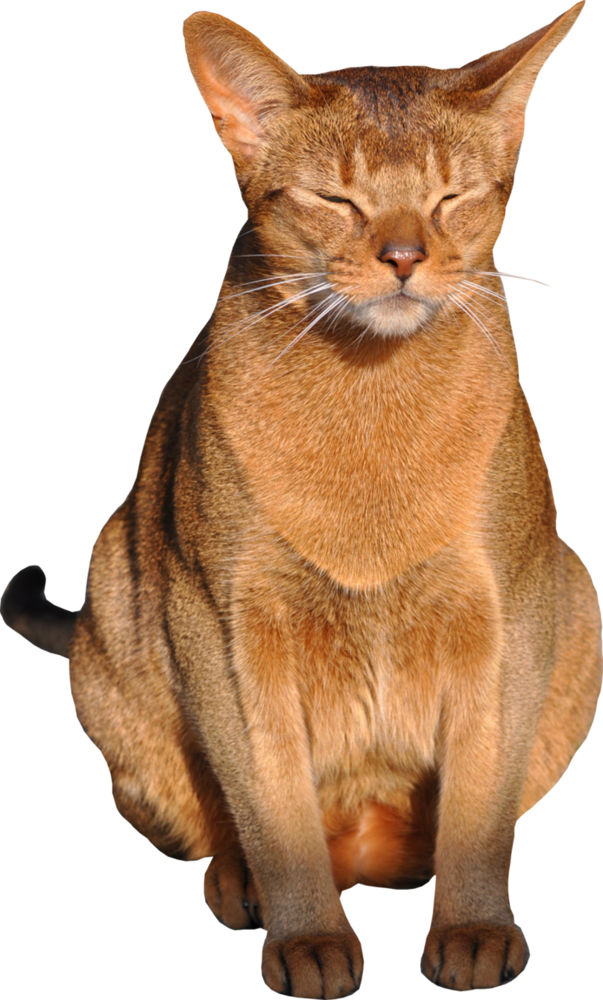
Demographic Data
In order of prevalence
Browsers of Choice
Chrome, Firefox
Preferred Site
Facebook, 4chan, Reddit
Preferred Search Engine
Google
Preferred Companions
Dogs, Cats, Rats

Slide 15
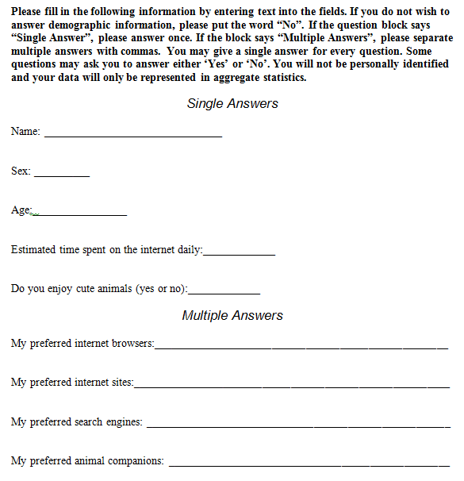
Pre-Test

Slide 16
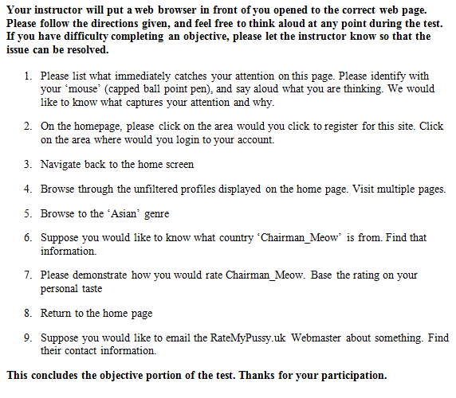
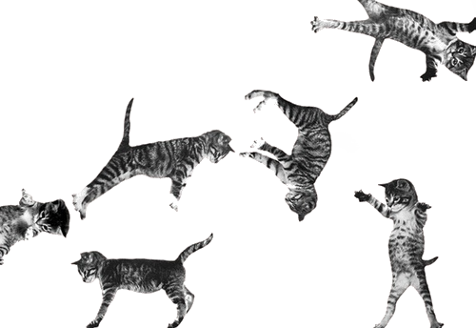
Tasks
Think Aloud
Paper Test

Slide 17
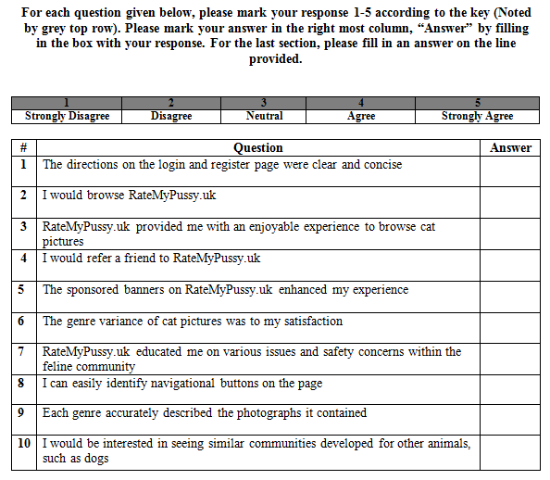
Post-Test
Likert Scale

Slide 18
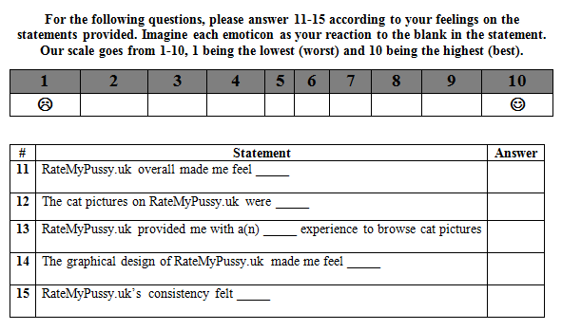
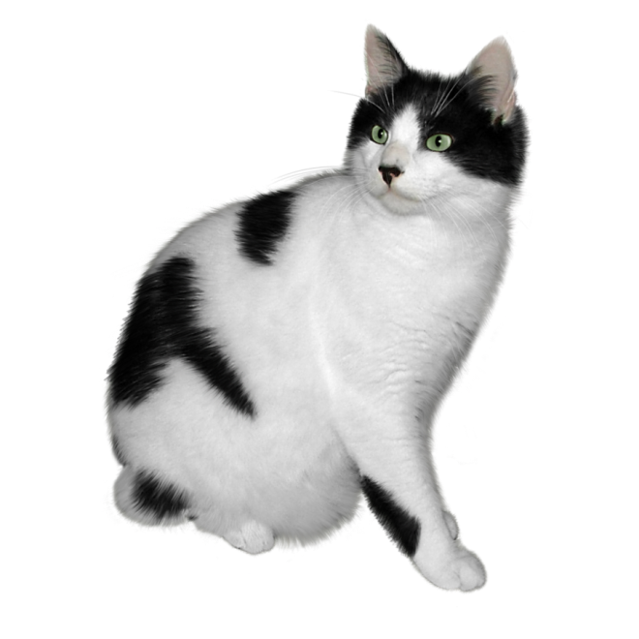
Post-Test
Differential Semantics

Slide 19
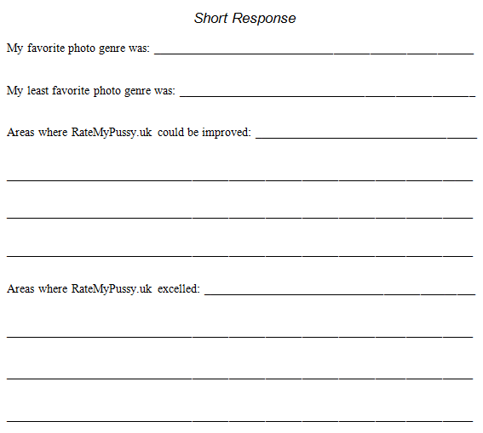
Post-Test
Free Response

Slide 20
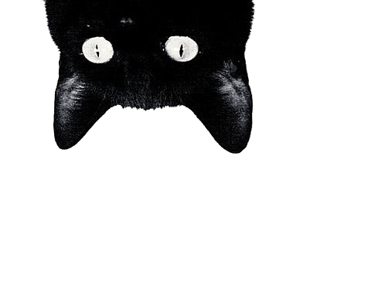
Demographic Biases
Recap
Strong male skew
Mostly Chrome users, some Firefox
All avid social media users
Strong Google bias
Strong dog skew

Slide 21
Raw Data
Gross

Slide 22
Raw Data

Slide 23
Raw Data

Slide 24
Conclusions

Slide 25
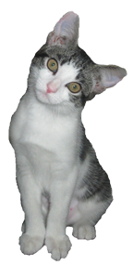
Conclusions

Slide 26
Conclusions

Slide 27
Conclusions
Older people were less receptive to RMP
Ads were not well received
This is to be expected
Men were more receptive than Women
Men: 71% satisfied against Women: 67%
Educational sections need to be enunciated

Slide 28
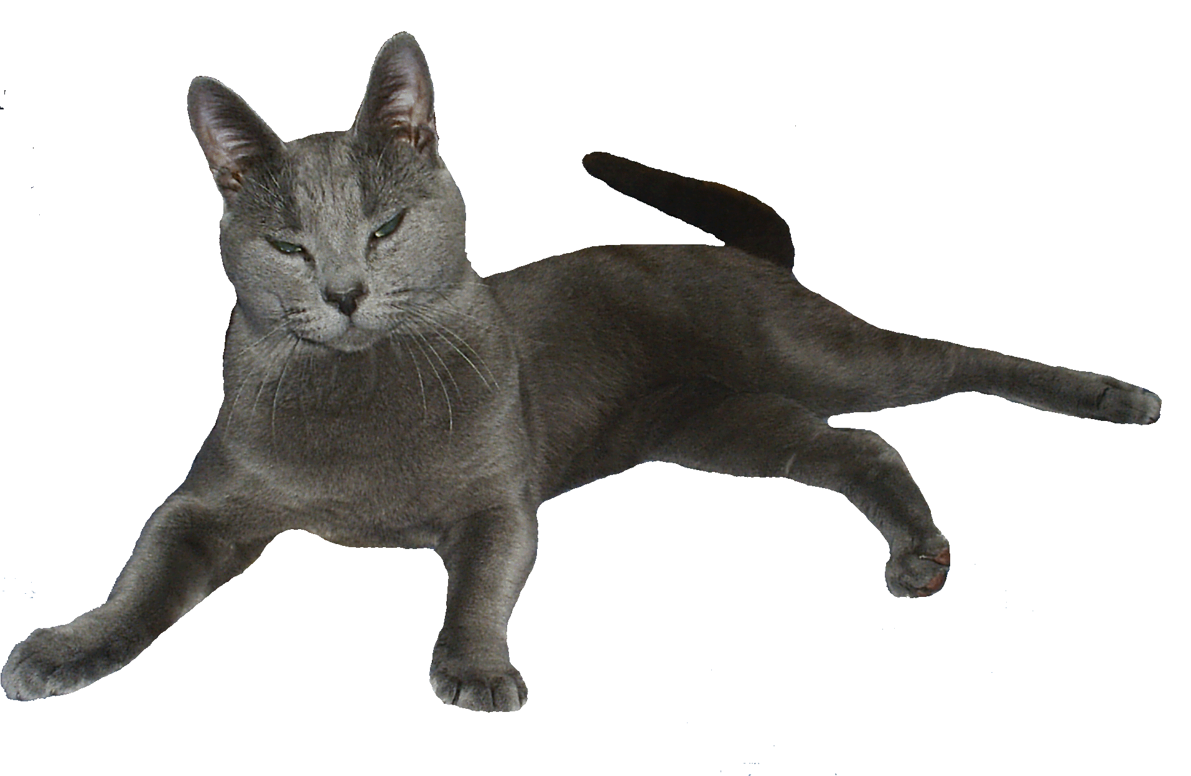
User Suggestions
Give a visual indicator for ratings
Stars, cat paws fish
Detailed instructions on registration page
Currently leaves the user to assume a lot
Interface Affordances
Show given ratings
Implement a “Favorites” feature

Slide 29
Register

Slide 30
Logged in

Slide 31
End

