Slide 1
Magnetically-Enhanced Whiteboard
Group 19 Jason Cooper, Yenny Lozada Tulsi Parikh, Marcelo Trujillo

Slide 2
Whiteboards
Dry-erase boards, or simply whiteboards, are one of the most effective, time-tested methods of communication. They save paper and allow for tools such as markers and erasers to be used with ease.
Notes:
(According to Emily, Thomas. "Reporter". Marketing. Retrieved 30 July 2011) (http://www.whiteyboard.com/history-of-whiteboards.html)

Slide 3
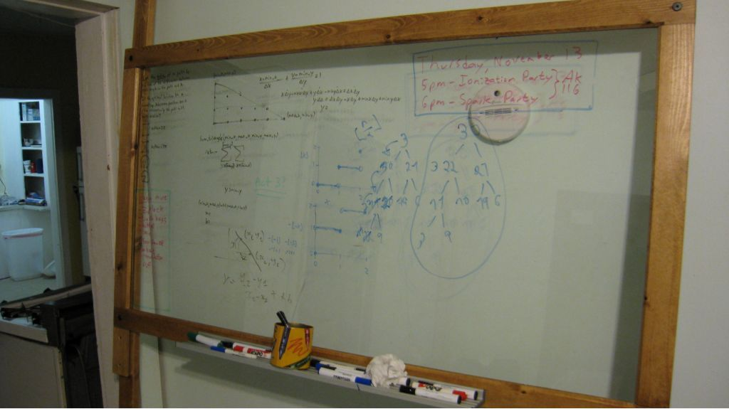
The Problem
No, not that people make their own dry-erase boards with a sheet of glass and several 2x4s.
The ledge holding markers, erasers, and other tools becomes cluttered, making it difficult retrieve items and more likely to loose items.
Notes:
http://cdn.instructables.com/FJ3/VCQI/FORZTJCK/FJ3VCQIFORZTJCK.LARGE.jpg

Slide 4
Goal
Create a revamped whiteboard interface that would enhance users’ experience by allowing greater usability.
In doing so, it would be necessary to incorporate all existing tools of the traditional whiteboard: markers, erasers, and drawing tools.

Slide 5
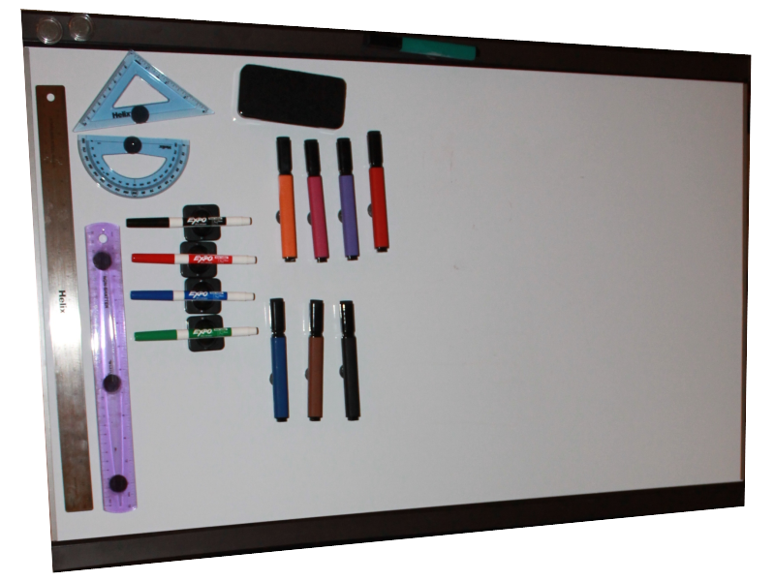
Birth
And with that, it was born…

Slide 6
Interface Components
Straight-edge, protractor, etc.
Eraser
Magnetic
whiteboard
Markers
galore
Magnetic
strips

Slide 7
Interface Components
Back of Whiteboard
More useful magnetic strips for storage

Slide 8
Some Design Inspiration
Example Tool Setup
Fun Tools
Markers
Eraser
Drawing Region
Look familiar?

Slide 9
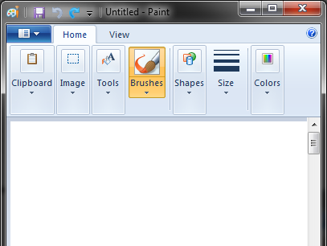
Some Design Inspiration
Maybe not familiar, but the interface follows the same toolbar design concept.
Fun Tools
Markers
Eraser
Drawing Region
It’s Microsoft® Paint

Slide 10
You-Choose Layout
Markers
Fun Tools
On top of that, the “toolbar” components can be freely moved around to allow for most convenience and efficiency.
Drawing Region
Eraser
Markers
Drawing Region
Fun Tools
Markers
Eraser

Slide 11
Choosing a Population
Convenience sampling techniques were used in selecting a population. We desired a population including both students and instructors on the UCF campus.
We determined four participants would be sufficient in carrying out the objective.

Slide 12
Population
A couple of our participant demographics were split.
Only two age groups were present in our sample.

Slide 13
Population
A couple of our participant demographics were split.

Slide 14
Population

Slide 15
Population

Slide 16
Pre-Evaluation
In trying to determine our population’s experience with whiteboards, we a few pertinent topics including previous use of whiteboards and use of drawing tools with a whiteboard.

Slide 17
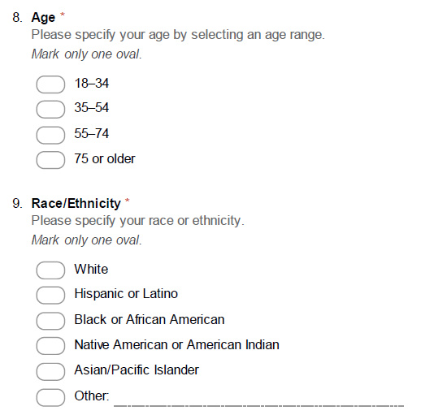
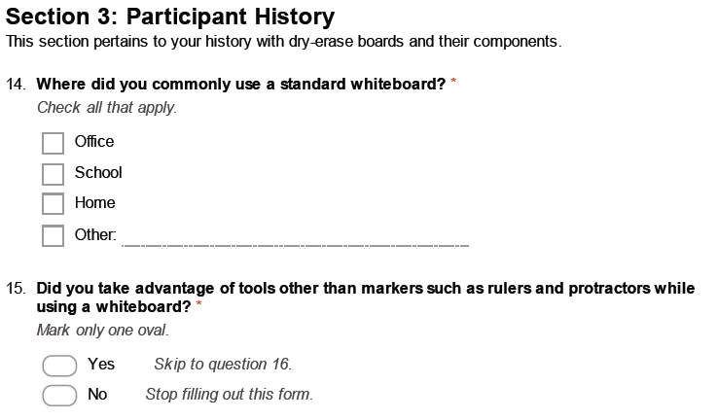
Pre-Evaluation
We orally administered the pre-evaluation.

Slide 18
Pre-Evaluation
It is noteworthy to mention that all participants have used a whiteboard previously and none have used drawing tools with one.

Slide 19
Pre-Evaluation
We received a number of responses as to where whiteboards have been most commonly used in their past.

Slide 20
Evaluation
The evaluation contained three components:
Tasks for use with a standard, non-magnetic whiteboard
Tasks for use with the magnetically-enhanced whiteboard (the primary interface being tested for usability)
Tasks for use with the magnetically-enhanced whiteboard again to determine additional usability

Slide 21
Evaluation
The first and second procedures contained an identical set of tasks.
Each contained a total of 13 tasks. Most of the tasks were repetitive to allow for the collection of more accurate data.

Slide 22
Evaluation
The third procedure contained roughly half the number of tasks. The included tasks were identical to the tasks from the first and second procedures.
Procedure 1
Procedure 2
Procedure 3
Tasks 1-13
Tasks 1-13
Tasks 1-7

Slide 23
Evaluation
The difference between the two is that the participants were permitted to use the magnetic features of the tools during the second procedure, whereas during the first, participants were not physically able to take advantage of such features.
Standard non-magnetic whiteboard
Procedure 1
Participants place tools on ledge
Magnetic whiteboard with magnetic tools
Procedure 2, 3
Fun Tools
Eraser
Markers
Fun Tools
Eraser
Markers

Slide 24
Evaluation
Each participant was video recorded. We used these recordings to obtain more precise time measurements.
For each item we had participants write or draw, we also had them erase. Times were measured for erasing too.

Slide 25
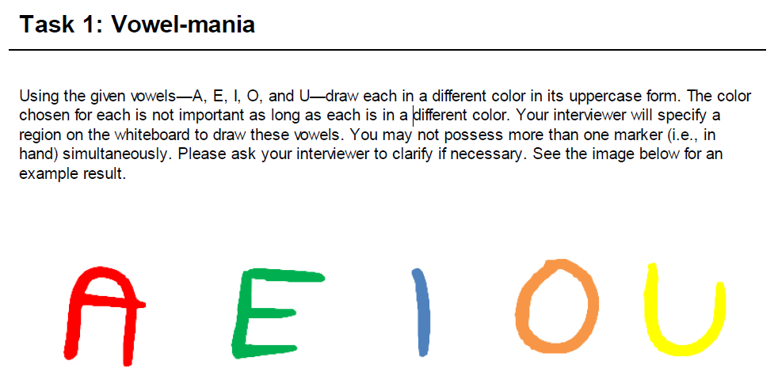
Evaluation
One task participants were asked to complete was…

Slide 26
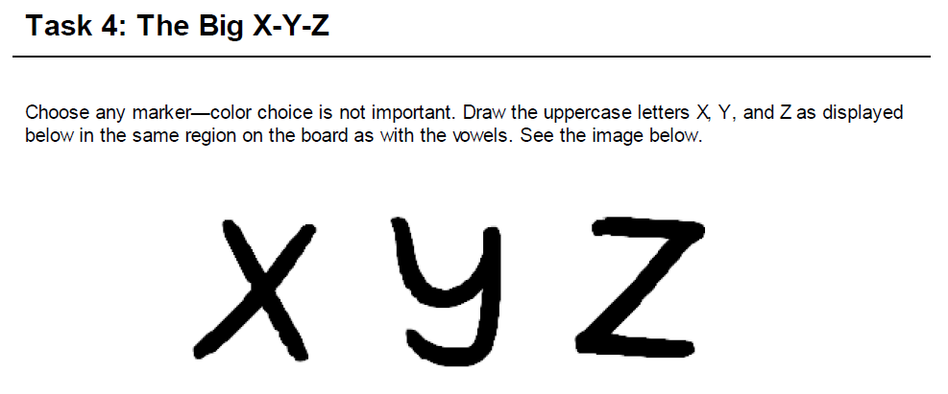
Evaluation
One task participants were asked to complete was…

Slide 27
Evaluation
One task participants were asked to complete was…

Slide 28
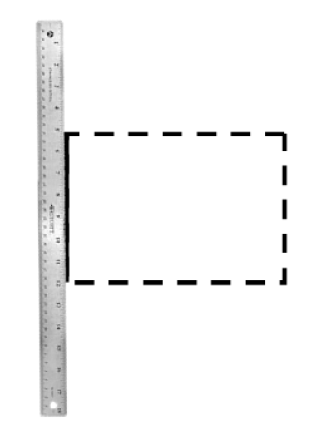
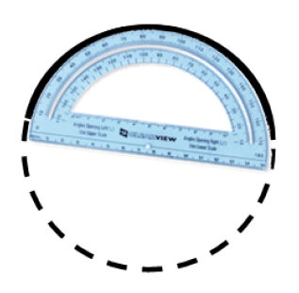
Evaluation
One task participants were asked to complete was…
By providing the participants with drawing tools such as rulers and protractors, we are providing a complete interface that matches or exceeds the components seen with the common whiteboard.

Slide 29
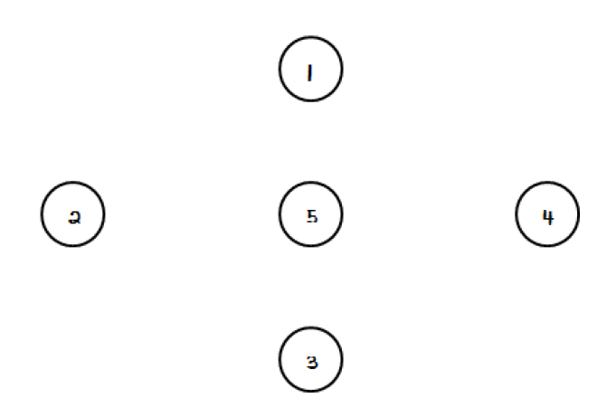
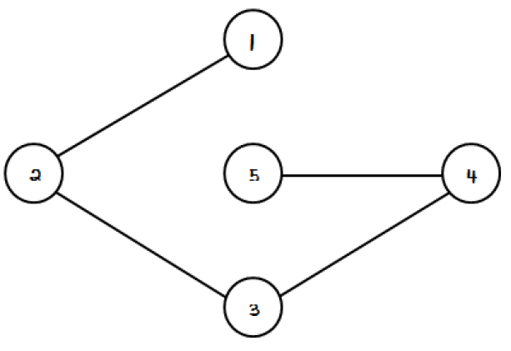
Evaluation
One task participants were asked to complete was…
Connect-the-Dots

Slide 30
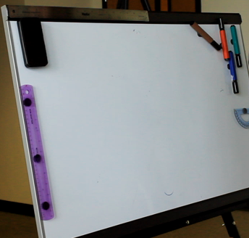
Evaluation
During the third procedure, in which use of magnetic features were permitted, users were asked to setup their own workspace.
Participant 3’s Customized Workspace

Slide 31
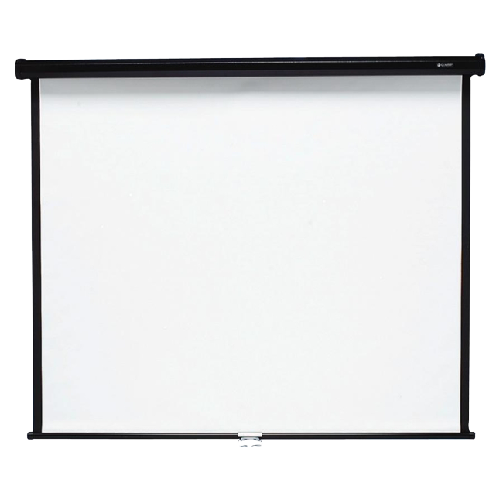
Evaluation
During the third procedure, in which use of magnetic features were permitted, users were asked to setup their own workspace.
Coming Up
Participant 2 Working in his Customized Workspace

Slide 32
Post-Evaluation
All participants responded that they found new or creative ways for using the magnetic surface of the whiteboard on the modified, magnetic design.

Slide 33
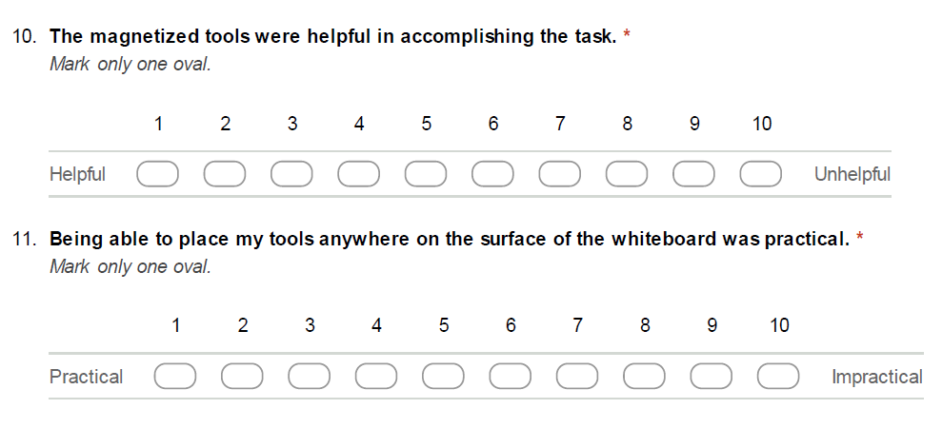
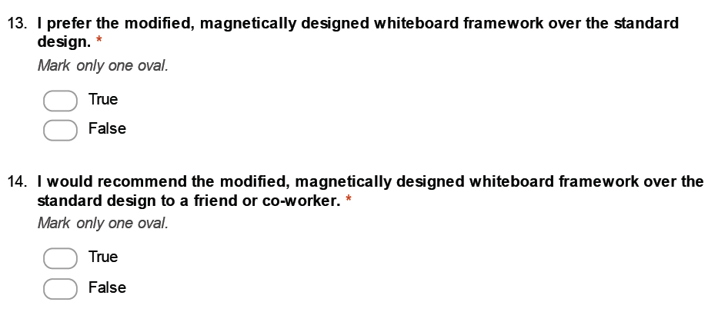
Post-Evaluation
We orally administered the post-evaluation.

Slide 34
Post-Evaluation
All participants responded that they preferred the magnetically designed whiteboard framework over the standard design and would recommend using the design to a friend or family member. These participants preferred not to use the ledge to store markers and other items.
Standard non-magnetic whiteboard
Participants place tools on ledge
Magnetic whiteboard with magnetic tools
Fun Tools
Eraser
Markers
PREFERRED
Fun Tools
Eraser
Markers

Slide 35
Post-Evaluation
The modified, magnetically designed whiteboard was fun to use.
Satisfaction

Slide 36
Post-Evaluation
All participants maximally agreed that they feel that the tools of the magnetic whiteboard are less likely to fall and get lost.
Safety, Effectiveness

Slide 37
Post-Evaluation
Ease of Use

Slide 38
Post-Evaluation
All participants maximally agreed that being able to place their tools anywhere on the surface of the whiteboard was practical.

Slide 39
Post-Evaluation
Comments
“[The magnetic whiteboard] worked pretty nicely…”
Would be nice if the protractor could have a knob on it at the center to easily spin it
Allow eraser be magnetized from the felt side
“Great product”
“I liked how you can place the tools anywhere an they don’t fall.”

Slide 40
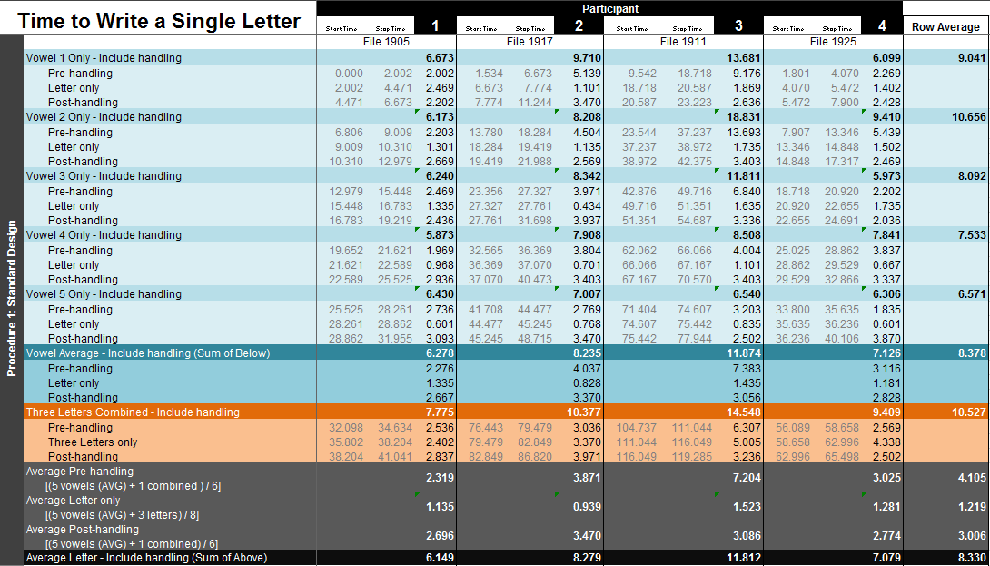
Compiling Data
We used Microsoft® Excel to store data and perform calculations. All task times were retrieved via pre-recorded videos.

Slide 41
Results
To determine whether or not the magnetically-enhanced whiteboard was more efficient than the standard, non-magnetic whiteboard, we concentrated on the time it took to write a single alphabetic letter.

Slide 42
Results
Efficiency, Learnability

Slide 43
Results
Efficiency, Learnability

Slide 44
Results
Efficiency, Learnability

Slide 45
Results
Efficiency, Learnability

Slide 46
Results
Efficiency, Learnability

Slide 47
Results
Efficiency, Learnability

Slide 48
Results
Efficiency, Learnability

Slide 49
Conclusion
Our results indicate that we have met our goal of creating a revamped whiteboard interface that would enhance users’ experience by allowing greater usability.

Slide 50
References
Thomas , Emily. "History of the Whiteboards." Whiteboards. Reporter magazine, 30 07 2011. Web. 12 Nov. 2013. <http://www.whiteyboard.com/history-of-whiteboards.html>.
http://cdn.instructables.com/FJ3/VCQI/FORZTJCK/FJ3VCQIFORZTJCK.LARGE.jpg

Slide 51
Interface

