Slide 1
CAP 4104 - Website Usability Improvement
By: Brian Jung, Charles Van Horn, John Best, Christopher Ratzlaff

Slide 2
Goals
To enhance the usability and readability of the Human and Technology Interaction Class Website.
To make the information from the website more accessible for students.

Slide 3
Room for Improvement
A clutter of information
Lack of quality in design
No universal navigation method to explore the website.

Slide 4
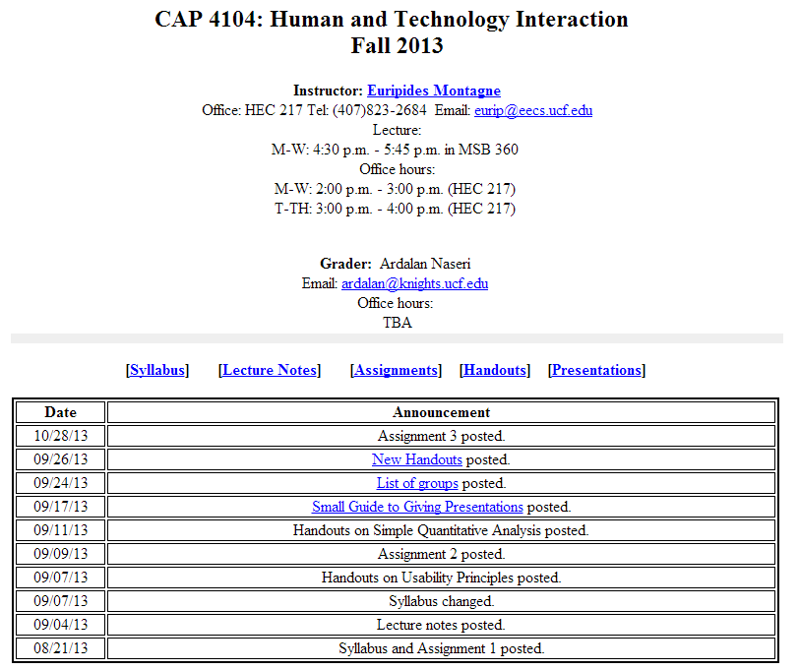
Clutter of Information

Slide 5
Clutter of Information cont.
Cramped information
Whitespace could be improved.
  According a study (Lin, 2004), it has been proven that whitespace can increase comprehension by almost 20% and influences the user’s overall satisfaction.

Slide 6

Lack of Quality Design
A study shows that color, shared background, and co-location are stronger group cues than outlines. (Beck and Palmer, 2002).

Slide 7

Lack of Quality Design cont.
For motivated users of an information site, bad design (busy layout, small print, too much text) hurts more than good design helps. (Sillence, Briggs, Fishwick, and Harris 2004).

Slide 8
Match between system and the real world design
Fitt’s Law
  Using larger objects to create more effectiveness between objects than utilizing many closely placed small items
Naturally flowing webpage instead of clicking and backing
Links closer to four corners of page

Slide 9
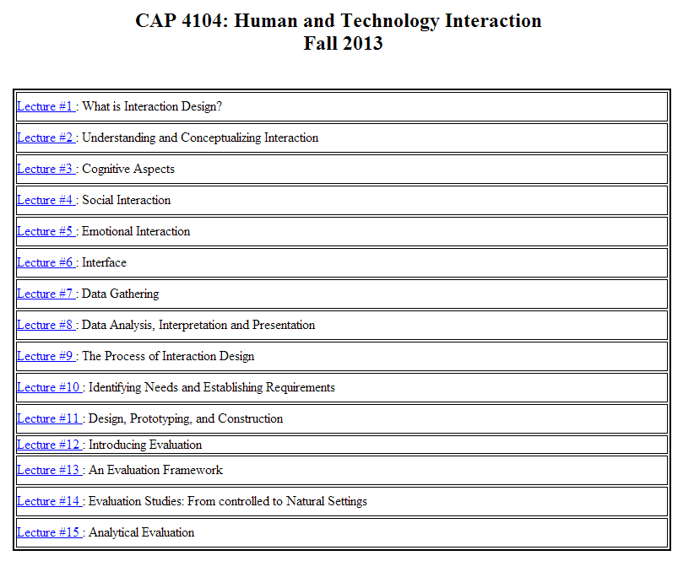
Lack of universal navigation method

Slide 10
Lack of universal navigation method cont.
Universal navigation bar affixed to the top of the website for faster and more intuitive navigation.

Slide 11
User Control and Freedom
Free flow design (Mouse Cursor)
User feels as they never left page
User only changes the screen they chose while border stays the same.
  Provides consistency in the feel
  Color consistency enhances users confidence
  Scheme of webpage consistent
    Actions
    Themes
    Background

Slide 12
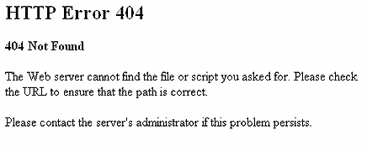
Error Prevention
Instructs user to check URL
Secondary instruction to contact Administrator
Missing file error

Slide 13
Pre Test Question
What is your age?
What is your gender?
How many years have you been using a computer?
Do you own a computer?
What operating system do you prefer on a computer?
How many hours a day do you surf the internet?
Which internet browser do you prefer to use When surfing the internet?
What do you mainly use the internet for?

Slide 14
Tasks for Usability Test
1. Find and download the Syllabus for this class to your machine.
2. What time do the Professor’s office hours start?
3. What announcement was posted on September 9th 2013?
4. Find and download the first assignment to your machine.
5. What is the name of the Lecture 7 Notes?
6. Find the TA’s email and write her a 1 sentence email, but do not send it.
7. What building is the Professor’s office in?
8. Find and download Lecture 12 to your machine.
9. Find and download the Handout “Simple Quantitative Analysis” to your machine.
10. What days are the Lectures given for this class?

Slide 15
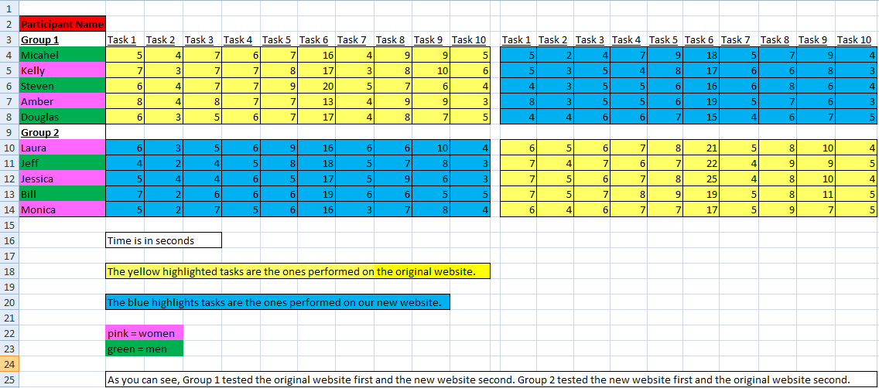
Usability Test

Slide 16
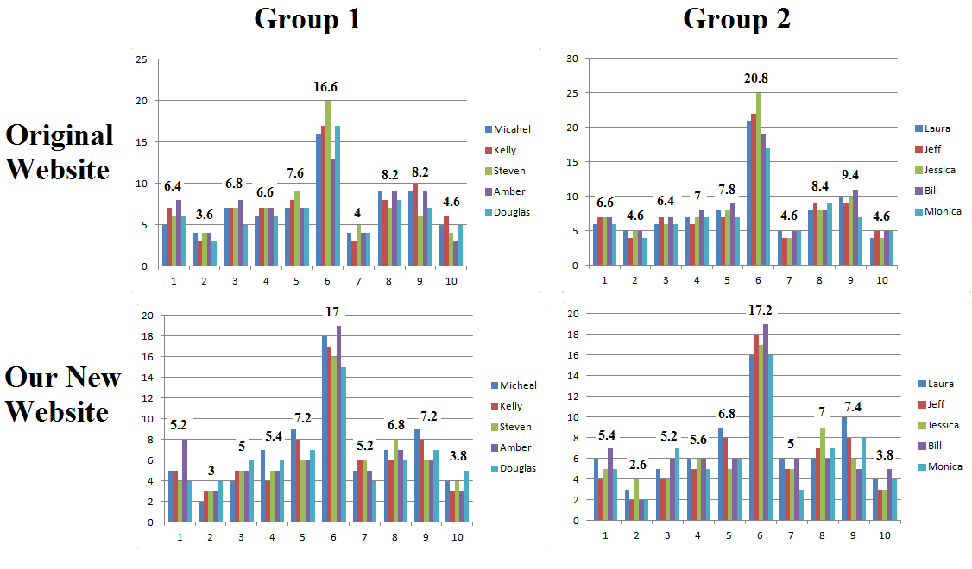

Slide 17
Analysis
The averages for both groups from both tests are lower with our new website than those of the original class website.
The changes our group decided on were statistically beneficial for users.

Slide 18
Post Test Questions
Learning to navigate was easy
On-screen Labels were helpful
It take too long to learn how to navigate
The button labels are clear and understandable
I would be comfortable using this webpage
Trying to complete the task was frustrating
I felt tense trying to complete the task
There are too many steps to complete the task
I feel that new users will find this webpage easy to use
I can easily recognize what the buttons are for from a distance
It is obvious that the users needs was taken into consideration when designing the web page
It is difficult to find the button that I am looking for
It is easy to find information

Slide 19
Suggestions for improvement from the Participants
Original Website
More spacing between text, not just only in the middle of the page
Differentiate between texts with different fonts, colors, and sizes
Have all the information on one page

Slide 20
Conclusion
Following general usability principles, improvements were made to the overall user interface and the user experience when browsing the new website.
Working closely with the HCI design goals in mind, the new website was able to improve the time it took to complete the majority of the tasks across the board.

