Slide 1

Interface Re-design
Group 23
CAP 4104: Human and Technology Interaction Aileen Baliwag
November 6, 2013 Michael Bobbitt
Jeremy DeFalco
Scott Holman

Slide 2
Goals
Test the usability of the Netflix website interface
Redesign the Netflix interface
    Based on the usability test results
    Make more user friendly

Slide 3
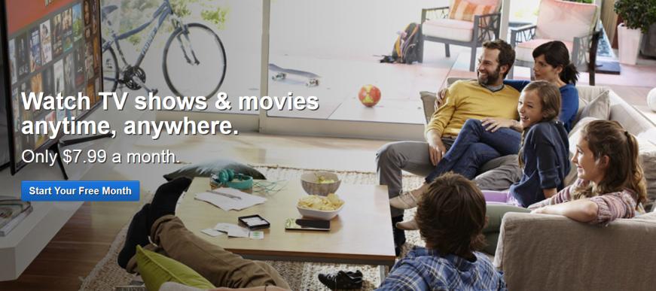
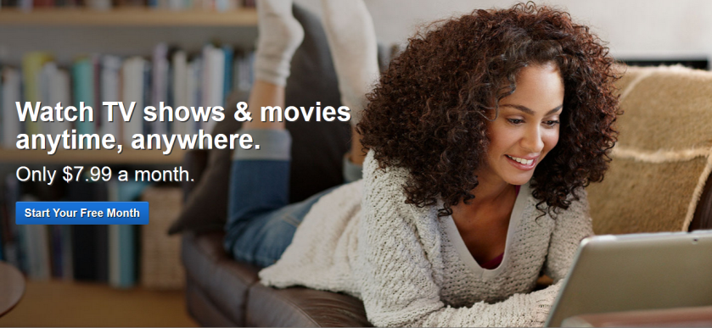
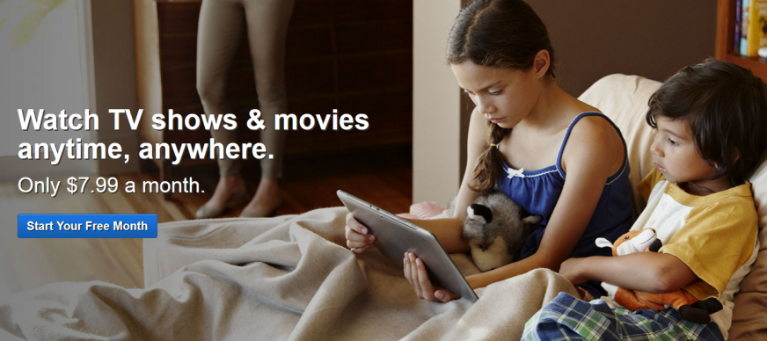
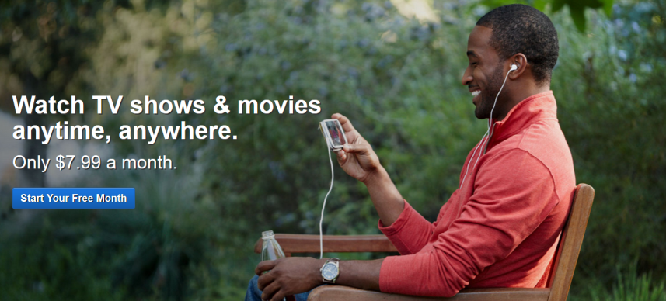
Netflix’s Audience

Slide 4
Netflix’s Audience
Not explicitly stated
Marketing and website images imply an all-ages audience

Slide 5
Testing Demographics
6 participants
  2 – approximately 25 years old
  2 – approximately 35 years old
  2 – approximately 65 years old

Slide 6
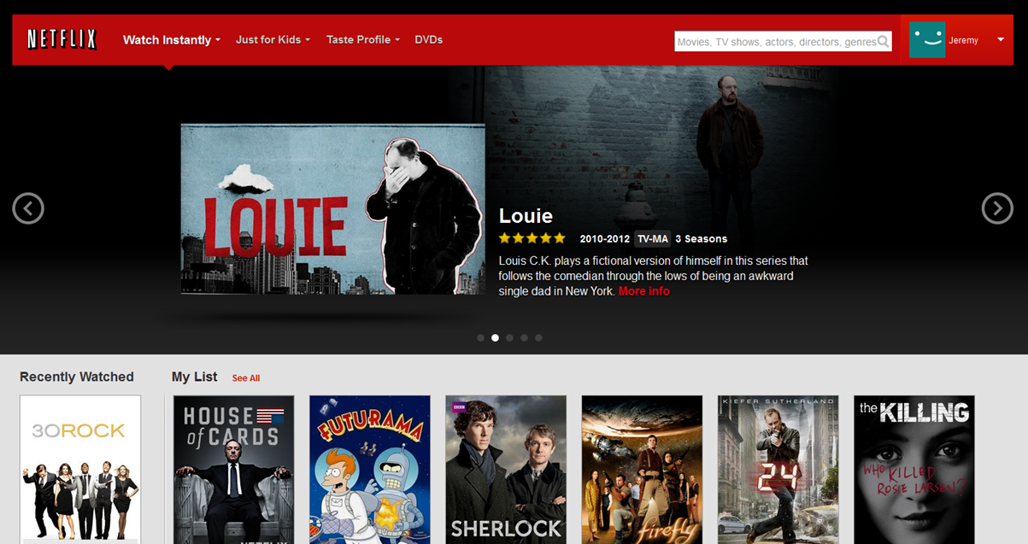
Two Main Interfaces
1) Movie and TV browsing interface

Slide 7
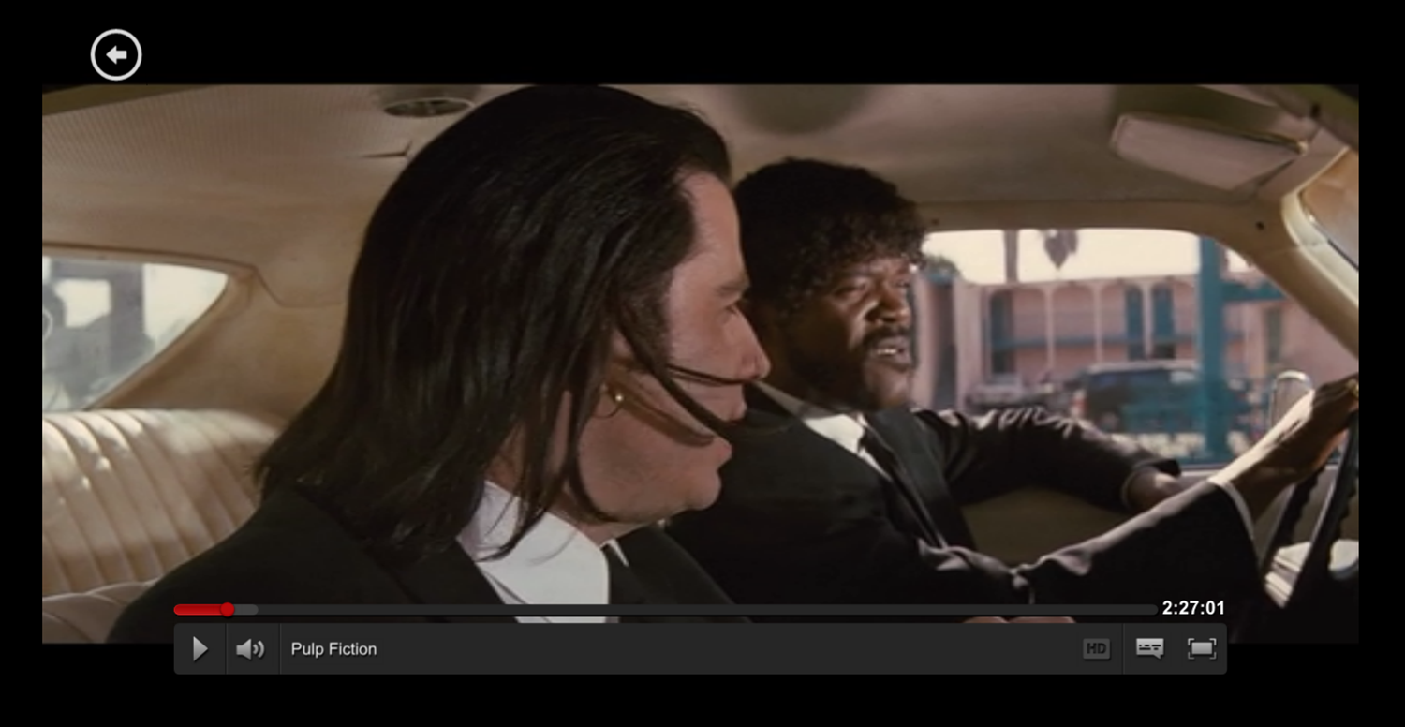
Two Main Interfaces
2) Video Player Interface

Slide 8
Usability Test

Slide 9
Usability Test
16 steps
Start test logged into Netflix homepage

Slide 10
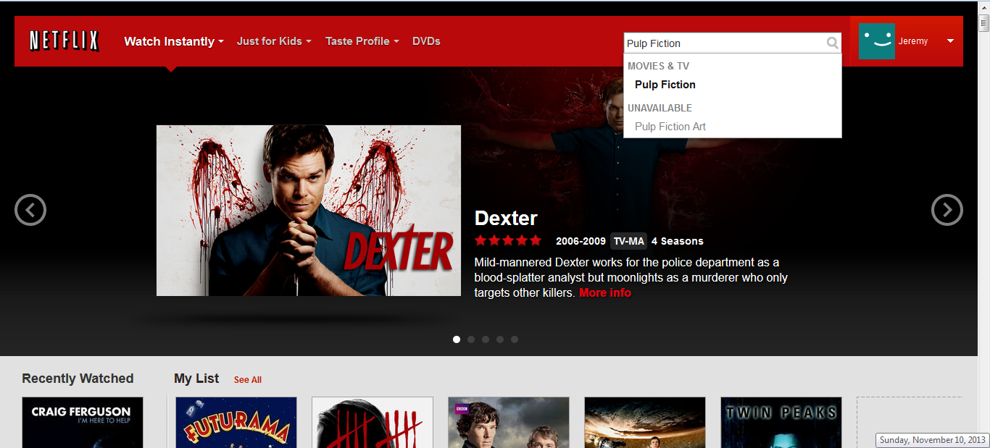
Usability Test
1) Search for “Pulp Fiction”

Slide 11
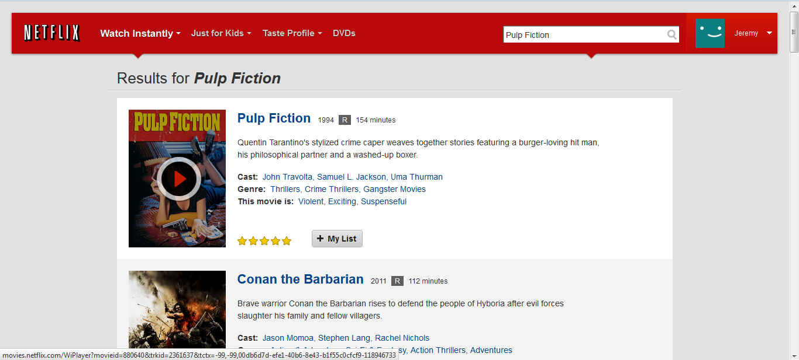
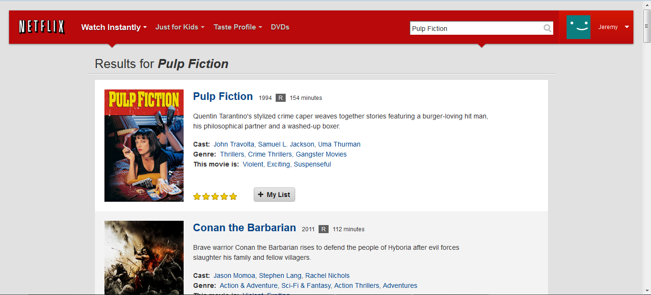
Usability Test
2) Play movie

Slide 12
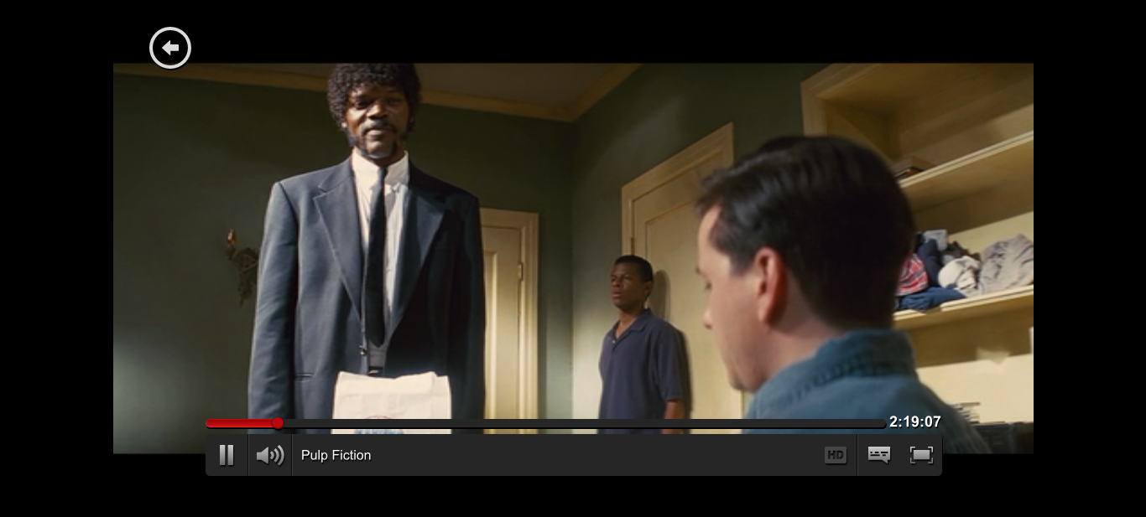
Usability Test
Player Interface

Slide 13
Usability Test
3) Pause movie

Slide 14
Usability Test
4) Advance movie to middle

Slide 15
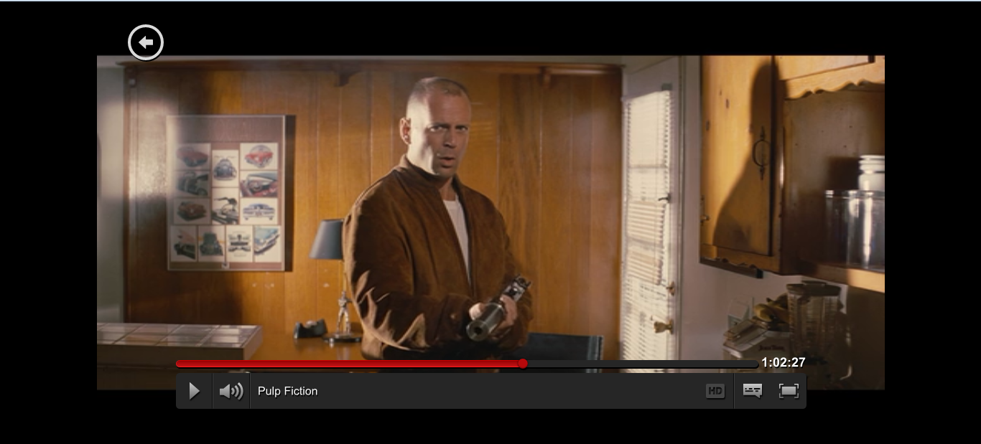
Usability Test
4) Advance movie to middle

Slide 16
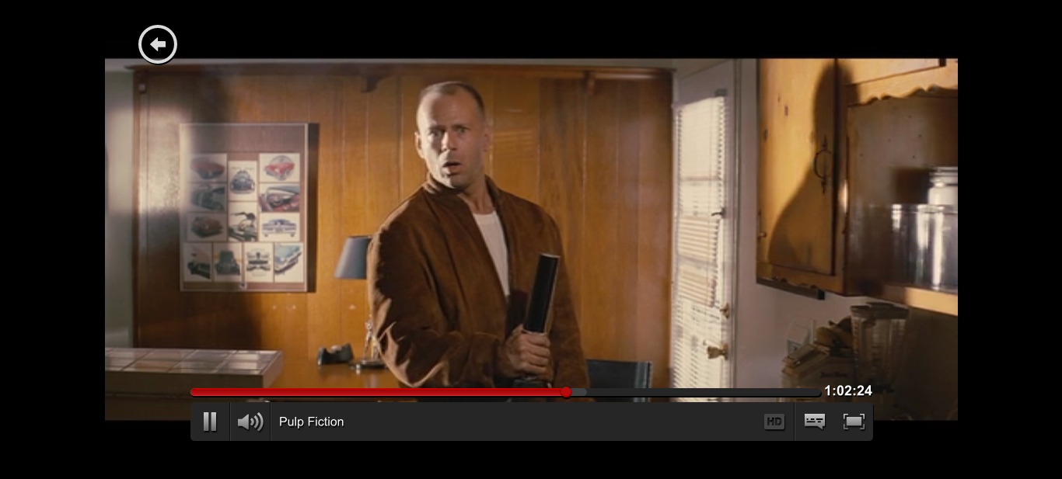
Usability Test
5) Unpause movie

Slide 17
Usability Test
6) Mute audio for a few seconds, then unmute

Slide 18
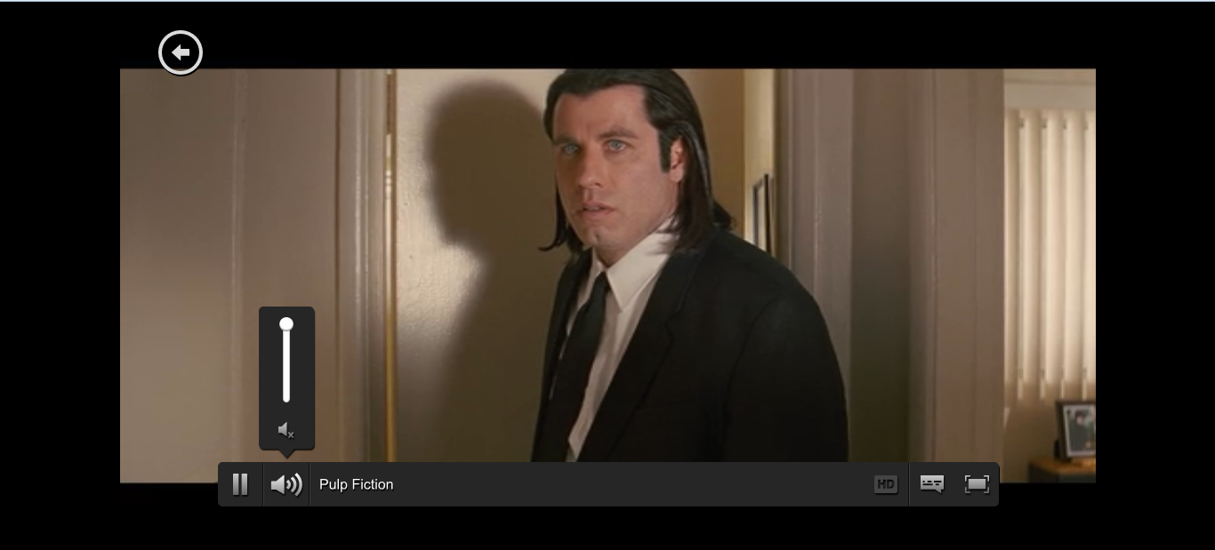
Usability Test
6) Mute audio for a few seconds, then unmute

Slide 19
Usability Test
7) Make movie full screen

Slide 20
Usability Test
8) Return to Search Results Screen

Slide 21
Usability Test
9) Give “Pulp Fiction” a star rating

Slide 22
Usability Test
10) Return to Netflix homepage

Slide 23
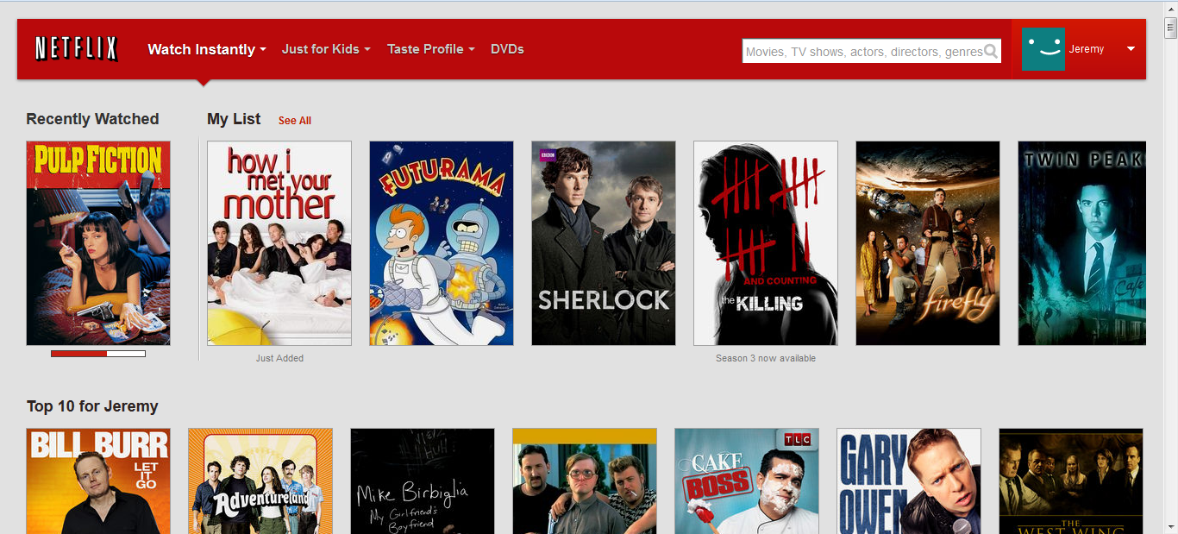
Usability Test
11) Search for “The Walking Dead”

Slide 24
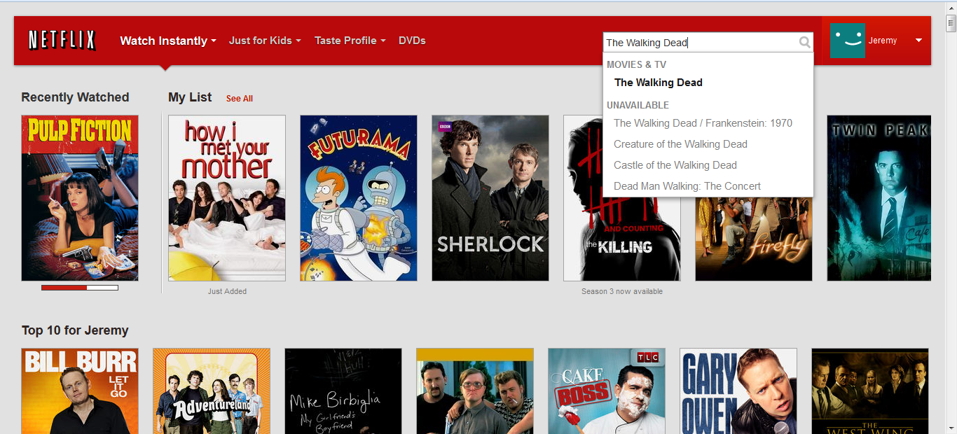
Usability Test
11) Search for “The Walking Dead”

Slide 25
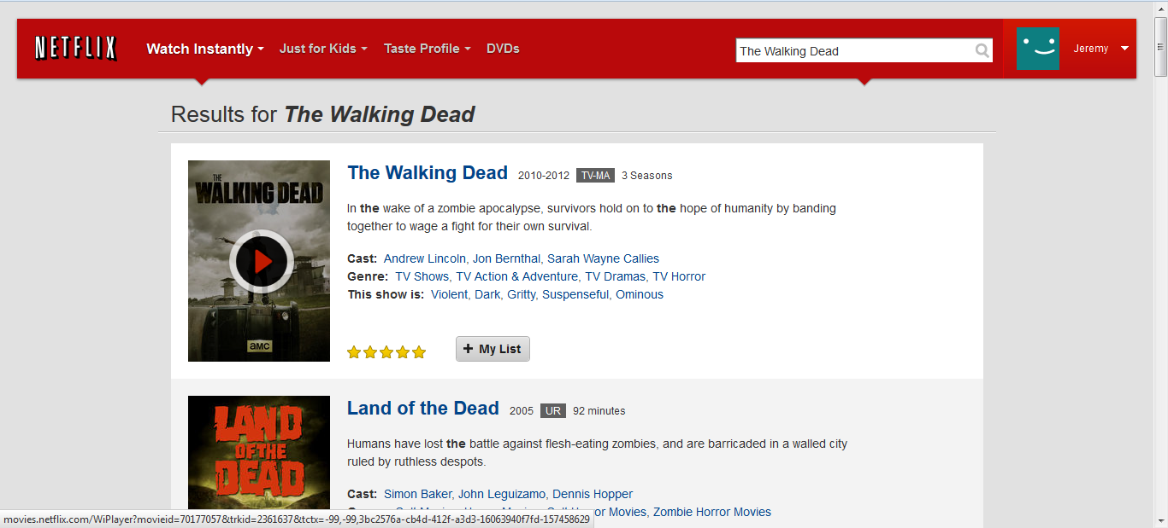
Usability Test
12) View The Walking Dead series page

Slide 26
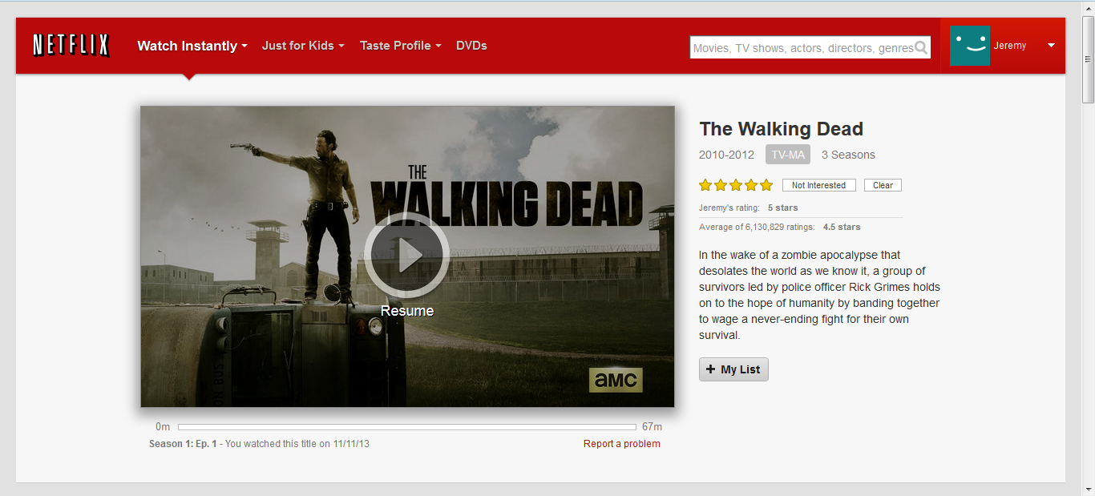
Usability Test
13) Play Season 2, Episode 6: “Secrets”

Slide 27
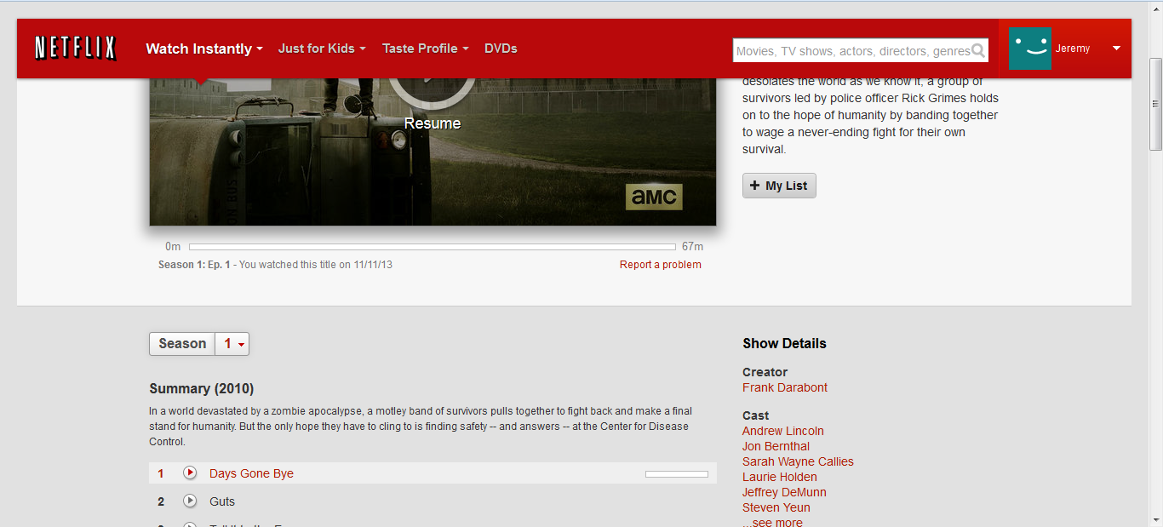
Usability Test
13) Play Season 2, Episode 6: “Secrets”

Slide 28

Usability Test
13) Play Season 2, Episode 6: “Secrets”

Slide 29
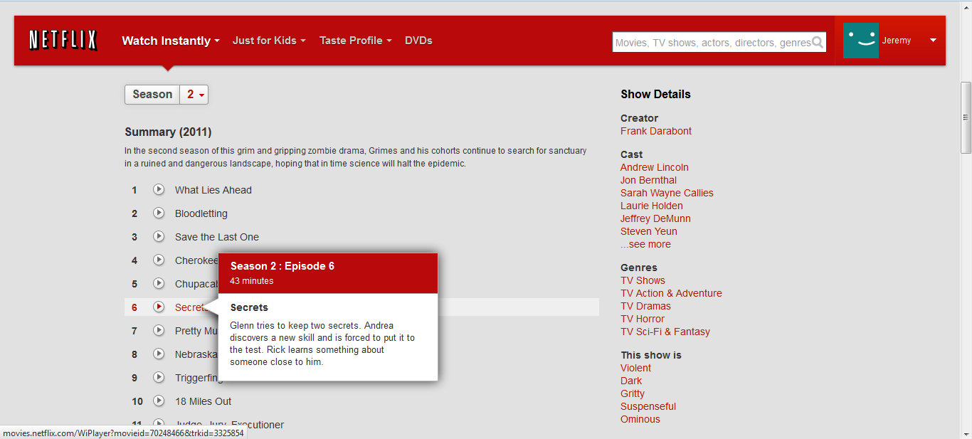
Usability Test
13) Play Season 2, Episode 6: “Secrets”

Slide 30
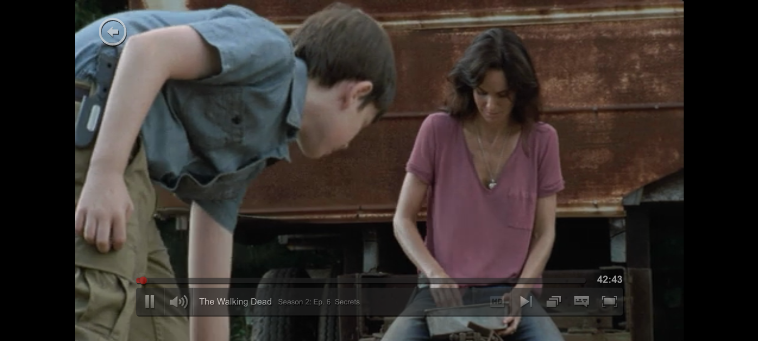
Usability Test
14) Watch a few seconds, then return to previous page

Slide 31
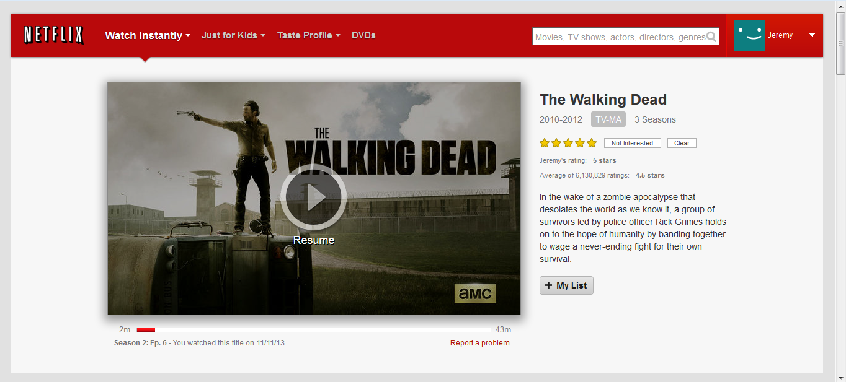
Usability Test
15) Sign out of Netflix

Slide 32
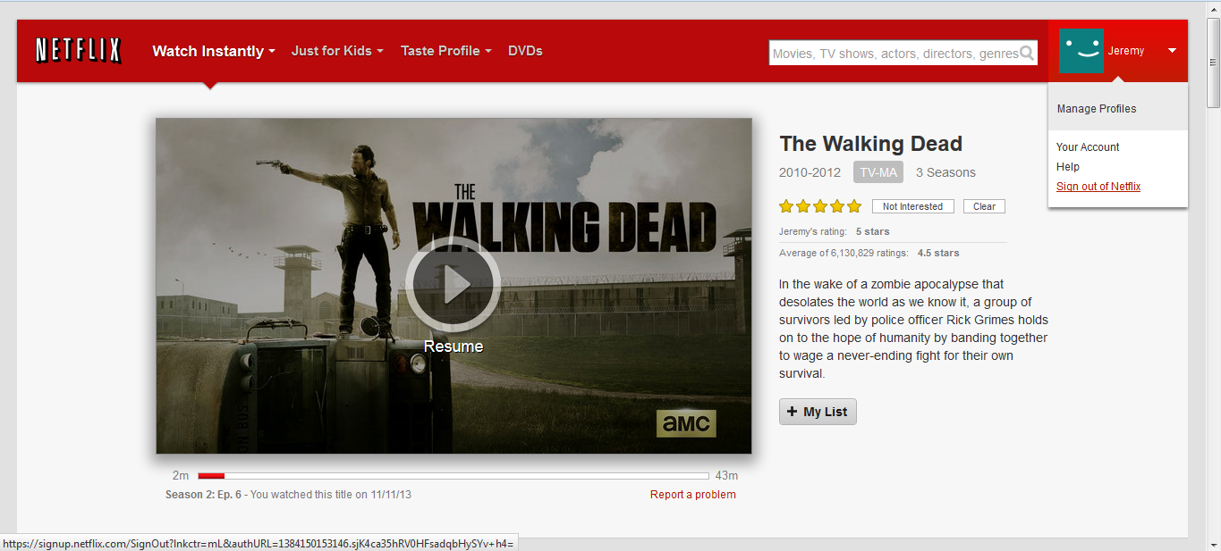
Usability Test
15) Sign out of Netflix

Slide 33
Results

Slide 34
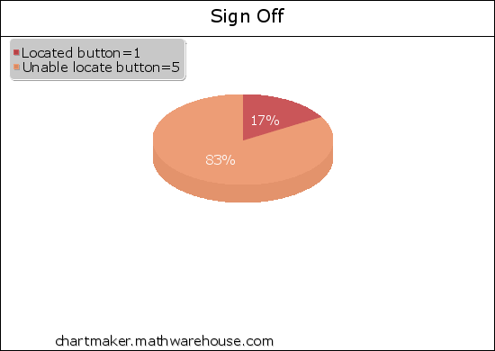
Results
83% were unable to locate the signoff option

Slide 35
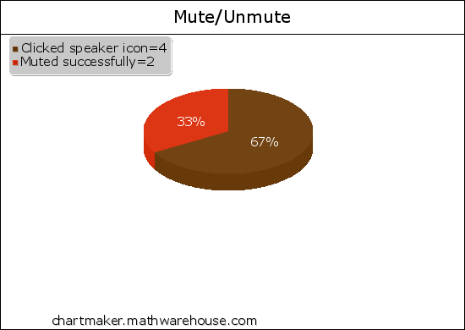
Results
67% kept clicking the speaker icon to mute the audio.

Slide 36
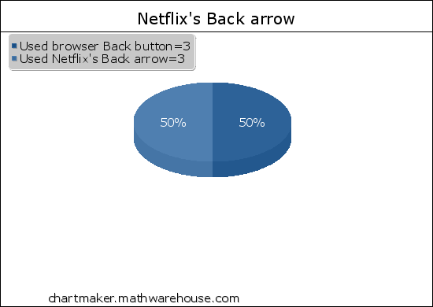
Results
50% used the Back browser button instead of using Netflix’s Back arrow

Slide 37
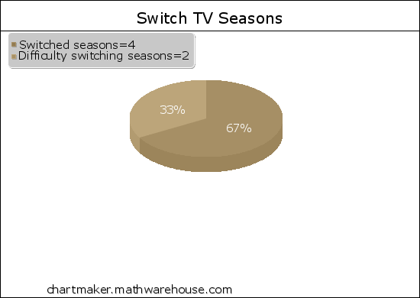
Results
33% had difficulty changing TV show seasons

Slide 38
Redesign

Slide 39
Redesign
Sign Off Button
Mute function
Netflix’s Back button
Changing TV show seasons

Slide 40
Old Homepage

Slide 41
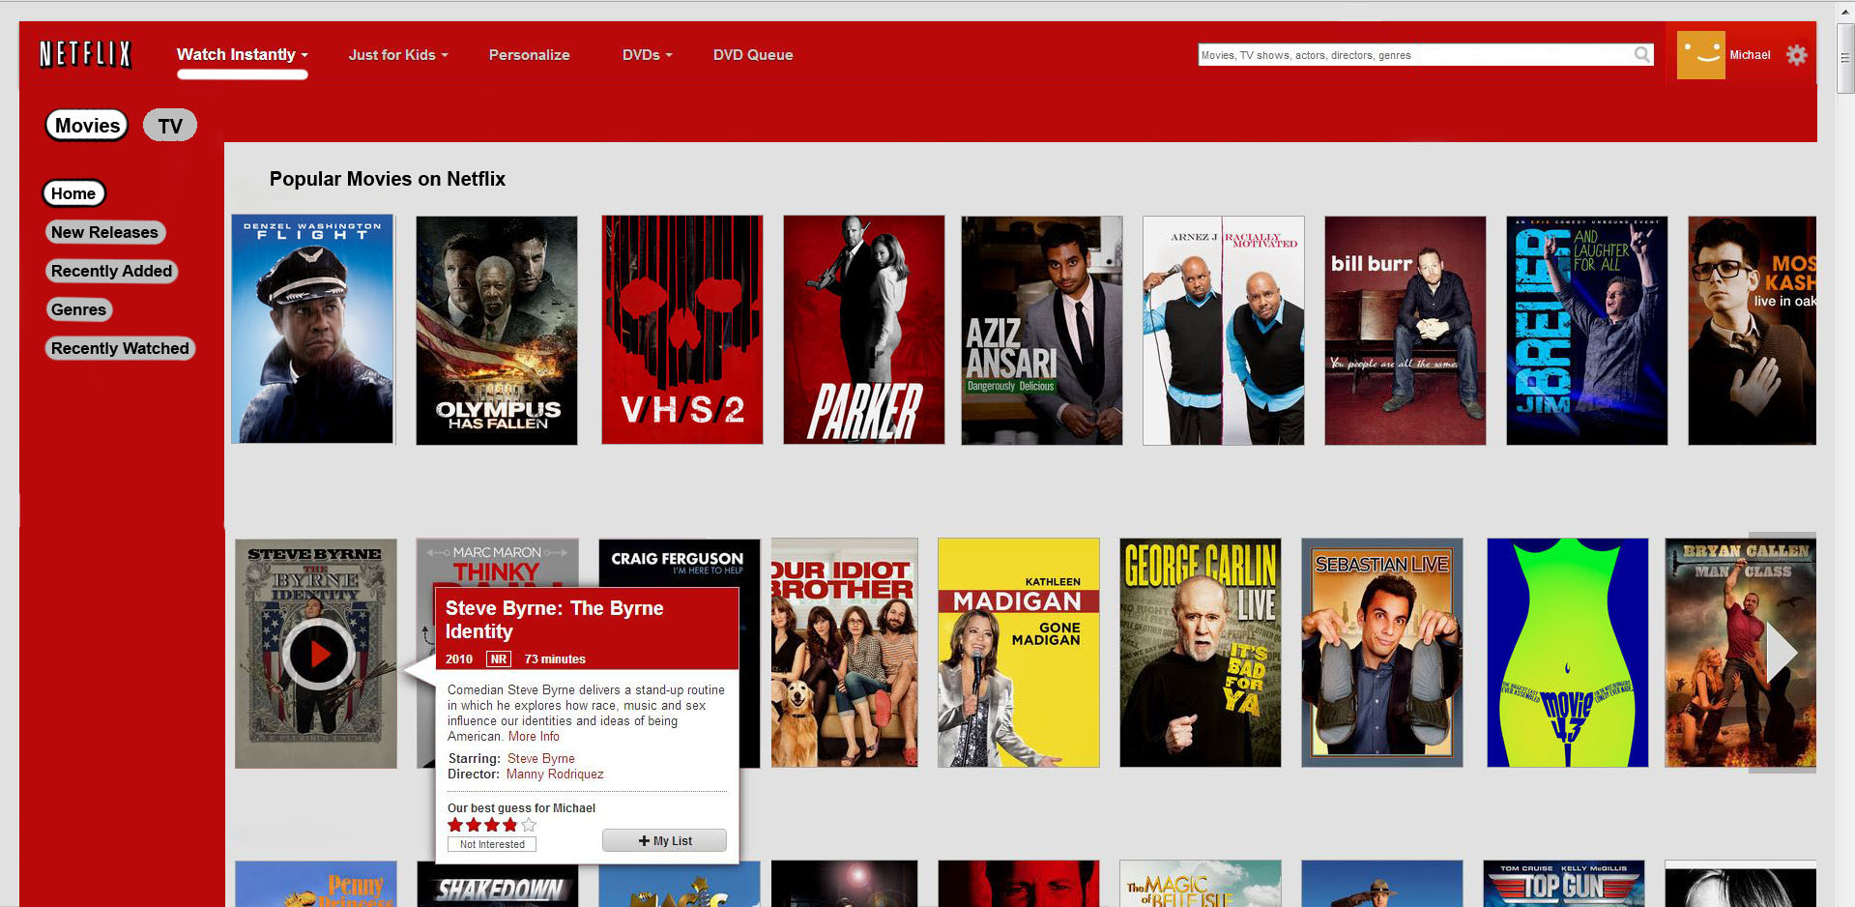
New Homepage

Slide 42
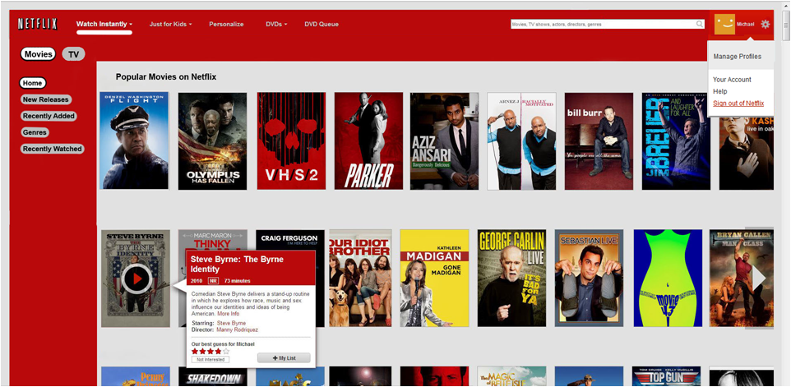
Gear / Sign out

Slide 43
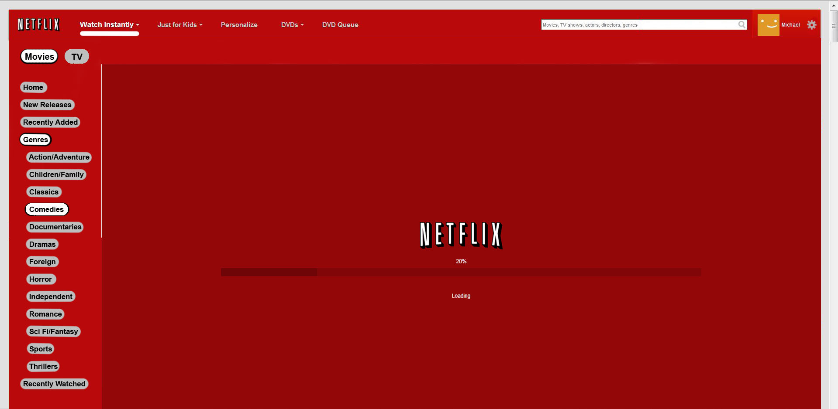
Loading

Slide 44
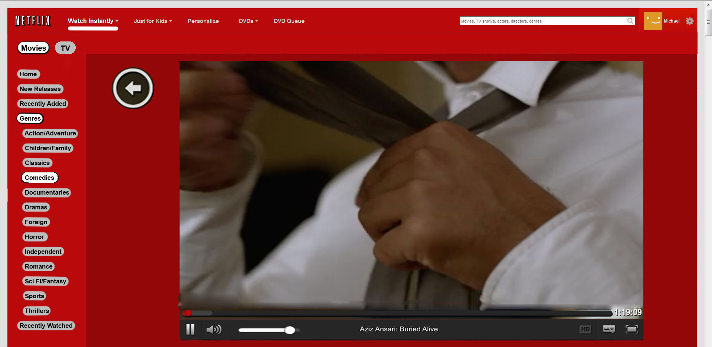
New Video Player

Slide 45

Redesign
Speaker icon “clickable” to mute audio
Back button now more pronounced

Slide 46
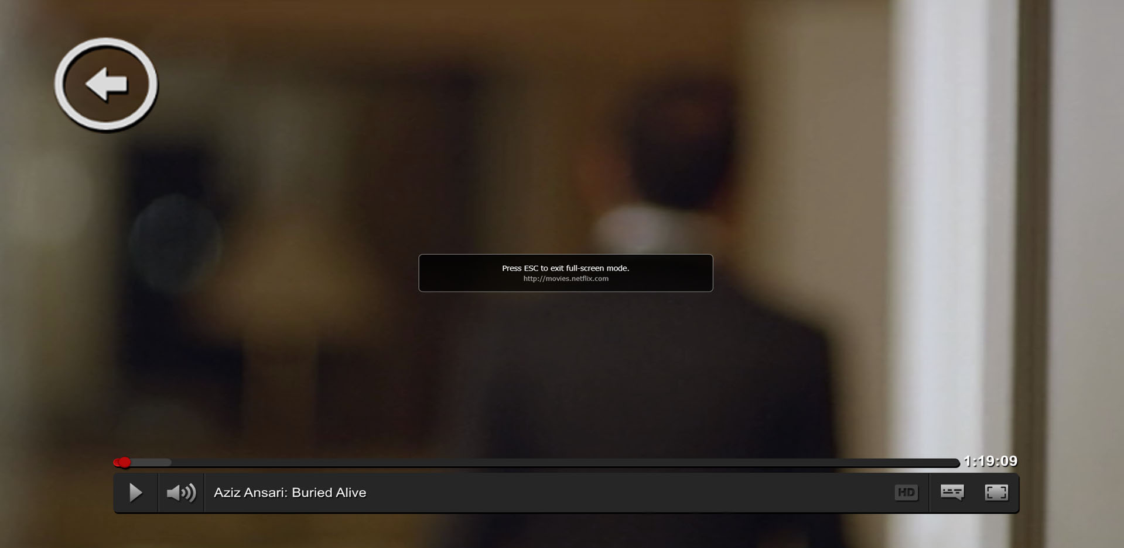
Full screen

Slide 47
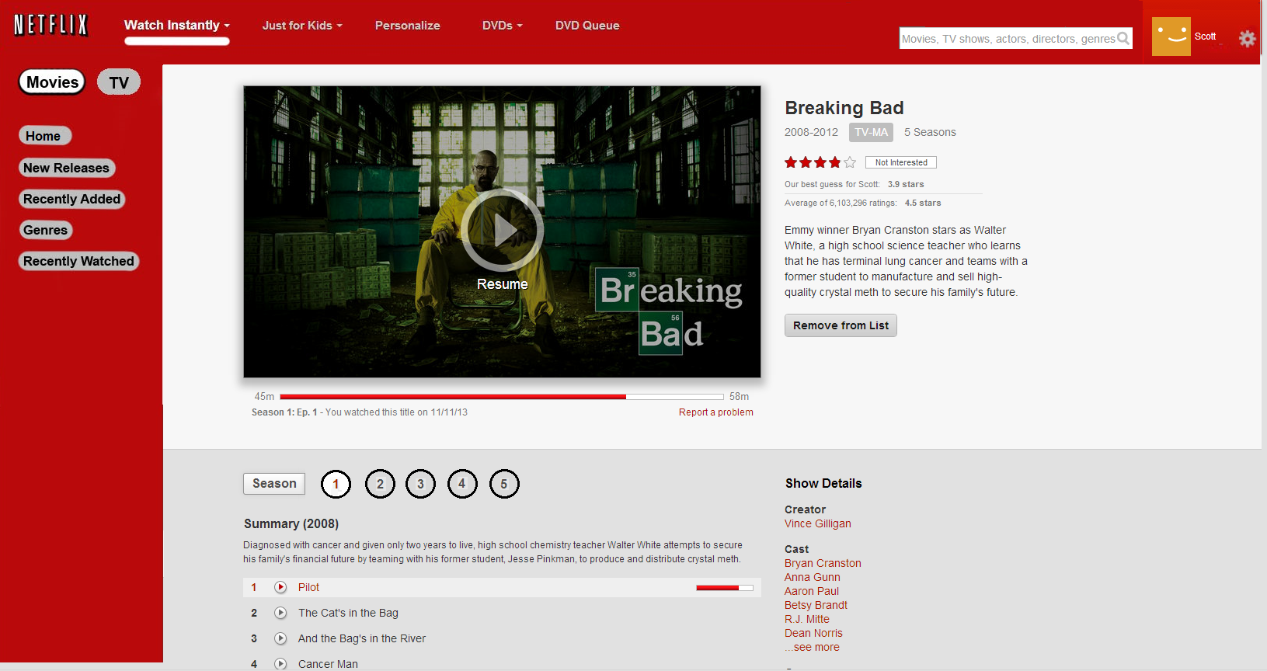
TV Season Selection

Slide 48
Additional Design Changes

Slide 49
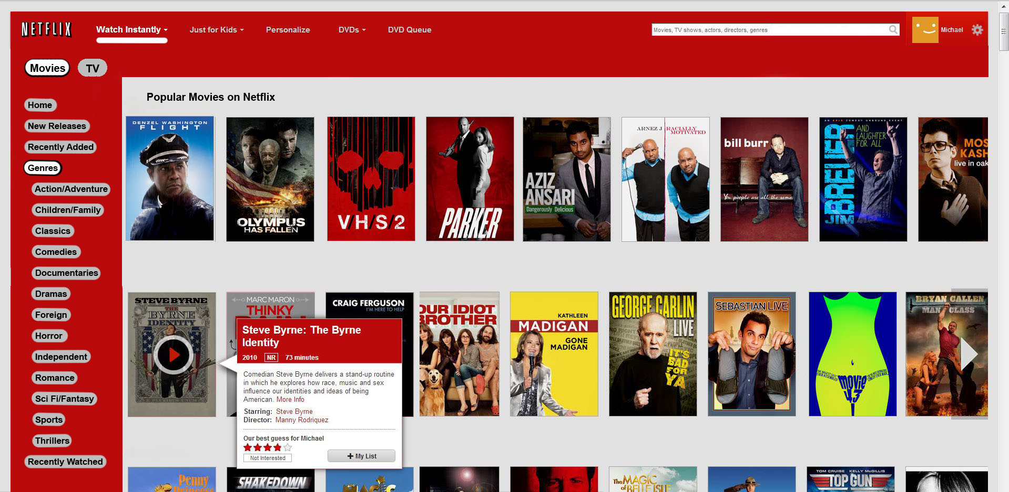
Genres

Slide 50
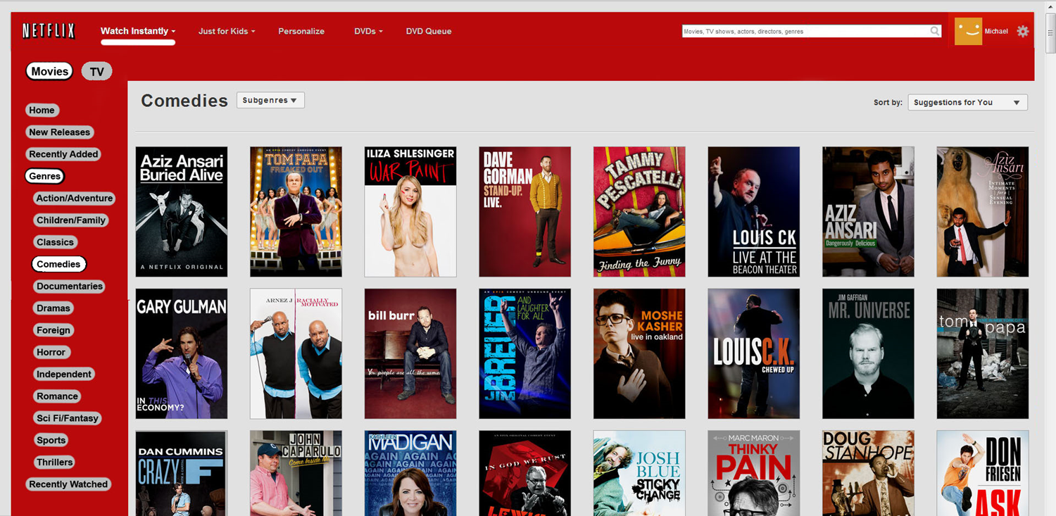
Genres

Slide 51
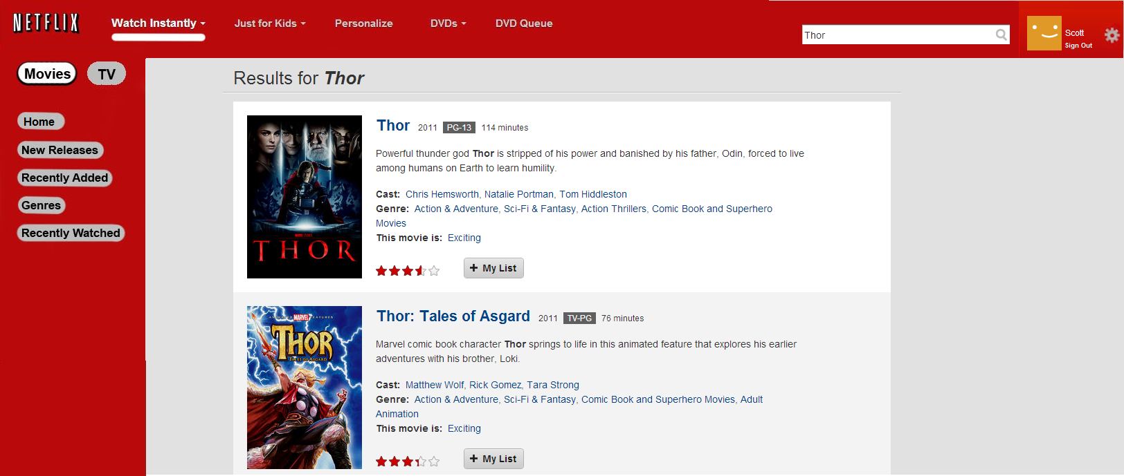
Search Results page

Slide 52
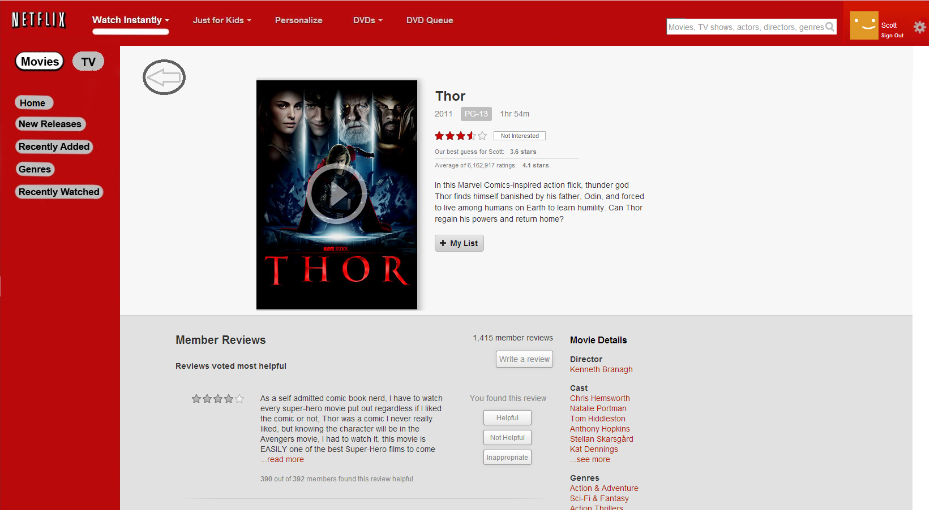
Movie page

Slide 53
Questions?

Slide 54
Fin.

