Slide 1
The Modern Oven
By Group 13
Joseph Gaudreau, Hon Lee, Paul Selice, and Steve Sandifer

Slide 2
Why did we choose an oven?
Lack of innovation and change
Home technology is evolving in many industries

Slide 3
Our Research
We gave a questionnaire to 20 people to see what things people like, don’t like, and new features they would like to see from their oven.
Specifically, we asked them about their ovens:
Safety
Simplicity
Look

Slide 4
The Questionnaire
What would you rate your current oven’s safety? (Answer on a scale of 1-10, with 1 being lowest and 10 being highest).
What would you rate your current oven’s simplicity? (Answer on a scale of 1-10, with 1 being lowest and 10 being highest).
How would you rate your current oven’s look? (Answer on a scale of 1-10, with 1 being lowest and 10 being highest).
If voice activation technology was available on an oven, how open would you be to considering it? (Answer on a scale of 1-10, with 1 being lowest and 10 being highest).
What other features would you like to see from your oven?

Slide 5
The Questionnaire Results

Slide 6
The Questionnaire Results (cont.)
Other features commonly asked for:
Better safety/child locks (6x)
Fire Suppressant (3x)
More Modern looking (7x)

Slide 7
The Modern Oven: Our Design
Capable of being controlled entirely by voice
LCD touch screen for physical controls
State of the art, intuitive safety features

Slide 8
Voice Control
A user can control everything from setting a temperature of the oven, the temperature of a specific burner, and setting a timer all with their voice.
Oven will read command back, ask the user to make sure it heard correctly, and the user must confirm before the action will be performed.
Example:
User: “Oven, preheat oven to 350”
Oven: “Preheat oven to 350, correct?”
User: “Yes.”

Slide 9
LCD Touch Screen for Oven
This oven possesses an LCD touch screen (the size of a 7 inch tablet) that can control all aspects of the oven including:
Temperature of the oven
Oven timer
Clock

Slide 10
Mockup of LCD Touch Screen for Oven
Standard Mode
12:00 AM
1 2 3 4 5 6 7 8 9 0
Current Temp: 350 F
Current Time Remaining:
10:00 min.

Slide 11
LCD Screens for each Burner
LCD Screen relays the current setting for each burner.
This setting is controlled by two buttons (up and down) next to each LCD, going from OFF, to the traditional 1-10 range for a burner.

Slide 12
Mockup of LCD Screens for each Burner
Current Level:
Current Level:
UP
UP
10
OFF
DOWN
DOWN
Time On: 5:25
Time On: 5:25

Slide 13
Safety Features
Oven will verify that voice command is correct by reading it back to the user, forcing the user to ‘OK’ it.
Oven can be locked (by a voice command or physical button press) to prevent a child from using oven features.
If the oven detects an unknown object on the cooktop, or smoke in the oven, it will sound an alarm, alerting the user to the issue and will power down after 30 seconds, if no response.
Color coded levels of heat to make it clear when a burner is hot.

Slide 14
‘Standard Mode’
For users who may not want to use voice control, the oven offers a ‘Standard Mode’, where it reverts to having controls like a traditional oven.

Slide 15
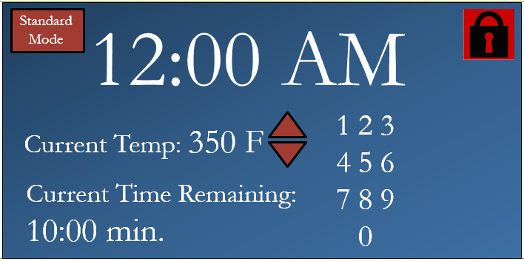
Mockup of Modern Oven
Current:
Current:
10
OFF
Current:
Current:
OFF
3

Slide 16
Conclusion
The oven this presentation describes meets all the issues raised by the individuals surveyed. It is safer, more modern looking, implements voice technology, and is capable of being just as simple as modern ovens.
If it could be manufactured and sold at a competitive price, our research seems to indicate that there would be a market for an oven with this feature set.

