Slide 1
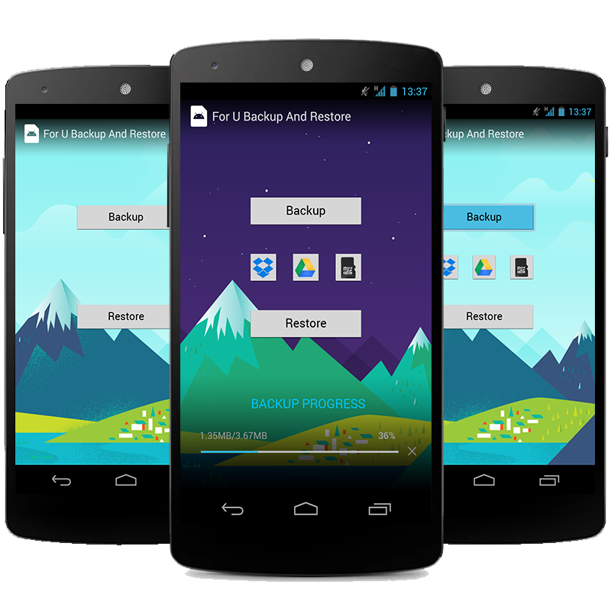
FUBAR
For U, Backup And Restore
Ryan Baley, Chris Craig
Bret Wood, Cameron Yeager

Slide 2
What is FUBAR?
Aside from its common use in the military, FUBAR is a back up program for SMS Messaging on the Android platform.
Its purpose is to provide the user with an easy to understand interface, with a simple set up and configuration.

Slide 3
What is FUBAR?
Aside from FUBAR allowing people to back up their text messages on their choice method, FUBAR also allows the user to restore their text messages, up to the latest 200 messages per contact.
This allows for the most up to date conversations to be kept in secure holding.

Slide 4
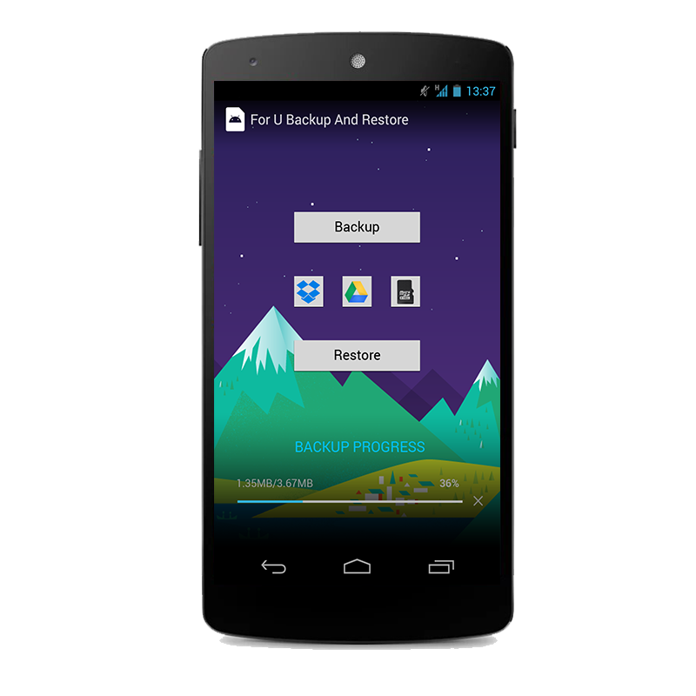
The Idea Behind FUBAR
FUBAR was designed with the idea to be as simple as possible, while providing high levels of efficiency, and needed levels of security.
A minimal number of options is given to the user to keep their experiences as consistent and error free as possible.
Because of its simple design, its aim is to be extremely easy to learn and use.

Slide 5
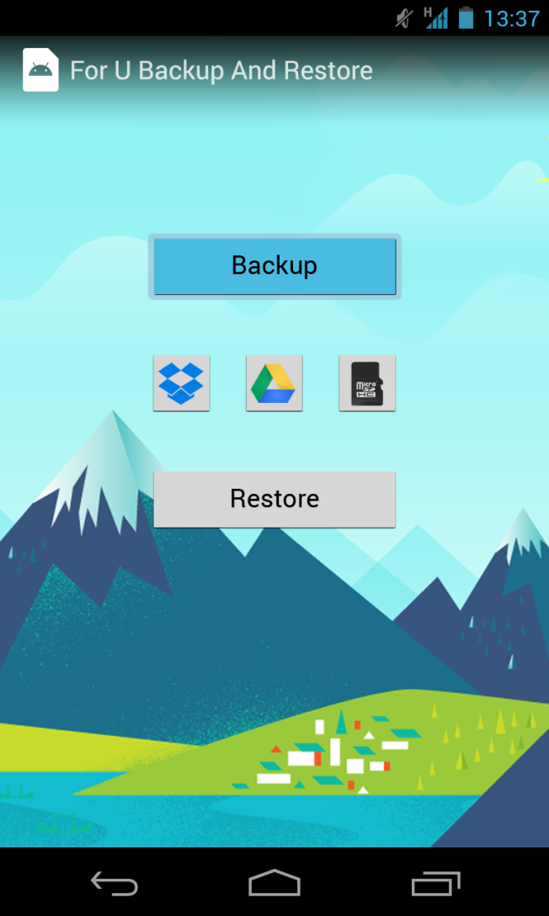
How FUBAR Works
When starting FUBAR, you have the option to “Backup” your messages, or “Restore” them from a previous “Backup”.
When the user chooses “Backup”, a simple row of options is given to them to choose their file destination.
The default choices are Dropbox, Google Drive, or the phones SD card.
More choices would be available if requested.

Slide 6
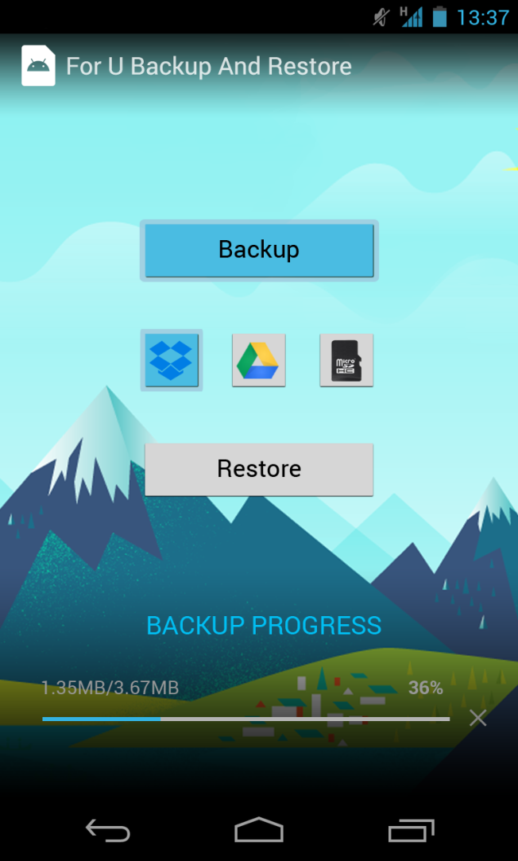
How FUBAR Works
Upon selection of the storage location, FUBAR will present the user with a progress bar showing the status of the backup.
This allows the user to track the applications work, as well as keeping them fully aware of the system’s current status.

Slide 7
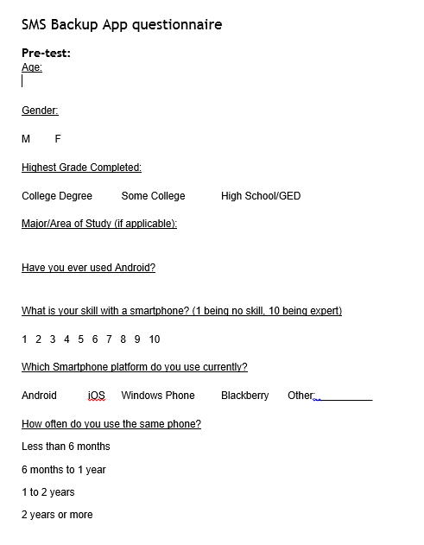
Pre Test

Slide 8

Tasks for Participants
Open the app
Tap Backup
Select Dropbox as the backup location
Wait for the backup to complete

Slide 9

Tasks for Participants
Tap Restore
Select Dropbox as the restore location
Select which version you would like to restore
Wait for the restore to complete
Check to ensure your messages were restores

Slide 10
Tasks for Participants
Tap Restore
Select Dropbox as the restore location
Select which version you would like to restore
Wait for the restore to complete
Check to ensure your messages were restored

Slide 11
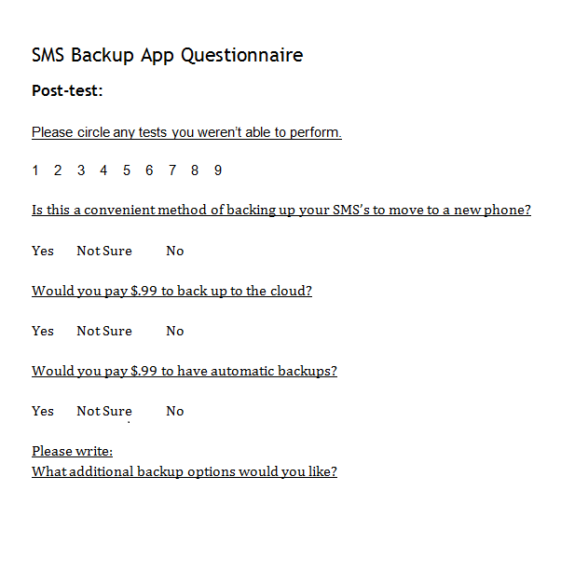
Post Test

Slide 14
Things to be Improved On
People wanted to see potentially more options available: Carbonite, Mozy, and other cloud storage options were given.
Email was also requested, as well as direct uplink to a PC via USB uplink.

Slide 15
Conclusion
Overall, reception of the program was positive and well taken.
While not high on the purchasing mark, it was shown that the program was at least well liked and could be a gateway to future programs.

