Slide 1
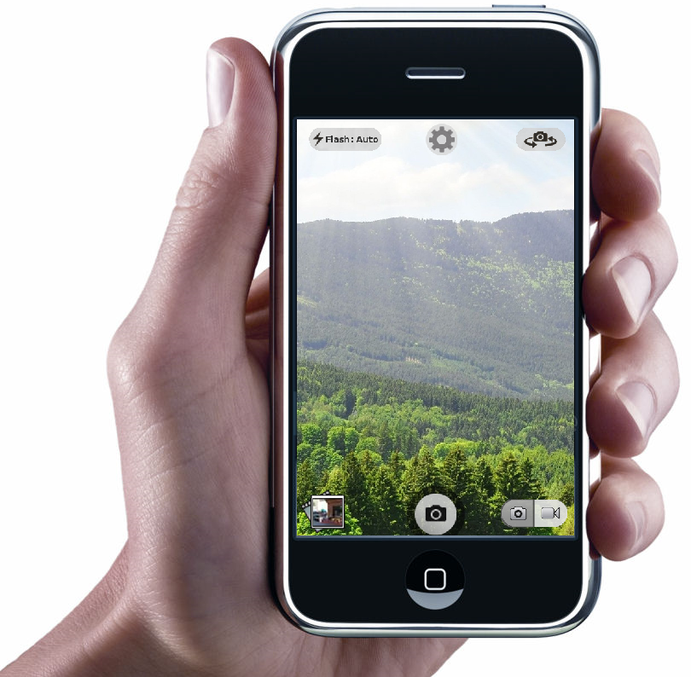
uCamera Smartphone App
Group 4
Daniel Ablanedo
Jason Bowman
Ciara Rodriguez
Benjamin Vanluven

Slide 2
iPhone Design Successes
Fingertip sized buttons are appropriately spaced.
This helps prevent erroneous user actions.

Slide 3
iPhone Design Successes
Important or commonly used buttons are given greater emphasis.

Slide 4
iPhone Design Successes
Abundant affordances and state changes communicate with the user.

Slide 5
iPhone Design Deficiencies
Inconsistent button design and functionality

Slide 6
iPhone Design Deficiencies
Minimalist icons do not always communicate effectively.

Slide 7
iPhone Design Deficiencies
Ergonomic problems make taking a picture awkward and inefficient

Slide 8
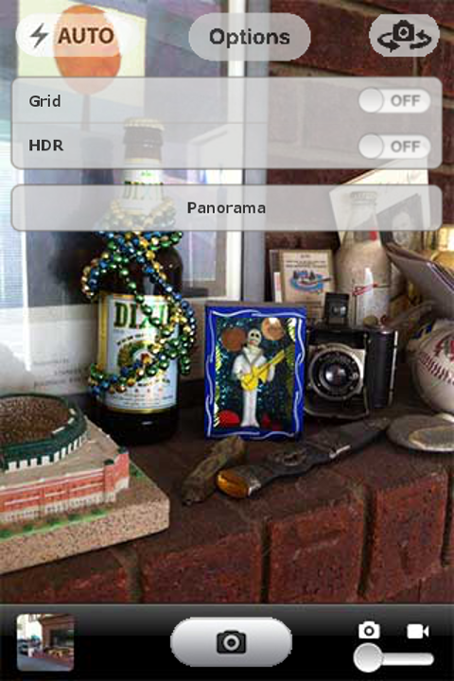
Camera Interfaces
iPhone Camera Interface

Slide 9
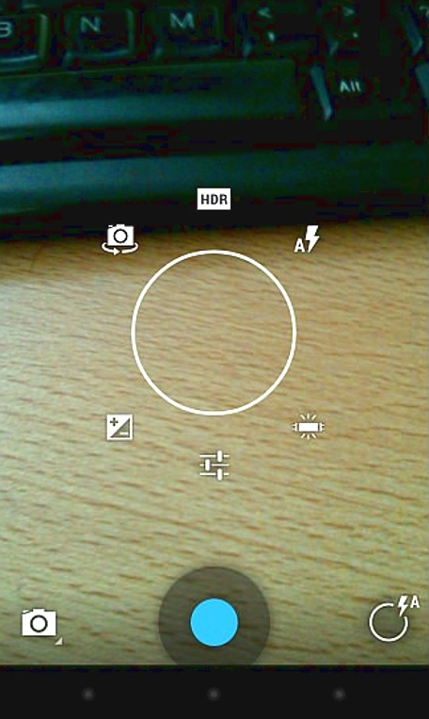
Camera Interfaces
Android Camera Interface

Slide 10
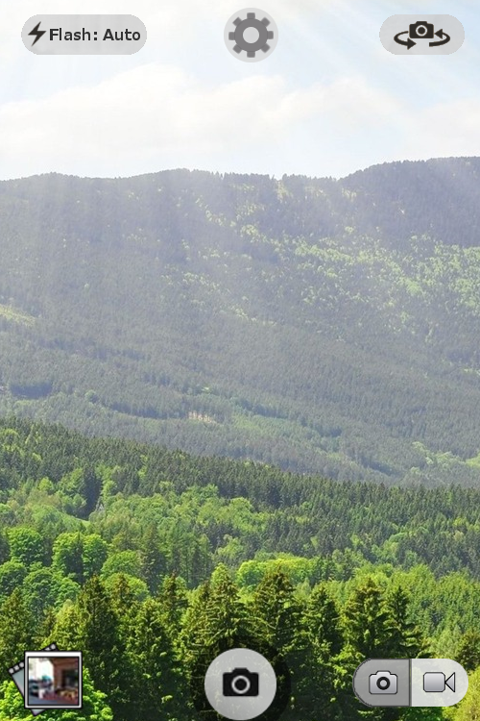
Camera Button Layout
uCamera Application Interface

Slide 11
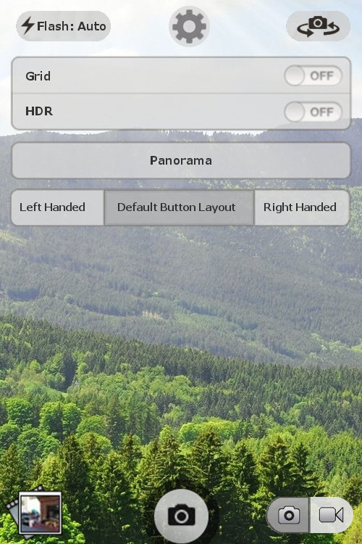
Camera Button Layout
Settings Menu:
Button layout option added based on usability test results.

Slide 12
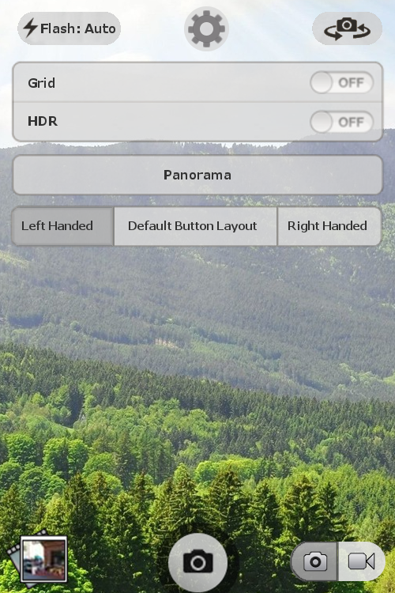
Camera Button Layout
Button Layout:
Changing to left handed layout option

Slide 13
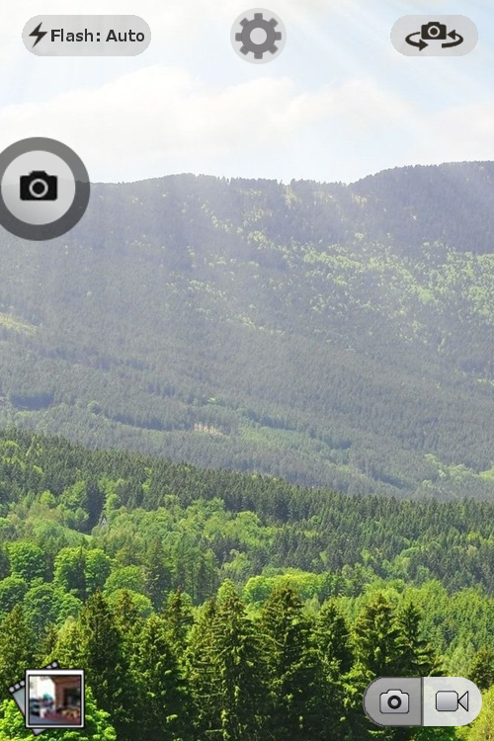
Camera Button Layout
Changing the button layout allows the user to easily reach the shutter release button while holding the device with one hand

Slide 14
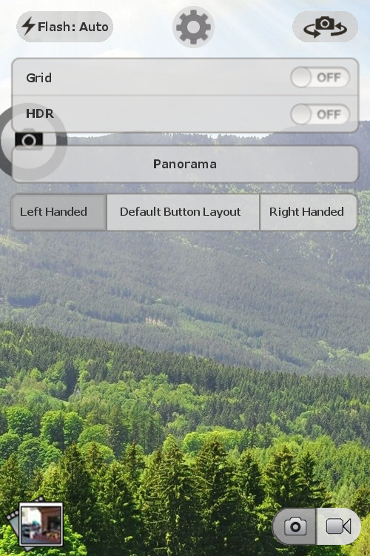
Camera Button Layout
Settings Menu:
Changing button layout to right handed

Slide 15
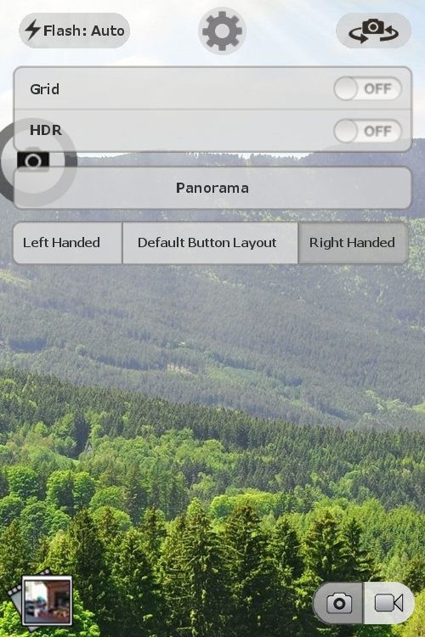
Camera Button Layout
Settings Menu:
Changing button layout to right handed

Slide 16
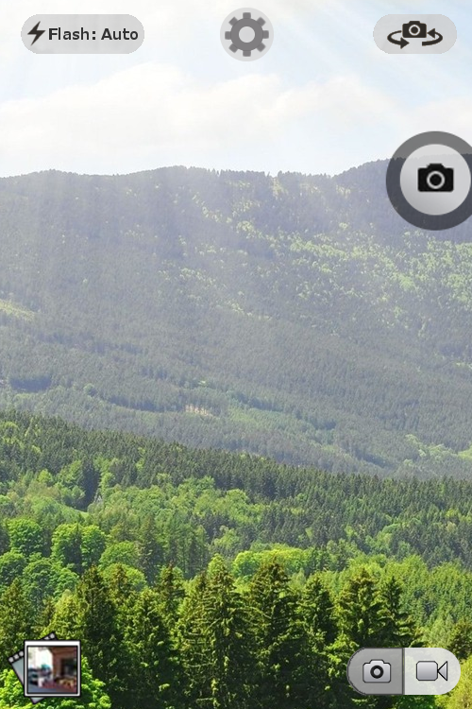
Camera Button Layout
Right handed shutter release button

Slide 17
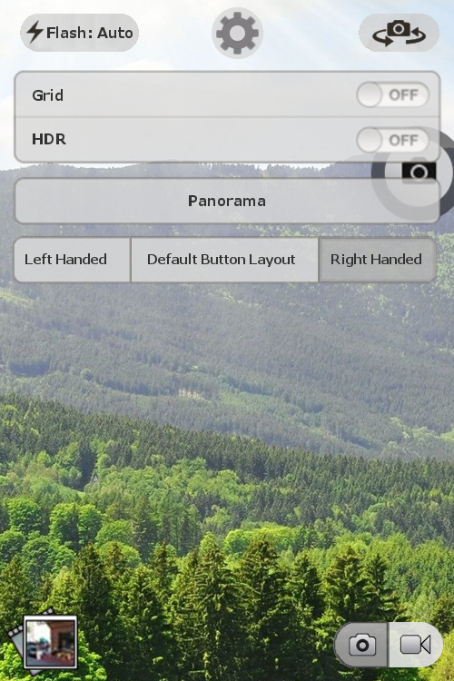
Camera Button Layout
Settings Menu:
Changing button layout to default

Slide 18
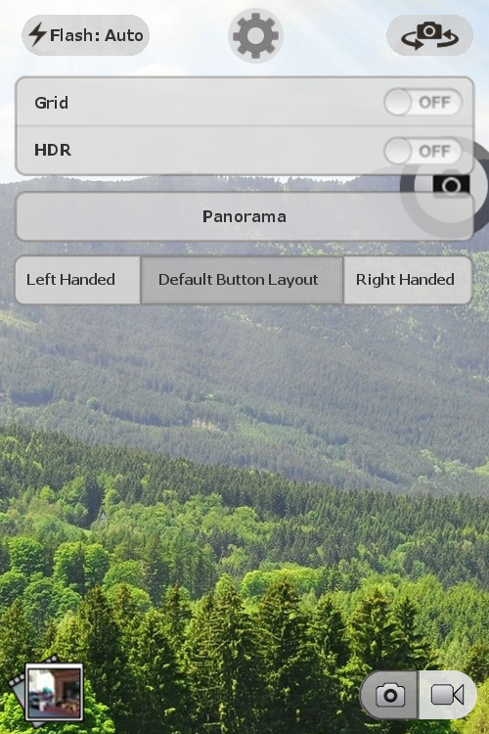
Camera Button Layout
Settings Menu:
Changing button layout to default

Slide 19
Camera Button Layout
Button layout options increase the efficiency of the interface and make it feel more personalized for the user.

Slide 20
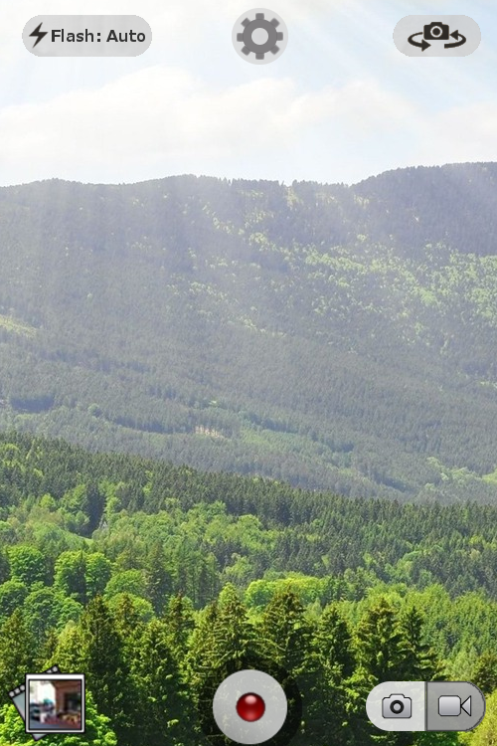
The default photo/video button is positioned 9 cm away from the user’s thumb, forcing them to stretch their thumb awkwardly across the screen, obstructing their view of the image.
9 cm

Slide 21
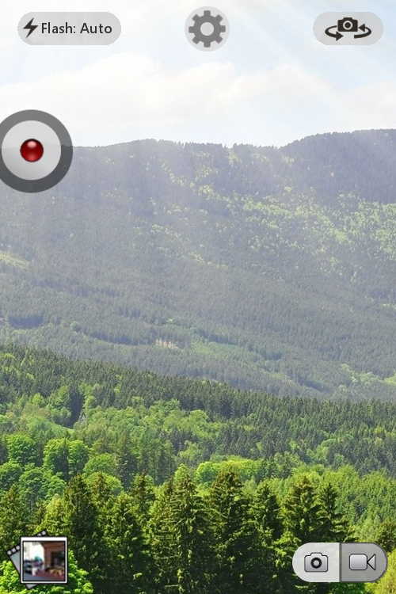
The customized photo/video button is positioned just 3.5 cm away from the user’s thumb, allowing them to reach it quicker and more comfortably, without obstructing the image view.
3.5 cm

Slide 22
Fitts’ Law
This formula is used to determine the time required for a user to press or click an icon.
An interface that is able to minimize this time will be more efficient for a user to operate.
$$T=K\log_{2}\left(D/S+1.0\right)$$

Slide 23
Fitts’ Law Variables

Slide 24
Fitts’ Law Applied For iPhone

Slide 25
Fitts’ Law Applied For uCamera

Slide 26
Fitts’ Law Comparison
iPhone = .759 seconds
uPhone = .6 seconds
The new interface is 20% faster!

Slide 27
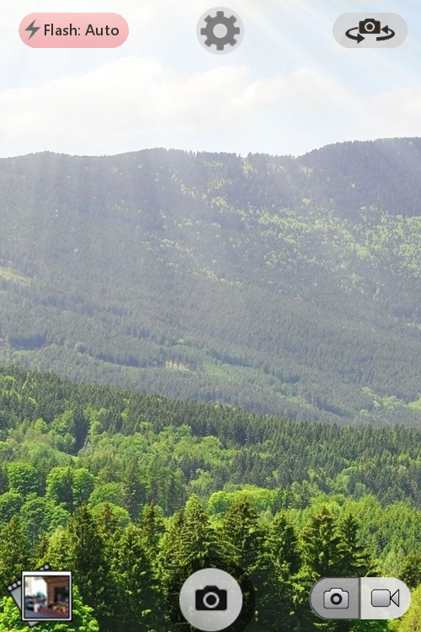
Take Photo
Camera Mode:
Switching from photo to video mode.

Slide 28
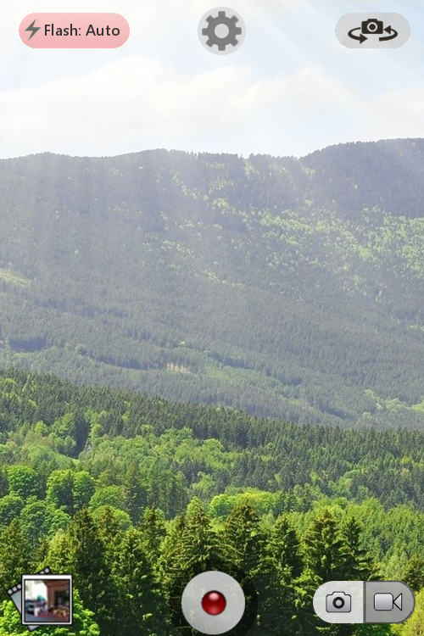
Record Video
Camera Mode:
Switching from photo to video mode.

Slide 29
Camera Flash
Flash Settings:
The flash setting is currently on auto, which is identifiable via the text on the flash button.

Slide 30
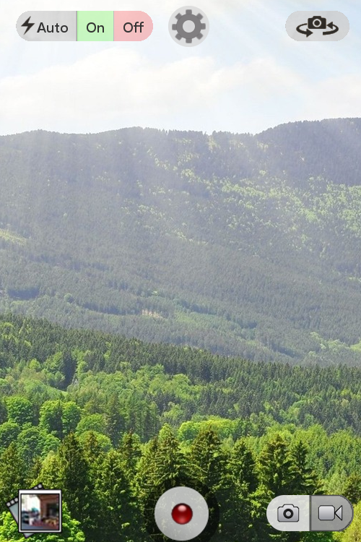
Camera Flash
Flash Settings:
The flash button provides three options if selected: Auto, On, and Off.

Slide 31
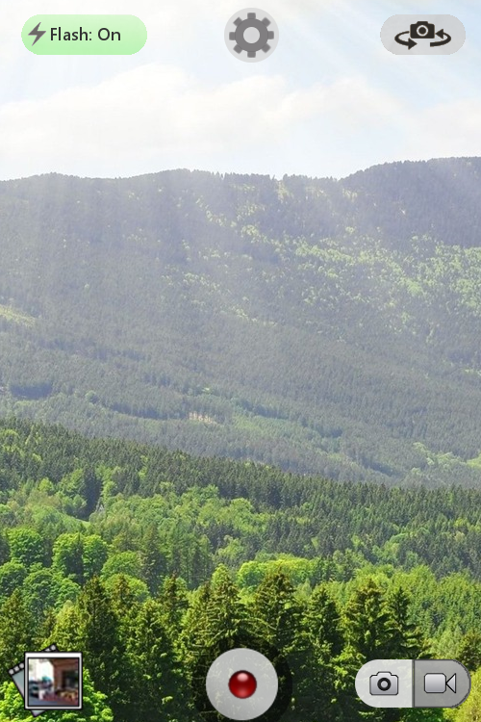
Camera Flash
Flash Settings:
If the ‘On’ option is selected the button background becomes green.
The green background indicates that the camera will flash if a photo is taken right now.

Slide 32
Camera Flash
Flash Settings:
If the flash button is selected again and ‘Off’ is chosen, the button background becomes red.

Slide 33
Camera Flash
Flash Settings:
Once ‘Off’ is selected, the background becomes red.
This indicates that the camera will Not flash if a photo is taken right now.

Slide 34
Camera Flash
Flash Settings:
When the flash is on ‘Auto’, the button background will change between red and green to indicate whether the camera will flash if a photo is taken at that exact moment.

Slide 35
Pre-Test

Slide 36
Pre-Test continued

Slide 37
List of tasks
How would you turn the flash on?
How would you turn the lens view around.
How would you go to options and switch the camera button to right handed.

Slide 38
List of tasks cont.
How would you take a picture using the right handed button.
How would you go to the picture gallery and delete the picture you just took.

Slide 39
Post-Test

Slide 40
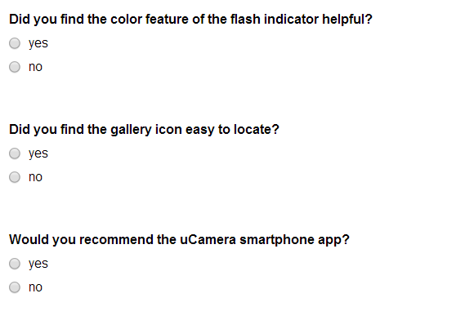
Post-Test continued

Slide 41
Results
How easy was the uCamera smartphone app to use?

Slide 42
Results
Do you feel that the buttons were well sized?
iPhone
uCamera

Slide 43
Results
Did you find the left/right handed feature helpful?

Slide 44
Results
Did you find the interface non-intrusive while taking pictures?

Slide 45
Results
Was the photo/video button easy to use?

Slide 46
Results
Did you find the color feature of the flash indicator helpful?

Slide 47
Results
Did you find the gallery icon easy to locate?

Slide 48
Results
Would you recommend this camera app?
iPhone
uCamera

Slide 49
QUESTIONS?

