Slide 1
Interaction of User with a 2013 Ford Focus Dashboard
John Best, Brian Jung, Christopher Ratzlaff, Charles Van Horn

Slide 2
Introduction
The interface
Goals
Tasks
Pre-test and Post-test
Results

Slide 3
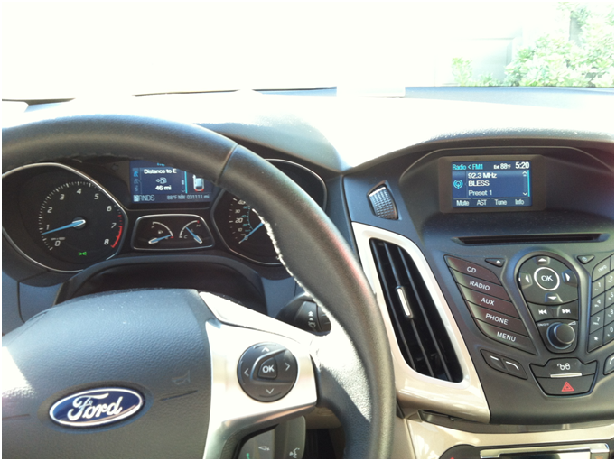
The Interface

Slide 4
Goals
To improve the overall customer satisfaction of the Ford Focus dashboard
To improve certain aspects that users did not like
To improve the usability of the dashboard
To provide a more positive experience for the user
To improve the overall safety for the drive

Slide 5
Tasks
Radio
  Turn on, increase/decrease volume, change station,set station to memory
GPS
  Turn on, set destination, start trip, turn off
Phone
  Turn on, dial a number, have the number connect, call using voice recognition, turn off

Slide 6
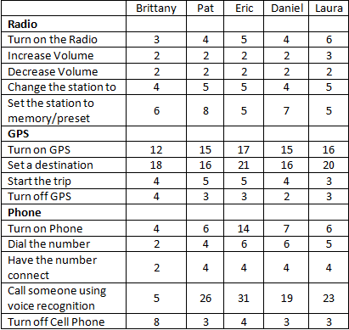
Participants actions

Slide 7
Pre-test & Post-test
We used the Likert scale as the foundation of our pre- and post-test.
Both tests were comprised of only closed-ended questions for accuracy.
A pre-test was used for gathering information on the participants
The post-test allowed us to evaluate the usability of the dashboard from the participants information

Slide 8
Post-test Questions
Q#1: Learning to use the device was easy.
Q#2: On-screen instructions are helpful
Q#3: I would recommend using this
Q#4: Did it take too long to learn to use
Q#5: The button labels are clear and understandable
Q#6: I would not like to use this everyday
Q#7: There is not enough information on the screen when I need it
Q#8: Using the dashboard is frustrating.
Q#9: I felt tense at times when using the device
Q#10: There are too many steps to get something to work
Q#11: The dashboard quickly responds to my touch.
Q#12: I feel that new users will find this device easy to use.
Q#13: It is easy to make the vehicle do what I want.
Q#14: I can easily recognize what the buttons are for from a distance.
Q#15: It is obvious that the drivers needs was taken into consideration when designing the dashboard
Q#16: It is difficult to find the button that I am looking for
Q#17: The device feels restrictive.
Q#18: It is easy to enter information.

Slide 9
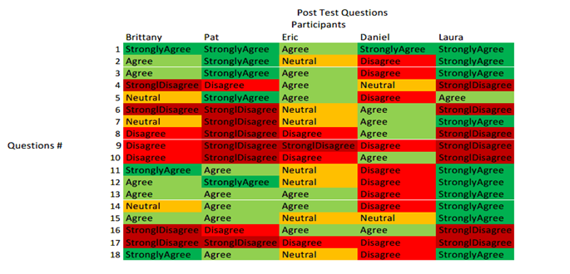
Results from Post test

Slide 10
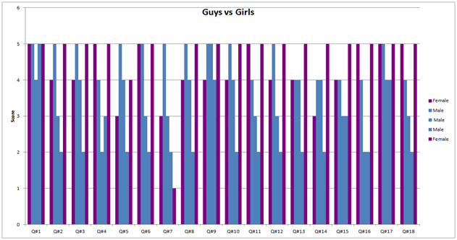

Slide 11
Analysis
Question 7
  Females did not feel that there was enough information on the screen for them when they were using the dashboard
Question 1
  All participants found the device easy to learn
Question 9
  No one felt tense interacting with the device
Question 18
  The genders disagreed on whether is was easy or not to enter information into the dashboard

Slide 12
Further Analysis
All participants took the most time when tasked with calling someone using the voice recognition function.

Slide 13
Improvements
Voice commands
  provide easily understandable voice actions
Improved Voice Recognition
  understand what is being said
Better Navigation
  easier to move through tasks
Improved Icons
  higher quality icons to easily perform the tasks ahead of the user

Slide 14
Conclusion
Enjoyable Experience
  All users reported having a pleasant experience
  No users were stressed by the tests
Manual Interaction
  Proved to be the most difficult
  Entering addresses, voice commands
Result Trends
  None gender specific
  4 out 5 seemed to have the same answer
  Times average
  GPS leading times

