Slide 1
[3]
Team 19
Jason Cooper
Marcelo Trujilo
Tulsi Parikh
Yenny Lozada

Slide 2
Overview
This study aimed at assessing the usability of the Redbox rental kiosk process with a population of eight users.
Participants were asked to carry out three simple set of tasks/ instructions
The main task was the complete rental process of a specific DVD movie from a Redbox® kiosk.
The user tasks were observed and documented taking notes of time, the users’ ability to navigate the screens, and any obstacles encountered.

Slide 3
Table of Contents
Background Information
Description of Interface
Population Selection
Pre-Evaluation
Evaluation
Post-Evaluation
Results
Effectiveness
Utility
Safety
Utility
Satisfaction
Conclusion
References

Slide 4
Background Information
The Redbox® rental success seems to stem from its aspects of accessibility, convenient product delivery, the rental kiosk, combined with an affordable rental price.
Redbox® rents out DVD’s, Blue-ray Discs and video games into its product selections.
There are over 32,000 locations – over 43,000 kiosks – throughout the US and recently into Canada.
Kiosks are generally located in grocery and convenience stores
Current prices of renting a movie is $1.20

Slide 5
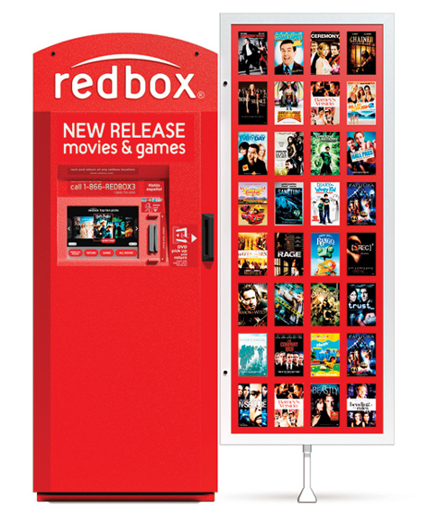
Description of Interface
Prism-shaped Redbox kiosk
with attached movie grid display.
Users can preview the top titles
before beginning any interaction
with the interface's touch-screen.
The primary interface includes
a touch-screen, magnetic stripe card
reader, and media dispenser, from
left-to-rightrespectively. [2]

Slide 6
Population Selection
Based on predictions using observed data with a number of experimental conditions in a study by Hwang and Salvendy [1], the two found that an optimal sample would consist of 8 to 12 individuals.
We decided that eight participants would be a practical, minimal and sufficient sampling to gather meaningful data.
Each member of the study’s team contacted and recruited participants randomly.
Our random selection was effective in gathering a diverse sample as reflected by the variety in gender, age range, education background, and Redbox past history.

Slide 7
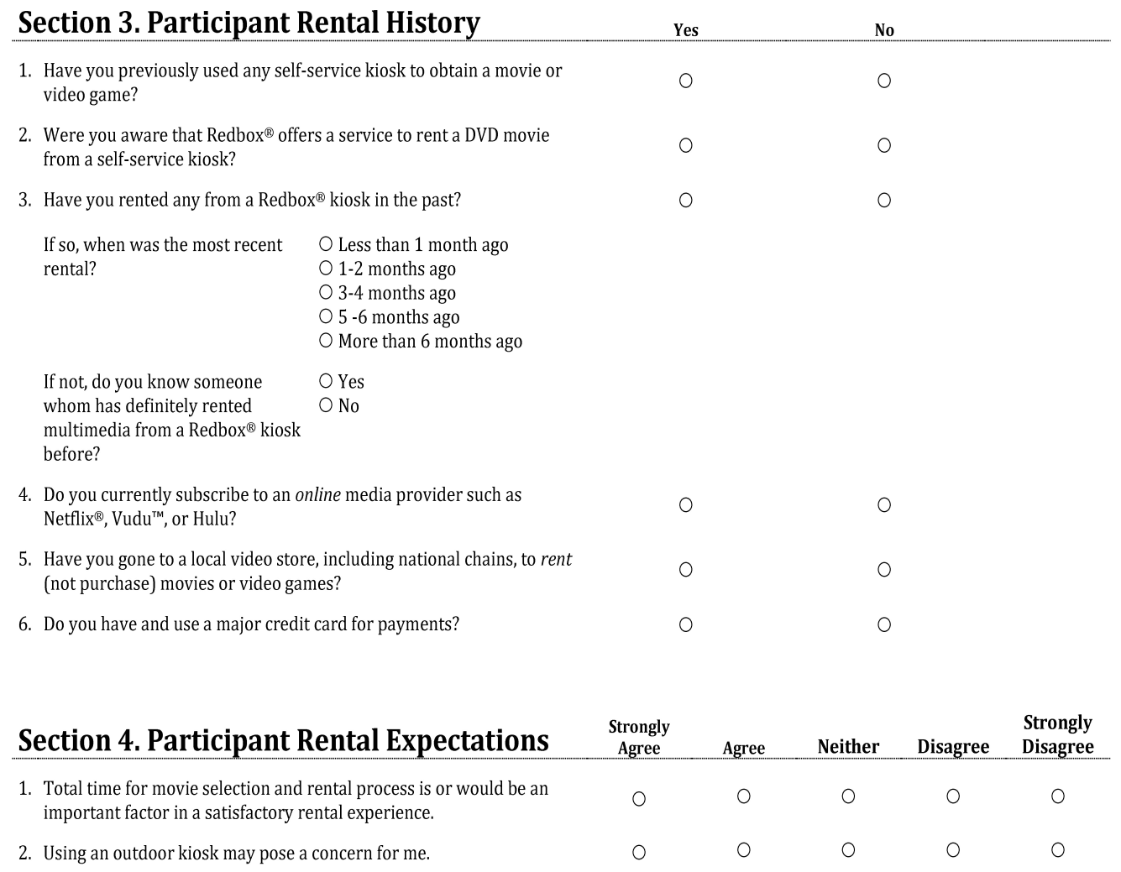
Pre-Evaluation
Sections 3 and 4, the two primary components, of the pre-evaluation. The topics included a participant’s rental history as well as his or her expectations during a self-service rental experience.

Slide 8
Evaluation
Components consisted of three individual methods for measuring its various aspects of usability
Selected areas of measurement: Effectiveness, Utility, Safety, and Satisfaction.
The first procedure measured the overall rental process and interaction with the interface.
The second procedure involved determining the kiosk’s utility.
The final procedure revolved around testing the kiosk’s safety.

Slide 9
Post-Evaluation
After all the procedures were completed, the interviewers asked participant to rate their Redbox rental experience,
We measured their experience using the 5-point Likert scale in this case, strongly agree, agree, neither agree nor disagree, disagree, and strongly disagree
List of subjective measures:
Ease of locating the specified movie title
Ease of navigating the interface
The sufficiency of movie details
The safety of the kiosk

Slide 10
Results
Results categories: effectiveness, utility, safety, and satisfaction.
Effectiveness section is actively measured by task-completion rates and errors
Utility includes data that allowed us to determine if the interface was useful for the participants’ needs and meets all their expectations.
Safety includes the users’ ability to recover from errors and mistakes.
Satisfaction includes data that helps create an overall feeling about the Redbox rental experience.

Slide 11
Effectiveness
Chart 1. Number of Unsuccessful Touch-Screen Tap Attempts.
Based on these results we can conclude that due to the complexity of the first procedure, users experienced a higher instance of unsuccessful screen taps, while in the second and third procedures users encountered less repeat taps,

Slide 12
Chart 3. Mistypes by Each Participant.
The task during which most errors occurred was the checkout process when participants were typing their email address
Chart 2. Incorrect Navigation Attempts

Slide 13
Based on the data result the 50% of participants have at least unsuccessful credit card swiping attempts.
Chart 4. Unsuccessful Credit Card Swipes.

Slide 14
Utility
The Redbox interface displayed sufficient detailed information on the movie with an average response between “agree” and “strongly agree” (1.25 on scale) reflecting participants rating this aspects as very useful. search or locating a specified movie was not rated as highly by most participants with an average response between “neutral” and “agree” (0.625 on scale), reflecting some difficulty with this functionally.
Chart 5. Overall User Utility Ratings.

Slide 15
Safety
Using the likert format “agree” and “strongly agree” for more than 50% of the participants is a concern to use an outdoor kiosk.
Users rated themselves comfortably able to recover from mistakes, such us navigating to the wrong screen or section of the interface providing users quick and easy ways to recover from errors.
Every participant was able to successfully recover from mistakenly navigating to the wrong screen on the Redbox kiosk interface.

Slide 16
Satisfaction
Chart 5. User satisfaction after rental experience.
Despite some difficulties or errors found in task 1, participants rated the interface positively. The Red box interface navigation was found to be easy to use while the checkout process was found not easy to perform.

Slide 17
Conclusion
Based on the observed results, we feel confident in reporting a high degree of success in using the Redbox kiosk interface by all participants.
They all expressed as a general sense of acceptance and desire to repeat their rental experience using this particular product choice.
Redbox’s accessible, inexpensive, intuitive, and user-friendly interface design generally facilitates the completion of the overall rental task.
This is reflected in its popularity, resulting in millions of users making Redbox their product of choice in the quick-and-easy rental market.

Slide 18
References
[1]Hwang, W., & Salvendy, G. (2010, May). Number of people required for usability evaluation: The 10±2 rule. Communications fo the ACM, 53(5), 130-133. Retrieved October 2, 2013
[2]Redbox Automated Retail, LLC. (n.d.). Redbox FAQs. Retrieved October 1, 2013, from Redbox Help Center: https://redbox.custhelp.com/app/top_faqs/
[3]Gadget Review. (2012, January 23). Netflix versus Redbox. Retrieved October 1, 2013, from Gadget Review: http://www.gadgetreview.com/2012/01/netflix-vs-redbox.html

