Slide 1
Dvorak vs. QWERTY
By: Josh Grenitz, Kyle Pritchard,
Kelsey Goldbarth, Michael Owens

Slide 2
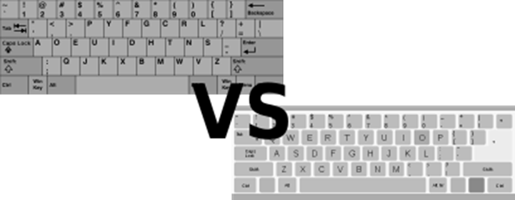

Slide 3
Why Dvorak?
The QWERTY keyboard suffers from some problems that Dvorak identified:
Many common letter combinations require awkward finger motions
Many common letter combinations require a finger to jump over the home row.
Many common letter combinations are typed with one hand. (e.g. was, were)
most typing is done with the left hand, which for most people is not the dominant hand.
16% of typing is done in the lower row, 52% on the top row, and 32% on the home row.
Dvorak typists can type about 400 of the English language’s most common words without ever leaving home row, while QWERTY can only type 100.
Dvorak does a total of about 70% of the work on home row, 20% on the bottom row, and 8% on the top row.

Slide 4
Selecting our Test Group
^{Randomly Selected}
^{Variety of typing knowledge}
^{Older users and Younger users}
Using computers for less or more time in their life
^{Typing more or less per day}

Slide 5
Pre-Test
Asked
Age Group?
Gender?
Computer use through life?
Computer use per day?
Why they type?
Whether or not they have heard of Dvorak?
Handedness?
If they look at the keyboard while typing?

Slide 6
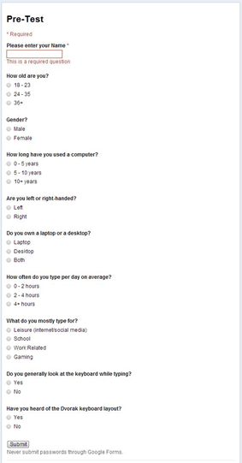

Slide 7
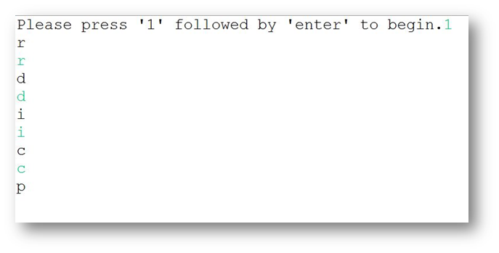
Testing
Program to test them
Asked the user to type 15 random letters, hitting enter after each
Timed each letter and output to a file

Slide 8
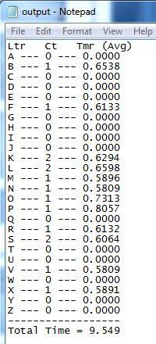
Testing Cont.
Also outputs the total time
3 times for each keyboard

Slide 9
Post-Test
Asked
Felt they compared using Dvorak keyboard?
Noticed the layout advantages?
Comfortable using new layout?
Did they look for each letter or remember area?

Slide 10
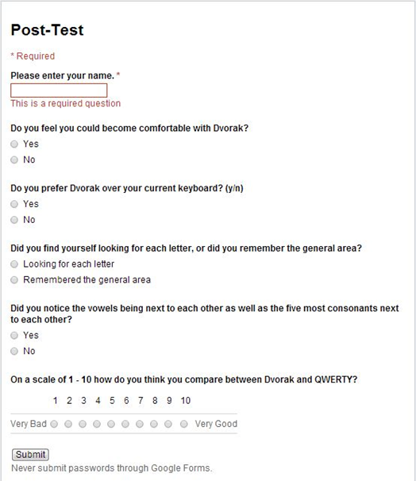

Slide 11
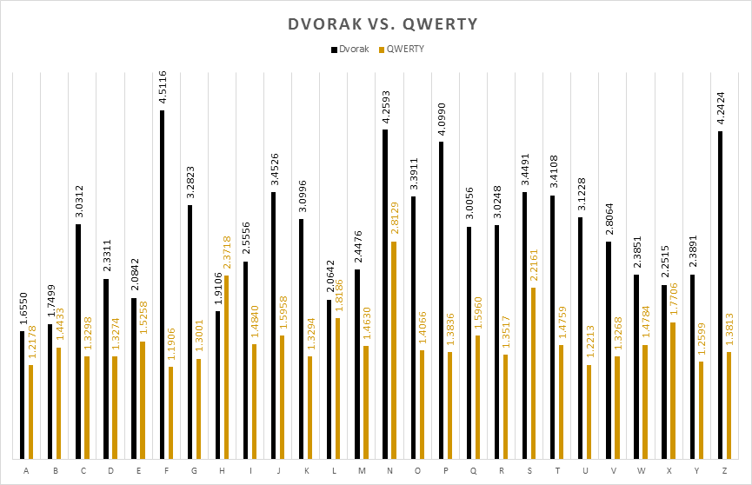
Results
Average Per Letter

Slide 12
Results Cont.
As seen on the previous graph
The letter “H” was actually, on average, typed faster on Dvorak
Though some times were much longer, it was only the user’s third time using this keyboard

