Slide 1
Logitech Harmony Ultimate Universal Remote
By: Joshua Servian
Thomas Sharman
Robert Sloan
Jeffrey Wong

Slide 2
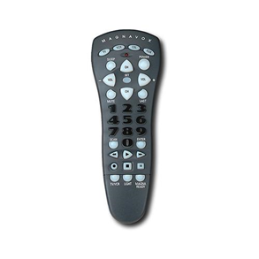
The Universal Remote
In 1985, Philips patented the
first universal remote using the
brand name Magnavox
The need for a centralized
remote to control multiple
consumer electronic devices
has been increasing over the
years.

Slide 3
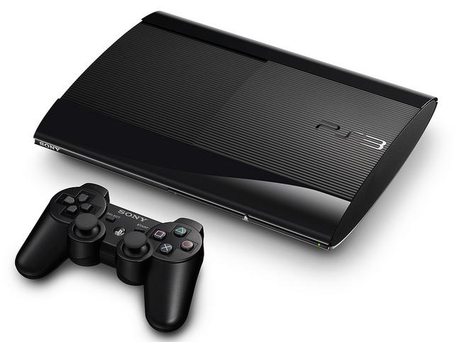
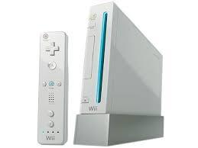
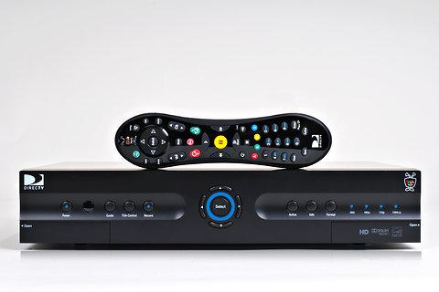
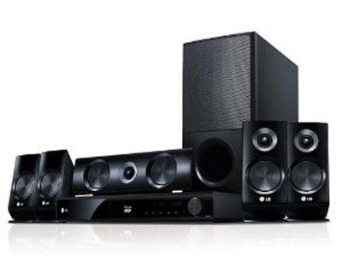
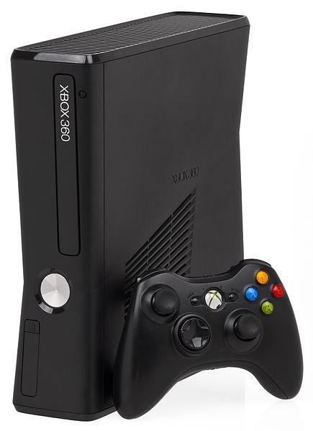
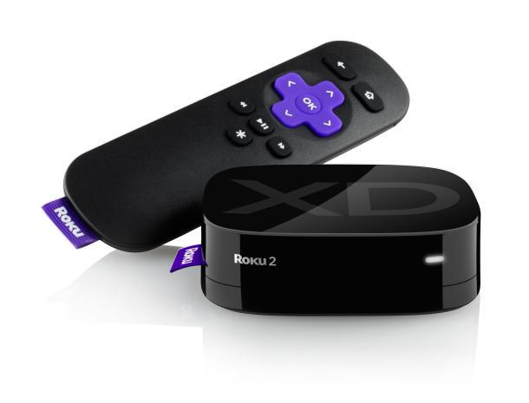
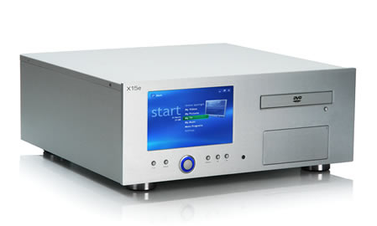
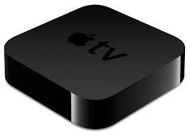
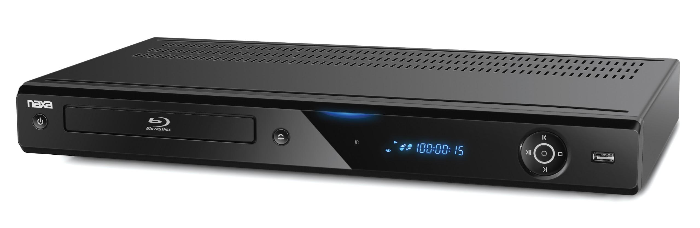
This is especially because of the introduction of
new technology which allows more advanced
devices: PlayStation 3, Xbox, DVD players,
DVR boxes, media computers, the Roku,
Boxee Box, surround sound receivers, and so
on.

Slide 4
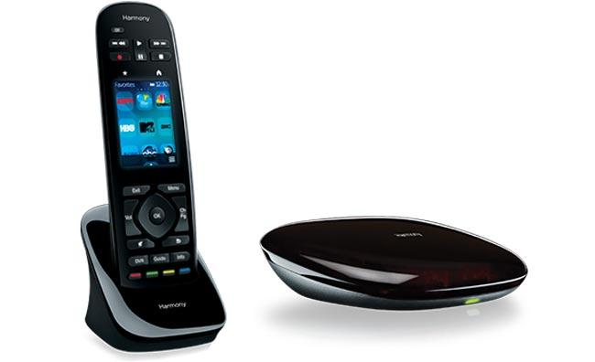
The Harmony Ultimate Universal Remote
This is one of the most advanced universal remotes
created and we are going to test how well the usability of it
is.
Harmony Ultimate gives you all the control you deserve. Control home theater devices behind closed cabinets and walls. Access IR devices as well as Bluetooth game consoles. Even use your
mobile phone as a powerful,
personal universal remote
control.

Slide 5
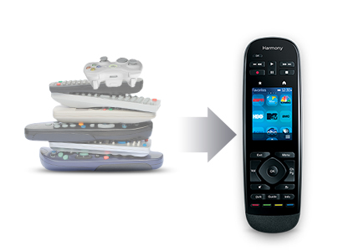
The Harmony Ultimate Universal Remote
Harmony Ultimate can control up to 15 devices and is compatible with over 225,000 home theater devices.
And unique to Harmony is the patented Smart State technology, which remembers your devices’ power and input settings and automatically adjusts them based on what you want to do.

Slide 6
What were the test goals?
Task success, usefulness, satisfaction, comprehension, and learning.
Is the Harmony Ultimate easy to use?
Is it intuitive?
Can all age groups use the remote easily?
What makes the Harmony Ultimate easier to use than other universal remotes?
Notes:
Task Success:
Observation of users following a certain task scenarios
Can they complete a given task and is it within a reasonable amount of time?
Usefulness:
Do users see the universal remote as fulfilling a real need?
Do users see value in using the universal remote?
Does it work better than other remotes with similar functionality?
Would they use it again?
Satisfaction:
Are users pleased with their experience using the remote?
Comprehension/Learning:
Could users perform similar tasks without having to reference instructions?
Can they recognize the functions the next time they use the remote?

Slide 7
Test Methods
The test methods that will be implemented include users having hands-on testing experience with the universal remote.
The project included scales of satisfaction and usefulness on scales such as 1 to 10 and very bad to very good.
The participants were given specific tasks to get familiar with the functions of the remote. These tested the participants ability to follow the instructions given by the interface and how well designed the interface is.

Slide 8
Task List
To ensure that the participants get fully familiarized with the Ultimate Harmony remote, we have a list of tasks that they must perform:
Connect the remote to the computer and set up the account
Connect the Harmony Hub to the home network
Add a TV
Add a gaming console (PlayStation 3, Xbox, or Wii)
Add a projector (Epson 710HD)
Philips Hue Lights

Slide 9
Heuristics
Visibility of System Status
Consistency and Standards
User Selection and Freedom
Aesthetic and Minimalist Design

Slide 10
Participants
The participants we chose for this usability testing were both male and female from a wide range of age groups. We had 1 person in each of these groups:
10-20
21-30
31-40
41-60
60+

Slide 11
Questionnaire: Pre Test
Each participant was asked to complete a pre and post questionnaire for the usability test. These are the pre test questions:
How much experience have you had operating remotes (TV or video games)?
How willing are you to perform the upcoming tasks?
What is the highest level of education you have completed?
If attending or completed college, what was your major?
What is the primary language spoken in your household?
Age and Sex

Slide 12
Questionnaire: Post Test
Did you feel physically capable to perform the tasks? Why?
On a scale from 0 to 10 (0 being very hard, 10 being very easy), how easy was it to connect the remote to the computer and set up the correct account?
How easy was it to connect the Harmony Hub to the network?
How easy was it to connect:
  The Sony Smart TV?
  The gaming console? (PlayStation 3, Xbox, Wii)
  The Epson 710HD Projector?
  The Philips Hue Lights?

Slide 13
Questionnaire: Post Test Cont.
How would you rate (Very Bad, Bad, Ok, Good, Very Good):
  The experience of using the remote?
  The quality of the remote?
  The helpfulness of the instructions provided while setting up the remote?
What was the easiest task? Why?
What was the most difficult task? Why?
Did you have any concerns when handling the remote? Why?
Did the remote feel natural to hold? Why?

Slide 14
Suggestions
Allow users to create profiles so that different people can have their own personalized settings
Allow more advanced features like programming specific buttons to function that you like from the original remote.

Slide 15
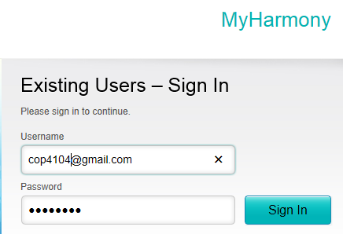
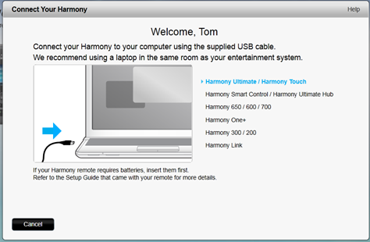
Usability Test
We asked participants to go to www.myharmony.com and Sign In using the provided login information.
Next they needed to connect the remote to the computer using a USB cable.

Slide 16
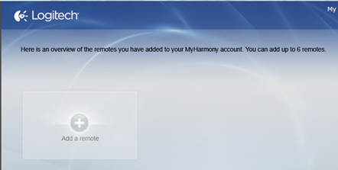
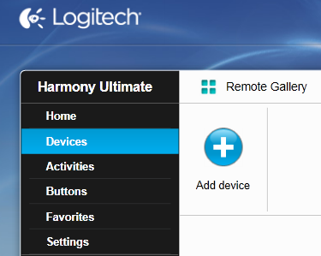
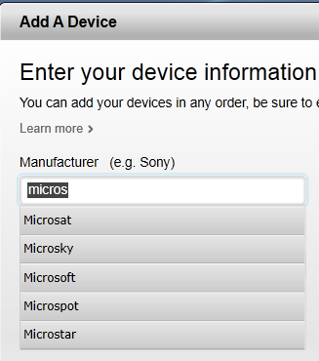
Usability Test
Then participants were asked to add the remote to the account they created.
The participants were asked to add the devices that were provided by entering the manufacturer and model number.

Slide 17
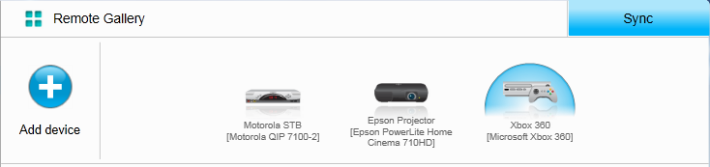
Usability Test
After adding each device it would display them in the Remote Gallery.
This notifies the user that the devices was successfully added.

Slide 18
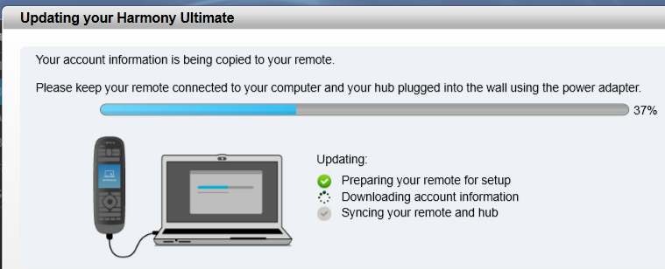
Usability Test
Next the participants were asked to press the Sync button.
This was the final step. Once the computer Syncs with the remote the participants were able to test its functionality.

Slide 19
Questions?

