Slide 1
Pandora: A Usability Test Case Study
CAP 4104 – Human & Technology Interaction
Jeremy Dorlouis, Dante Marone, Joe Pate, Diego Reano
10/5/2013

Slide 2
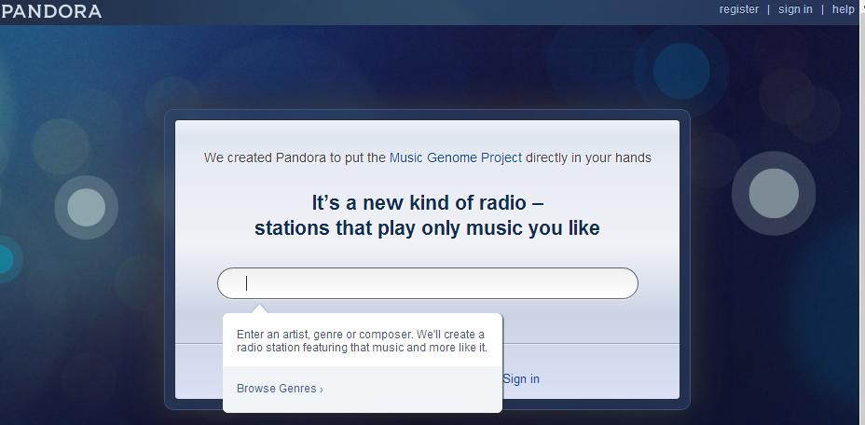
PANDORA
The starting screen for Pandora Internet Radio. Note the simplicity of the interface: it is comprised of only one search box.

Slide 3
DESCRIPTION OF PANDORA
Pandora is an automated music recommendation service and "custodian" of the Music Genome Project.
Designed to be an easy to use interface.
The fast and efficient interface will make the user feel more efficient, creating a more pleasant use of the interface (Preece, 2002, p. 35).
The start page has one major element present: the search bar. This search bar can be used to look for a genre, artist, or song that a user prefers to start the creation of a new station.
  Once the user executes this action, they are directed to a different, more complex, section.

Slide 4
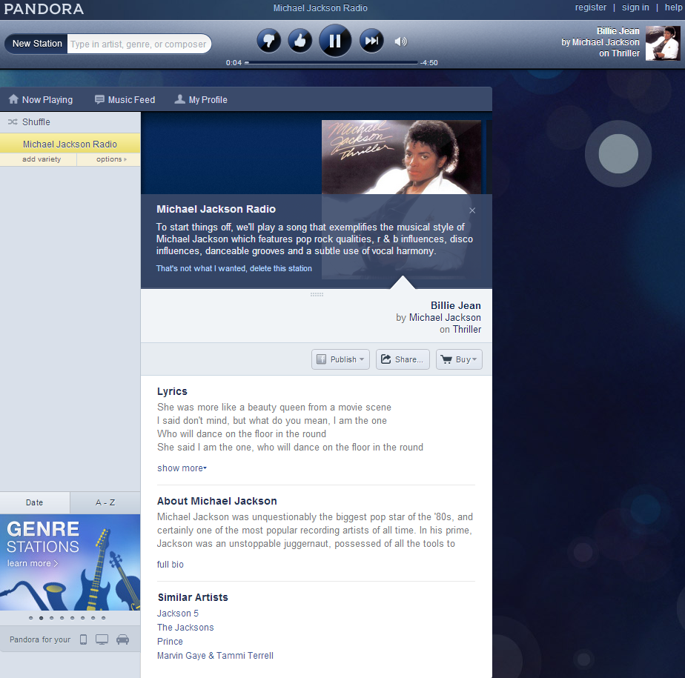
DESCRIPTION OF PANDORA
User are taken directly to a new section that
  automatically starts playing a song from the desired artist.
The user is presented with the following information:
  the artist
  lyrics to current song
  list of similar artists
  quick tutorial.
It is important to manage the space utilized by the interface in a correct manner, this leads to a more efficient user experience and to less time wasted for the user (Karray, 2008, p. 152).

Slide 5
DESCRIPTION OF PANDORA
When the user is listening to music, they are able to do more advanced actions by interacting with the rest of the interface.
The interface shows different sections that are color coded so they can be easily identified by the user.
Color coding the different menus, buttons, and layouts is an important tool for providing feedback to the user and creating a more intuitive interface (Buxton, 1983, p. 41).
The users can choose to:
  buy a song
  look at the lyrics for the song currently playing
  rate a song as either good or bad, and
There are other higher-level actions that are secondary to the experience, but they are there in case they are ever needed, and make the interaction more pleasant.

Slide 6
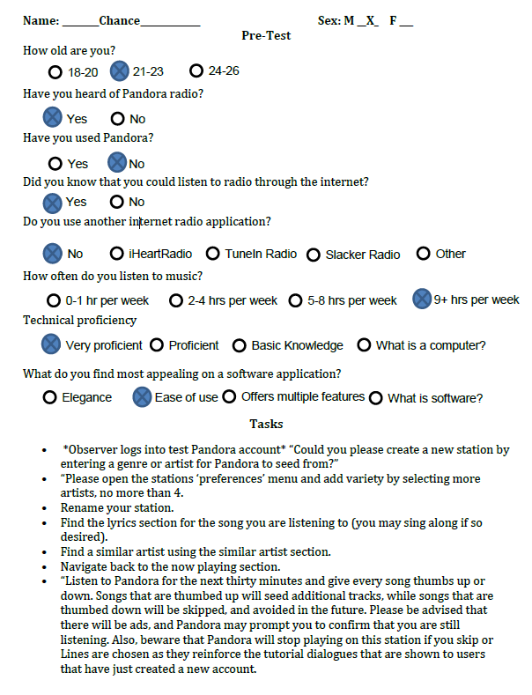
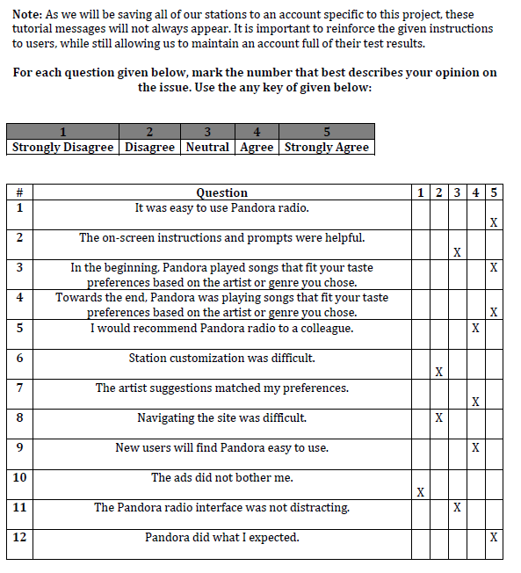
DESCRIPTION OF EXPERIMENT

Slide 7
DESCRIPTION OF EXPERIMENT
This usability test was conducted in order to gain understanding on how the user engages with the Pandora Internet Radio user interface.
The main goal is to show if the Pandora Internet Radio interface is user friendly and intuitive.
The experiment consisted of:
  Pre-test
  Task to complete
  Post-test
These results would then be gathered and compared to come up with a conclusion on the usability of Pandora; as well as, to understand the positive and negative aspects of the interface.

Slide 8
POPULATION SELECTION
Selected age range of 18 years of age to 26 years of age
Test subjects were selected at random and asked for their voluntary participation in the study
Test subjects were informed that the focus was on the evaluation of the interface and not them
The population represented a broad audience with different proficiencies and technical abilities, which allowed this study to cover all the main areas of using Pandora and evaluating the full extent of the user interface.

Slide 9
PRE-TEST
Eight questions designed to gather demographic information
Answers can be quantified for measurement
Half of the questions gauge the user’s familiarity with internet radio
Other half gathers information about the user

Slide 10
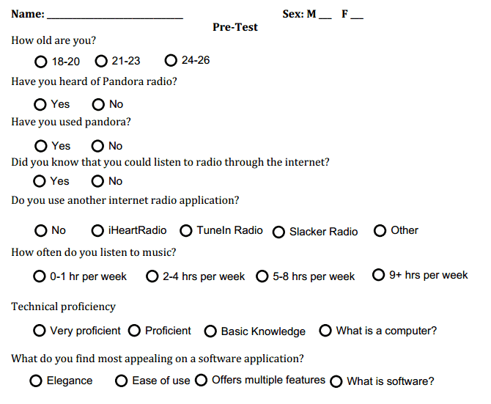
PRE-TEST

Slide 11
TEST/TASK
Created based off of the tool tips located from within Pandora’s web interface.
Instructions were read aloud to subjects
The observer readily provides help to the users when needed
Certain questions were modified from the script depending on the circumstance.
After test subjects have had the chance to freely experience Pandora, they are ready to share their opinions on the following post-test section.

Slide 12
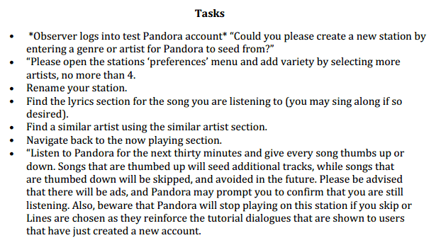
TEST/TASK

Slide 13
POST-TEST
Contains all of the hard data from the test
12 questions designed from Likert principles
  Asked the user to give their feelings on specific aspects of the experience in a quantitative scale
Questions revealed:
  the difficulty of the interface
  if the given instructions are adequate for use
  the user’s feelings towards Pandora’s evolving music selection
  the interface’s appeal to the user
  if Pandora functioned in a fashion the user would expect from an internet radio application

Slide 14
TEST RESULTS
Eight total participants
Pre-Test Results show:
  mostly people between the ages of 24 and 26 use internet radio, directly followed by people 21-23 years of age.
  most people had already heard of Pandora radio
  most people do not use any other radio application even though most of them listen to music more than four hours per week.

Slide 15
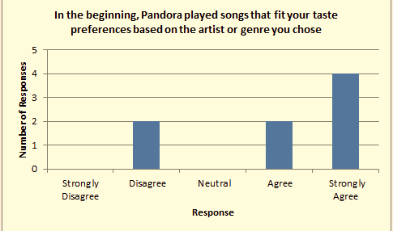
RESULTS
The majority of people agreed that Pandora played songs that fit the taste of the user, proving that the predictive algorithm used by Pandora was implemented correctly.

Slide 16
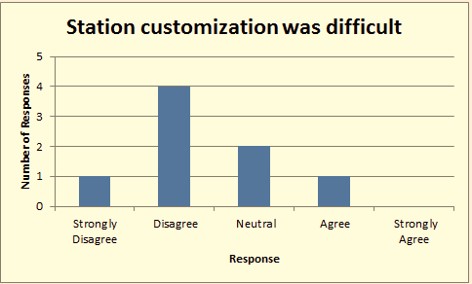
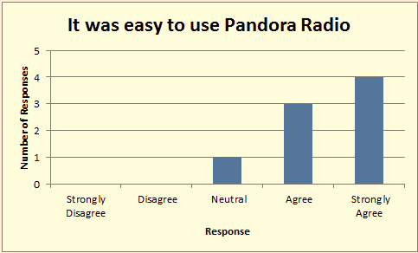
RESULTS
The vast majority of people (62.5%) agree that setting up and customizing a radio station was not difficult. Almost everyone (except for one outlier) agrees that Pandora is easy to use. (87.5% of the users)

Slide 17
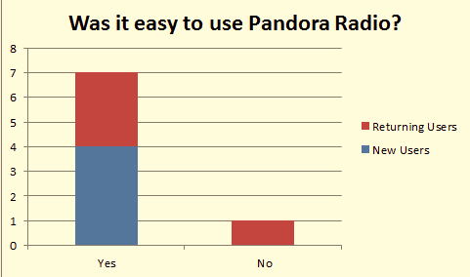
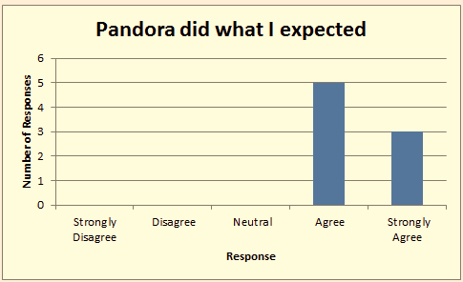
RESULTS
Both new and returning users agree that Pandora is easy to use (only one outlier). All users agreed that Pandora was responsive and intuitive, and did what it was expected.

Slide 18
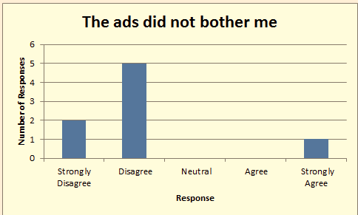
RESULTS
However, most users agreed that the ads were a negative aspect of the interface.

Slide 19
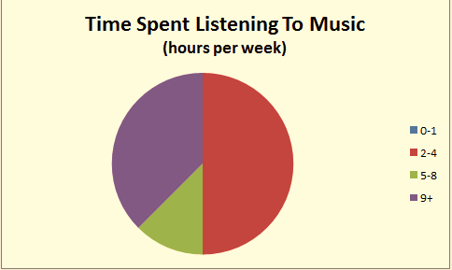
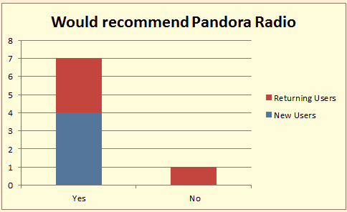
RESULTS
Most users listen to music at least 4 hours per week, and they would all recommend Pandora to other people

Slide 20
CONCLUSION
Based on the results, most people agree that the Pandora user interface is intuitive and user friendly.
People liked Pandora because of the way the predictive algorithm was implemented; providing an effortless procedure for creating the optimal radio station.
There was one major aspect that deteriorated the user experience. The way Pandora implemented their ad system, tends to annoy most people (7 out of 8).
  A way to solve this issue would be to make the ads not interrupt the stream of music
From all the results gathered, the usability test concludes that Pandora is an easy to use, user-friendly interface with very few negative aspects.

Slide 21
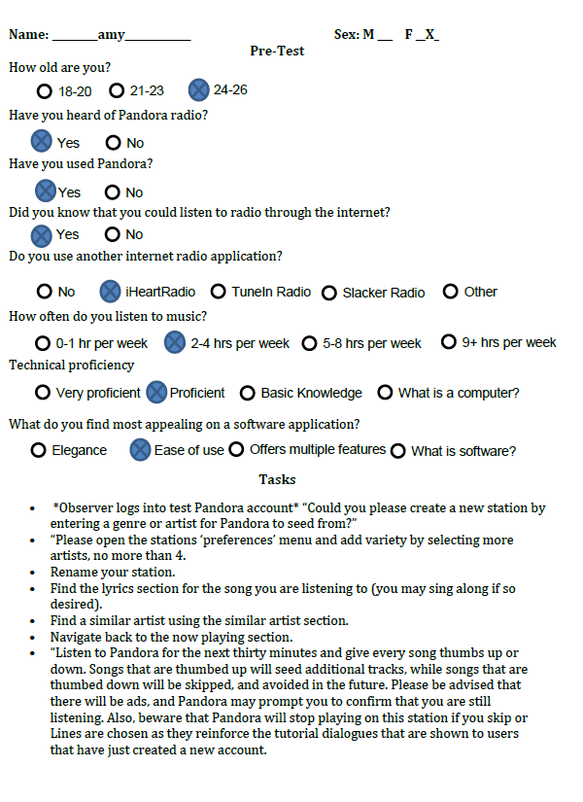
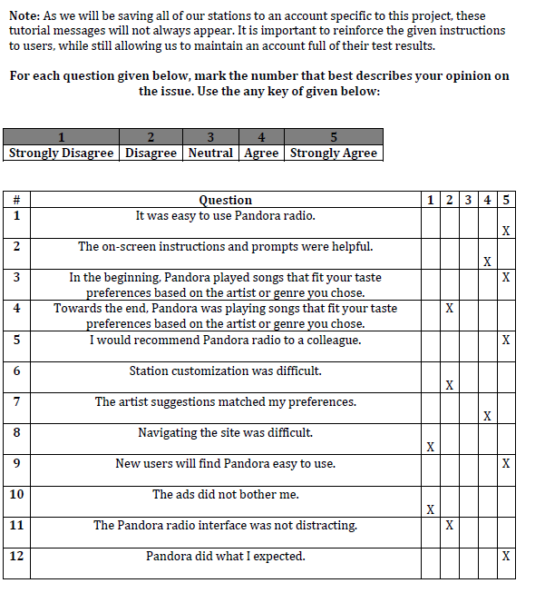
EXAMPLE TEST

Slide 22
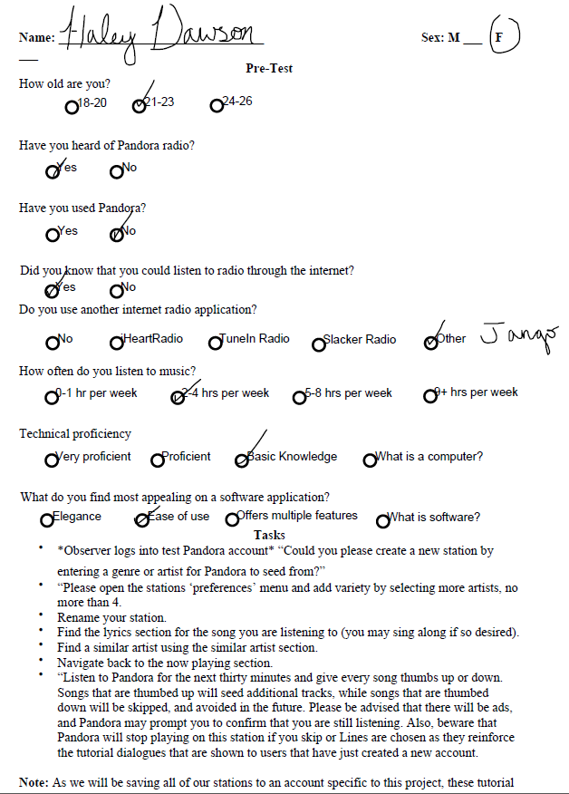
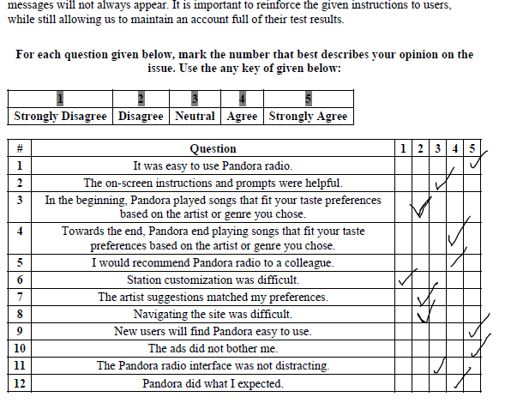

Slide 23
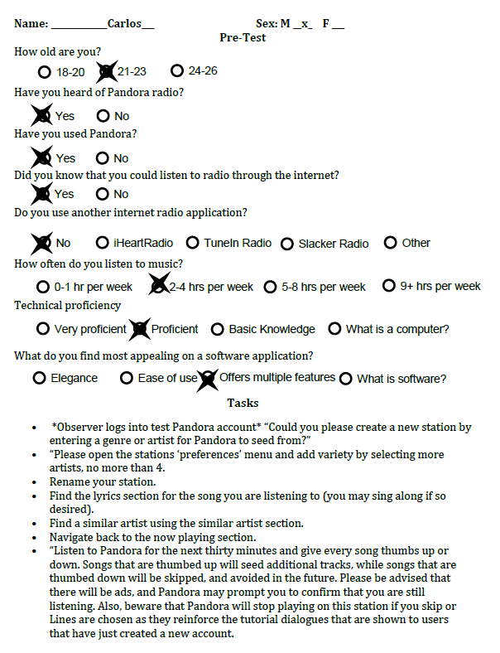
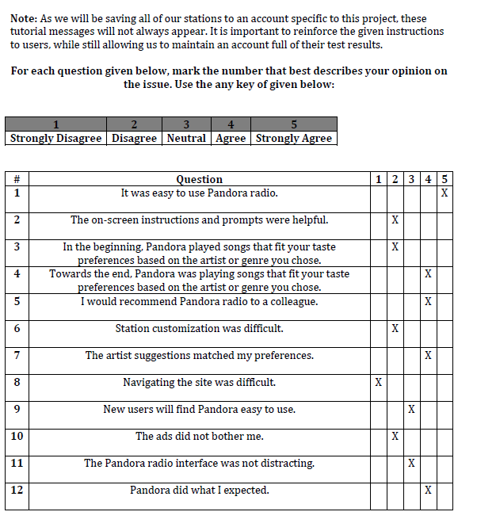

Slide 24
REFERENCES
Buxton, W., Lamb, M. R., Sherman, D., & Smith, K. C. (1983). Towards a Comprehensive User Interface Management System. Computer Graphics, 17(3), 35-42.
Coons, S. A. (1963). An Outline of the Requirements for a Computer-Aided Design System. Proceedings-Spring Joint Computer Conference, 2(1), 299-304.
Karray, F., Alemzadeh, M., Saleh, J. A., & Arab, M. N. (2008). Human-Computer Interaction: Overview on State of the Art. INTERNATIONAL JOURNAL ON SMART SENSING AND INTELLIGENT SYSTEMS, 1(1), 137-159.
Kimball, M. A., & Hawkins, A. R. (2008). Document design: a guide for technical communicators. Boston: Bedford/St. Martin's.
Myers, B. A. (1998). A Brief History of Human Computer Interaction Technology. ACM interactions, 5(2), 44-54.
Preece, J., Rogers, Y., & Sharp, H. (2002). Interaction design: beyond human-computer interaction. New York, NY: J. Wiley & Sons.

