Slide 1
PlayStation Vita
Usability Evaluation
David Morris
Dylan Rund
Daniel Allen
Dennis Lutchman

Slide 2
Description of Interface
For our Project we used the PS Vita.
The Vita uses a combination of physical buttons and touchpad interfaces

Slide 3
Description of Interface Cont.
14 Total Buttons
X Triangle Circle and Square
Volume up Volume Down
Power on and Home
4 Directional Buttons
Start and Select

Slide 4
Description of Interface Cont.
2 Touch Pads
Front 5 Inch Display
960 x 544 Resolution
Back Touch Sensetive Pad
2 Analog Sticks
Game and Memory Stick Duo Slot

Slide 5
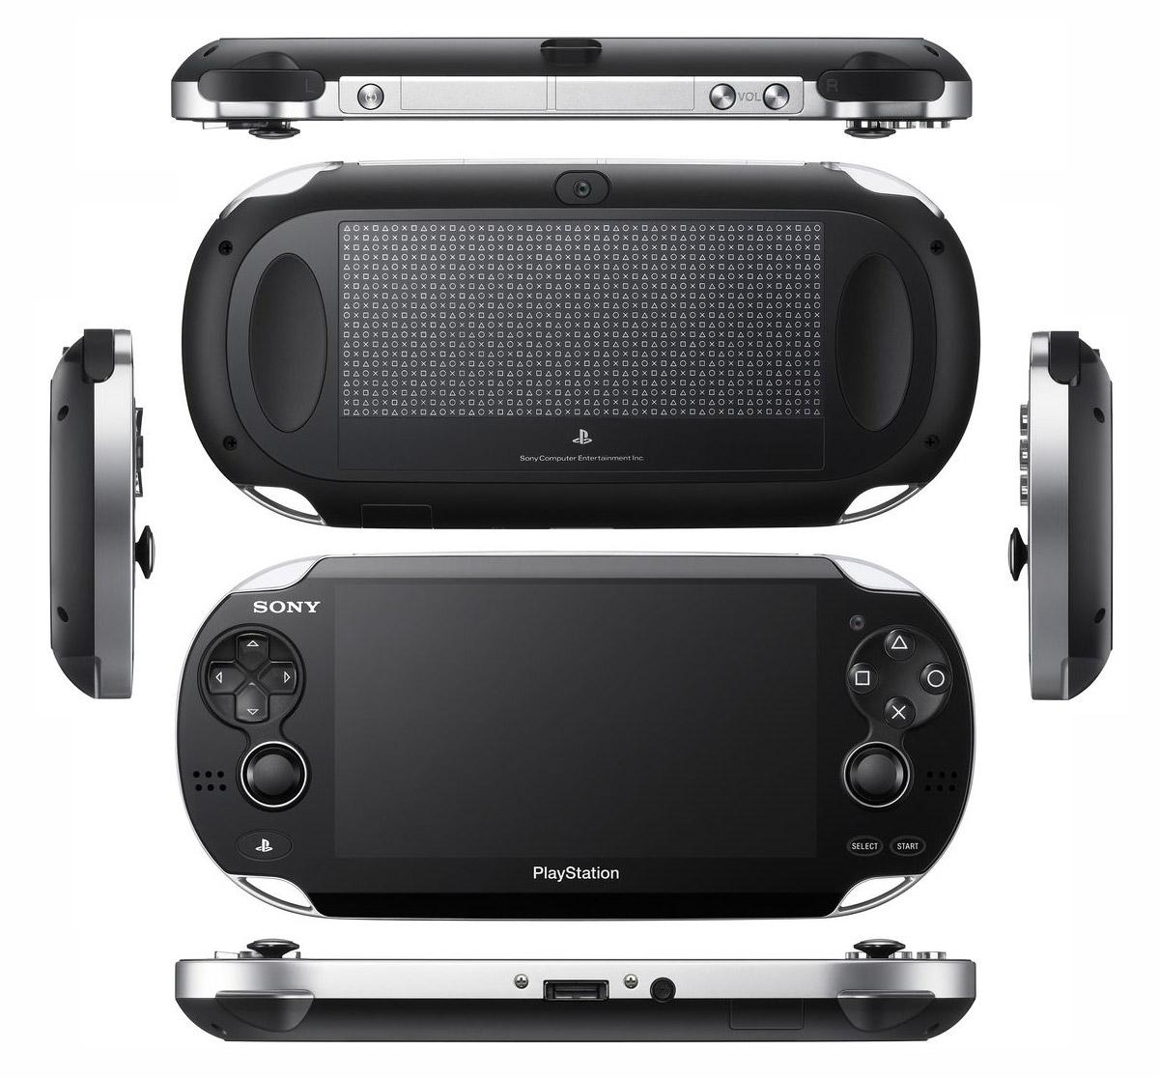
Picture of Interface

Slide 6
Test Goals
Determine if the button layout is effective
Determine if the software is easy to navigate
Evaluate the effectiveness of the multi processing concept

Slide 7
Test Methods
Keystroke model
Used to create a baseline
Analyzed participants time vs baseline

Slide 8
Participants
Randomly selected from campus
Age range: 18 - 25
Education level: Some college
Technical skill level:

Slide 9
Preliminary Questions
Likert scale
Initial opinion of device and its features
Experience with handheld electronics

Slide 10
Tasks
Game Play
Augmented reality
Touch pad
Software Interface
Launch applications
Multi-task
Hardware Interface
Basic button functions
Insert game cartridge

Slide 11
Post Questions
Change in initial opinion
Suggested improvements
Differential semantics to rate features

Slide 12
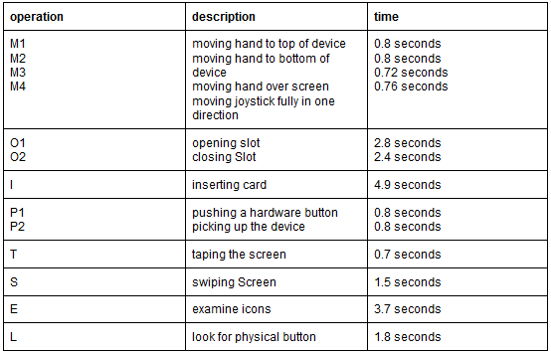
Keystroke Model

Slide 13
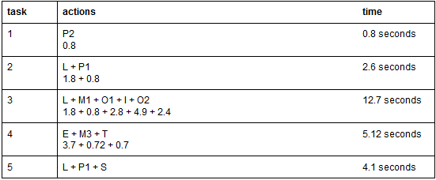
Keystroke Model Cont.

Slide 14
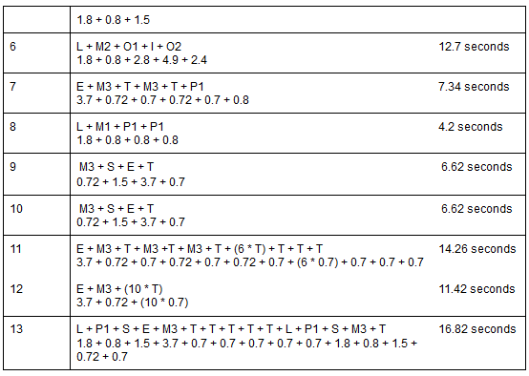
Keystroke Model Cont.

Slide 15
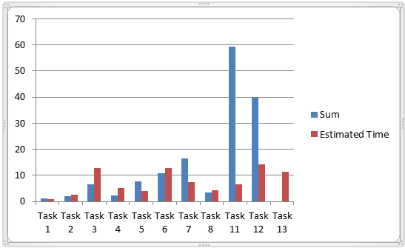
Average Time vs Calculated Time

Slide 16
Average Time vs Calculated Time
User out-performed our calculations for most tasks
4 Tasks took longer than expected
1 Participant was unable to complete Task 13
Why?

Slide 17
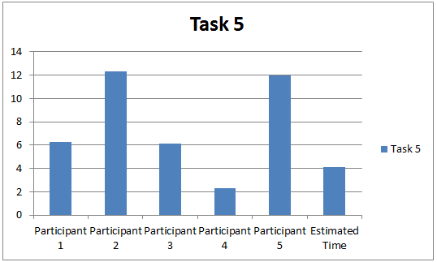
Task 5

Slide 18
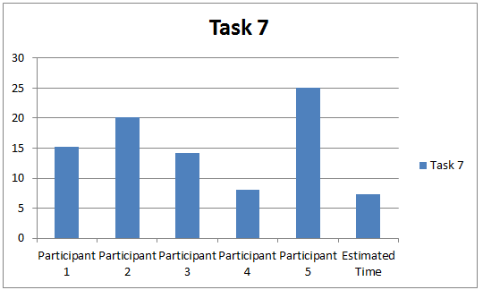
Task 7

Slide 19
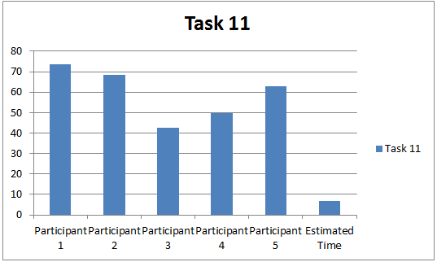
Task 11

Slide 20
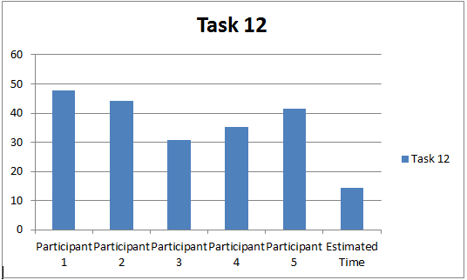
Task 12

Slide 21
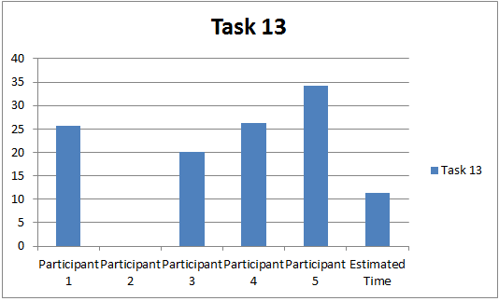
Task 13

Slide 22
Task Analysis
Task 5
Exit out of the game back to the dashboard (main menu).
3.7 seconds longer to complete
Unclear set of commands to close
How to fix?
Create an indication to swipe from top right to bottom left

Slide 23
Task Analysis Cont.
Task 7
Launch camera application and take a picture.
9.18 seconds longer to complete
No indication which button to press to take picture
How to fix
Indictation, “Press R to take Picture”

Slide 24
Task Analysis Cont.
Tasks 11 and 12
Both these tasks involved using the internet
11 Needed to download netflix
12 Needed to visit ign.com
Problems with internet latency
How to fix
Not an interface issue.
Faster load times on internet applications

Slide 25
Task Analysis Cont
Task 13
Most complex task
Minimize game, open music app, play song, return to game
1 Participant could not complete
Same issues as task 5
How to fix
Better indication after pressing PS Home

Slide 26
Survey Analysis
Gaming ability: Difference between men and women due to experience
Games gear towards men
Touch screen improvement
Use outside of menu navigation
Built-in Web Browser
Sluggish
Imprecise touch screen control

Slide 27
Survey Analysis Cont.
Augmented Reality
Issues with lighting due to poor quality camera
Games
Occasional crash when returning to a game
New user help
Tutorial for navigation
Analog sticks
Too small for precise movement

Slide 28
Conclusion
Most users rated it highly
Slight issue with touch screen precision
Slight software interface problems
Overall very effective interface

