Slide 1

Usability Test
Assignment #2
CAP 4104: Human and Technology Interaction Aileen Baliwag
October 6, 2013 Michael Bobbit
Jeremy DeFalco
Scott Holman

Slide 2
Introduction
Netflix Website
  Available in various mediums
      website, mobile devices, game consoles
  Streaming available via internet access
Designed for users of all ages
Focus on new users with various backgrounds
  Evaluate usability and experience

Slide 3
Overview of Forms
Pre-Test
  Collected demographic information
Testing Steps
  Functions focused on to evaluate usability
Usability Evaluation
  Successful/Unsuccessful
Post-Test:
  Measured customer satisfaction

Slide 4
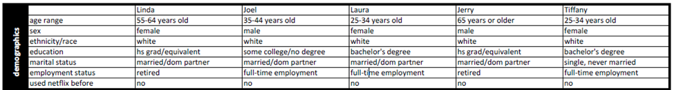
Population
First time users
Wide range of:
  Age
  Gender
  Education

Slide 5

User Pre-Test
Basic demographic questions
One simple pre-evaluation question
Education and age were important secondary questions to gather

Slide 6
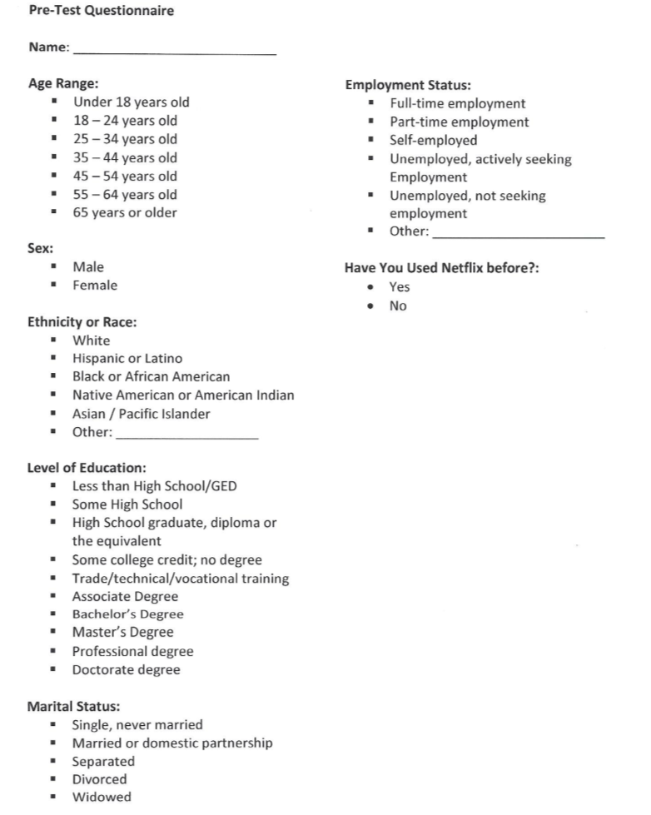
User Pre-Test

Slide 7
Testing
6 participants
  2 – approximately 25 years old
  2 – approximately 35 years old
  2 – approximately 65 years old

Slide 8
Testing
Test subjects tested individually
One by one given a request to perform a basic action with the interface
    Successful/Not Successful

Slide 9
Testing

Slide 10
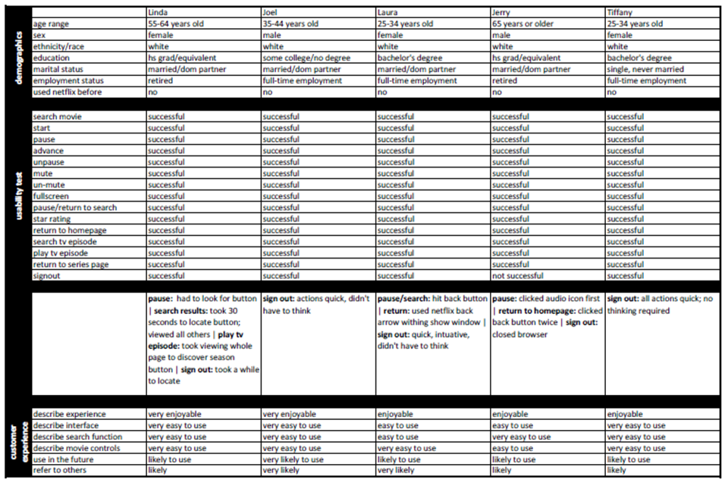
Results

Slide 11
Recommendations
Volume control
Clear user options
    ‘Log out’ button
Alter Navigatinon Utility
    Make Netflix Back Button more visable
Increase visibility
    Switching between seasons
    Video playback
Audio options

Slide 12

Recommendations continued
Social media expansion
  Watch with friends
  Sharing
  Profile building

Slide 13
The End
(Thunderous applause)

