Slide 1
Calculator Interface Evaluation
Khemjai Harkissoon
CAP 4104
10/5/113

Slide 2
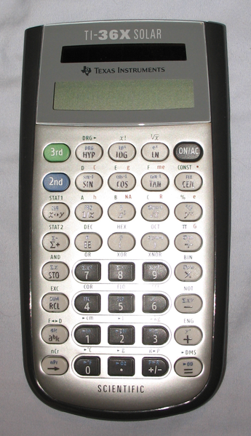
TI-36X Solar
Scientific Calculator

Slide 3
Age Group
16~18
  High School
19~22
  College/University
33~40
  “Adult”

Slide 4
Tasks
Please remove the covering that is over the calculator.
Now please turn on the calculator.
Please complete the following math problems and record your answers on the paper given:
Using the calculators function, please preform the following calculations and record them on the paper given
Now please record what mode that the calculator is in.
Please change the mode of the calculator to Radians.
Now please change the mode of the calculator back to the original state.

Slide 5

Topics Applied from Class Lectures
Think Aloud protocol
  Benefits
Quantitative data
  Answers from test
Qualitative data
  Physical features of the calculator

Slide 6

Color code modes
  Good Idea, shaky implementation
Solar Powered Interface
  Good idea, needs sunlight to be active
It does what a calculator does best
  Calculations

Slide 7
References
Lumsden, J. (2008). Handbook of research on user interface design and evaluation for mobile technology. Hershey, PA: Information Science Reference.
Treu, S. (2013). User Interface Evaluation A Structured Approach. New York: Springer-Verlag New York Inc.

