Slide 1

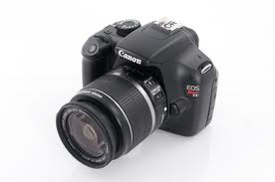
Usability Test
Group 6
Jorge Bensus, Ulises Santos, Amjad Sheikh, Robert Stephens
CAP 4104

Slide 2
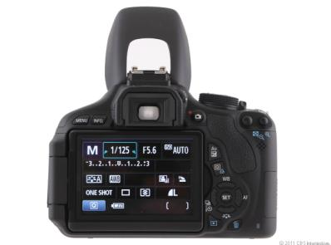
Introduction
Canon claims the Canon Rebel T3 DSLR (Digital Single-Lens Reflex) Camera is easy to use.
  12.2 Megapixels
  SD/SDHC/SDXC memory card
  High Resolution 1920 x 1080
  2 mini-HDMI out
  34 – custom settings
  2 sec. shutter speed delay

Slide 3
Goal
“The Canon EOS Rebel T3 is a premium entry level DSLR that captures excellent still images and video…” (Derrick Story, Macworld Magazine).
Easy to use for consumers with little to no experience in using DSLR cameras.
Easy to use as a point and shoot camera.
Population Targeted
  18 – 25 years of age.
  UCF students
  Non-Technical Degree seeking students (No Engineers)

Slide 4
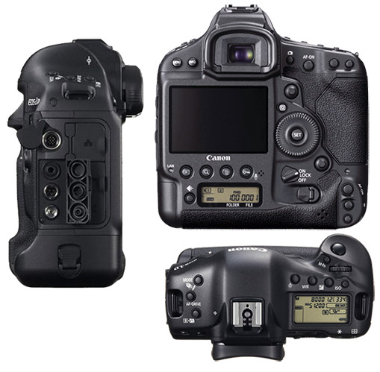
Bad Interface

Slide 5
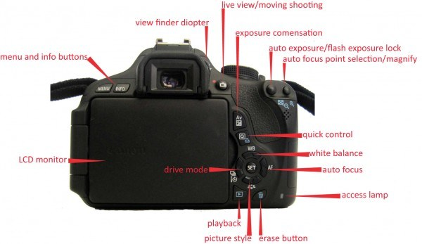
Interface

Slide 6
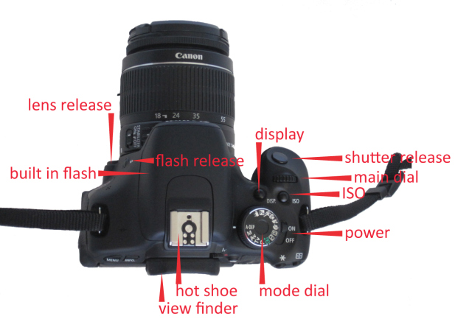
Interface

Slide 7
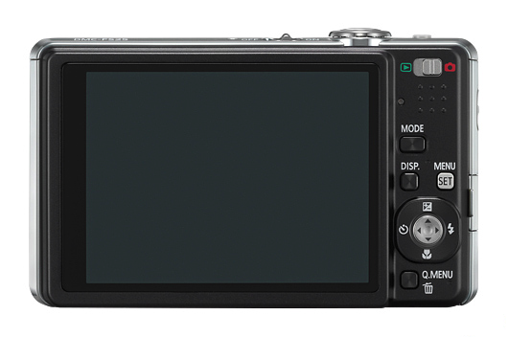
Good Simple Interface
Nikon Point and Shoot Camera

Slide 8
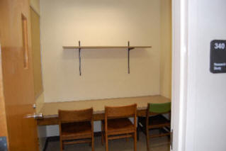
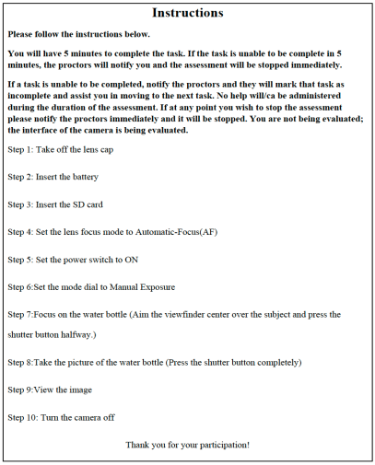
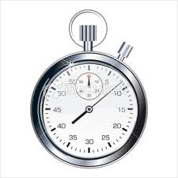
Experiment

Slide 9



Data Gathering

Slide 10
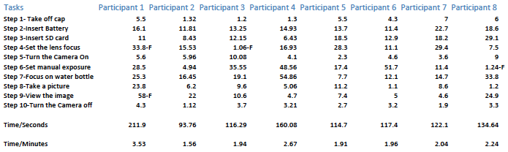
Results
Four participants were familiar with the camera “%50 of the participants.”
Average total time to finish the tasks was 2.25 minutes
Passing Rate was at %96

Slide 11
Results
Tasks Passed Per Participant
Only three participants failed to complete all the tasks.
Participant one failed two tasks.
Participants three and eight failed one task each.

Slide 12
Average time
Participants were given five minutes to finish the tasks.
Participant 1 took the longest time to finish 3.53 minutes

Slide 13
Difficulty of tasks
Step 6 was the most difficult task only because the participants were expecting a touch screen instead of dial.

Slide 14
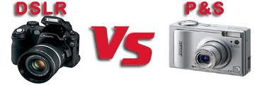
Conclusion
The Original Goal
Initial Interface Research
Planning Testing Phases and Resources

Slide 15
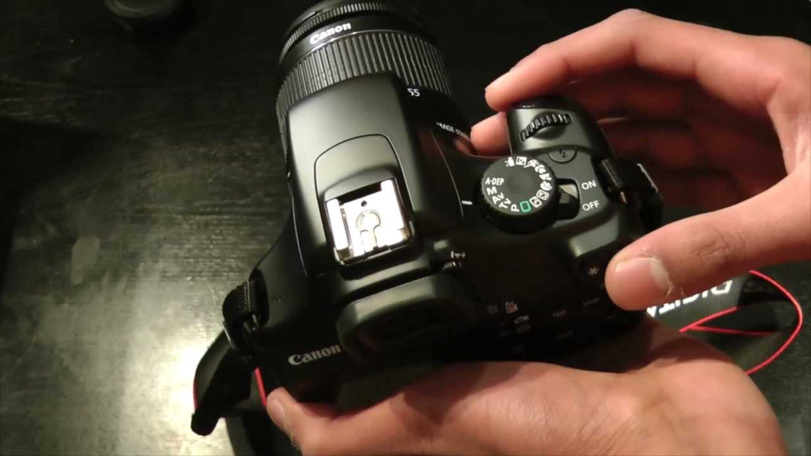
Cont.
The Usability Test
Conducting Testing
Observing and Gathering Data

Slide 16
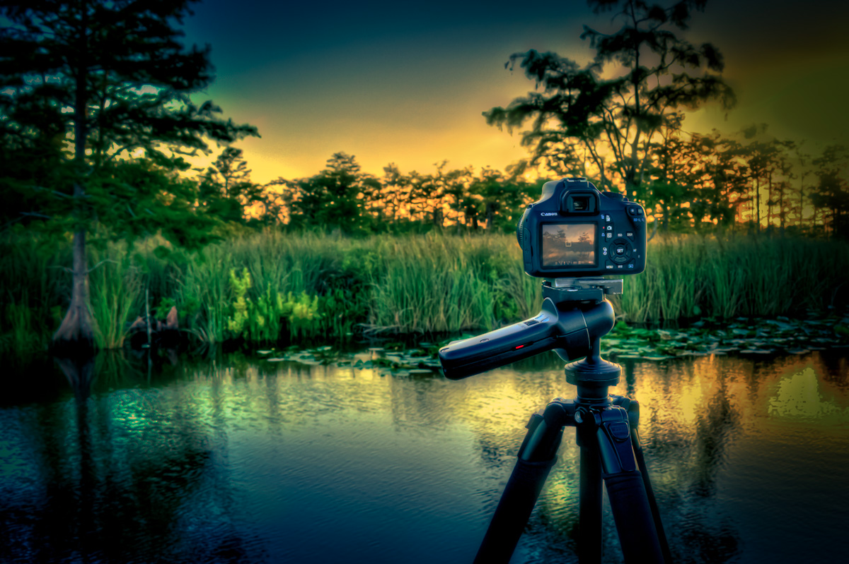
Cont.
The Results
Processing and Interpreting Findings
Developing Charts based on Findings

Slide 17
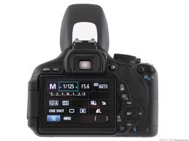
The Bottom Line
Final Remarks
User’s Recommendations
Group’s Conclusion

