Slide 1
Google Music Interface Usability
Ryan Baley
Chris Craig
Cameron Yeager
Bret Wood

Slide 2
Purpose of Project
To test the usability of Google Music, and to see how well people adapt to new applications.
To see if people will decide to use new applications over older preference.

Slide 3
Population Selection Variables
Age range:
15-25
Level of Education:
College (Majority)

Slide 4
Tasks for Participants
Open the Google Music App
Switch from “On Device” to “All Music” so you have access to all online music
Browse through “My Library” for an artist you like
Play a song from this artist
Start an “Instant Mix” with a song from this artist
Go to the “Shop” section, and pick an album from another artist you like
Go through the purchasing process, but DO NOT ACTUALLY BUY THE ALBUM
Go back to the home screen of the device

Slide 5
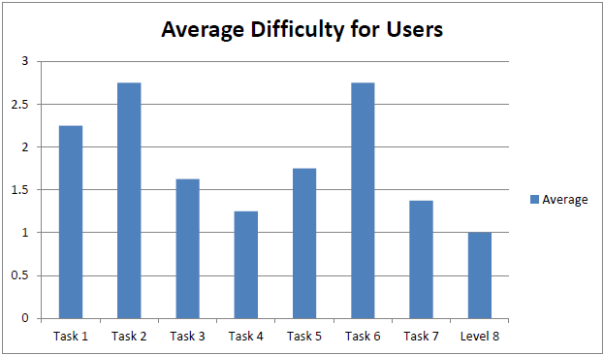
Result Averages
Notes:
Talk about the graph in particular first. Then click to fade the arrows in and point out that task 2 and 6 were the most difficult.

Slide 6
Result Averages
Average Reported Education Level:
Some College
Average Reported Smartphone Skill:
8.125 / 10
Average Reported Google Music Review:
7.125 / 10

Slide 7
Issues During Testing
The most common problem was not being able to switch from music on the device to all music available to the user, including that stored online.
Another user had a problem launching the app, but that was a single instance.

Slide 8
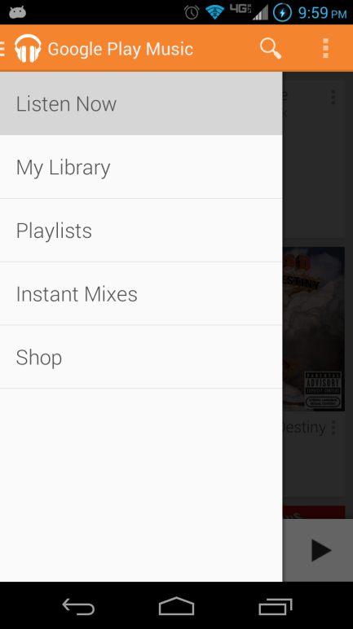
Proposed Solutions
Easier access
More descriptive language

