Slide 1

Google Mobile Maps
& HCI Principles
Group 1
Andrew Meyer
William Ellett
Jeff Hubbard
Brandon Catubig

Slide 2

Presentation Outline
What is Google Maps?
Evaluation Methods
Study Details
Results
Conclusion

Slide 3
So…
What is Google Maps?

Slide 4
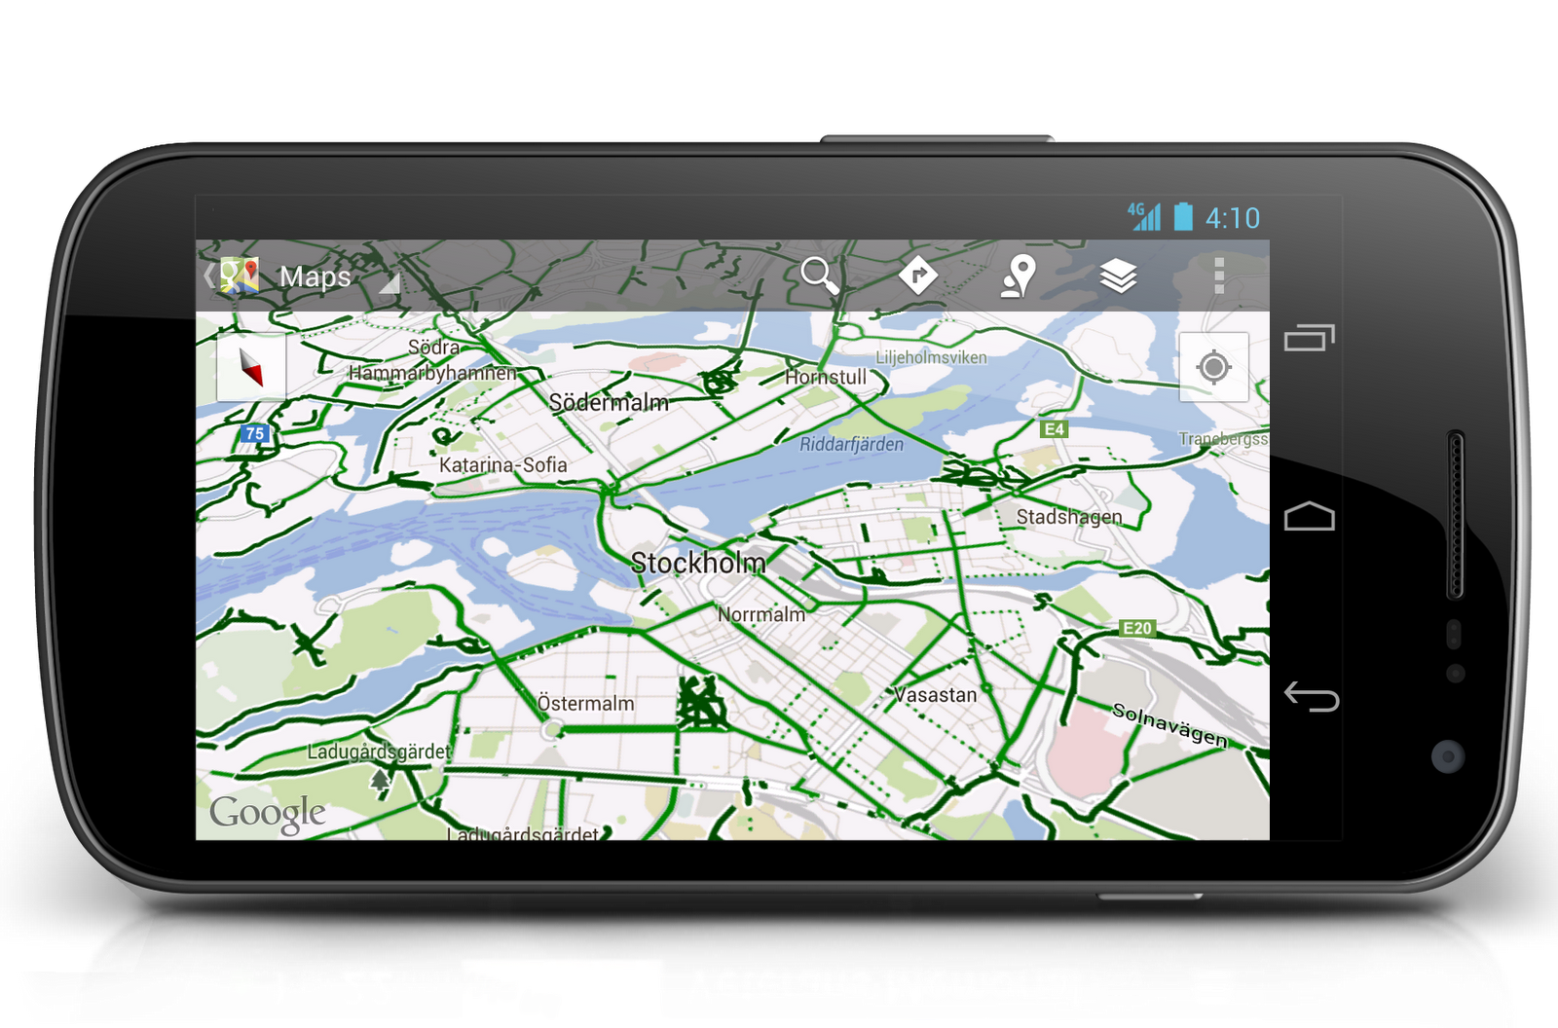

Slide 5

Technology Implemented - GPS
GPS was developed by the US Department of Defense to provide navigation services for the military.
It has since become an integral asset in various industries and applications, such as for recreation, surveying, and vehicle tracking.

Slide 6
Google Maps - Description
Delivering step by step driving directions
Displaying traffic information
Displaying satellite imagery
Providing access to results such as locations, phone numbers, reviews and additional relevant details

Slide 7
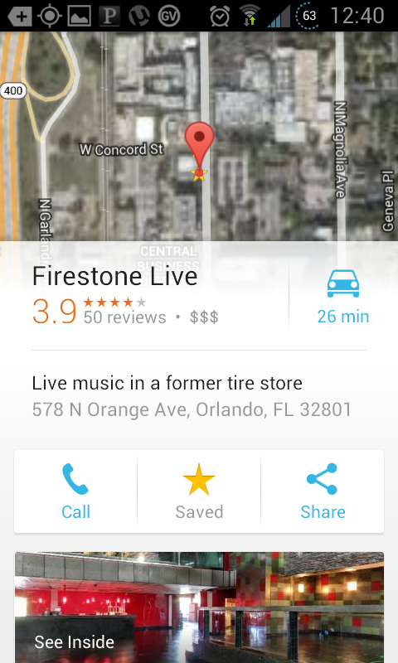
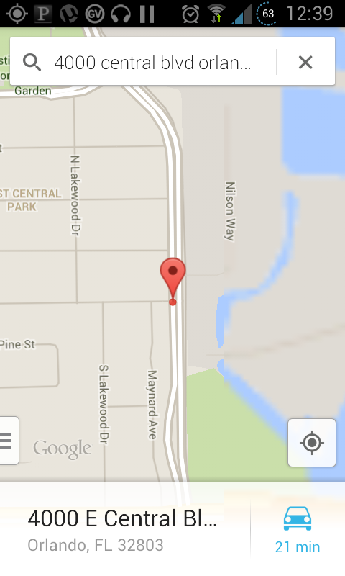
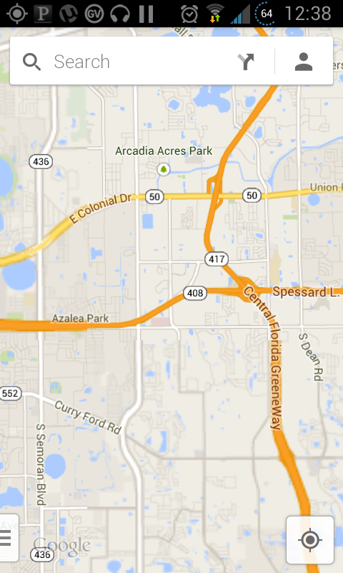
Google Maps - Interface

Slide 8



Google Maps - Target Population

Slide 9
Evaluation Methods
Pre-Test Questionnaire
Post-Test Questionnaire
Usability Test

Slide 10
Evaluation: Usability Test
10 heuristic principles proposed by Nielson
Visibility of system status
Match between system and real world
User control and freedom
Consistency and standards
Error prevention
Recognition rather than recall
Flexibility and efficiency of use

Slide 11
Evaluation: Usability Test
Cont.
Aesthetic and minimalist design
Help users recognize, diagnose, and recover from errors
Help and documentation

Slide 12
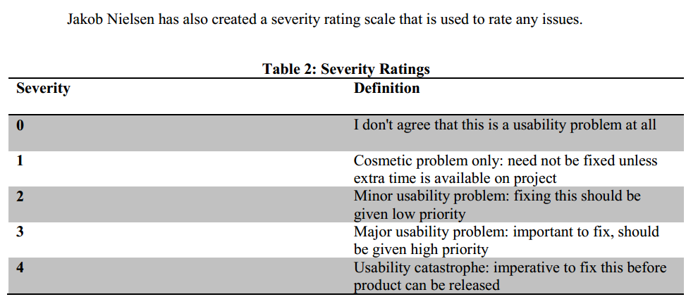
The Rating Scale

Slide 13
Goals
Uncover and document hidden usability issues
Uncover and document user interface bugs
Gain a better understanding of the usage patterns likely to be exhibited
Research and gain experience in conducting mobile usability testing
Generation of a prioritized list of usability problems + improvements

Slide 14
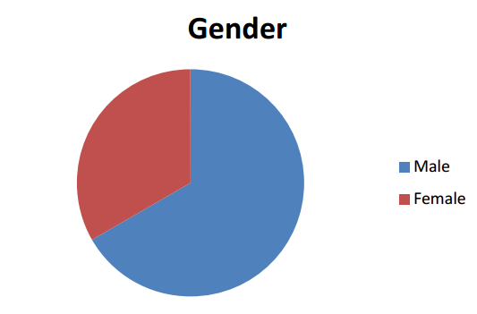
Study Details - Population
6 Participants
4 Male, 2 Female
3 members between 18-22
1 between 28-32
1 between 46-50

Slide 15
Study Details - Pre-Test
Focuses on the demographics of the evaluators.
Quantify the experience level of the users.
Several general questions are asked, such as gender and age, as well as a few specifics such a user experience, etcetera.

Slide 16
Study Details - List of Tasks
The majority of the tasks that were chosen were based off of the example activities used by Jacqueline Cerretani in her document, "Usability Testing - Google Maps for Mobile".
These activities basically follow a practical approach, and put users in a scenario they themselves would likely encounter while using the device.

Slide 17
Study Details - Post-Test
Post questionnaire with a series of free response questions as well as likert style questions.
Yes/No type questions to help indicate the usability rating, any perceived user errors, and user generated resolutions.

Slide 18
Results
Across a diverse demographic, the usability tests showed that GMM is approachable to most audiences. All participants in the study were able to complete both proposed scenarios in under 10 minutes each.
Problem areas with the application seemed localized to the method of menu navigation or menu layout. (swiping with very little direction on the main page)
Most participants agreed the overall difficulty of using the application, even for the first time, was low. It seems to have ported its browser-based counterpart faithfully.
These points indicate that GMM is highly usable with a small learning curve. All participants showed improvement with using the application in the second scenario coming from the first.

Slide 19
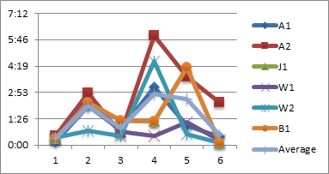
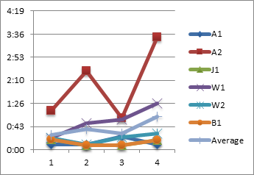
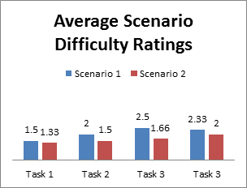
Results (cont.)
Fig 1. Time taken for participants to complete scenario 1.
Fig 1. Time taken for participants to complete scenario 1.
Fig. 2 Time taken for participants to complete scenario 2.

Slide 20
Conclusion of Google Maps
Multiple user complaints which yielded room for HCI principles to be applied.
Shortfall of the product is the assumption that the user is familiar with the specific interface.
Many of the users noted issues had to do with problems of using the application.
Issues involving visibility, flexibility, error recovery and documentation.

Slide 21
Conclusion of Google Maps
The severity of these problems, according to Nielsen, is low.
GMM received a high overall opinion
GMM scored very highly from a usability standpoint.
Many users were very satisfied with their experience and would opt for GMM over traditional maps and most alternative mobile mapping features.

Slide 22
Final Thoughts
According to this study, Google Mobile Maps is a solid product in which a few minor changes could generate a more concrete user experience.

Slide 23

The End
Group 1
Andrew Meyer
William Ellett
Jeff Hubbard
Brandon Catubig

