Slide 1

Evaluating the Steam Application
Paul Selice, Joseph Gaudreau, Steve Sandifer, and Hon Lee
Group 13

Slide 2
What are we doing and why?
We are conducting a user test on the Steam Application (the standalone store, not the website).
We will select 5 human test subjects, give them a pretest, ask them to perform certain tasks within the application, and then ask them some post-test questions to see how it went.
We are seeking to evaluate the usability of the steam application from different users with varying ages and computer skill levels.
Each user will be using a desktop computer running Windows 8, with the Steam application already installed.

Slide 3
Pre-Test
What age group do you fall in? (Please select “Under 20”, “20-30”, “31-40”, “41-50”, or “Over 50”)
Do you online shop regularly (at least once a month)?
Have you played video games before?
Do you currently play video games at least once a month?
Would you say you are a better than average computer user?
Have you ever used or heard of the Steam store before?
Have you ever used the Steam standalone store before?

Slide 4
Pre-Test (cont.)
This test uses the Likert scale and the Semantic differential to quantify the users experience and opinions.
We selected these questions to give us some context and explanation as to why a particular user to succeed or not succeed with the tasks we gave them.
It will also allow us to see if someone might be experiencing difficulty due to their age, or their lack of confidence with the computer.

Slide 5
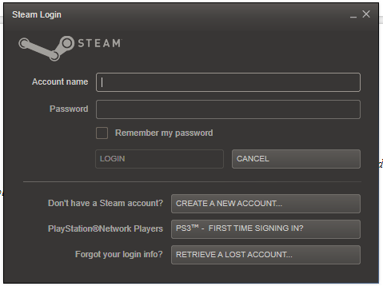
To begin with…
Starting out, a user will be asked to open the application, and create a new account.

Slide 6
Searching, Picking out a Game
We asked the users to search for Star Wars: Knights of the Old Republic, and add it to their cart.

Slide 7
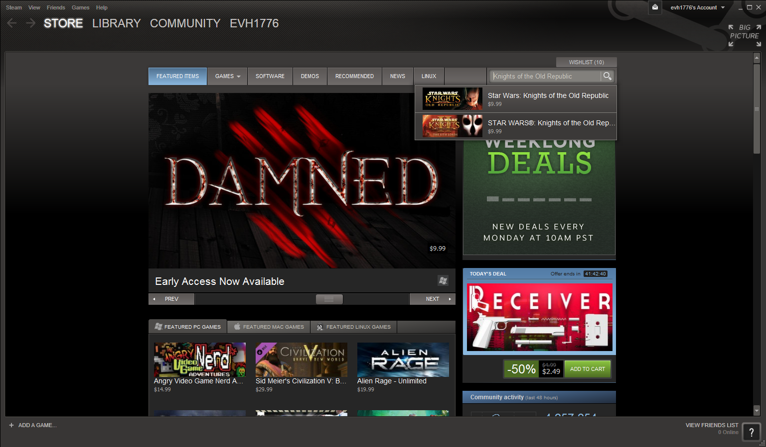

Slide 8
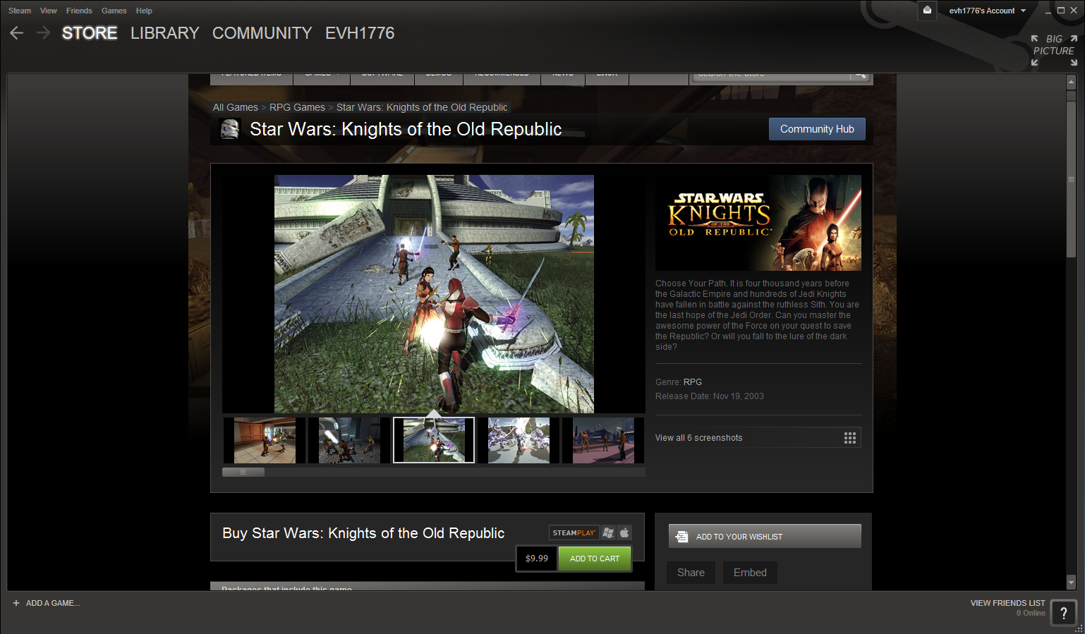

Slide 9
Picking Another Game
We then returned the user to the home screen and let them pick any game of interest to them.
After that, they purchased both games (we returned them immediately after this experiment).
Then, they installed the games.

Slide 10
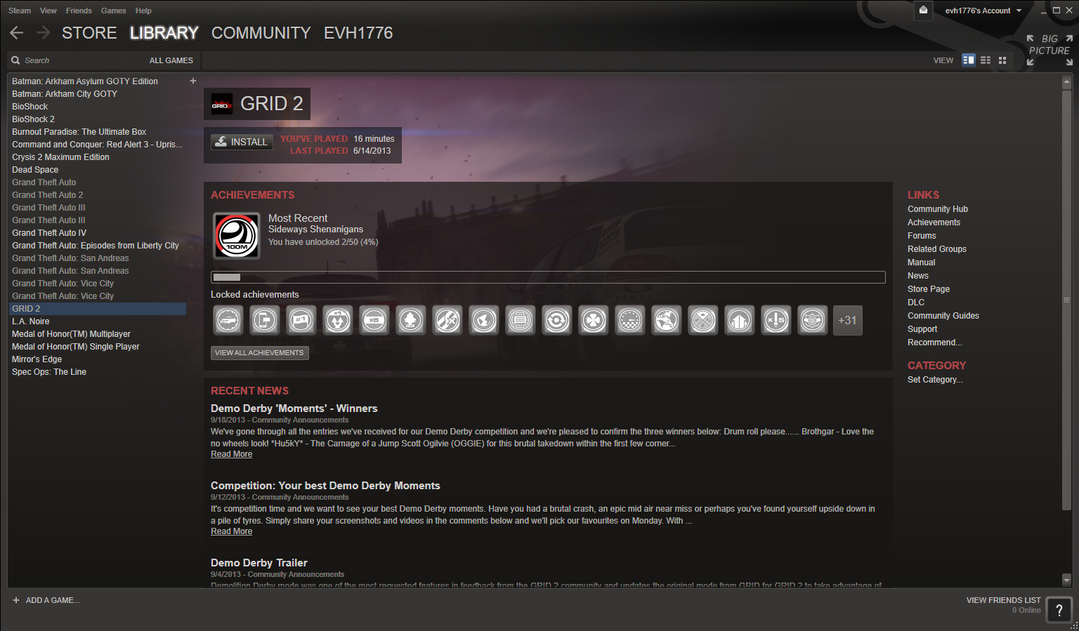

Slide 11
Post-Test
Were you able to complete all of the tasks?
Did you find the Steam application easy to use and understand?
Did you feel that your information (Signup, purchasing information) was secure?
Would you recommend the Steam store to a friend or family member?
This test also uses the Likert scale and the Semantic differential to quantify the users experience and opinions.

Slide 12
Participant 1
Alicia is a 17 year old high school senior in Melbourne, FL.
She has experience online shopping, frequently plays video games (on a console), considers herself better than average on the computer, and has used the Steam store before (but never purchased anything).
She completed all of the tasks in 7:31, found it easy to use and secure, and would recommend it to a friend.

Slide 13
Participant 2
Nick is a 23 year old recent college graduate (majored in accounting), living in Orlando.
He frequently online shops, has played video games (although not recently), doesn’t play games on the computer, but would consider himself an above average computer user. He has never heard of or used the Steam store before.
He was able to complete all tasks in 6:46, found it easy to use and secure, and would recommend it to friends and family members.

Slide 14
Participant 3
Will is a 33 year old youth pastor from Melbourne, FL.
He online shops, and frequently plays video games (including PC games). He considers himself a better than average computer user, and has heard of the Steam store before, but has never used it.
He did not complete all tasks. Will did not feel comfortable putting his credit card information in, although he did stress that he had the technical ability to do so.
Will found it easy to use and understand, but did not find it secure and would not recommend it to other people.

Slide 15
Participant 4
Jaime is a 48 year old mother of 3 living in Melbourne, FL.
She online shops, played video games as a child, does not consider herself a better than average user, and has never used or heard of all the Steam application.
She was able to complete all tasks in 27:14, and while she thought the store was secure, she did not find it easy to use and would not recommend it to others.

Slide 16
Participant 5
Robert is a 63 year old father of 2 and grandfather of 3 residing in Orlando, FL.
He has not online shop, but has played video games (he was specific in saying he used to be very good at Ms. Pac-Man but not regular Pac-Man). He does not own a computer, and has never heard of the Steam application before.
He was not able to complete all the tasks, as he did not have an email address to register and did not wish to continue with the test. Robert did not find it easy to use, did not find it secure, and would not recommend it to anyone else.

Slide 17
So What Do These Results Mean?
Overall, these results are not surprising. To summarize it in one sentence, young users have no trouble with it, but people over 30 struggle to understand the Steam store.
We believe that by simplifying the login/signup process and making the purchasing process seem more secure, they could greatly increase sales with age groups and ability levels who might be too intimidated or not able to complete a purchase.
Also, the Steam store could conceivably increase sales with people already using the store by simplifying the process.
It seems to be a situation where the benefits of increasing usability would greatly outweigh the cost.

