Slide 1
Mapping Medically Relevant RNA Isoform Diversity in The Aged Human Frontal Cortex with Deep Long-Read RNA-seq
Bernardo Aguzzoli Heberle, J. Anthony Brandon, Madeline L. Page, et al.
Nature Biotechnology, 22 May 2024

Slide 2
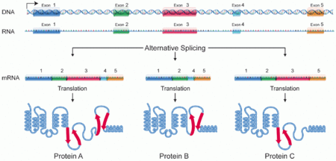
What are RNA isoforms?
Variants of RNA transcripts from the same gene, produced via alternative splicing, promoters, or polyadenylation.
Human genes generate an average of 8 RNA isoforms.
RNA isoforms can have distinct or opposing functions (e.g., BCL-XL vs. BCL-XS in apoptosis).

Slide 3
Why is studying RNA isoforms useful?
Limitation: Short-read RNA-seq collapses isoforms into a single measurement, oversimplifying the biology.
Challenge: Isoforms can have distinct functions, making it crucial to study them individually, especially in neurological diseases like Alzheimer’s and Parkinson’s.
Short-read RNA-seq (Illumina, Ion Torrent)
Long-read RNA-seq (PacBio, Oxford Nanopore)
Long-read RNA-seq is particularly useful for detecting RNA base modifications, isoform discovery, and ab initio transcriptome analysis, while short-read RNA-seq is more suitable for high-throughput gene expression profiling.

Slide 4
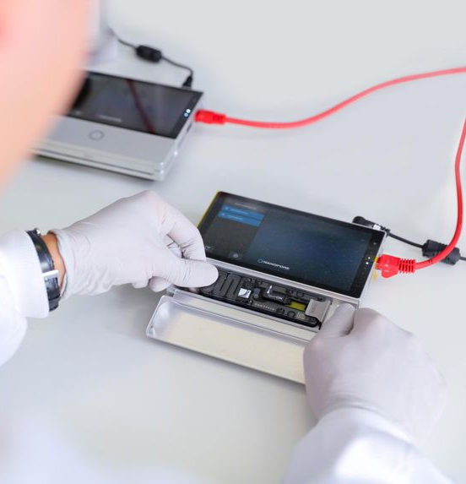
Goal of The Study
Investigate RNA isoform diversity in the human frontal cortex using long-read RNA-seq.
Focus on understanding isoform variation in medically relevant genes linked to neurological diseases.
Discover new isoforms and explore their medical relevance in Alzheimer’s and other brain-related diseases.
Oxford Nanopore

Slide 5
How Oxford Nanopore Sequencing Works

Slide 6
Methodology
Subjects:
12 postmortem human frontal cortex samples (6 Alzheimer’s disease patients, 6 controls).
Sequencing:
Long-read RNA-seq with Oxford Nanopore PromethION (35.5M reads per sample).
Analysis:
Data processed using bambu for isoform discovery and quantification.
Ensured high RNA integrity (RIN > 9.0).

Slide 8
RNA Isoform Quantification
Key Findings:
Total Isoforms: 28,989 isoforms from 18,041 genes.
Types: 20,183 protein-coding, 2,303 long non-coding RNAs, 3,213 retained introns, and others.
Expression Threshold: Isoforms considered expressed if CPM > 1.

Slide 9
Key Findings: RNA Isoforms in Medically Relevant Genes
1,917 genes expressed multiple isoforms in the frontal cortex.
1,018 genes had isoforms with distinct protein-coding sequences.
57 genes were associated with brain diseases (e.g., schizophrenia, Parkinson’s, Alzheimer’s).

Slide 10
Discovery of New Isoforms
New RNA Isoforms:
Discovered 53 new isoforms in medically relevant genes.
Example: TREM2 (linked to Alzheimer’s) has a newly discovered isoform skipping exon 2.
Other Notable Genes: MAOB, implicated in Parkinson’s, had 9% of its expression from a new isoform.

Slide 12
Differential RNA Isoform Expression
99 differentially expressed isoforms identified between Alzheimer’s patients and controls.
Key Example: TNFSF12 gene had two isoforms with opposing expression patterns—TNFSF12-219 upregulated in Alzheimer’s and TNFSF12-203 upregulated in controls.

Slide 13
Functional Insights from Isoform Studies
Distinct Functions of Isoforms:
Example: BCL-XL is anti-apoptotic, while BCL-XS is pro-apoptotic.
Changes in the expression ratio of isoforms can influence disease progression (e.g., cancer therapy targeting BCL-X isoforms).

Slide 17
Validation of Findings
Mass spectrometry (MS) and existing datasets (ROSMAP, GTEx) used to validate isoforms.
A small number of isoforms successfully validated at the protein level.

Slide 18
New Gene Body Discoveries
Identified 267 high-confidence isoforms from 245 new gene bodies (previously unannotated genomic regions).
94% validated with uniquely mapped reads in external datasets (GTEx, ROSMAP).

Slide 19
Medically Relevant Genes with Multiple Isoforms
APP (Amyloid Beta precursor protein): 5 distinct isoforms.
MAPT (Tau protein): 4 isoforms, important in Alzheimer’s.
BIN1: 8 isoforms, associated with Alzheimer’s.

Slide 20
Spliced Mitochondrial RNA Isoforms
Discovered 5 spliced mitochondrial RNA isoforms, containing two exons each.
This was unexpected, as previously annotated mitochondrial transcripts have only one exon.

Slide 21
Implications for Disease Diagnosis and Treatment
RNA isoform analysis can lead to new diagnostic tools and therapeutic targets.
Example: Differential expression of isoforms in Alzheimer’s provides potential biomarkers for early diagnosis or treatment.

Slide 23
Limitations of the Study
Small Sample Size: Only 12 samples (6 AD, 6 controls), limiting generalizability.
Sequencing Accuracy: Some isoforms difficult to quantify due to the complexity of long-read sequencing.

Slide 24
Future Directions
Larger Datasets: Needed to validate findings, especially in tissue-specific isoform expression.
Single-Cell Sequencing: Combining long-read sequencing with single-cell techniques could provide deeper insights into cell-type-specific isoform expression.

Slide 25
Conclusion
Summary of Findings:
Significant isoform diversity in medically relevant genes.
Discovery of new isoforms provides new insights into neurological diseases.
Differential isoform expression could reveal disease mechanisms and potential biomarkers.
Takeaway: Long-read RNA sequencing is crucial for understanding RNA isoform complexity and its role in human disease.

Slide 26
Thank you!
Reference:
Aguzzoli Heberle, B., Brandon, J.A., Page, M.L. et al. Mapping medically relevant RNA isoform diversity in the aged human frontal cortex with deep long-read RNA-seq. Nat Biotechnol (2024). https://doi.org/10.1038/s41587-024-02245-9
Student: Syed Yahya Raza
Professor: Dr. Xiaoman Li

