Slide 1
Epigenetic inheritance of diet-induced and sperm-borne mitochondrial RNAs (Tomar, et. al, 2024)
Rom Peles

Slide 2
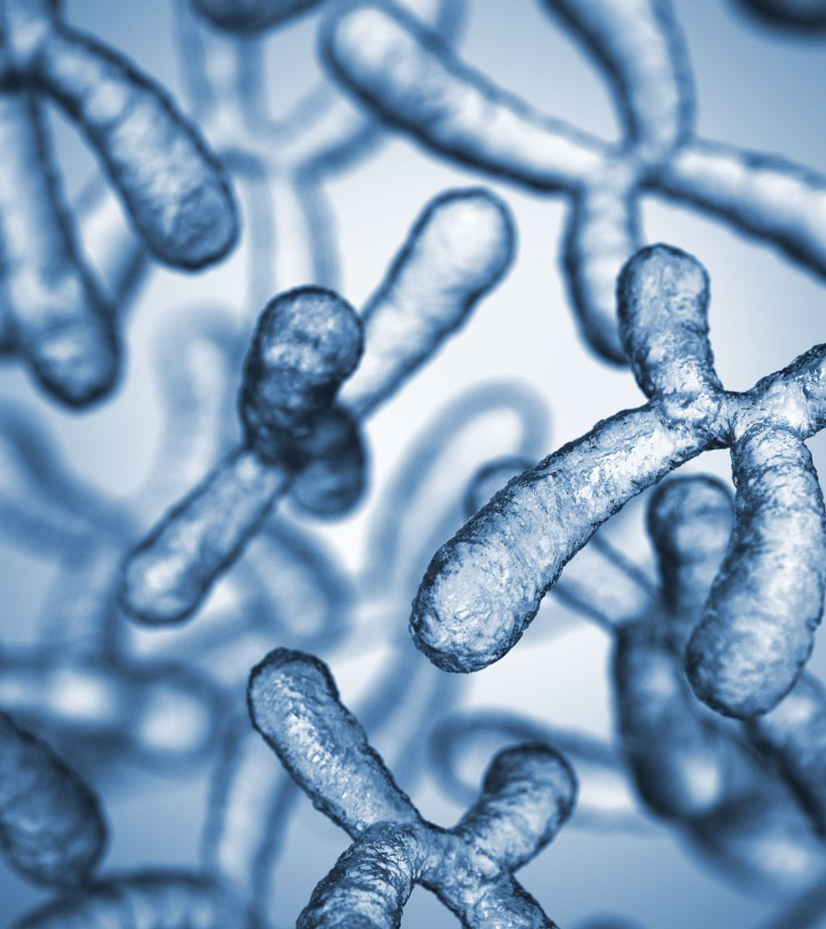
Background Information on sncRNAs
Prior to conception, spermatozoa have a collection of small non-coding RNAs (sncRNAs)
Previous research still unclear as to whether sncRNAs are known to be influenced by environmental factors (father’s lifestyle, stress, health, etc.)
Though established research is still murky, it suggests direct links between the presence/absence of specific sncRNAs and resulting phenotypes in offspring
Since offspring do not inherit mitochondria from father, suggests new method of heredity beyond Mendelian genetics

Slide 3
Background Information on Spermatozoa
Spermatozoa undergo two basic phases of development
~35 days in the seminiferous tubules
~7 days in the epididymis
Both stages are important for sperm development, but epididymal phase considered more sensitive to environment
Relationship between obesity in father and child long established, but mechanisms unclear and at what phase they transpires

Slide 4
Importance of sncRNAs
sncRNAs include
→ tRNA (transfer)
→ miRNA (micro)
→ piRNA (PIWI)
→ siRNA (small interfering)
→ snoRNA (small nucleolar)
, etc.
Study mostly focused on mtRNA (mitochondrial tRNAs) and their fragments (mt-tsRNAs)
Figure 1: Bresesti, Chiara, et al. “Long Non-Coding RNAS: Role in Testicular Cancers.” Frontiers, Frontiers, 5 Jan. 2021, www.frontiersin.org/journals/oncology/articles/10.3389/fonc.2021.605606/full.

Slide 5
mt-tRNAs and mt-tsRNAs
This study mostly focuses on expression levels related to
mtRNAs (mitochondrial transfer RNAs)
mt-tsRNAs (mitochondrial transfer small RNAs)
mt-tsRNAs are usually made from mtRNAs
Previous research has established that expression levels in each are related to metabolic changes and processes like oxidative stress
Sometimes, mt-tRNA levels rise, then fragment into mt-tsRNAs (inverse relationship)

Slide 6
Importance of mt-tRNAs and mt-tsRNAs
Functions of both not clearly established, especially mt-tsRNAs
Besides mitochondrial translation, more possible mt-tRNA ancillary functions undiscovered (involved in signalling pathways)
mt-tsRNAs may simply be natural byproduct of mt-tRNA production or decomposition
More likely that mt-tsRNAs involved in complex regulation of mt-tRNA expression and transcription levels for other genes

Slide 7
Aims of Study
Find out if sncRNAs in epididymal and/or developing germ cells in testes are influenced by diet, comparing high-fat and low-fat diets
1
If so, identify and quantify relative abundance of sncRNAs
2
Establish relationship between presence of mt-RNAs and mt-tsRNAs with mitochondrial function
3
Demonstrate non-Mendelian form of heredity and how paternal obesity can spread to offspring
4

Slide 8
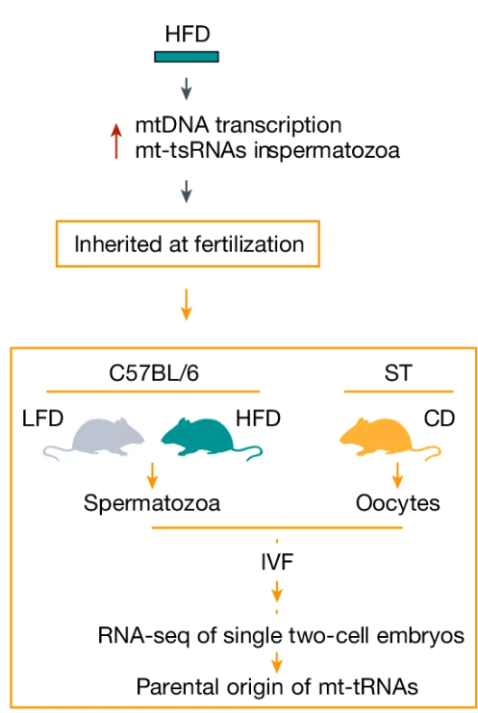
Mouse Experiments
Two cohorts of male mice were fed either a high-fat diet (HFD) or low-fat diet (LFD) for 2 weeks beginning once they reached 6 weeks of age
IVF performed with epididymal spermatozoa and oocytes
RNA sequencing done on embryos with special emphasis on mt-tRNAs and mt-tsRNAs
Profiled the transcriptomes of two-cell embryos to track parental origins of mtRNAs using SNPs
Figure 3A: Tomar, A., et al. “Epigenetic inheritance of diet-induced and sperm-borne mitochondrial RNAS.” Nature, vol. 630, no. 8017, 5 June 2024, pp. 720–727, https://doi.org/10.1038/s41586-024-07472-3.

Slide 9
Bioinformatics Methods/Materials

Slide 10
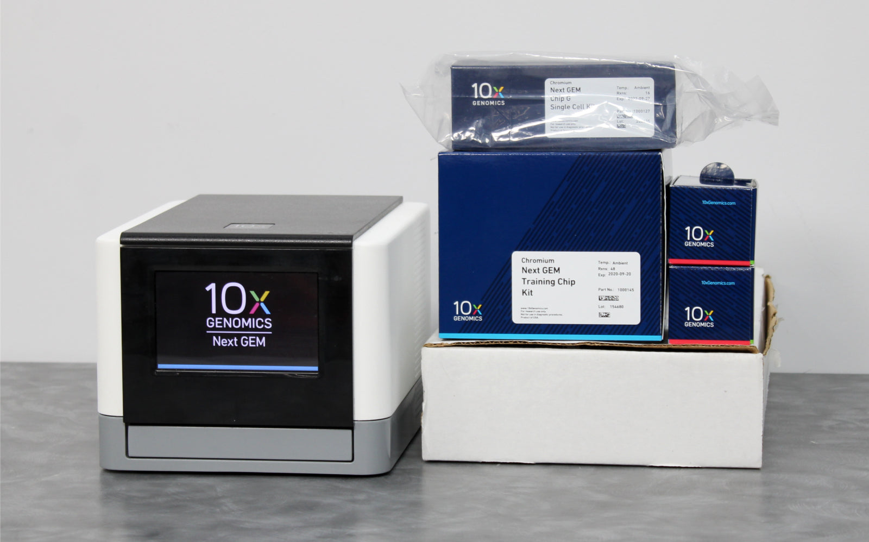
Machines Used
Ten thousand cells were targeted using the Chromium Next GEM Chip G Single Cell and the Chromium Next GEM Single Cell 3′ Gel Bead Kit v3.1
This chips enables analysis of gene expression of thousands of individual cells at the same time
cDNA synthesis and Chromium Next GEM Single Cell 3′ Library Kit v3.1 utilized for library preparation

Slide 11
Programs Used
The raw sequencing data were demultiplexed with Cell Ranger (10x Genomics) mkfastq to generate fastq files for each sample
The raw count gene expression data was used for differential gene expression analysis for all tested genes, and the data was shrunk using Deseq2
Deseq2 (cited >70,000x) Uses technique called shrinkage to sort through count data and remove outliers

Slide 12
Library samples underwent paired-end sequencing on an Illumina NovaSeq 6000 platform, using the recommended cycle count

Slide 13
Reads Mapping
Reads were trimmed using cutadapt. Trimmed and quality-filtered reads were used for further analysis.
Reads mapping and differential expression analysis performed via the A.I.R. (Artificial Intelligence RNA-Seq) software from Sequentia Biotech

Slide 14
Experiments and Results

Slide 15
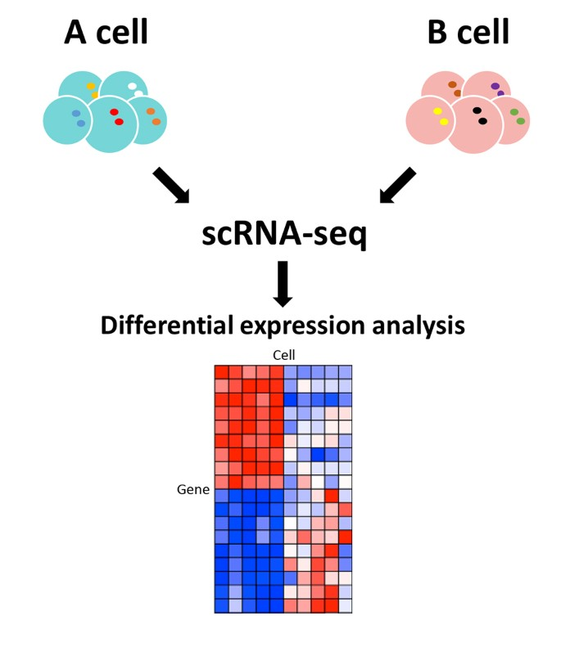
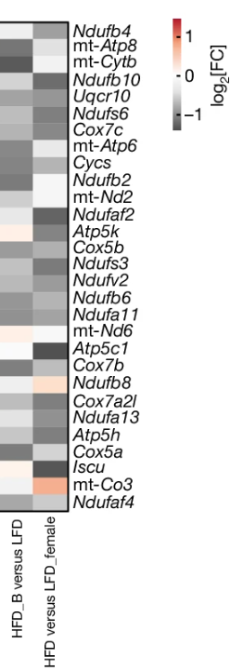
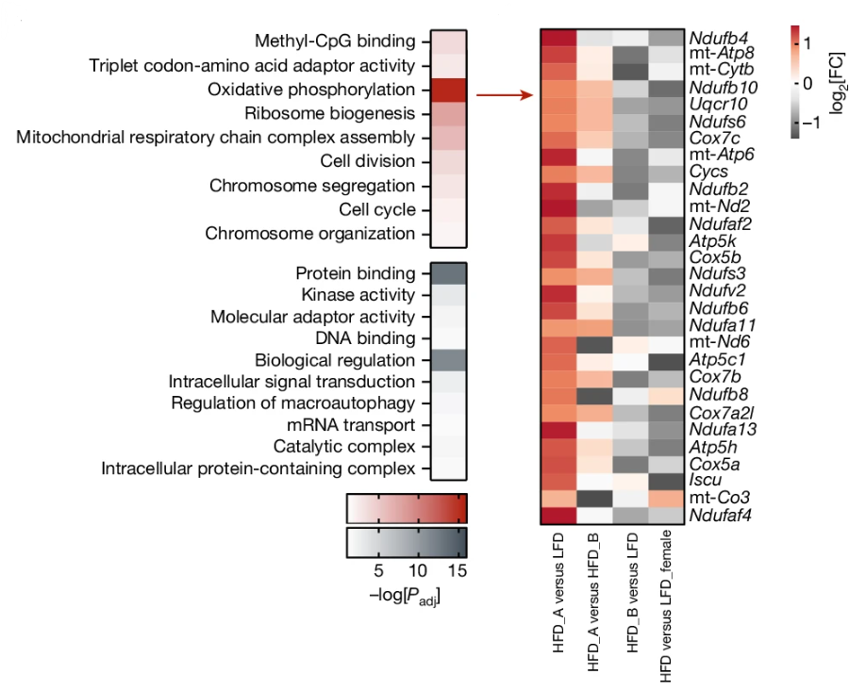
Findings
Differential gene expression analysis of embryos demonstrated differences in expression of specific clusters of genes
Genes related to mitochondria and oxidative phosphorylation were downregulated (coupled with upregulation of mtDNA transcriptional machinery).
Mt-tRNA and mt-tsRNA upregulation likely compensatory response to diet-induced mitochondrial dysfunction
Figure 4B, Figure 4C: Tomar, A., et al. “Epigenetic inheritance of diet-induced and sperm-borne mitochondrial RNAS.” Nature, vol. 630, no. 8017, 5 June 2024, pp. 720–727, https://doi.org/10.1038/s41586-024-07472-3.

Slide 16
Findings
Upregulation of mt-tRNAs in spermatozoa which then fragment into mt-tsRNAs suggestive of lower mitochondrial function (exact reason is unclear)
Expression level differences in genes more pronounced in male offspring
Variations in different types of sncRNAs also found

Slide 17
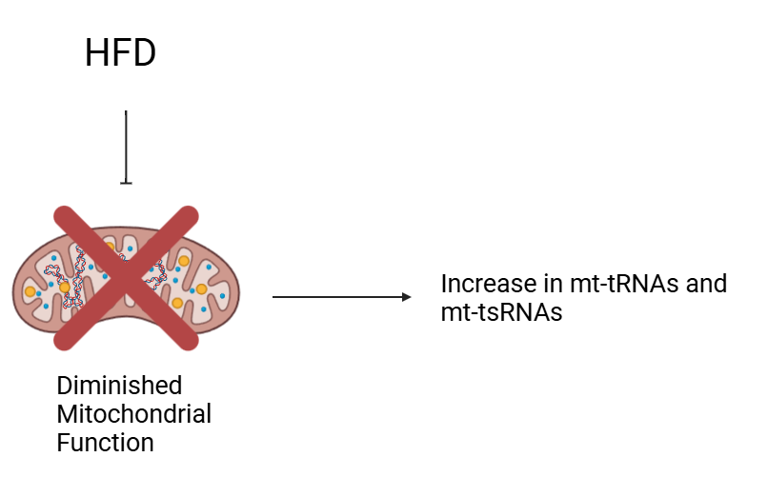

Slide 18
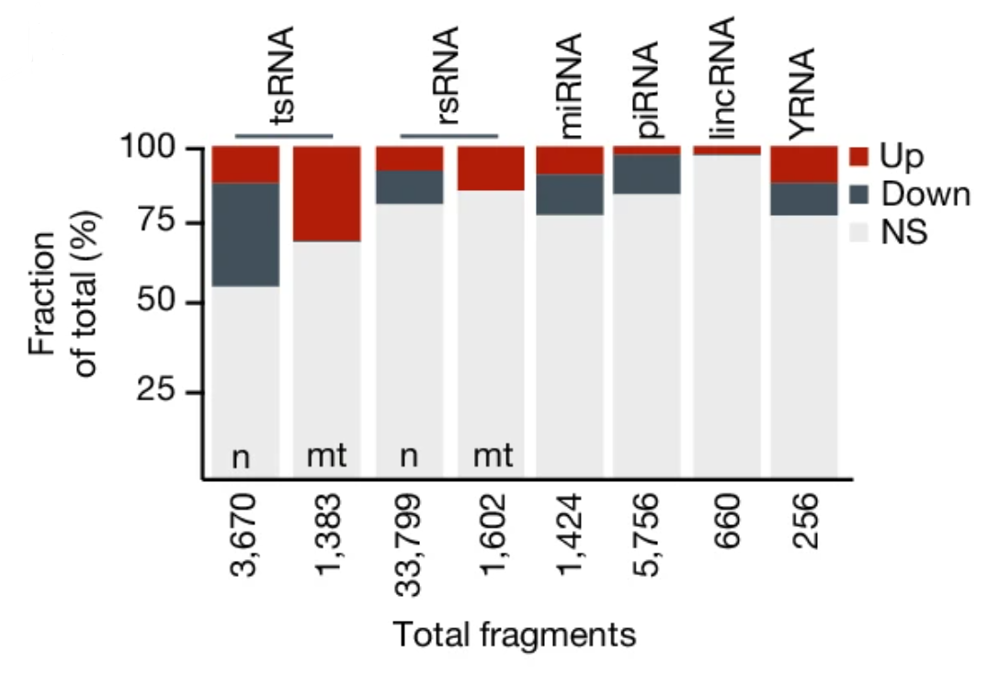
Figure 2B: Tomar, A., et al. “Epigenetic inheritance of diet-induced and sperm-borne mitochondrial RNAS.” Nature, vol. 630, no. 8017, 5 June 2024, pp. 720–727, https://doi.org/10.1038/s41586-024-07472-3.

Slide 19
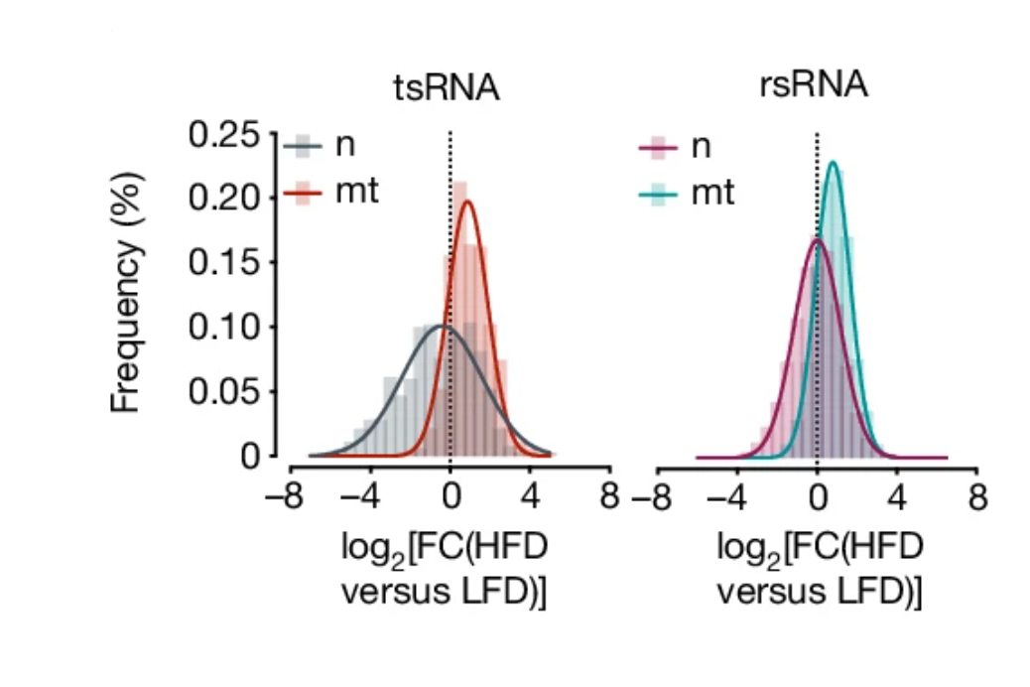
Figure 2C: Tomar, A., et al. “Epigenetic inheritance of diet-induced and sperm-borne mitochondrial RNAS.” Nature, vol. 630, no. 8017, 5 June 2024, pp. 720–727, https://doi.org/10.1038/s41586-024-07472-3.

Slide 20
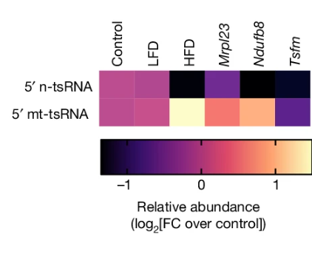
Figure 4J: Tomar, A., et al. “Epigenetic inheritance of diet-induced and sperm-borne mitochondrial RNAS.” Nature, vol. 630, no. 8017, 5 June 2024, pp. 720–727, https://doi.org/10.1038/s41586-024-07472-3.

Slide 21
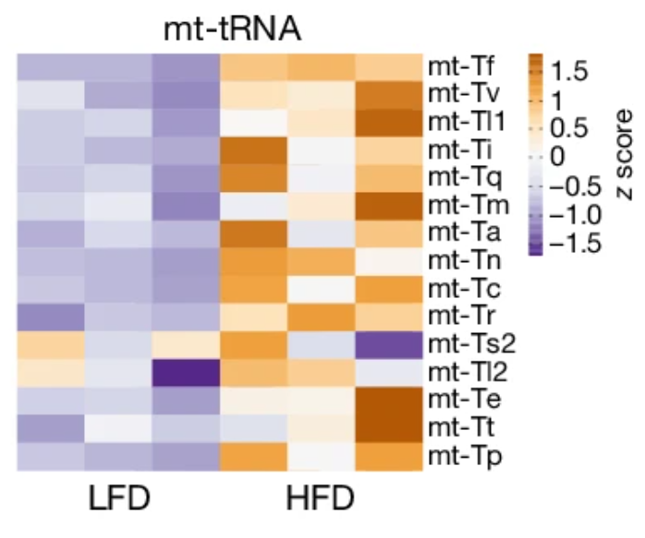
Figure 2H: Tomar, A., et al. “Epigenetic inheritance of diet-induced and sperm-borne mitochondrial RNAS.” Nature, vol. 630, no. 8017, 5 June 2024, pp. 720–727, https://doi.org/10.1038/s41586-024-07472-3.

Slide 22
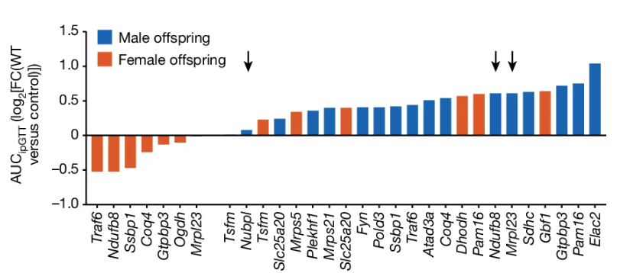
Figure 4H: Tomar, A., et al. “Epigenetic inheritance of diet-induced and sperm-borne mitochondrial RNAS.” Nature, vol. 630, no. 8017, 5 June 2024, pp. 720–727, https://doi.org/10.1038/s41586-024-07472-3.

Slide 23
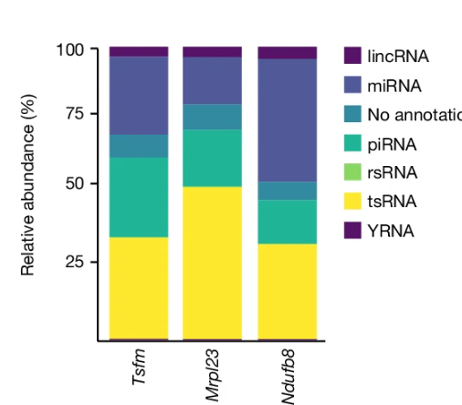
Figure 4I: Tomar, A., et al. “Epigenetic inheritance of diet-induced and sperm-borne mitochondrial RNAS.” Nature, vol. 630, no. 8017, 5 June 2024, pp. 720–727, https://doi.org/10.1038/s41586-024-07472-3.

Slide 24
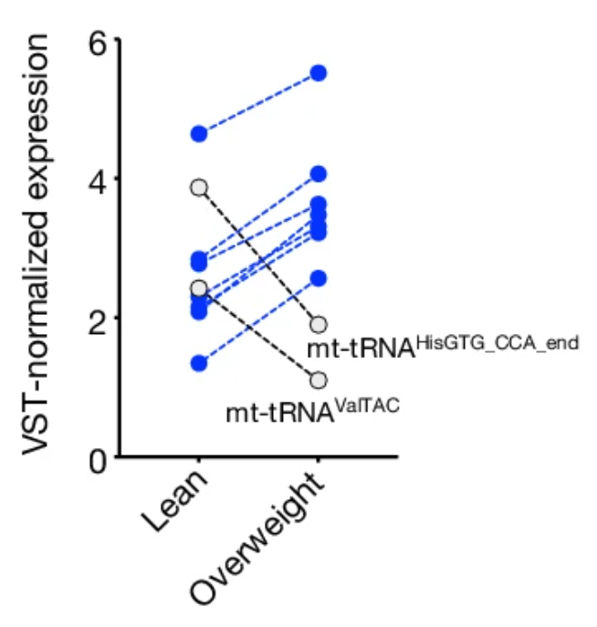
Additional Final Tests on Human Spermatozoa
mt-tsRNA levels tested via RNA-seq in human spermatozoa
Done to see if results from mice (HFD → upregulated mt-tsRNA relationship) are applicable to human subjects
Consistent with results from Mice (same genes also downregulated in both)
Figure 2G: Tomar, A., et al. “Epigenetic inheritance of diet-induced and sperm-borne mitochondrial RNAS.” Nature, vol. 630, no. 8017, 5 June 2024, pp. 720–727, https://doi.org/10.1038/s41586-024-07472-3.

Slide 25
Importance of Findings
Demonstrate new mechanism for fathers to transfer information to mitochondria of offspring
Offer potential method to determine spermatozoa health prior to fertilization and may offer potential diagnostic insight into health of father
Sheds further light on possible mechanism by which father’s weight is related to child’s likelihood of developing diabetes
Suggest that mt-tRNAs and mt-tsRNAS are related to body mass index (BMI) and indicative of paternal health

Slide 26
Future Directions
See if expression levels and high-fat diet causes shift from oxidative phosphorylation to glycolysis in offspring
See mechanisms for mt-tRNAs becoming mt-tsRNAs and the importance/further implication of this finding
Further elucidate exact functions and pathways related to mt-tRNAs and mt-tsRNAs
Look for more epigenetic relationships between father and child

Slide 27
References
1. “CUTADAPT.” Cutadapt, cutadapt.readthedocs.io/en/stable/. Accessed 14 Oct. 2024.
2. “DESEQ2.” Bioconductor, bioconductor.org/packages/release/bioc/html/DESeq2.html. Accessed 14 Oct. 2024.
3. Tomar, A., et al. “Epigenetic inheritance of diet-induced and sperm-borne mitochondrial RNAS.” Nature, vol. 630, no. 8017, 5 June 2024, pp. 720–727, https://doi.org/10.1038/s41586-024-07472-3.

