Slide 1
Oxford Nanopore R10.4 long-read sequencing enables the generation of near-finished bacterial genomes from pure cultures and metagenomes without short-read or reference polishing.
Mantas Sereika, Rasmus Hansen Kirkegaard, Søren Michael Karst, Thomas Yssing Michaelsen, Emil Aarre Sørensen, Rasmus Dam Wollenberg and Mads Albertson
Nature Methods 19, 823–826 (2022)
https://doi.org/10.1038/s41592-022-01539-7
Parker Tyson – BSC4434

Slide 2
Introduction/Background
Oxford Nanopore R10.4 long-read sequencing enables the generation of near-finished bacterial genomes from pure cultures and metagenomes without short-read or reference polishing.
This Photo by Unknown Author is licensed under CC BY-NC-ND

Slide 3
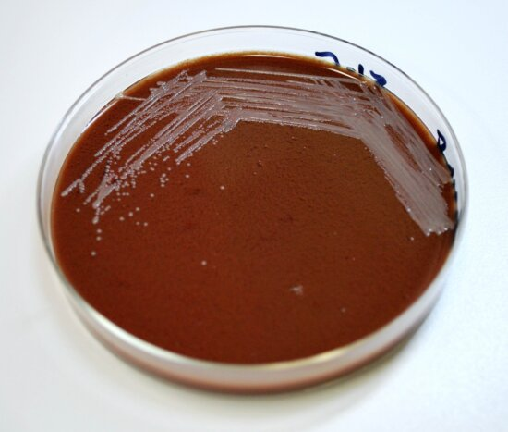
Microbial genome sequencing
This Photo by Unknown Author is licensed under CC BY-NC-ND
Metagenomic sampling
Pure culture

Slide 4
Traditional methods for generating near finished genomes
Illumina
R.9.4.1 Nanopore
PacBio HiFi
[1]
[4]
[5]

Slide 5
Genome Sequencing challenges
Homopolymer regions are portions of DNA where a single nucleotide is repeated many times. This makes it challenging to accurately count the number of repeated bases.
“AAAAAAAAAAAAA”
Long-read methods are more error prone and thus need short-read polishing.
+ Cost
+ Complexity
Near identical DNA
+ Time

Slide 6
Illumina
Low cost
Short read length (~150 bp)
Suffers with homopolymer regions
Struggles with metagenomic samples
Sequencing technology: Sequencing by synthesis. Sequencing Technology | Sequencing by synthesis. (n.d.). https://www.illumina.com/science/technology/next-generation-sequencing/sequencing-technology.html

Slide 7
Oxford R9.4.1 Nanopore
Low cost
Long read length
Suffers with modal read accuracy
Sequencing technology: Sequencing by synthesis. Sequencing Technology | Sequencing by synthesis. (n.d.). https://www.illumina.com/science/technology/next-generation-sequencing/sequencing-technology.html

Slide 8
Oxford R9.4.1 Nanopore Cont.
Shortcomings can be improved with Illumina polishing
Illumina + R9.4.1 increases quality of results
Polishing increases cost
Sequencing technology: Sequencing by synthesis. Sequencing Technology | Sequencing by synthesis. (n.d.). https://www.illumina.com/science/technology/next-generation-sequencing/sequencing-technology.html

Slide 9
PacBio HiFi
Most accurate technology
Long read length – good for homopolymer regions
Cost prohibitive
Sequencing technology: Sequencing by synthesis. Sequencing Technology | Sequencing by synthesis. (n.d.). https://www.illumina.com/science/technology/next-generation-sequencing/sequencing-technology.html

Slide 10
Oxford R10.4 Nanopore
Comparable accuracy to HiFi at coverages 40 or greater
Long read length – good for homopolymer regions
Great value (~1/5 of HiFi)
Minimal improvement with Illumina polishing
Sequencing technology: Sequencing by synthesis. Sequencing Technology | Sequencing by synthesis. (n.d.). https://www.illumina.com/science/technology/next-generation-sequencing/sequencing-technology.html

Slide 11
How Oxford Nanopore Sequencing works
1
Electric current flows through a “nanopore”
2
Long reads of DNA or RNA are fed through the nanopore
Changes in current are measured as nucleotides travel through the nanopore
Each nucleotide has a unique electrical current signature allowing for identification
3
How basecalling works: Oxford Nanopore Technologies. Oxford Nanopore Technologies. (n.d.). https://nanoporetech.com/platform/technology/basecalling

Slide 12
R9 Nanopore
Reader
~96% Modal Accuracy
One reader in nanopore
Reader
Oxford Nanopore Technologies. (n.d.). Accuracy. Oxford Nanopore Technologies. https://nanoporetech.com/platform/accuracy

Slide 13
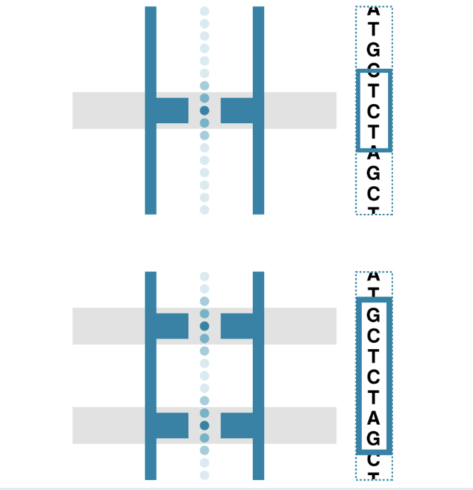
Nanopore R10.4 Improvements
Historically long-read nanopore sequencing was poor due to high error rate​
Oxford nanopore R10.4 long-read sequencing enables the generation of near-finished bacterial genomes from pure cultures and metagenomes without short-read or reference polishing​
Increased modal accuracy ~98%​
R9
R10
How basecalling works: Oxford Nanopore Technologies. Oxford Nanopore Technologies. (n.d.). https://nanoporetech.com/platform/technology/basecalling
Historically long-read nanopore sequencing was poor due to high error rate
Oxford nanopore r10.4 long-read sequencing enables the generation of near-finished bacterial genomes from pure cultures and metagenomes without short-read or reference polishing
Increased modal accuracy ~98%

Slide 14
R10.4 and Homopolymers
Main improvement of R10.4 vs R9.4.1 is with homopolymer reads
Improved accuracy with with homopolymers 10bp or less
Very few (~1%) genomes in this study contained homopolymers more than 10bp at regular frequency
Sereika, M., Kirkegaard, R.H., Karst, S.M. et al. Oxford Nanopore R10.4 long-read sequencing enables the generation of near-finished bacterial genomes from pure cultures and metagenomes without short-read or reference polishing. Nat Methods 19, 823–826 (2022). https://doi.org/10.1038/s41592-022-01539-7

Slide 15
Methods
Oxford Nanopore R10.4 long-read sequencing enables the generation of near-finished bacterial genomes from pure cultures and metagenomes without short-read or reference polishing.

Slide 16
Microbial sources
Zymo DNA standard
Sludge biomass from Fredericia Wastewater Treatment Plant
DNA Extraction
Qiagen
Then size selection below 10 kbp
DNA QC
Concentrations were measured with Qubit dsDNA HS kit
DNA size/distribution via Agilent 2200 Tapestation system
DNA purity through NanoDrop

Slide 17
Reference Genome
NCBI RefSeq genome database
Genome Quality
CheckM tool
QUAST Tool (indels)
Read Mapping
Bowtie2
Minimap2
Binning Tools
MetaBAT2
MaxBin2
Vamb

Slide 18
Results
Oxford Nanopore R10.4 long-read sequencing enables the generation of near-finished bacterial genomes from pure cultures and metagenomes without short-read or reference polishing.

Slide 19
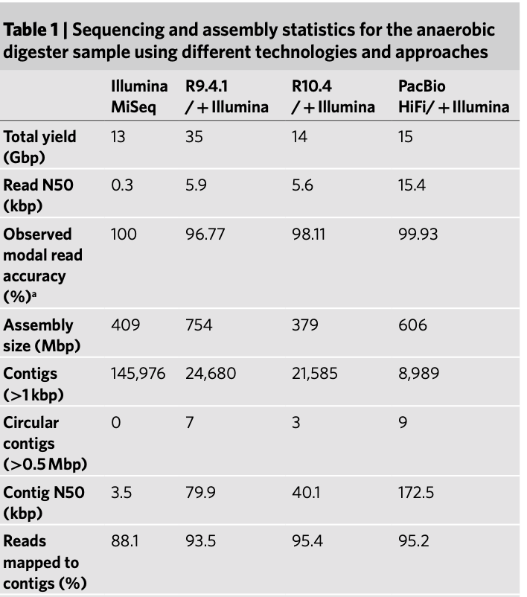
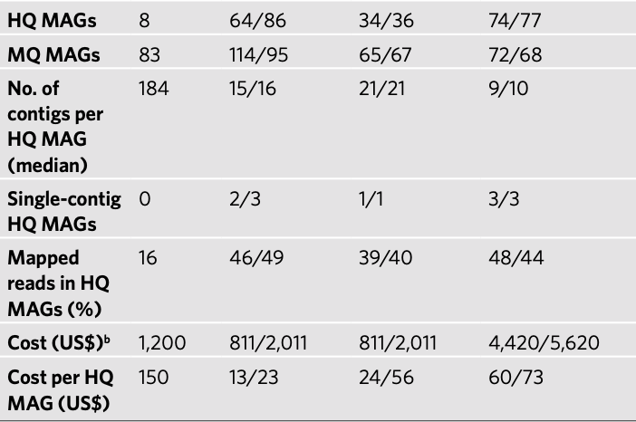
Data comparison​
Sereika, M., Kirkegaard, R.H., Karst, S.M. et al. Oxford Nanopore R10.4 long-read sequencing enables the generation of near-finished bacterial genomes from pure cultures and metagenomes without short-read or reference polishing. Nat Methods 19, 823–826 (2022). https://doi.org/10.1038/s41592-022-01539-7

Slide 20
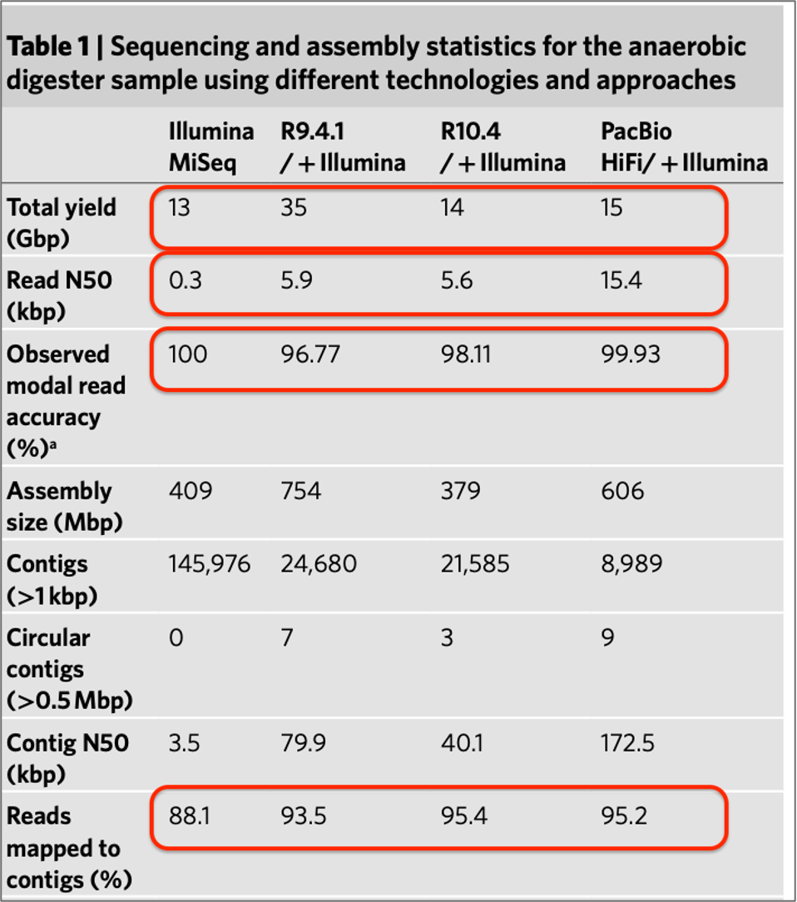
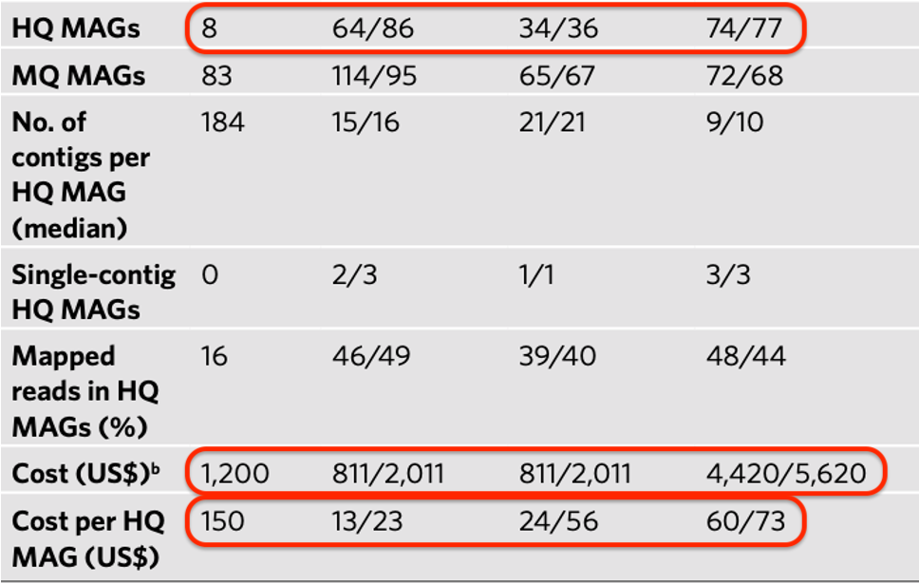
Data comparison​
Sereika, M., Kirkegaard, R.H., Karst, S.M. et al. Oxford Nanopore R10.4 long-read sequencing enables the generation of near-finished bacterial genomes from pure cultures and metagenomes without short-read or reference polishing. Nat Methods 19, 823–826 (2022). https://doi.org/10.1038/s41592-022-01539-7

Slide 21
Read Accuracies​
Sereika, M., Kirkegaard, R.H., Karst, S.M. et al. Oxford Nanopore R10.4 long-read sequencing enables the generation of near-finished bacterial genomes from pure cultures and metagenomes without short-read or reference polishing. Nat Methods 19, 823–826 (2022). https://doi.org/10.1038/s41592-022-01539-7

Slide 22
R10.4 vs R9.4.1 with homopolymers
Sereika, M., Kirkegaard, R.H., Karst, S.M. et al. Oxford Nanopore R10.4 long-read sequencing enables the generation of near-finished bacterial genomes from pure cultures and metagenomes without short-read or reference polishing. Nat Methods 19, 823–826 (2022). https://doi.org/10.1038/s41592-022-01539-7

Slide 23
Observed indels of de novo assemblies per 100 kbp at different coverage levels, with and without Illumina polishing
Sereika, M., Kirkegaard, R.H., Karst, S.M. et al. Oxford Nanopore R10.4 long-read sequencing enables the generation of near-finished bacterial genomes from pure cultures and metagenomes without short-read or reference polishing. Nat Methods 19, 823–826 (2022). https://doi.org/10.1038/s41592-022-01539-7

Slide 24
Discussion and Conclusions
Oxford Nanopore R10.4 long-read sequencing enables the generation of near-finished bacterial genomes from pure cultures and metagenomes without short-read or reference polishing.

Slide 25
Implications of R10.4
No need for Illumina polishing!
More Economical
Simplistic
Metagenomic Friendly

Slide 26
Oxford Nanopore 10.4 with high coverage produces results comparable to the accuracy standard, PacBio HiFi
Nanopore 10.4 is much more affordable than HiFi
Better results than previous similar cost methods
More accessible to researchers allows for higher quality research
Comparable to PacBio HiFi

Slide 27
Drawbacks of R10.4
Homopolymers >10 bp
Low coverage bins still require illumina polishing
LOWER THROUGHPUT THAN R9

Slide 28
Limitations of Study
Limited range of metagenomic samples
Some apple to oranges comparison

Slide 29
References
Sequencing technology: Sequencing by synthesis. Sequencing Technology | Sequencing by synthesis. (n.d.). https://www.illumina.com/science/technology/next-generation-sequencing/sequencing-technology.html
Sereika, M., Kirkegaard, R.H., Karst, S.M. et al. Oxford Nanopore R10.4 long-read sequencing enables the generation of near-finished bacterial genomes from pure cultures and metagenomes without short-read or reference polishing. Nat Methods 19, 823–826 (2022). https://doi.org/10.1038/s41592-022-01539-7
How basecalling works: Oxford Nanopore Technologies. Oxford Nanopore Technologies. (n.d.). https://nanoporetech.com/platform/technology/basecalling
Oxford Nanopore Technologies. (n.d.). Accuracy. Oxford Nanopore Technologies. https://nanoporetech.com/platform/accuracy
HiFi reads - highly accurate long-read sequencing. PacBio. (2024a, August 21). https://www.pacb.com/technology/hifi-sequencing/

Slide 30
Questions?

Slide 31
This Photo by Unknown Author is licensed under CC BY-SA-NC

