Slide 1
DETECTION of RNA using agoTRIBE (microRNA) AND scGRO-seq (nascentRNA) IN SINGLE CELLS
BIOMEDICAL INFORMATICS
SONAM GUPTA
FALL 2024

Slide 2
NATURE BIOTECHNOLOGY
VOLUME 42
AUGUST 2024
NATURE
VOL 631
JULY 2024

Slide 3
BACKGROUND
Single Cell
Transcriptomics
microRNA & nascentRNA
Enhancers & Gene
RNA-seq vs GRO-seq
agoTRIBE vs CLIP-seq

Slide 4
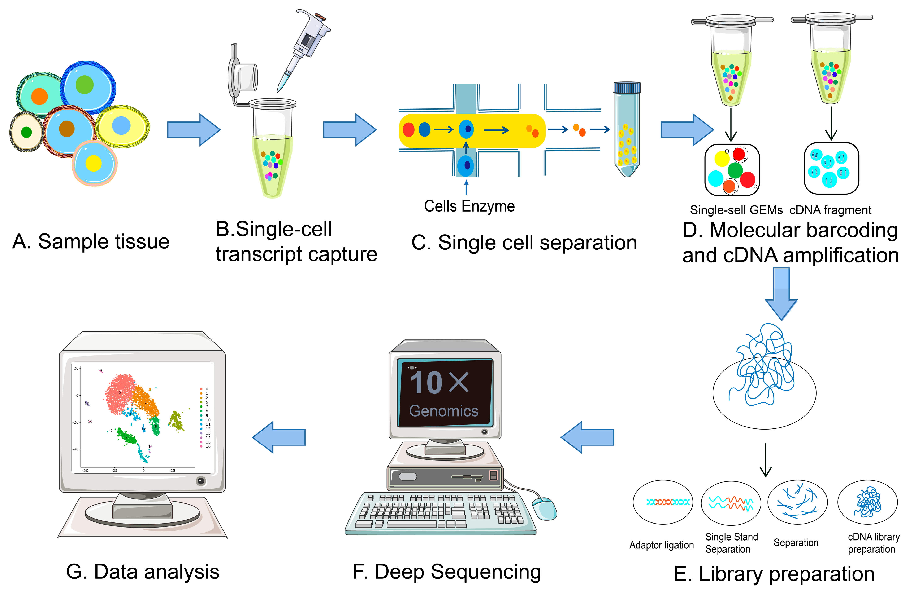
SINGLE CELL
https://www.mdpi.com/ijms/ijms-24-02943/article_deploy/html/images/ijms-24-02943-g001-550.jpg

Slide 5
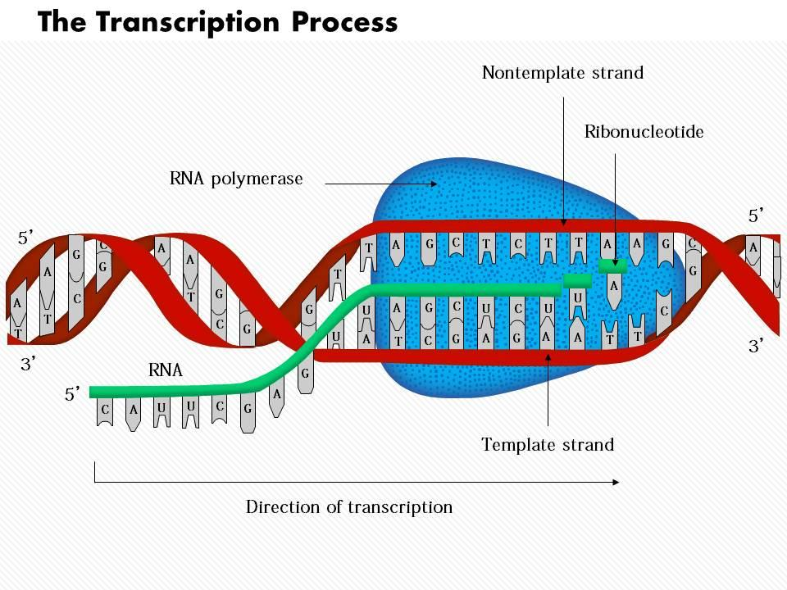
TRANSCRIPTION
https://cdn1.byjus.com/wp-content/uploads/2018/11/Central-Dogma-DNA-to-RNA-to-Protein.png
https://www.slideteam.net/media/catalog/product/cache/1280x720/0/9/0914_the_transcription_process_medical_images_for_powerpoint_Slide01.jpg

Slide 6
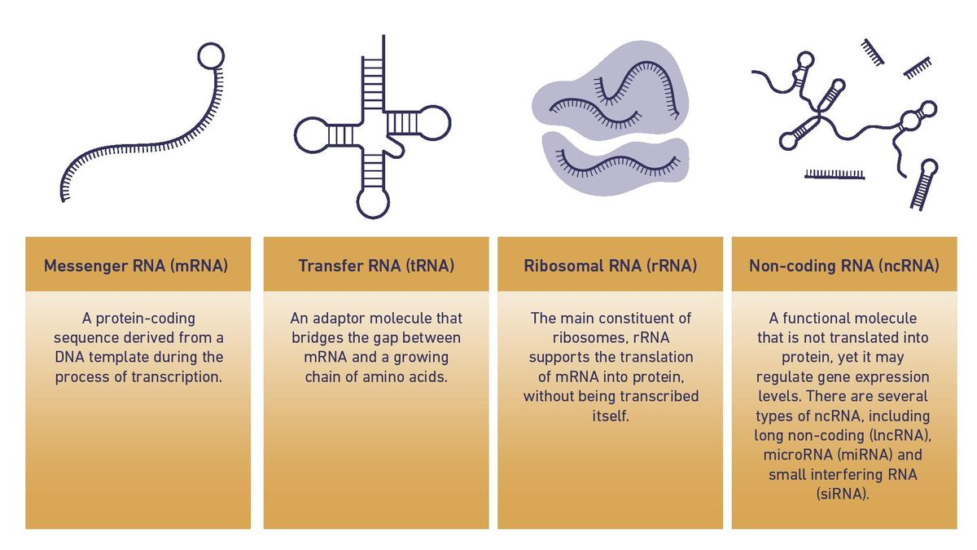
TRANSCRIPTOMICS
range of messenger RNA, or mRNA, molecules expressed by an organism
https://assets.technologynetworks.com/production/dynamic/images/body/55/64229-tn-mrna-articleimage-la-v1-l.webp?cb=12606418

Slide 7
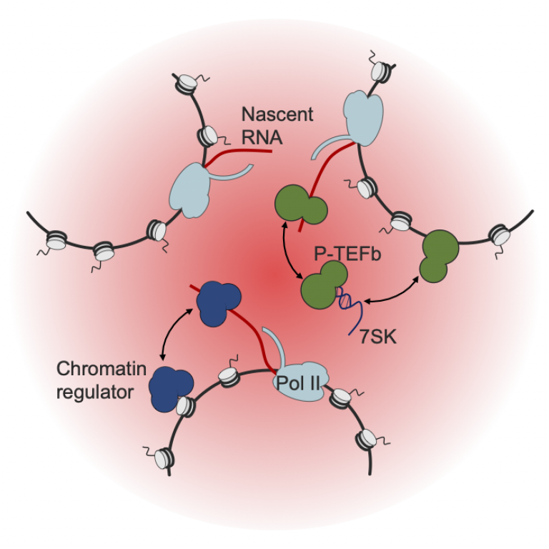
microRNA vs nascentrna
Small nc RNA that Post Transcr.. regulates gene expression
Measures gene/
enhancer activity
https://images.theconversation.com/files/561975/original/file-20231127-26-jqjjuh.png?ixlib=rb-4.1.0&q=45&auto=format&w=1000&fit=clip
https://www.ucl.ac.uk/cancer/sites/cancer/files/styles/large_image/public/rna_fig2_0.png?itok=pju7_aGD

Slide 8
ENHANCERS
Unstable RNA
Stable RNA
https://upload.wikimedia.org/wikipedia/commons/thumb/d/d7/Regulation_of_transcription_in_mammals.jpg/1000px-Regulation_of_transcription_in_mammals.jpg

Slide 9
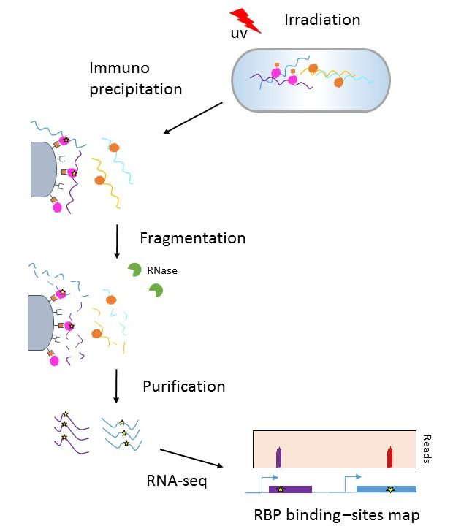
CLIP-seq
Cross Linking
Immuno Precipitation
Sequencing
Protein Binding Regions
CLIP-seq from A.E.Saliba 2017
https://www.france-genomique.org/technological-expertises/regulome/clip-seq/?lang=en

Slide 10
agotribe
Fusing the miRNA effector protein Argonaute2 to the RNA editing domain of ADAR2 allows the detection of miRNA targets transcriptome-wide in single cells.
agoTRIBE identifies functional miRNA targets supported by evolutionary sequence conservation.

Slide 11
Fig 1a-c: agoTRIBE Fuses AGO2 and editing domain of ADAR2
Schematic
Cytoplasmic localization
RNA binding protein of interest
RNA editing domain

Slide 12
Fig 2a-c: agoTRIBE detects miRNA targets through RNA editing
n=50K HEK-293T cells

Slide 13
Fig 2d-f: agoTRIBE detects miRNA targets through RNA editing
agoTRIBE resembles CLIP-seq method
n=1000 miRNA targets
n=1000 putative mRNA targets

Slide 14
Fig 2g-i: agoTRIBE detects functional miRNA targets through RNA editing
agoTRIBE provides sequence conservation evidence

Slide 15
Fig 2j-l: agoTRIBE detects miRNA targets through RNA editing
global miRNA inhibition by T6B
Schematic
609 TargetScan targets and 14,515 background transcripts
1,000 agoTRIBE targets (112 with seed sites) and 996 HITS-CLIP targets (62 with seed sites)

Slide 16
Editing with fusion protein does not alter transcriptome composition
703 agoTRIBE-transfected cells and 26 control cell
Fig 3a-d: miRNA Targeting in single cells

Slide 17
Fig 3e: miRNA Targeting in single cells

Slide 18
Fig 3f-o: miRNA Targeting in single cells
proof of principle that agoTRIBE can detect miRNA targeting both in single cells and across distinct populations of single cells.
n=540

Slide 19
Fig 3p-z: miRNA Targeting in single cells
proof of principle that agoTRIBE can detect miRNA targeting both in single cells and across distinct populations of single cells.

Slide 20
ADVANTAGES
No antibodies
Both ordinary bulk or scRNA-seq to detect editing events
Straightforward, applied to individual cells
Detects individual target sites, not binding sites

Slide 21
FUTURE DIRECTION
Study heterogeneity of miRNA targeting in homologous cell populations
Study miRNA targeting in organoids
The agoTRIBE fusion protein on an inducible promoter would allow profiling of miRNA targeting in individual cell types of complex tissues

Slide 22
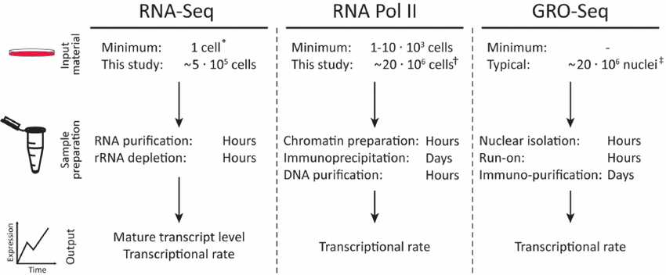
RNA-SEQ vs GRO-SEQ
https://www.researchgate.net/publication/270661379/figure/fig5/AS:295077697081347@1447363413165/Methods-overview-Outline-of-iRNA-seq-GRO-seq-and-RNAPII-ChIP-seq-methodologies.png

Slide 23
sc Global Run On-seq
A single-cell nascent RNA seq assay that uses click chemistry and unveils coordinated transcription throughout the genome.
scGRO seq can estimate burst size and frequency by directly quantifying transcribing RNA polymerases in individual cells
It can also use non-polyadenylated histone gene transcription to elucidate cell cycle dynamics.
Spatial-temporal resolution helps identify network of enhancers and genes

Slide 24
Development of scGRO-seq Click Chemistry
Label nascent RNA + modified nucleotide triphosphate (NTPs) that are compatible with Copper (I)-catalyzed azide-alkyne cycloaddition (CuAAC or click chemistry) to measure genome-wide nascent RNA quantitatively
This study used 2635 individual mouse embryonic stem cells and found that transcription initiates at enhancers (before gene)!

Slide 25
FIG 1a: Schematic and benchmarking of single-cell nascent RNA sequencing
Schematic
Nascent RNA labelled with prop-argyl
Click Chemistry

Slide 26
FIG 1b: Schematic and benchmarking of single-cell nascent RNA sequencing
Representative genome browser screenshots
GENE
ENHANCER
17 batches of scGRO–seq experiments with 39 96-well plates and 3,744 cells, of which 36 plates and 2,635 cells passed the threshold!

Slide 27
FIG 1c-f: Schematic and benchmarking of single-cell nascent RNA sequencing
A snapshot of genome-wide transcription at various cell resolutions
Gene
Enhancer
UMIs per cell
n=19K
n=12K
n=10K

Slide 28
FIG 2a-f: Inference of transcription kinetics using scGRO-seq
scGRO seq facilities study of transcription burst kinetics at single cell level
(n = 13,142).

Slide 29
FIG 2g-h: Inference of transcription kinetics using scGRO-seq
scGRO seq facilities study of transcription burst kinetics at single cell level
Burst size >1
Burst frequency
Gene Enrichment – TF role in burst freq & size

Slide 30
FIG 3a-d: Cell cycle inference by non-polyadenylated replication-dependent histone gene expression
Cell cycle inference from histone genes
Lack of polyadenylation
Heat Map
-40%
+20%
n=122,479 and 244 cells
Extended S phase = low transcription level

Slide 31
FIG 4a-c: Coordinated transcription of functionally related genes
Co-transcription of interdependent genes

Slide 32
FIG 5a, b, d: spatial and temporal coordination between genes and enhancers
Enhancer-Gene temporal coordination

Slide 33
FIG 5c: spatial and temporal coordination between genes and enhancers
Enhancer-Gene temporal coordination

Slide 34
Advantages & Disadvantages
- Less efficient
- Limited nascent RNA per cell at any given time
- Preservation of nuclear integrity
+ Assessment of co-transcription
+ Prediction of enhancer gene regulatory networks
+Multimodality

Slide 35
Future direction
Optimized biochemical steps to replace multiple rounds of nascent RNA purification and nucleic acid ligation with click chemistry
Adaptations such as high-throughput droplet encapsulation and enhanced capture efficiency for research and clinical settings
The adaptability and efficiency of scGRO-seq help study investigational dynamics and regulatory mechanisms across diverse biological contact

Slide 36
THANK YOU
QUESTIONS?

