Slide 1
Single-Cell Atlas of Human Brain Vasculature
Ji Chang
University of Central Florida, Biomedical Sciences, Ph.D
Dr. Xiaoman Li
PCB5596 Fall 2024

Slide 2
OUTLINE
Introduction: Single-cell atlas of human brain vasculature
Paper 1: Single-cell atlas of the human brain vasculature across development, adulthood and disease
Result 2: A single-cell atlas of the normal and malformed human brain vasculature
Conclusion/Perspectives

Slide 3
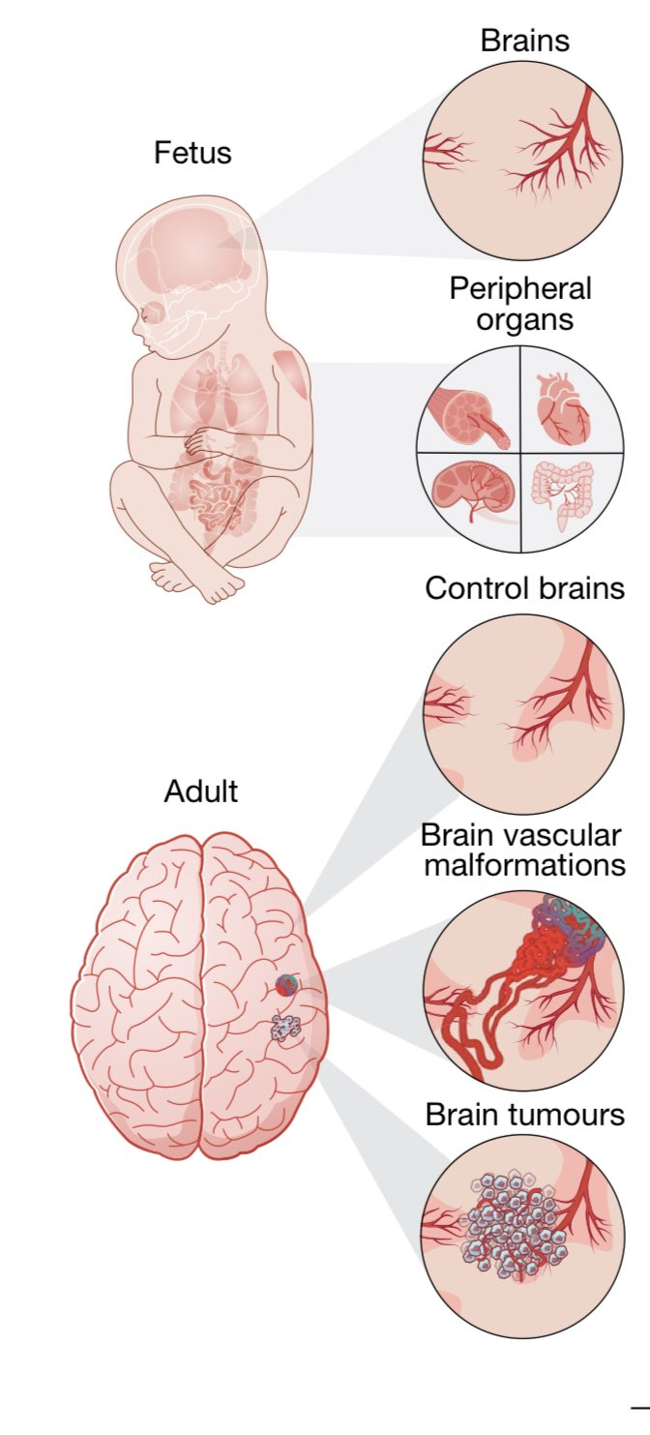
Single-Cell Brain Atlas
A comprehensive reference atlas of individual single brain cells
Provides insights into the molecular architecture and heterogeneity of the developing adult and diseased human brain vasculature
Creating this will allow us to understand disease, and help to develop targeted therapies.

Slide 4
Paper 1
Single-cell atlas of the human brain vasculature across development, adulthood and disease

Slide 5
Experimental Workflow and Validation
117 samples taken from human fetuses and adult patients for control and diseased states

Slide 6
Construction of molecular sc-atlas
The EC from the assorted samples showed prominent transcript heterogeneity and distinct gene expression signatures.
The heat maps indicate the different expression of the top genes and compares the fetal versus adult control brain endotheliums
There are a total of 997 common dysregulated pathways between fetal and adult
Notes:
b. Red shows high expression, blue shows low expression, and white shows intermediate expression.
c. Shows the comparison of the adult vs the fetal brains dotplot heatmap where c represenets pathological, d represents brain vascular malformation, e represents brain tumors in brain endothelium, and f represents the signatures based on differential gene expression analyses

Slide 7
IF Imaging of Tissues Sections
The arrows indicate an absence of expression in blood vessel ECs throughout the different tissue.
These images confirm that there are differential expression of PLVAP and ESM1 in fetal and adult diseased brain samples
These data sets indicate that the signals driving vascular growth during fetal development are silenced in the adult control brain and reactivated in brain tumors

Slide 8
UMAP of Fetal and Adult Pathological Brain
UMAP plot of the 243,521 fetal and adult/control pathological brains among 5 fetal 9 adult and 29 pathological individuals.
This plot shows the subclusters arranged according to AV zonation grouped into 14 major EC clusters

Slide 9
Inter-tissue heterogeneity and AV zonation of brain vascular EC
Provides insights into the molecular architecture and heterogeneity of the developing adult and diseased human brain vasculature
Notes:
10x genomics chromium system

Slide 10
Inter-tissue heterogeneity and AV zonation of brain vascular EC
These data sets show the signaling patterns of different EC subtypes and their overall signal strength
Angiogenic capillaries displayed upregulation of several signalling pathways including diseased, fetal, and adult control brain

Slide 11
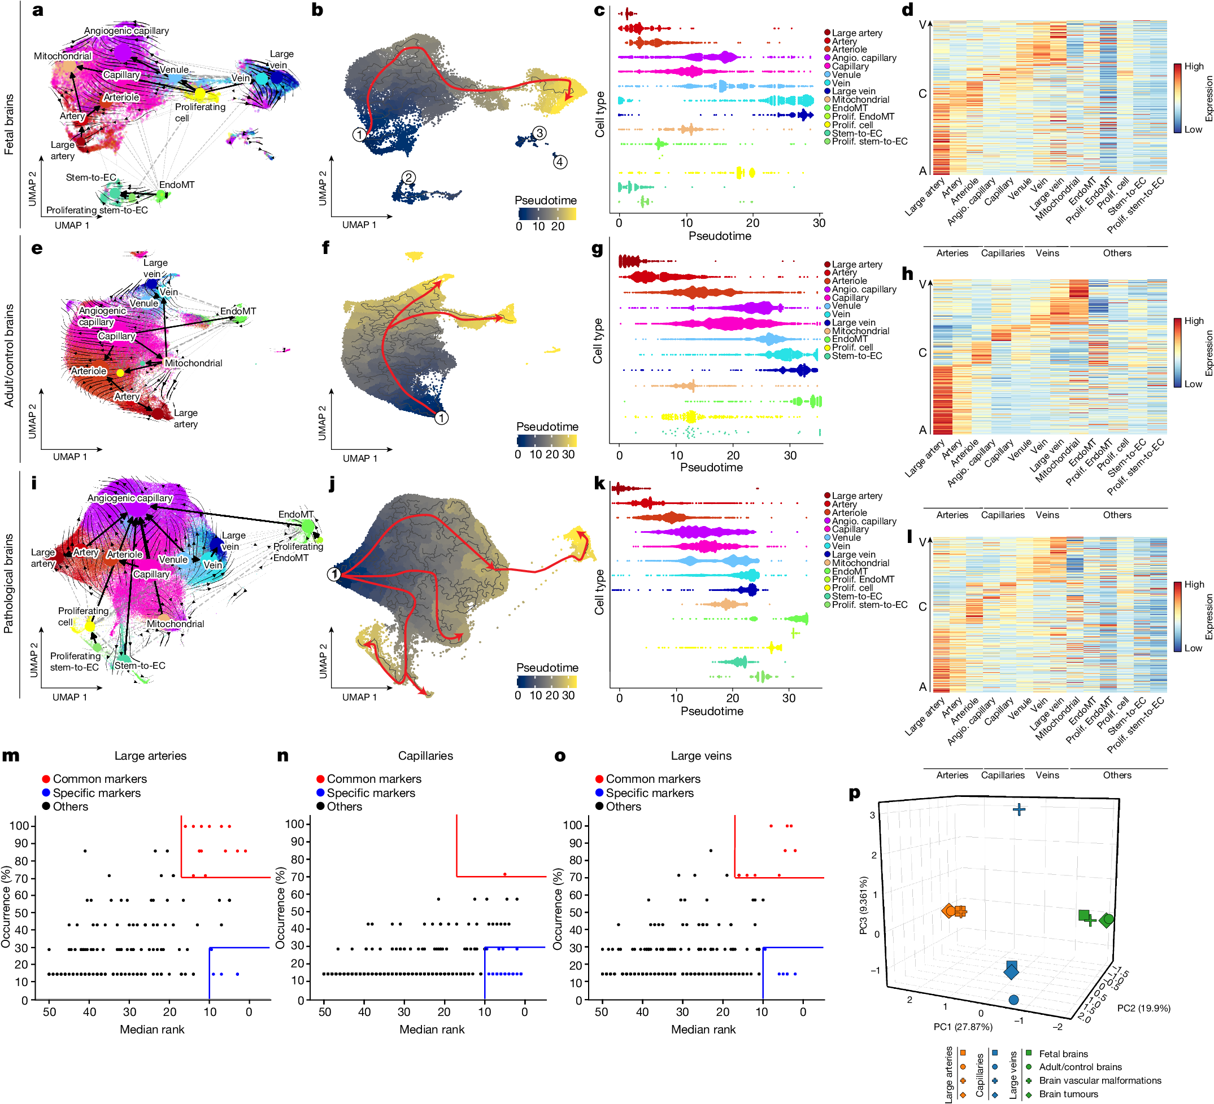
UMAP plots of fetal, adult, and pathological brain by AV specification

Slide 12
Common and Tissue-Specific Markers in ECs
Capillaries showed more tissue-specific markers compared to large arteries and veins, which shows higher susceptibility of capillary EC to microenvironment tissues

Slide 13
UMAP Plots of CNS and CNS Singature Analysis
CNS properties were observed in fetal and adult brains while the pathological brains had an alternate CNS signature and different peripheral signature

Slide 14
Alteration of CNS Specificity In Pathological Brain Vascular EC
The arrowheads indicate blood-vessel ECs expressing the indicated markers in different tissues

Slide 15
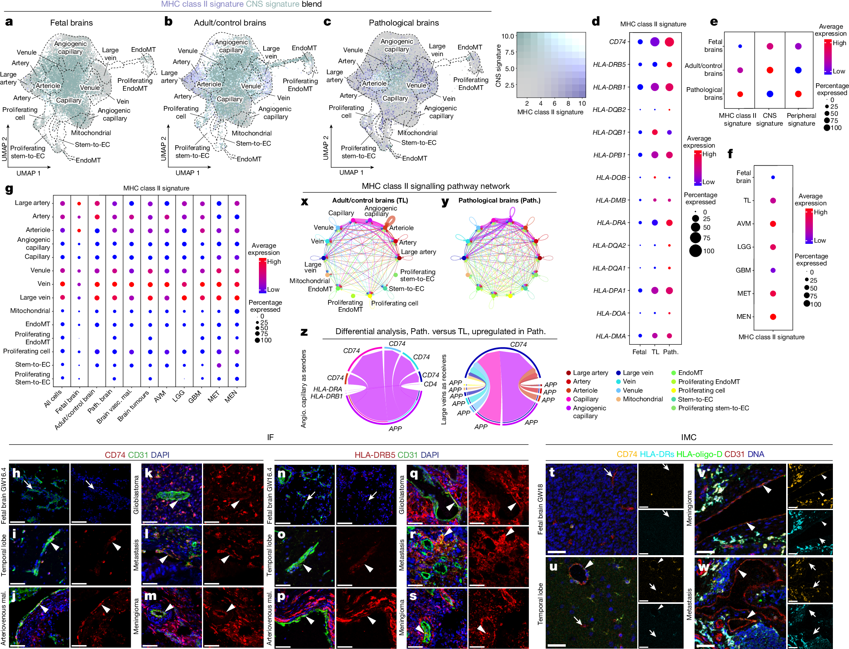
Upregulation of MHC Class II receptors in Pathological Brain Vasculature

Slide 16
Upregulation of MHC Class II receptors in Pathological Brain Vasculature
The arrowheads indicate ECs expressing their indicated marker

Slide 17
Summary
This paper demonstrates a large-scale single-cell molecular atlas of a developing fetal, adult/control, and pathological diseased human brain at a very high resolution and detailed data processing
This data allows for an understanding of organizing principles and single-cell heterogeneity at a genetic level
This paper uses developing fetal, adult/control, and diseased human brain vasculature

Slide 18
Paper 2
A single-cell atlas of the normal and malformed human brain vasculature

Slide 19
Importance of this research
Currently, we lack a comprehensive atlas of cerebrovascular cells in the human brain which disables us to have a better understanding of disease mechanisms and therapeutic strategies
This research will go into creation of a cell atlas for the adult human brain and arteriovenous malformations (AVMs)

Slide 20
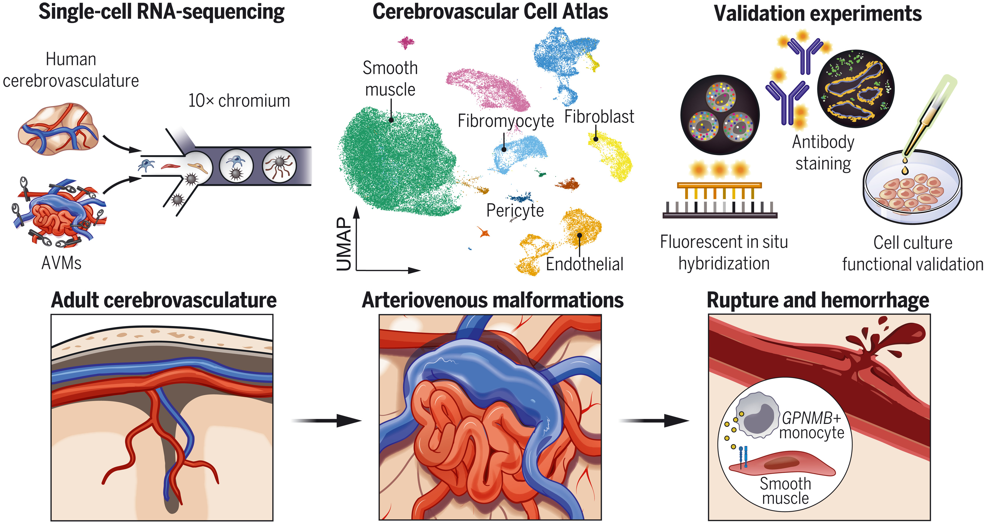
The Adult Human Cerebrovascular Cell Atlas

Slide 21
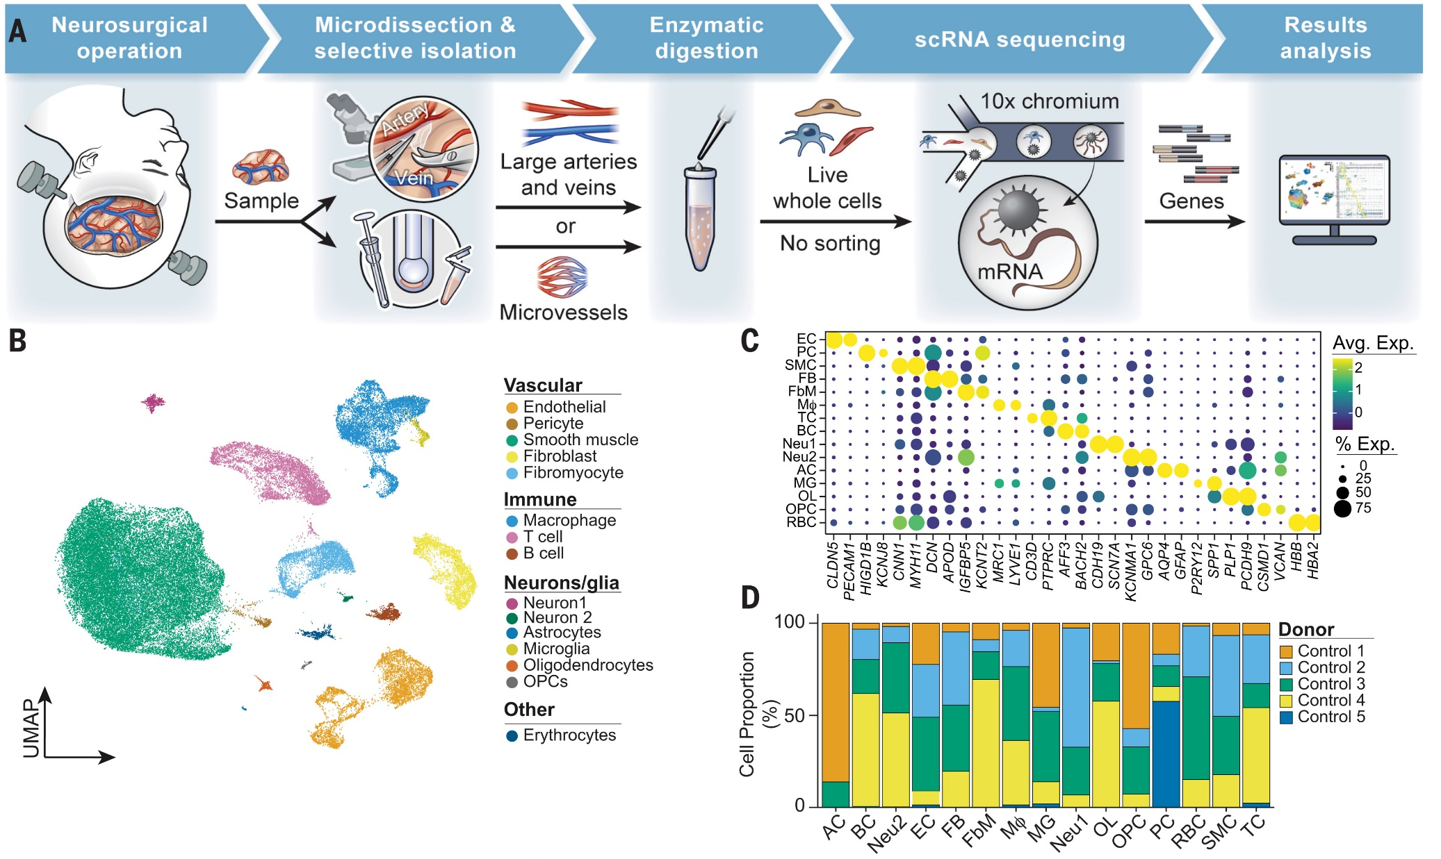
Cells Of The Human Cerebrovasculature and Methodology
scRNA-seq was performed on 181,388 individual cells and more than 40 defined cell states were identified from AVM’s.

Slide 22
Cells of the Human Cerebrovasculature
They identified two clusters of DCN and APOD perivascular fibroblasts which confirms presence of perivascular fibroblasts
Notes:
Three clusters of cells were identified in Arterial zonation
Able to identify three clusters of endothelial cells within arterial zonation
Three of perivascular cells

Slide 23
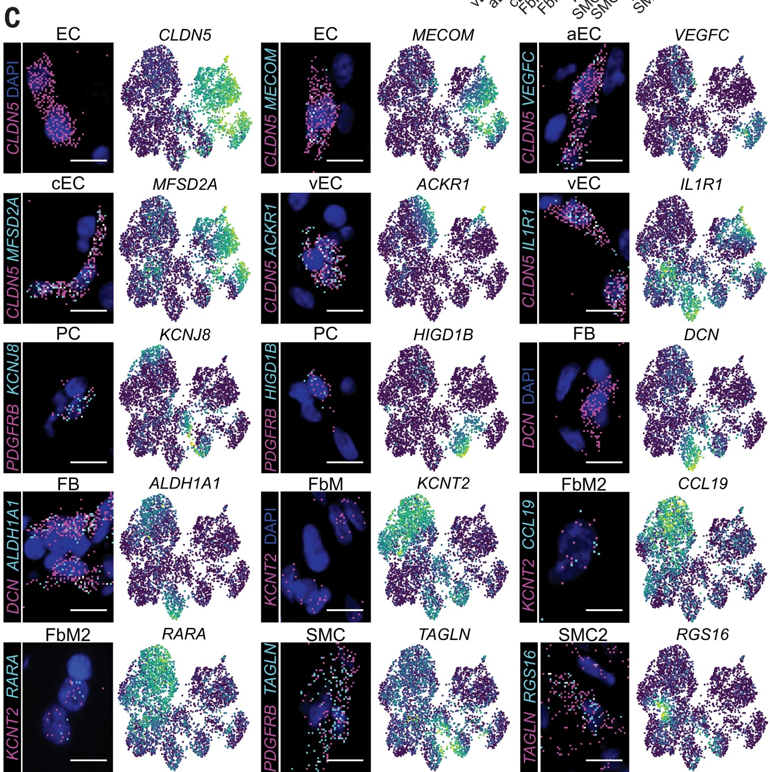
Spatial RNA Resolves Cells of the Human Cerebrovasculature
The UMAP visualization defined by cell gene expressions are quantified, assigned to cells, and plotted among different cells.
Fibromyocytes and perivascular fibroblasts may be endogenous sources of retinoic acid in the adult human brain

Slide 24
Cell Sampling and Isolation with Representative Microscopy

Slide 25
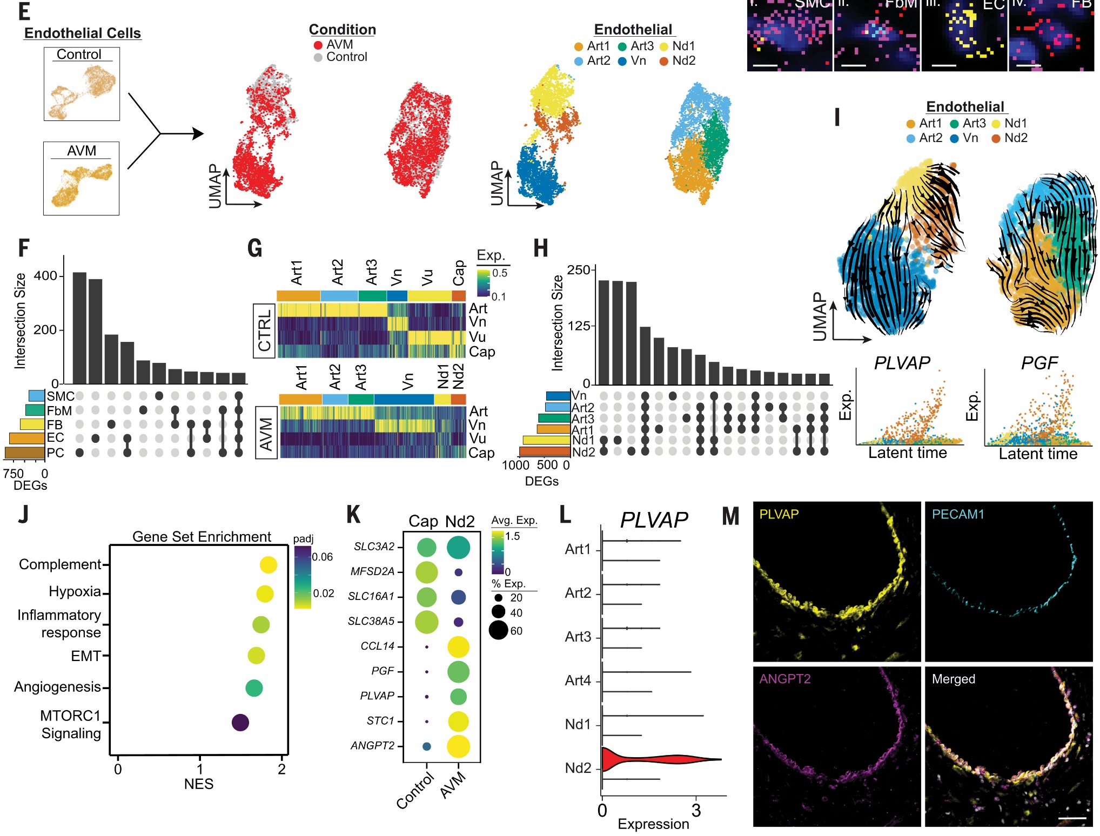
Cellular Aberrancy in the Malformed Cerebrovasculature

Slide 26
Cerebrovascular Inflammation With Malformation
These UMAP visuals and data show that the coembedded immune cells are distinct in the composition of different cells
This data indicates that the immune cell microenvironment changes with cerebrovascular-derived inflammation

Slide 27
Cerebrovascular Inflammation with Malformation

Slide 28
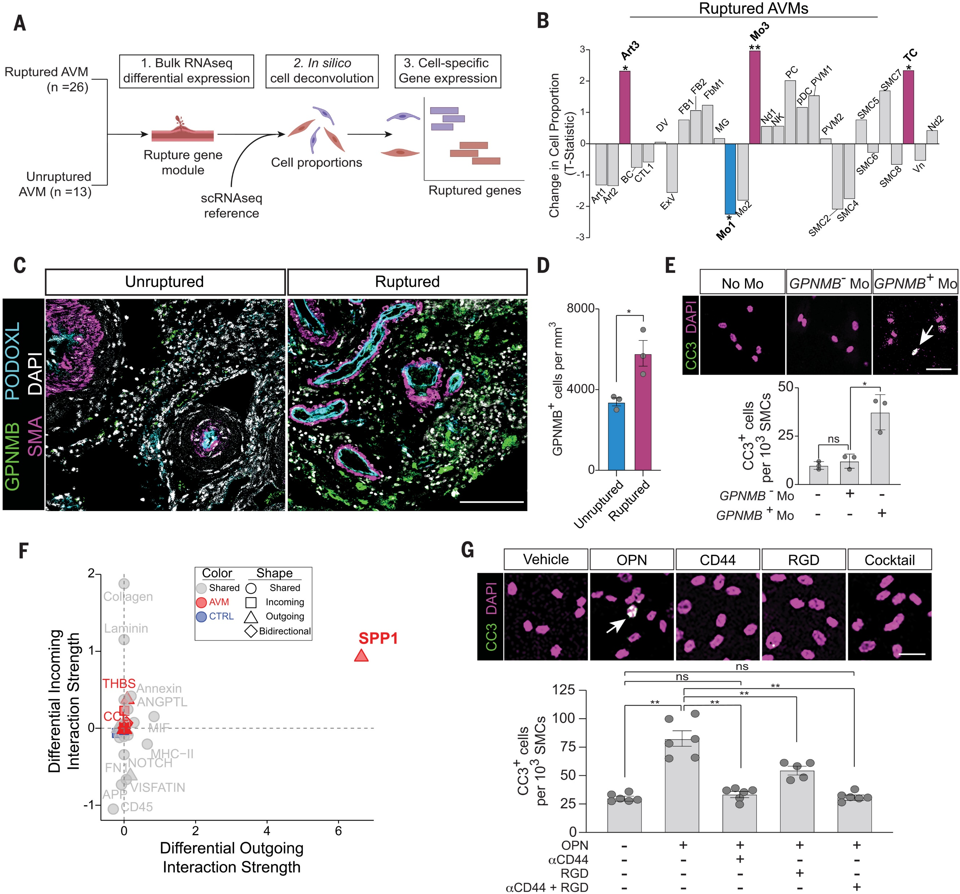
Cell States Implicated in Brain AVM Rupture
The ruptured gene module and unruptured gene module was recorded and gene expression was extracted and compared
This data shows the different cells and their states when implicated in an AVM rupture

Slide 29
Summary
This paper presents a cell-resolution atlas that looks into transcriptomic heterogeneity and cell function and interaction in the human adult cerebrovasculature.
This atlas has many possibilities for clinical medicine and applications with its defined cellular and gene expression changes in AVMs.
This cell atlas is able to understand single cell heterogeneity and its interaction in the human cerebrovasculature.

Slide 30
Conclusion/Perspectives

Slide 31
Conclusion
Both papers show the strides towards a better understanding of the human brain vasculature in developing brains, adult, and pathological diseased brains.
Some future works for this paper would be collecting single-cell atlas application towards other brain vascular diseases.

Slide 32
Thank You! Questions?
i

Slide 33
Supplemental Information
3

Slide 34
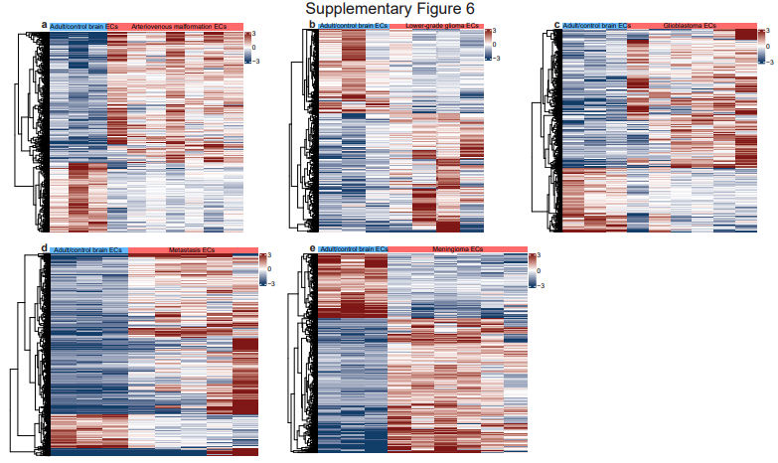
Supplemental
iii

Slide 35
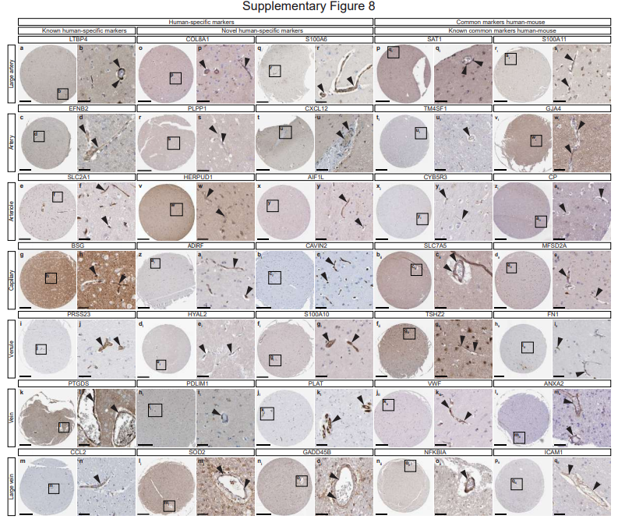
Supplemental
iii

Slide 36
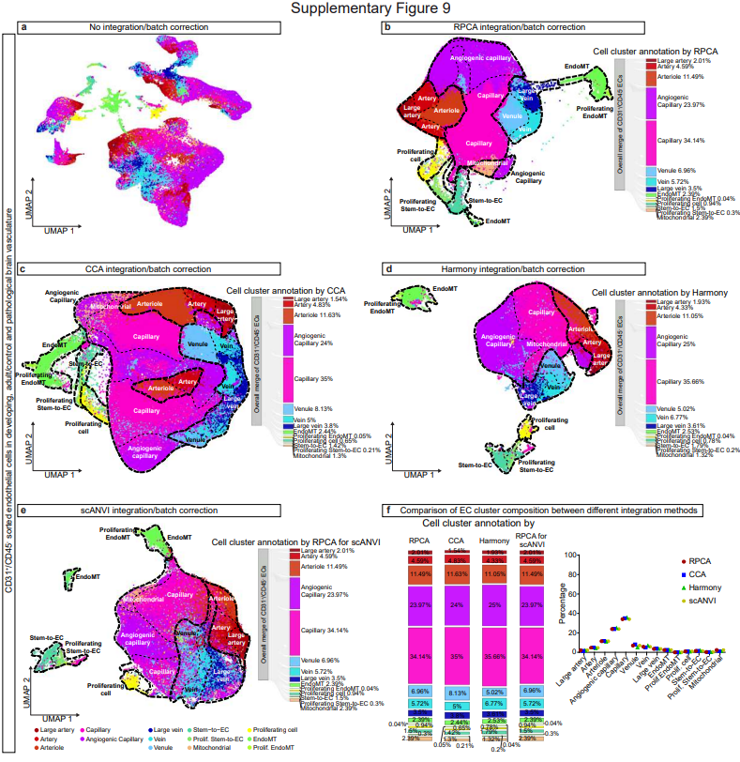
Supplemental
iii

Slide 37
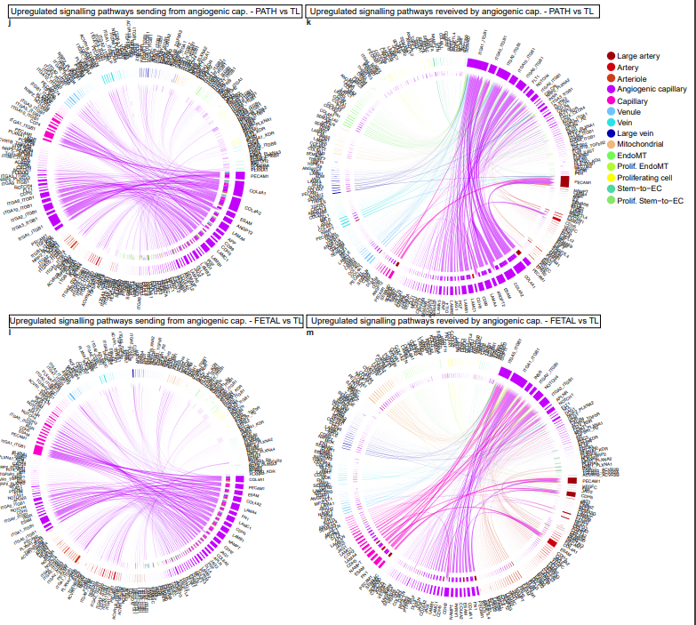
Supplemental
iii

