Slide 1
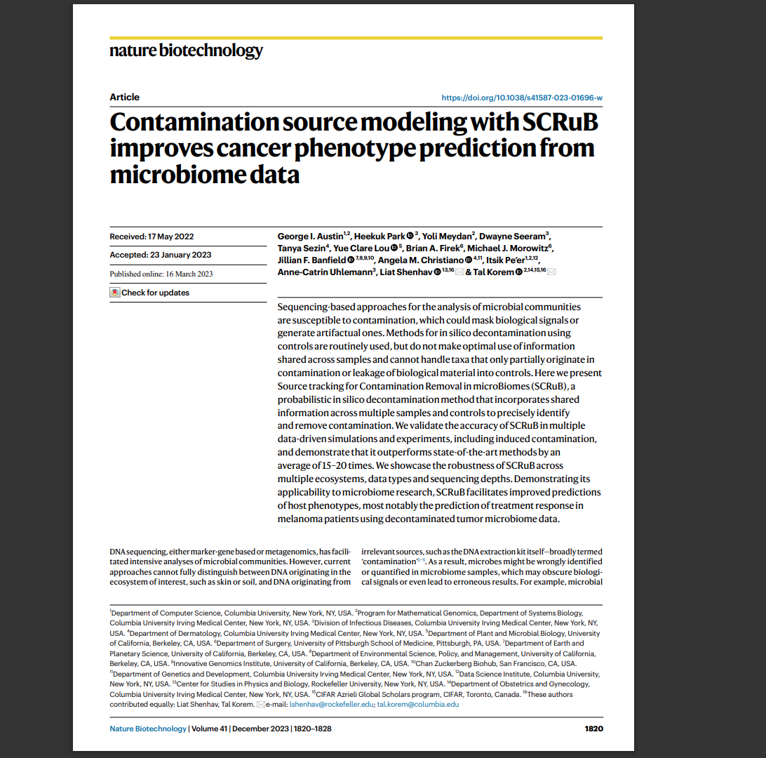
Using SCRuB to Reduce Noise in Microbiome Data
Presented by Jacob Woodard

Slide 2
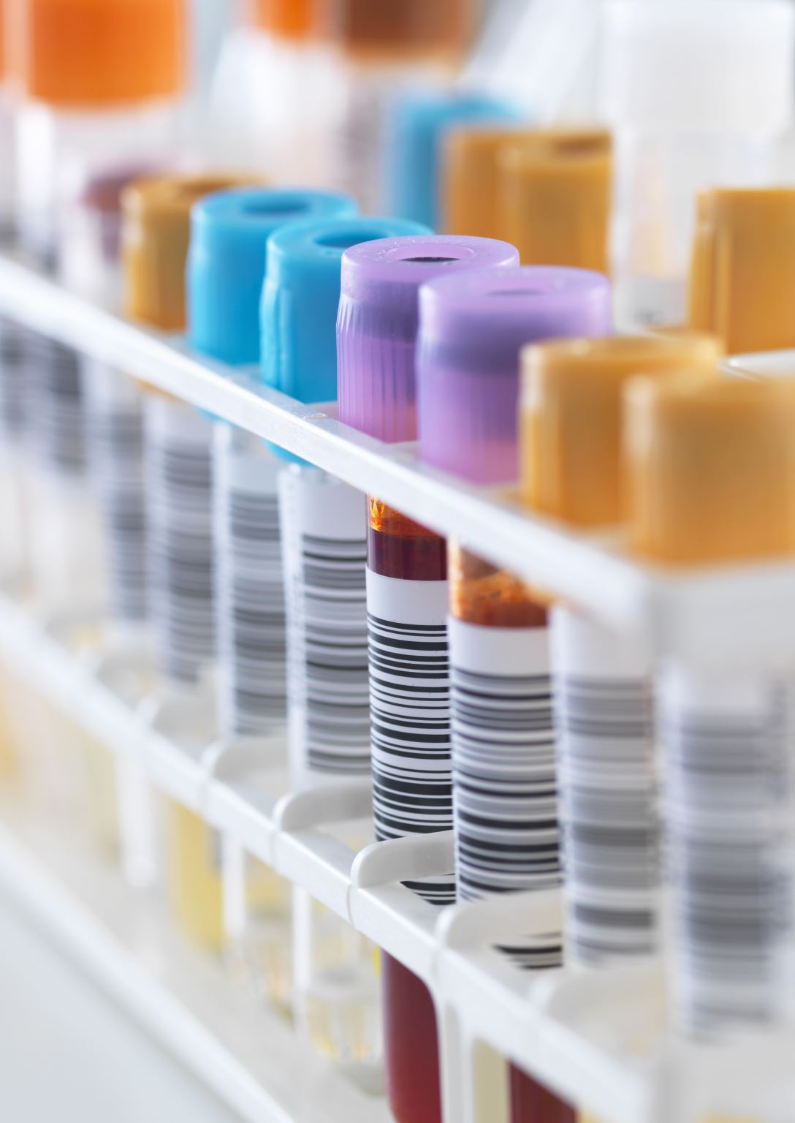
What is SCRuB
Source-tracking for Contamination Removal in microBiomes (SCRuB) is a computational tool designed to enhance the accuracy of microbiome data by identifying and removing contamination from sequencing experiments. It differs from other methods by distinguishing genuine biological presence from contamination.

Slide 3
What's the Use
Improve the accuracy of microbiome data analysis by removing contamination
Leverage shared information across samples and address well-to-well leakage
Be versatile across ecosystems, data types, and sequence depths
Goal: Be robust, retain taxa if present, be accurate

Slide 4
How Does SCRuB Know?
It utilizes two main computational technique. A probabilistic source-tracking model that distinguishes genuine from contamination by assuming that each sample contains a mixture of true material and contamination. Identifying contamination be means of a control specifically collected to capture contamination. Second, an expectation-maximization model estimates the amount of contamination in each sample, which allows it to track contamination across multiple sample and controls.

Slide 5
Assumptions of Data Generation

Slide 6
SCRuB Workflow

Slide 7
In-silico Assessment
JSD (Jensen_Shannon Divergence)->Lower equals “better”

Slide 8
Accounting for well-to-well leakage
Well-to-well leakage can occur from your sample to your control, which hard for other methods to correct. SCRuB, when using real experimental data was shown to keep the true sample even though it was detected in the control because of its novel probabilistic model that accounts for shared contamination sources.

Slide 9
Correction of well-to-well leakage

Slide 10
Human Samples Contamination
To evaluate SCRuB's ability to handle well-to-well leakage in human-derived samples, researchers processed samples from four different body sites (stool, skin, saliva, and vagina) alongside extraction controls.
Visualizations before decontamination revealed clustering of controls with nearby samples, indicating substantial leakage.
After decontamination with SCRuB, the contamination source was correctly identified, with the controls clustering independently from the biological samples, demonstrating SCRuB's ability to handle leakage.
Overall, SCRuB showed superior decontamination performance, correctly handling leakage and leading to higher consistency between replicates of human-derived samples

Slide 11
Experiment 1

Slide 12
Experiment 2

Slide 13
Prediction of Melanoma Treatment Response
SCRuB was tested for its ability to improve melanoma classification by analyzing microbial data from plasma samples using metagenomic sequencing.
In comparison to other decontamination methods, SCRuB demonstrated the highest predictive accuracy for melanoma, achieving an area under the receiver operating characteristic curve (AUROC) of 0.92, significantly better than alternatives like decontam and microDecon.
SCRuB was further tested on tumor microbiome data from melanoma patients, showing superior performance in predicting responses to immune checkpoint inhibitor therapy, maintaining high alpha diversity and minimizing the removal of true biological signals.
In a challenging cross-cohort setting, where melanoma samples from one center were used to predict outcomes in a different center, SCRuB showed strong predictive power (AUROC 0.84), outperforming other methods, proving its effectiveness in clinical applications across different datasets and contamination sources.

Slide 14
SCRuB Modeling Types of Contamination

Slide 15
Melanoma Classification

Slide 16
Melanoma Treatment Response

Slide 17
Overall Claims
Improves microbiome data analysis by more accurately identifying and removing contamination compared to existing methods.
Handles well-to-well leakage effectively, preserving true biological signals that other decontamination methods often misclassify as contamination.
Enhances cancer phenotype predictions, particularly for melanoma, demonstrating significantly higher accuracy in classifying patients and predicting treatment responses.
Outperforms alternative methods across multiple ecosystems, data types, and contamination scenarios, showing broader utility in both clinical and environmental microbiome studies.
Maintains higher biological diversity in decontaminated samples, making it more effective in revealing key biological signals that other methods may mask.

Slide 18
Validation of SCRuB
Data-Driven Simulations: Tested SCRuB’s performance using simulations with varying levels of contamination and well-to-well leakage, comparing its output to known ground truths.
Real-World Dataset Analysis: Applied SCRuB to microbial sequencing data from 96-well plates (Minich et al.), where known bacterial monocultures were used to measure the pipeline's accuracy in handling well-to-well leakage.
Human-Derived Samples: Evaluated SCRuB’s effectiveness on stool, skin, saliva, and vaginal samples to test its ability to differentiate between contamination and true biological signals.
Clinical Data Testing: Used SCRuB on plasma microbial DNA and tumor microbiome datasets to predict cancer phenotypes and treatment responses, showcasing its real-world utility in clinical settings.
Comparison with Other Methods: Benchmarked SCRuB against existing decontamination methods (e.g., microDecon, decontam) in all tests, consistently demonstrating higher accuracy in retaining true-positive taxa.

Slide 19
Limitations
Dependence on detailed metadata: SCRuB’s ability to handle well-to-well leakage requires access to detailed technical metadata, such as the spatial location of samples during processing, which may not always be available.-Computational complexity: The probabilistic model used by SCRuB might be more computationally intensive compared to simpler decontamination methods, potentially limiting its use in very large datasets.
Performance in extreme scenario: Although SCRuB generally outperforms other methods, its effectiveness may be reduced in cases of very high contamination levels or unusual contamination patterns.
Applicability to non-microbiome studies: SCRuB’s current framework is designed for microbiome data, so its use outside of this domain may require significant adaptation or may not be directly applicable.

Slide 20
Future Research
Expansion to non-microbiome studies: Future research could explore adapting SCRuB's probabilistic contamination removal model to other types of sequencing data, such as transcriptomics or proteomics.
Optimization for larger datasets: Investigating more computationally efficient versions of SCRuB could make it more accessible for analyzing very large datasets, such as those generated in large-scale population studies.
Integration with other decontamination methods: Future work could explore combining SCRuB with other tools to create a hybrid approach that addresses specific limitations in certain types of contamination scenarios.
Application in diverse environments: Researchers could apply SCRuB to various fields, such as environmental microbiome research (e.g., soil, marine ecosystems) or forensic microbiology, to assess its broader utility and refine its methods for different contexts.
Improvement in handling extreme contamination: Developing enhanced versions of SCRuB that perform better in cases of extremely high or unusual contamination could improve its robustness in a wider range of experimental settings.
Clinical applications: Future studies could explore using SCRuB for real-time clinical diagnostics, such as improving the accuracy of microbial analysis in liquid biopsies or tissue samples for disease detection and treatment monitoring.

Slide 21
END
Austin, George I., et al. "Contamination Source Modeling with SCRuB Improves Cancer Phenotype Prediction from Microbiome Data." Nature Biotechnology, vol. 41, 2023, pp. 1820-1828, https://doi.org/10.1038/s41587-023-01696-w.

