Slide 1
BSC 4434
Prof. Xiaoman Li
Barbara Stewart
“Simultaneous monitoring of disease and microbe dynamics through plasma DNA sequencing in pediatric patients with acute lymphoblastic leukemia”

Slide 2
Acute Lymphoblastic Leukemia (ALL)
Fast growing immature white blood cells that proliferate in the bone marrow.
Chemotherapy is treatment for it.
Immunocompromised patients are more susceptible to bacterial infections
Notes:
ALL is short for acute lymphoblastic leukemia, which is a type of cancer characterized by the rapid overproduction of white blood cells in the bone marrow. This proliferation impedes the production of normal cells leads to health compromise. Is predominant in children, in fact, ALL is the most common child leukemia that is why this study is done in pediatric patients.
Treatment usually leads to chemotherapy which shows the most success in children, but, it is very common for immunocompromised patients to be susceptible to bacterial infections. So, patients need to be in constant risk assessment.

Slide 3
Purpose of the Study
Hybrid Capture next-generation sequencing panel
Disease clearance on 20 patients
Notes:
So, knowing all that, the purpose of the study came to be the feasibility assessment of a hybrid capture next generation sequencing panel to longitudinally measure molecular leukemic disease clearance and microbial species abundance in 20 ALL patients.
EXPLAIN FIGURE 1
Which I want to pause and explain because every word in that sentence has a meaning. When talking about hybrid capture it can be DNA or RNA specific sequences that are “captured” by tiny probes relating to what is trying to be studied. By saying next generation sequencing is basically proving what we learned in class and comparing a model, faster, cost effective sequencing technologies with let’s say “first generation sequencing” like Sanger.
And, the panel is basically explaining what is being studied, in this case is host-microbe interaction and disease clearance in 20 patients with ALL. 168 samples were collected from these patients over a 6 week period.

Slide 4
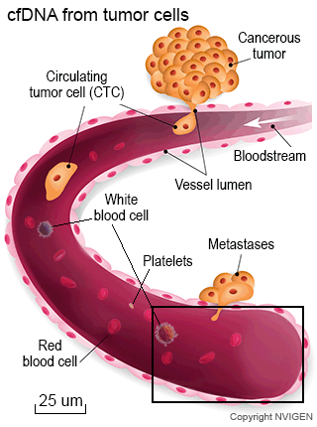
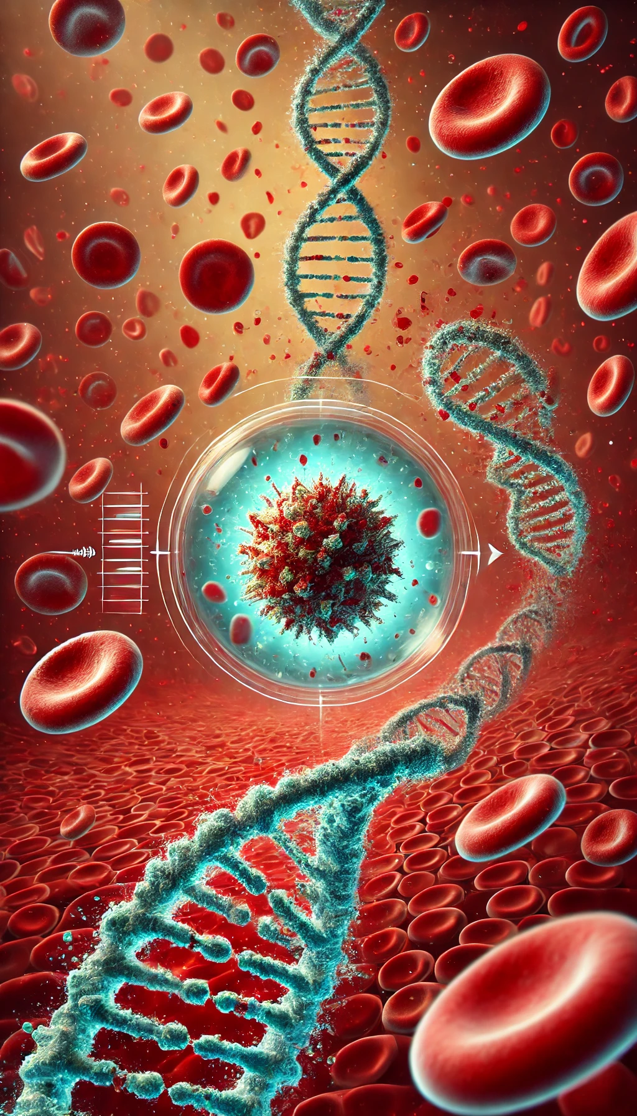
Nucleic Acids
cfDNA
ctDNA
mcfDNA
Notes:
Now, as I said in the previous slide, a hybrid technology can capture many types of nucleic acids or genetic information. For this study they used cell free DNA which is just DNA in plasma. Circulating tumor DNA and microbial cell free DNA.
I wanted to point out the choice of nucleic acids to use because I find it really interesting that the reason they are using circulating tumor DNA, which is DNA excreted from tumor cells circulating in plasma looking for methods of proliferation, is to reduce the need of surgically removing infected tissue for examination. Which is very common in any type of cancer, not only ALL. ALL is the most common pedriatic cancer, so patients on top of being immunocompromised because of induction chemotherapy they need to measure disease clarification by surgically removing infected tissue. These choices are certainly less invasive.
Additionally, infectious complications remain the major cause of treatment-associated mortality, so for that reason they are proposing studying microbial cell free DNA in the patients, to use it as a prognostic tool in the directions of the patients health.

Slide 5
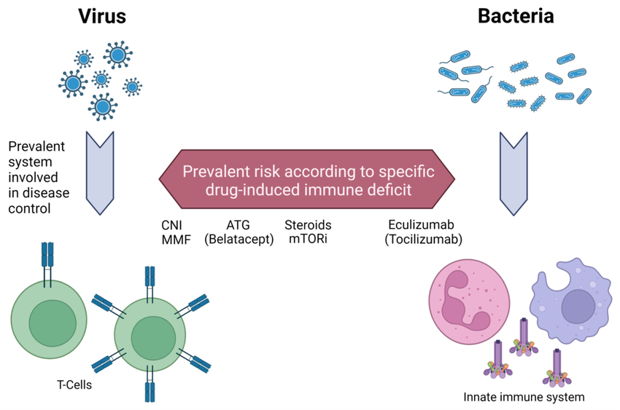
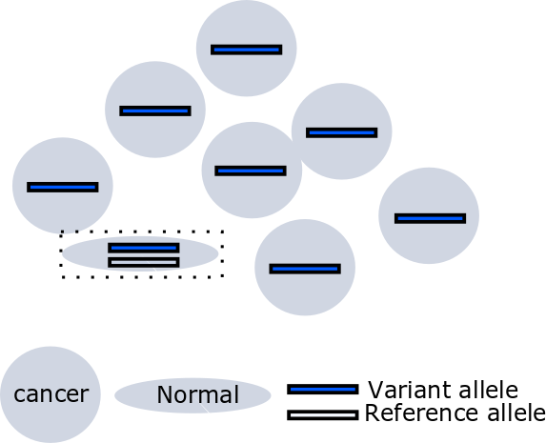
Leading Causes of Mortality
Two leading causes of mortality for patients with ALL
Disease persistence
Relapse
Infectious microbes as immunosuppressants
Variant Allelic Fractions (VAFs)
Notes:
So, they say that in this study they want to examine the two leading causes of mortality in patients with ALL to hopefully propose new technologies to reduce them right?
The two leading causes are disease persistence and relapse, that is very common in any type of cancer. And, the role of infectious microbes acting as immunosuppressants when patients are immunocompromised.
To do so, they used NGS to look for microbes in patients undergoing cancer treatment and they looked for mutations by comparing cell free DNA with circulating tumor DNA which is where variant allelic fractions comes to play.

Slide 6
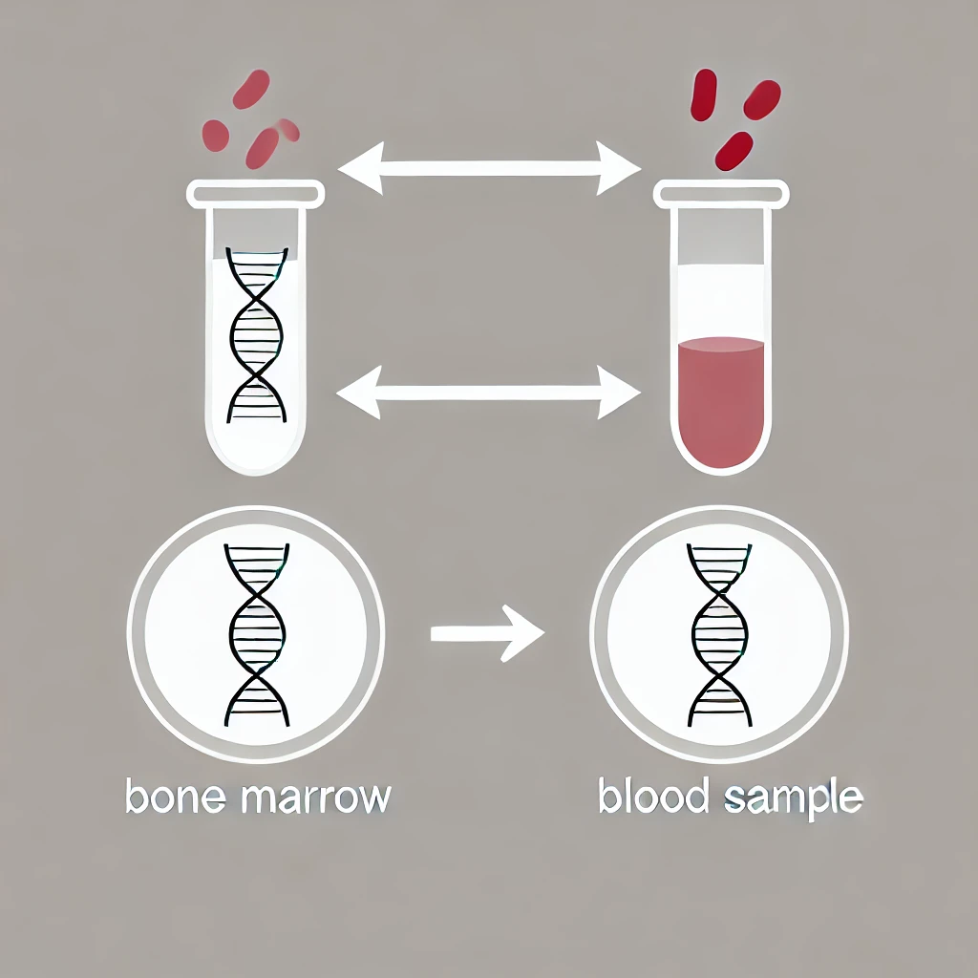
Key Findings from Leukemia Study on ctDNA Dynamics
We can detect and monitor leukemia by analyzing ctDNA.
Invasive bone marrow examinations may be unnecessary for analyzing small genomic variants.
During the first 6 weeks of treatment, the human virome is dynamic in patients with ALL.
Notes:
In this comparison they found that doing invasive bone marrow examinations may be unnecessary, which is good because less surgical procedure, so less risk for microbial infection. The reason being that the variant allelic fractions were so small because the cell free DNA and circulating tumor DNA that they can detect and monitor leukemia only from the bloodstream. That is what they mean by saying that •they can detect and monitor leukemia by analyzing ctDNA.
And, •During the first 6 weeks of treatment, the human virome is dynamic in patients with ALL. Which im going to get more into it later on.

Slide 7
RESULTS

Slide 8
Study Overview
FIG 1B. Shows how sequencing depth of all chromosomes is uniform. Data accurately represents all genome and reduces bias.
Notes:
This figure shows how all chromosomes of the genome of all the patients were studied. Including sex chromosomes. The higher the depth In the y axis the more it was read about that chromosome, so as you can see, the bars are very uniformly distributed suggesting that all the chromosomes were read with complete accuracy.

Slide 9
Study Overview
FIG 1C. Changes over time during induction chemotherapy of patients with ALL.
Early Induction (Days 1-3)
Mid Induction (Days 4-14)
Late Induction (Days 15-42)
Post Induction (Days 43-117)
Notes:
There are a couple factors important to point out about this figure, day 42 was end of induction, of no more chemotherapy. They distributed in early, mid, late and post induction but for me what really makes sense is only the post induction because no factors were changed since the day the treatment started until it was finished but… important to note is that the yield of cfDNA in both peripheral blood and noncellular bone marrow was about the same at early induction. Peripheral blood yield reached its peak starting the mid induction period, this makes sense because cells are distributed throughout the body and more susceptible to chemotherapy. Now, the peak for non cellular bone marrow yield was the end of mid induction suggesting that cells at the bone marrow were surviving treatment longer than the ones in the bloodstream, also, there are more white blood cells are in the bone marrow so that might be a reason why It took longer.
Then, at post induction they both had about the same pattern for yielding which is a great sign since this suggests that at least for this study there was no relapse.

Slide 10
Patient dynamics in mutation VAF clearance
Variants were observed with custom-panel ctDNA NGS in diagnosis.
Each patient had an average of 2.3 detectable mutation
Genetic diversity plays an important role in how the treatment behaves differently for every patient.
Fig 2A. Pie chart showing unique mutations in patients during diagnosis.
Notes:
Now, as I mentioned before, the severeness of the illness was measured in this study by the amount of variant allele fractions or mutations the patient had. Mutants were collected using NGS and, In this figure they are showing how those mutants were analyzed.
Each patient had an average of 2.3 detectable mutations, 15% of the cases had 0 mutations which is good because is showing how genetic diversity plays an important role in any cancer research, some patients responded to the treatment by having 5 or more mutations and some had 0. So, this is the real takeaway about cancer research and why NGS is such an important key, all boundaries of the genome need to be biometrically measured for a succesfull treatment to happen.

Slide 11
Mutational Clearance
Fig 2B. Heat map focusing on VAFs changes over time in various compartments.
Notes:
Now, the study focuses on showing how ngs can control the relapse and immunosuppression of patients but a key factor that is shown is how the whole point of it is that mutations start and increase while the patient is receiving treatment and most of them are cleared by the end of the treatment.
So, this is what this figure is showing, the heat map focuses on VAFs and there are some boundaries unique for each patient on these mutations happening on peripheral blood and noncellular bone marrow, again, genetic diversity. Cases 10, 14, 15, and 16 had mutations after the end of treatment showing how treatment affects each individual differently and giving insight to doctors on how they should proceed with each case. And, for case 17, mutations were found on day 147 way after the end of treatment but only on peripheral blood, suggesting a case of spatial heterogenicity. This is also very important to continue treatment because here mutant cells were circulating and not agglomerating on specific tissue, this can make treatment for this patient more difficult, but getting this data from NGS is important for prognostic evaluation

Slide 12
Distribution of mutations
Mutations are more prominent at the early stages and then clear or reduce by the end of induction therapy (EOI).
Increasing overlap as therapy progresses.
Fig 2C. Comparison of VAFs across different compartments. Fig 2D. Venn Diagram of the overlap of mutations in different sample types.
Notes:
Here, this 2 diagrams are showing the distribution of mutation, for graphs in C they are separated in cellular bone marrow, noncellular bone marrow and peripheral blood. As you can see, in all the cases mutations are almost induced in early stages of treatment and then they tend to be cleared.
All of these cases were gathered and they did a Venn diagram which is the one at D to show how can these mutations correlate in different samples. Key notes can be that cellular bone marrow and peripheral blood shared the most amount of similar mutations (23 out of 30) in the early stages, but then, mutations in cellular bone marrow were cleared, so at late stages of the treatment peripheral blood and ncbm shared 15 mutations which is a great result because from the therapy can be more generalized.

Slide 13
Identification of microbial species
Key features:
Case 1 and 3 did not go microbial enrichment.
The capture DNA is prepared for sequencing using paired-end sequencing
The process uses two tools: Kraken and Blast.
Notes:
Now, moving on from VAFs, we are now in the part of the study where they analyzed the microbes present. This pictures is just an illustration of how the work was done, the samples were collected, cell free DNA was pulled down and the library was prepared with paired end sequencing. Then they used a two step process for the bioinformatics part of recognizing and analyzing the microbes, first Kraken, since it is a broader method to sort out a taxonomic characterization and then they used BLAST to sort out the specific genomes of strains of microbes present.
Another thing is that case 1 to 3 didn’t get microbial enrichment so there is no results on microbial distribution for these cases. A very important thing that they mentioned in the paper but not show results of is that they used 5 healthy patients and 5 patients with acute myelogenous leukemia as their controls.

Slide 14
Identification of microbial species
Fig 3B. Dynamics of microbial species in different compartments.
Notes:
Here are the results for cultivation of microbial species. Overall, the finding was that these microbes are dynamic and attack during different stages of the therapy. This indicates that the microbial environment in these patients is not static but changes during treatment, likely influenced by the therapy itself and the patient’s shifting immune status.
For this picture I want to talk about bacteria particularly since they have the most prominent results. For example, cutibacterium is a skin commensal bacteria, as you can see almost of all the patients that were on treatment were suffering from this species, suggesting that it is an opportunistic bacteria.
The Bacillus species is a known cause of mortality of ALL patients and it was detected in many of them, suggesting that can be a bacteria involved somehow in this illness.
There is also the genus Ralstonia, that is present in all the healthy controls but only one of the 126 cases of ALL. It is not shown on these results.
For fungus, Malssezia was detected in 60% healthy controls, 82% of ALL samples, and none of the AML samples this can be for many different factors like immunosupresion, microbiota, external factors, etc.

Slide 15
Identification of viral species
Fig 4A. Viral species across peripheral blood.
Comparison between ALL/Healthy/AML patients
Notes:
For this figure they are showing trending viral species in peripheral blood of ALL patients compared to the healthy and AML ones.
Things to note: all healthy individuals had only one viral species, human vetaherpervirus 6B and this same one was only present in 1 of the 17 cases of ALL.
53% of the patients had at least one viral species detected at diagnosis, and 9 out of 9 of the patients that had a species detected at diagnosis had this same species detected at some other stage of treatment.
6 out of the 8 patients that didn’t have a virus detected at diagnosis had one detected at another stage. Which takes me to my next slide.

Slide 16
Overlap of microbes
Fig 4B. Distribution of microbes in different compartments.
Compartment specific distribution
Fig 4C. Venn diagram showing overlap of microbes in different compartments.
Minimal overlap between PB and NCBM
No bacteria found in all three compartments
Notes:
In these 2 figures is a rushed conclusion of the microbe part of the study. All ALL patients had Herpesviridae, Polyomaviridae, Parvoviridae, and Anelloviridae, five different herpes were detected and 16 out of 17 patients had at least one viral species, suggesting that the herpes viral family is common to reactivation in children with ALL,
Fungus and viruses tend to be more in bone marrow and peripheral blood while bacteria tend to be compartment specific. There was also no bacteria found in all three compartments, that is a common feature in bacteria since they tend to agglomerate in species.

Slide 17
DISCUSSION

Slide 18
Discussion Key Points
Correlations
Custom ctDNA capture strategy was effective monitoring disease persistence and microbial dynamics.
At diagnosis, PB and cellular leukemia cells are closely correlated, but after therapy begins, NCBM and PB ctDNA become more aligned.
invasive bone marrow exams may not be needed for small variant detection in ALL.
Dynamics
The comparison between bone marrow and peripheral blood (PB) provided insights into the spatial dynamics of leukemic evolution and microbe invasion.
dynamic changes in microbial species during treatment

Slide 19
Discussion Key Points
Limitations
The approach used does not assess copy number variations (CNVs) or gene fusions.
Only microbial known species.
Susceptibility to microbial agents.
Future Directions
Assess copy number variations (CNVs) or gene fusions.
RNA sequencing
Molecular monitoring in future clinical trials
Fewer invasive bone marrow biopsies

Slide 20
Materials and Methods
Patients from St. Jude Children’s Research Hospital
Sequencing
MiSeq (illumina)
WES
NextSeq (illumina)
Custom capture panel design

Slide 21
References
https://www.science.org/doi/10.1126/sciadv.abj1360
https://www.jkangpathology.com/slide/allele/allele#1
https://www.nvigen.com/cfdna-extraction-tutorial/
https://www.researchgate.net/figure/A-schematization-of-immune-system-prevalent-activation-during-viral-and-bacterial_fig1_359337827

Slide 22
Closing Slide

