Slide 1
Metagenomic and Functional Analysis of Genomic Sequencing Data Featuring: Combined effects of host genetics and diet on human gut microbiota and incident disease in a single population cohort by Youwen Quin et. al and Identification of antimicrobial peptides from the human gut microbiome using deep learning by Yue Ma et. al
Presented By: Alexander Hall

Slide 2
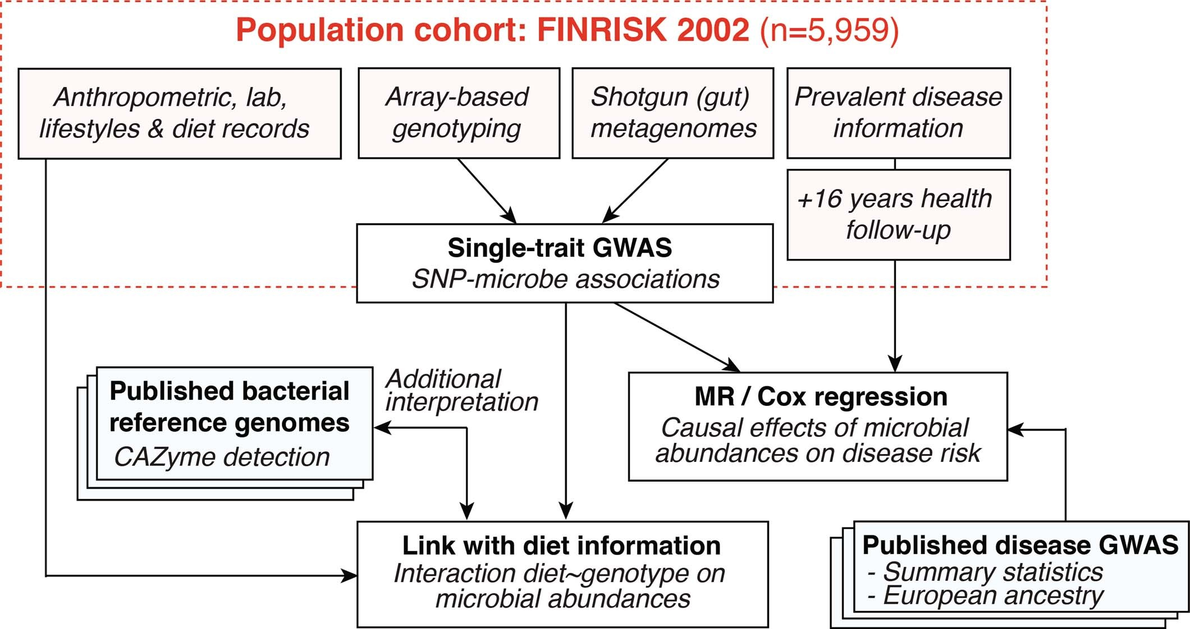
Study Details and Connection
Combined effects of host genetics and diet on human gut microbiota and incident disease in a single population cohort
Utilizing a combination of metagenomic analysis of participant microbiomes alongside NGS sequencing of the host, correlations between host genes and microbial abundance were identified via genome wide association and reference genome profiling
Participants sourced from the 2002 FINRISK Study
(Extended Data Figure 1, Qin et al., 2022)

Slide 3
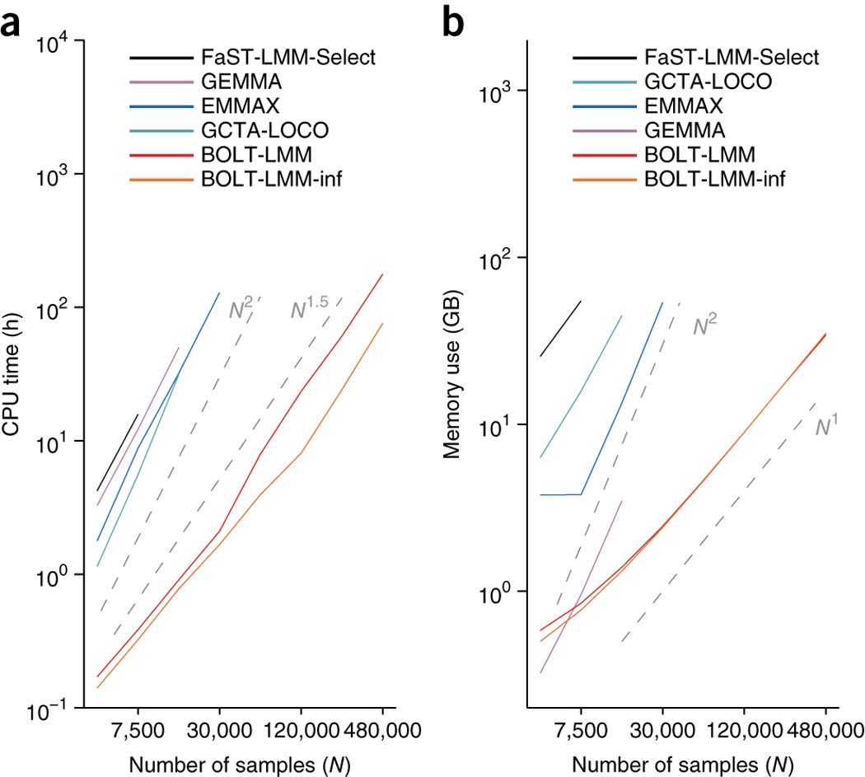
BOLT-LMM
The BOLT-LMM is a Linear Mixed Model algorithm improved for large datasets through significant improvements in CPU and Memory usage compared to other options (Loh et. al, 2015)
It utilizes Bayesian mixed-model analysis through comparing association statistics derived through VCA-like methods and statistics derived from a mixed Gaussian distribution analysis of the SNP data
Only the associations for which the Gaussian distribution prediction accuracy exceeds the infinitesimal model will utilize a comparison between both models, preventing unnecessary computations
The net result is a high-efficiency algorithm for comparing the expected random and actual impact of a given genetic association
Figure 1, Loh et. al, 2015

Slide 4
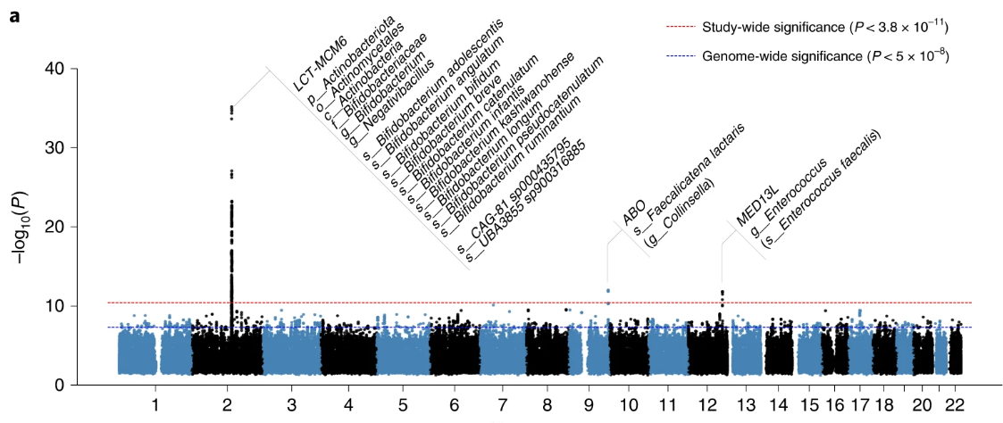
Genome-Wide Association of Host and Microbiome
(Figure 1.a, Qin et al., 2022)
Data from shotgun metagenomic sequencing with Illumina HiSeq 4000 Systems and Illumina genome-wide SNP arrays was analyzed using BOLT-LMM v2.3.2 with P-value analysis by GTCA-COJO

Slide 5
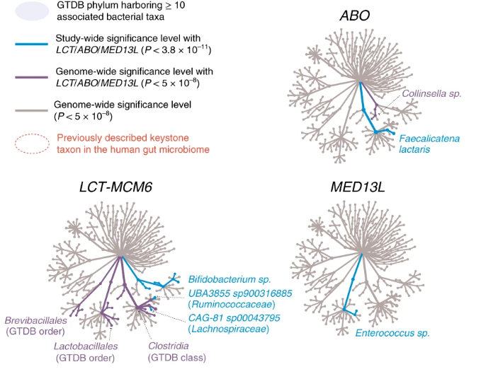
Identified Loci of Interest
Taxonomic Tree visualization of bacterial taxa identified to be associated with the labeled gene loci
The taxa highlighted in blue were the primary groups analyzed as these represent the most statistically significant correlations found from the data
Most species did not show a statistically significant correlation, and of the correlated species only those highlighted here showed specific correlations to these loci
(Figure 1.c, Qin et al., 2022)

Slide 6
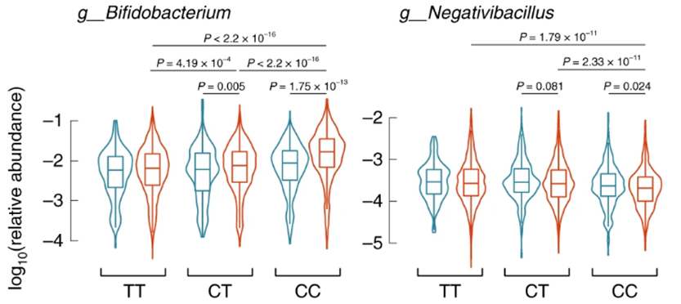
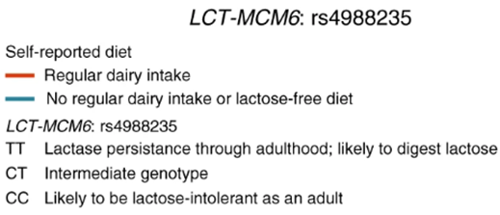
Functional Analysis of Genomic Data Based on Lactose in Diet (Part 1)
(Figure 2.a, Qin et al., 2022)
Using genotyping data from the study, the abundance of bacteria present in participants was compared for each genotype of the LCT-MCM6 gene with and without lactose consumption
Bifidobacterium uniquely showed greatly increased growth in lactose-intolerant participants with regular dairy intake

Slide 7
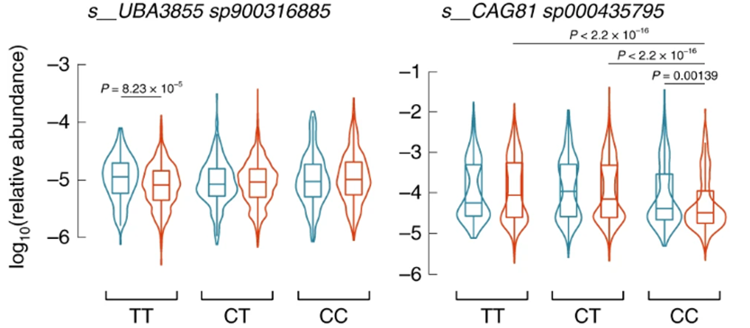
Functional Analysis of Genomic Data Based on Lactose in Diet (Part 2)
(Figure 2.a, Qin et al., 2022)
Conversely, CAG81 showed a detectable decrease in abundance with dairy consumption in lactose intolerant participants that was not observed in those which could digest lactose
UBA seemed to show a decrease in presence with dairy consumption in lactose-digesting individuals possibly indicating an increase in competition crowds this species out

Slide 8
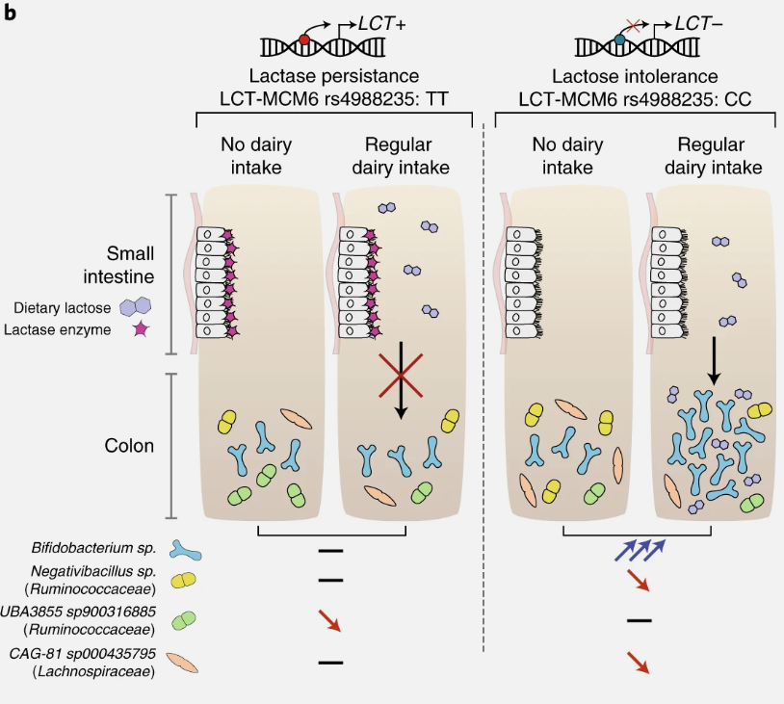
Representation of Results
The results of the individual assays provide insights into the potential relationships between not only the host diet and genome, but also competitive relationships with each other under different conditions
In particular, there is strong evidence of Bifidobacterium competitively inhibiting the growth of Negativibacillus and CAG-81 species when dietary lactose is available and not broken down by the host
(Figure 2.b, Qin et al., 2022)

Slide 9
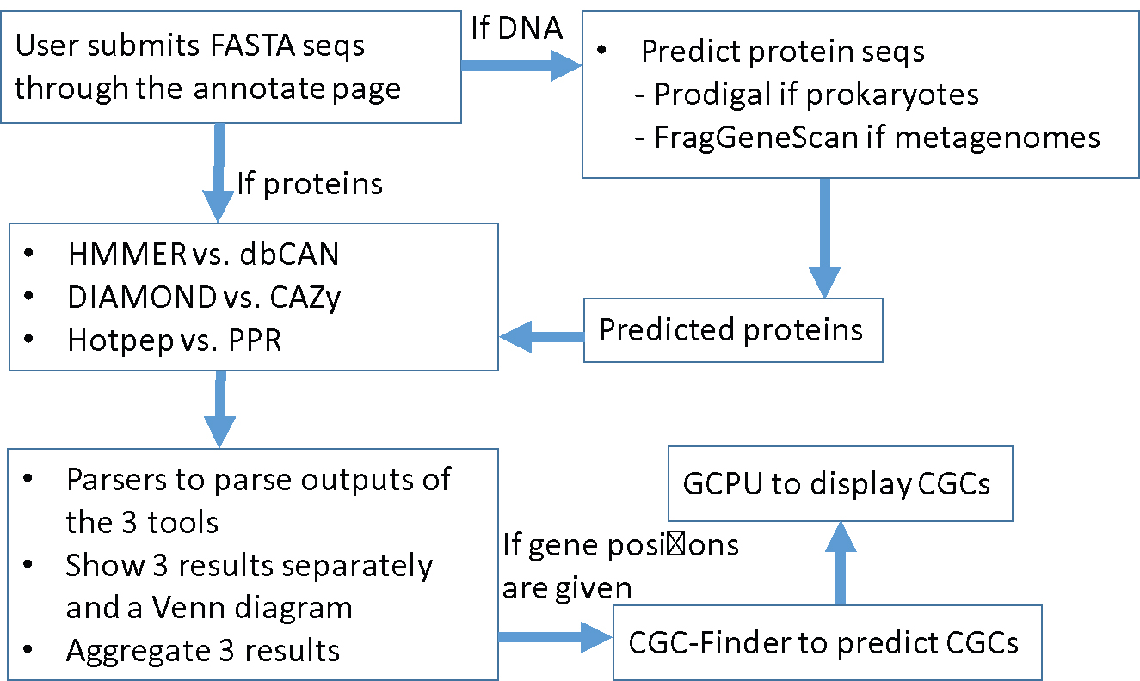
CAZyme Profiling with dbCAN2
(Figure 2, Zhang et al., 2018)
The run_dbCAN2 tool processes provided gene or protein sequences using multiple search tools: HMMER search through dbCAN HMM databse, DIAMOND search against the CAZy annotated CAZyme databse, and Hotpep search for the PPR short peptide library (Zhang et al., 2018)
Together, these provide a functional identification of CAZymes from provided genomes

Slide 10
Reference Genome CAZyme Profiling of ABO-Associated Species
(Figure 3, Qin et al., 2022) – with additional red highlighting
Carbohydrate-Active Enzymes were identified via the run_dbCAN2 tool, which identified CAZymes from reference databases for each species tested above
Of the ABO-associated species, only F. lactaris showed evidence of blood-antigen-targeting CAZymes

Slide 11
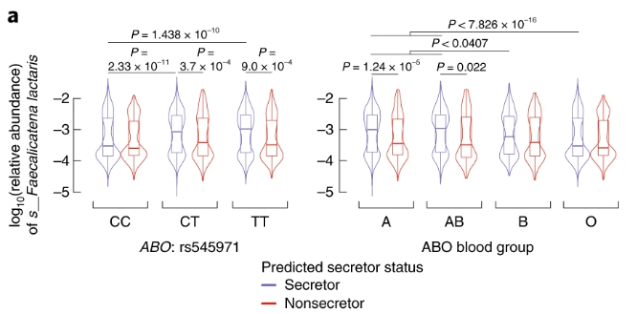
Microbiome Abundance of F. lactaris Associated with ABO Secretion
(Figure 4.a, Qin et al., 2022)
By utilizing the previous SNP data gathered through Illumina sequencing and genotyping of FUT2 variant rs601338, researchers were able to determine both blood type and whether patients secreted the A and/or B antigens in their bodily fluids – including those in the intestinal lumen

Slide 12
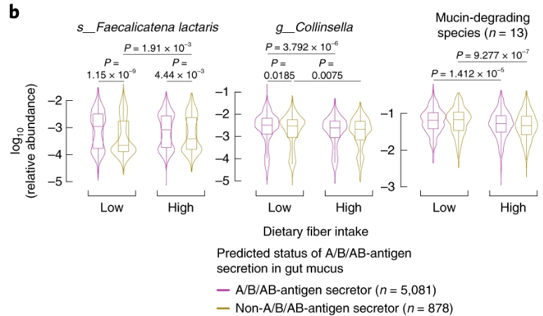
Abundance of F. lactaris in Non-Secretors is Greatly Impacted by Fiber Intake
The abundance of the two ABO-associated species in participants reporting high and low fiber intake was compared, as this has been shown to have an impact on some mucin-degrading species
It was identified that an increase in fiber intake significantly improves the growth of F. lactaris in ABO non-secretors
This pattern was not observed with Collinsella species, and the impact of dietary fiber was relatively low for ABO secretors for F. lactaris
(Figure 4.a, Qin et al., 2022)

Slide 13
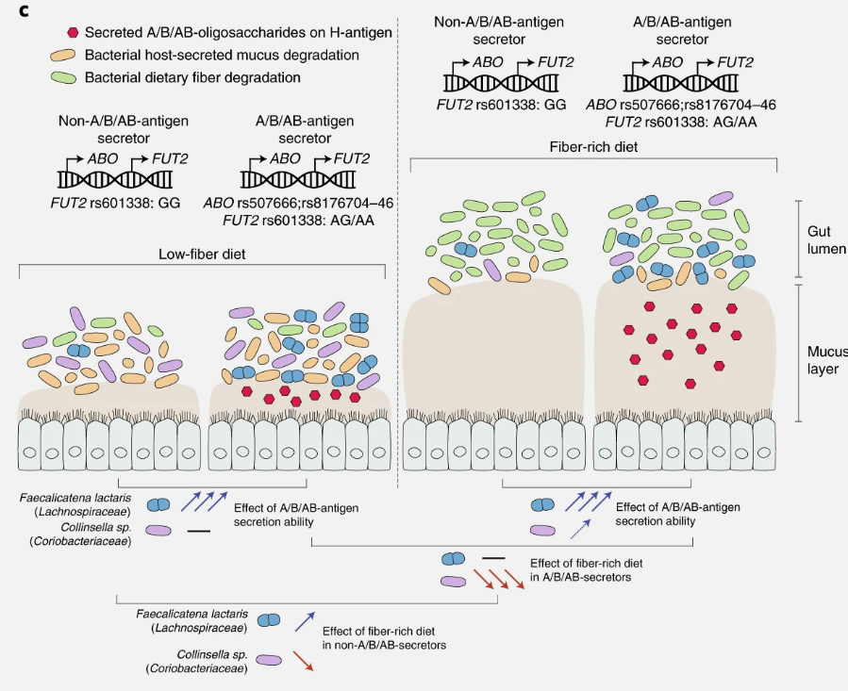
Representation of Results
The individual analyses indicate that F. lactaris has a unique affinity for the A/B/AB antigens and exhibits a unique lack of response to fiber in the presence of these antigens compared to Collinsella and other mucin-degrading bacteria
(Figure 4.c, Qin et al., 2022)

Slide 14
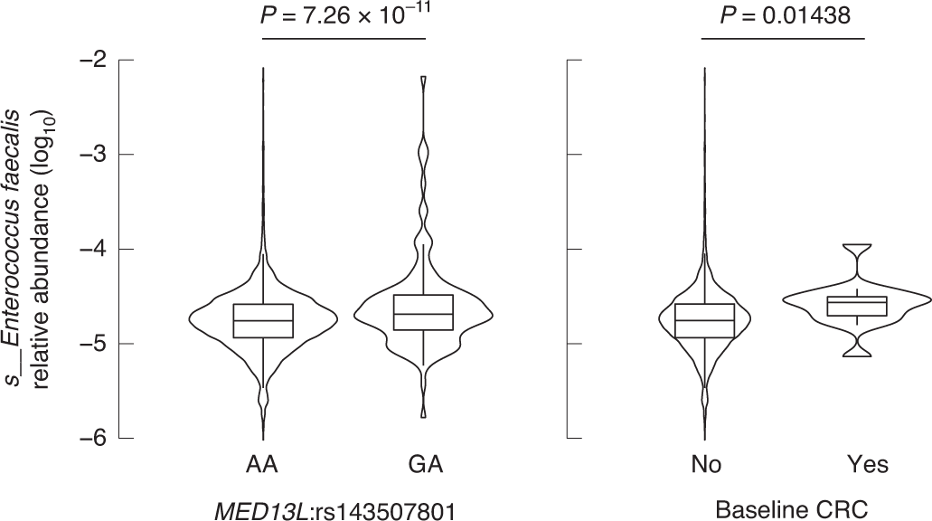
Correlation of E. faecalis Abundance and Colorectal Cancer
(Figure 5, Qin et al., 2022)
The abundance of E. faecalis was compared between genotypes of the MED13L locus and for participants with and without a history of colorectal cancer

Slide 15
Summary and Significance of Studies
Through the usage of metagenomic analysis and other methods on large host and microbiome genome databases, a variety of unique trends and products can be identified that is otherwise not practical to identify in smaller sample sizes. Through the FINRISK data, the researchers were able to identify:
Links between lactose intolerance and the abundance of Bifidobacterium species
New insights into the potential for blood type to alter the composition of the intestinal microbiome especially for F. lactaris, and insights into its preference for blood antigens over other energy sources such as dietary fiber compared to other ABO-associated species
Putative connections of the abundance of E. faecalis as a potential indicator or effector for colorectal cancer through the MED13L locus

Slide 16
Study Details and Connection
Identification of antimicrobial peptides from the human gut microbiome using deep learning
Utilizes a combination of proteomics, metagenomics of the intestinal microbiome, and deep-learning analysis to identify potential therapeutic antimicrobial peptides made by intestinal flora
The dataset comprises of 15 independent metagenome cohorts, and so required a novel method for analysis of such a large dataset for potential AMP sequences
Deep Learning Models were taught using existing AMP and Non-AMP data from publicly available datasets for identification of likely AMP sequences
Identified potential AMP proteins were tested for their effectiveness

Slide 17
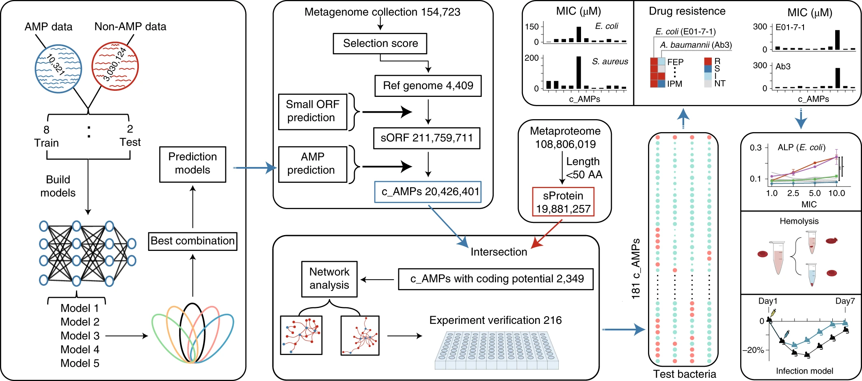
Introduction to the Deep-Learning Workflow
(Figure 1, Ma et al., 2022)

Slide 18
Metagenome Data Collection
A total of 9,316 publicly available metagenomes spanning 46 datasets from multiple populations, body sites, and host ages were used to form the initial 154,723 genomes (Table 1, Pasolli et. al, 2019)
This initial set was scored by:
-Completeness - the fraction of genes that are expected to be there which were actually found
-Number of Contigs – Overlapping, continuous sequence of DNA found through the assembly
-Contamination – Foreign, redundant, or mis-annotated genes
Through this selection process, a final set of 4,409 genomes were selected to act as the reference genomes for the study

Slide 19
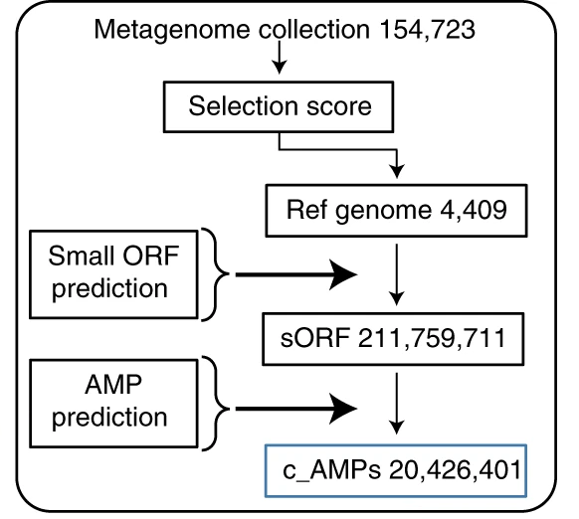
Metagenomic Analysis
Each genome was selected or rejected based on completeness and contamination
The remaining genomes were used as a reference for the identification of open reading frames
The open reading frames were predicted through the usage of the EMBOSS software for each reference genome
The open reading frames were analyzed using a Deep-Learning Algorithm to identify potential AMPs by structure

Slide 20
Preparation of AMP and Non-AMP Data for Models
In order to ensure a conclusive sample of AMP and Non-AMP data for model training, the following data sources were utilized:
AMP Data: The ADAM (“A Database of Anti-Microbial peptides”), APD (Antimicrobial Peptide Database), CAMP (Collection of Anti-Microbial Peptides), and LAMP (A Database Linking Antimicrobial Peptides) were used to gather the initial set of AMP data
These were then filtered to remove duplicates and sequences in excess of 300AA to provide the final data set
Non-AMP Data: The full UniProt database of cytoplasmic proteins not associated with antimicrobial activity of any variety, nor effector proteins or excreted proteins was utilized as the initial database for the Non-AMP Data
These were also filtered to remove sequences in excess of 300AA, as well as any sequences which matched those in the AMP database

Slide 21
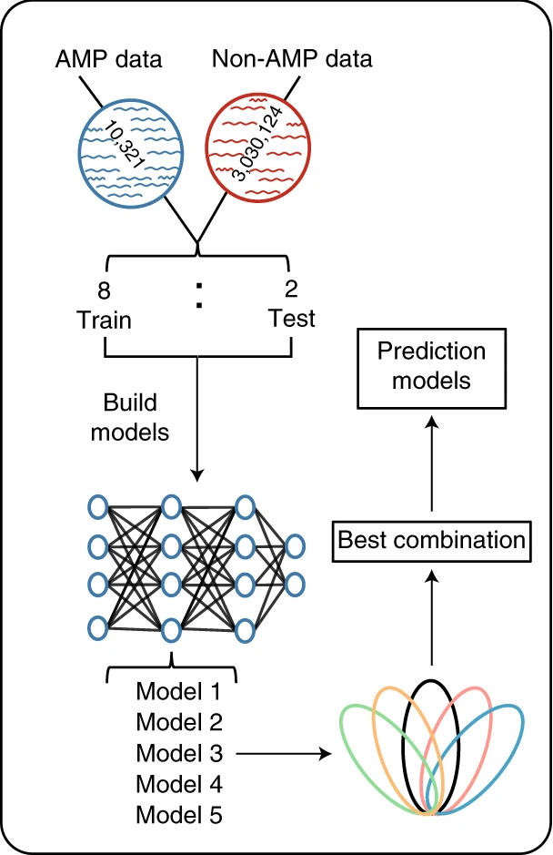
Deep-Learning Development Through Protein Analysis
The initial Natural Language Processing (NLP) models were trained using an extensive database of AMP and Non-AMP proteins of length <300 AA
The models were trained using 80% of the AMP data and a smaller subset of Non-AMP, then tested using a subset of the remaining 20% of AMP sequences and non-AMP sequences of length < 50AA
The 5 highest accuracy models based on determination of AMP and Non-AMP structures were tested together, and combinations of models were examined for combined precision
The final optimal combination of 3 models: ATT, LSTM, and BERT were chosen to act as the prediction model for the metagenomic data

Slide 22
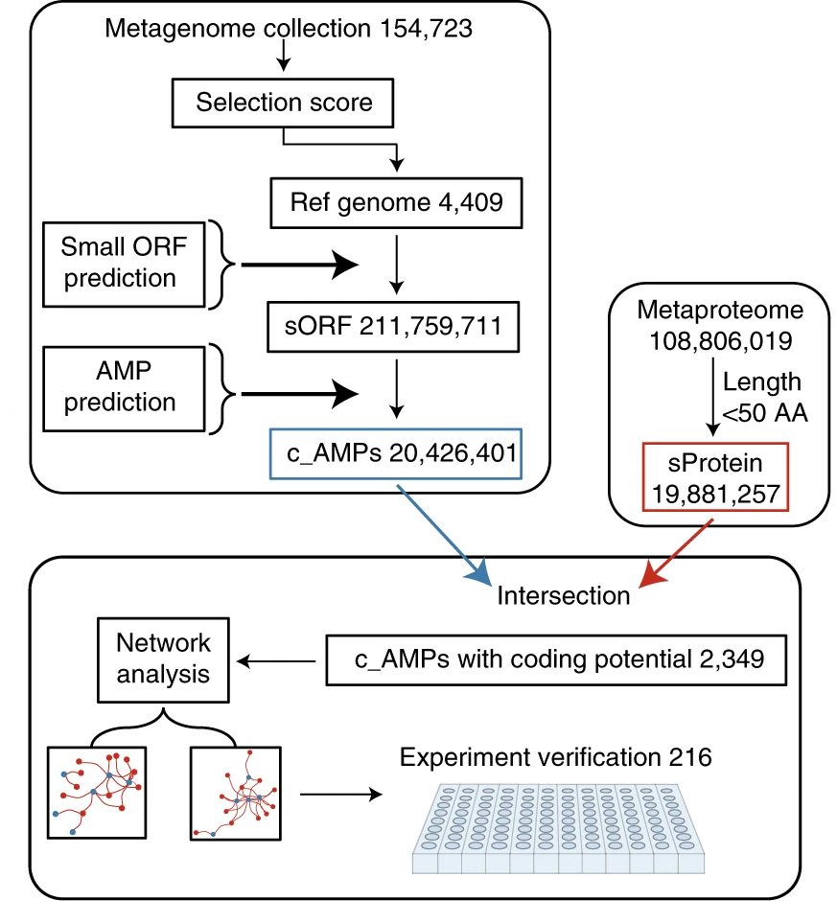
Combined Proteomic and Metagenomic Analysis to Identify Potential AMPs
The predicted AMP ORFs are validated using the metaproteome data for proteins < 50AA to determine whether each ORF corresponds to a known protein in the cells
Of those with a corresponding protein, network association for a negative relationship with other members of the microbiome was used to identify compounds with the highest likelihood of antimicrobial efficacy

Slide 23
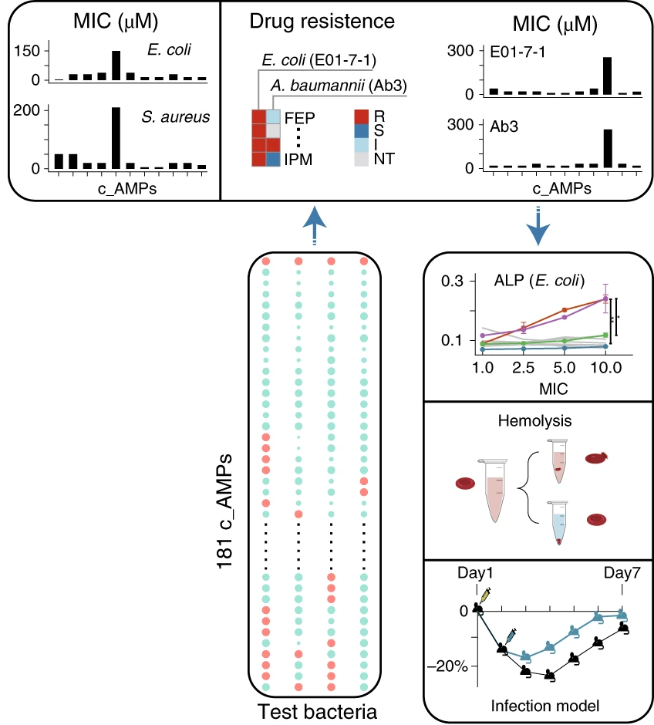
Practical Results of Sequencing Data Analysis
The 216 candidates were tested in parallel against multiple species to determine their effectiveness
Initial testing provided evidence that at 60 μM concentration, 181 of the original 216 AMP candidates could inhibit at least one tested species effectively
Finally, the 3 most effective AMPs were tested for risk of hemolysis in the host and effectiveness of microbial clearing using an in vivo mouse model

Slide 24
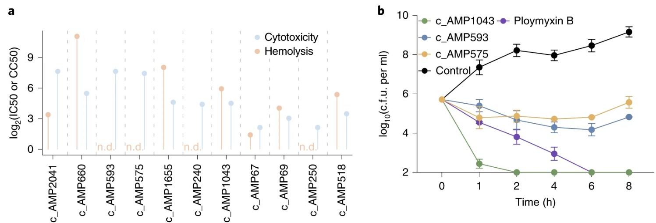
Cytotoxicity and Hemolysis Treatment Assays
(Figure 5.a and 5.b, Ma et al., 2022)
The selected AMPs were tested for cytotoxicity and hemolysis using E. coli and human RBCs in culture with varying concentrations of the AMP to determine which options showed the highest therapeutic potential for further testing

Slide 25
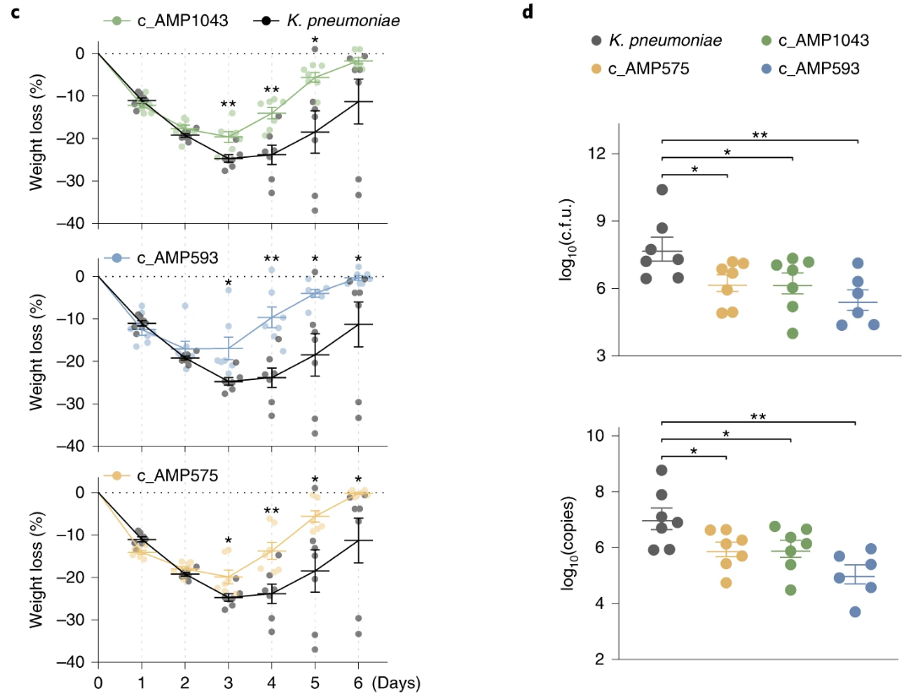
Mouse Model Treatment Assays
Mouse models were infected with K. pneumoniae and treated with three of the top-performing AMPs
Weight loss and rate of recovery were utilized as measures of overall therapeutic impact
Sampling of lung tissue from some of the mice after 24hrs of incubation with each treatment confirmed through c.f.u. and PCR analysis that each AMP induced a large decrease in bacterial load
(Figure 5.c and 5.d, Ma et al., 2022)

Slide 26
Summary of Deep-Learning Workflow
(Figure 1, Ma et al., 2022)
The overall workflow has demonstrated the ability to analyze broad metagenomic datasets for potential AMPs through a multi-method analysis of the sequence, protein alignment, network analysis, and experimental validation with in vitro and in vivo models

Slide 27
Summary and Significance of Studies
The study succeeded quite thoroughly in its initial objectives,
It developed a functional workflow for the analysis of large-scale metagenome data for AMP development
Devised a novel and highly effective deep-learning model for the identification of likely AMP sequences within large gene datasets
Isolated several thousand potential candidates for AMP research
Successfully derived a total of 181 compounds with antimicrobial activity out of 216 tested
The study overall demonstrates the value of combining bioinformatic, metagenomic, and proteomic analysis to derive directly useable results from broader datasets, and provides an excellent example of a complete workflow using these principles

Slide 28
Limitations of Studies
While the studies succeeded in their objectives, there were still multiple limitations:
The FINRISK study utilized a 2002 cohort as their primary dataset which may lack some recently developing trends
Furthermore, as the data is pulled primarily from the Finnish population, it is unknown whether the trends identified in the FINRISK analysis apply with similar accuracy and severity for other populations
The AI models of the metagenomic study are intrinsically limited to identifying AMPs which share similarity with existing AMPs, and its possible some sequences excluded may still exhibit antimicrobial activity in novel ways

Slide 29
Paper References
Qin, Y., Havulinna, A.S., Liu, Y. et al. Combined effects of host genetics and diet on human gut microbiota and incident disease in a single population cohort. Nat Genet 54, 134–142 (2022). https://doi.org/10.1038/s41588-021-00991-z
Loh, PR., Tucker, G., Bulik-Sullivan, B. et al. Efficient Bayesian mixed-model analysis increases association power in large cohorts. Nat Genet 47, 284–290 (2015). https://doi.org/10.1038/ng.3190
Han Zhang, Tanner Yohe, Le Huang, Sarah Entwistle, Peizhi Wu, Zhenglu Yang, Peter K Busk, Ying Xu, Yanbin Yin, dbCAN2: a meta server for automated carbohydrate-active enzyme annotation, Nucleic Acids Research, Volume 46, Issue W1, 2 July 2018, Pages W95–W101, https://doi.org/10.1093/nar/gky418
Ma, Y., Guo, Z., Xia, B. et al. Identification of antimicrobial peptides from the human gut microbiome using deep learning. Nat Biotechnol 40, 921–931 (2022). https://doi.org/10.1038/s41587-022-01226-0
Pasolli E, Asnicar F, Manara S, Zolfo M, Karcher N, Armanini F, Beghini F, Manghi P, Tett A, Ghensi P, Collado MC, Rice BL, DuLong C, Morgan XC, Golden CD, Quince C, Huttenhower C, Segata N. Extensive Unexplored Human Microbiome Diversity Revealed by Over 150,000 Genomes from Metagenomes Spanning Age, Geography, and Lifestyle. Cell. 2019 Jan 24;176(3):649-662.e20. doi: 10.1016/j.cell.2019.01.001. Epub 2019 Jan 17. PMID: 30661755; PMCID: PMC6349461.

