Slide 1
Meningioma DNA methylation groups identify biological drivers and therapeutic vulnerabilities
Alexander Sutton

Slide 2
Key terms
Meningioma- typically benign intracranial tumors, most common
NF2/Merlin- common defect in CNS, LOF for tumor suppressor, merlin
CNV- copy number variant, large structural variations in chromosomes
WHO grade- world health organization classification of tumors
Beta-methylation- ratio of methylation at specific locus
Notes:
Beta methylation is a value from 0-1, 0 indicating no copies of a specific site are methylated, and 1 indicating all were.

Slide 3
Overview- Purpose
Meningiomas are highly misunderstood in their occurrence and biology, leading to a difficulty in treatment
To better understand genetic profiles within the tumors, methylation tests were done controlling the influence of CNV’s on the results of methylation profiling as well as other negligible factors
Profiling allowed for meningiomas to be grouped into 3 major categories

Slide 4
Overview- meningioma
meningiomas are extremely variant in their genetic abnormalities, namely their number and location of CNV’S.
Methylation, which could give insight into gene expression, however, is unreliable in the presence of such varied CNV’s.
Tumors must alter gene expression to become more aggressive, leading to increased/decreased methylation at different loci.
Ex. A sample with 1000 copies of the same gene, all methylated

Slide 5
Methylation vs deletion/amplification
Methylation is not the only way to inhibit gene expression, however it is more difficult to detect and can overlap with gene amplification
In the case of meningiomas, any amplification/deletion will be seen as a CNV
Issue arises when CNV’s can also be methylated- overexpressed, yet turned off?

Slide 6
Gathering data
Data came from 2 distinct samples- a “discovery” group, and a follow up “validation” group
From UCSF and University of Hong Kong, respectively
With a 200 and 365 sized cohort, total number of samples was 565.

Slide 7
Bioinformatic analysis
Illumina methylation EPIC beadchip was used, analyzed in SeSAMe
SEnsible Step-wise Analysis of DNA MEthylation BeadChips
Filtered out background noise, statistically unusable data, nonlinear bias correction from dye
Methylation analysis was performed via minfi
Removed probes containing SNP’s, x/y chromosomes, previously reported cross-reactive probes, and statistically insignificantly binding probes.
Everything is done in “R”

Slide 8
Grouping data
All data was turned into groups via principal-component (PC) analysis
*Base command ‘prcomp’
Gave an optimal number of 3 or 4 categories
Using 4 resulted in less than 5% of variance between similar groups, so 3 were used

Slide 9
Data?

Slide 10
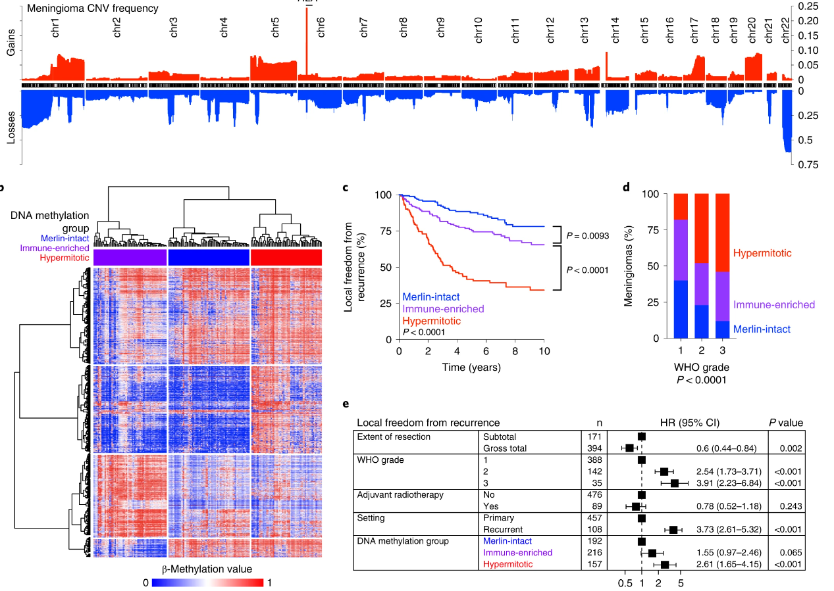
General Methylation Results
Most understandable format

Slide 12
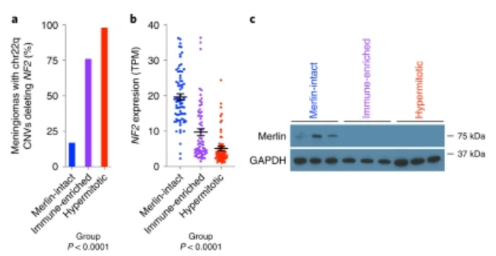
NF2/Merlin Methylation
More aggressive tumors display less NF2 genes and less Merlin expression

Slide 13
Immune enriched meningioma
Increased expression in polymorphic HLA locus via copy number amplification
responsible for immune infiltration
Notes:
T cell enrichment in immune enriched (fig. b)

Slide 14
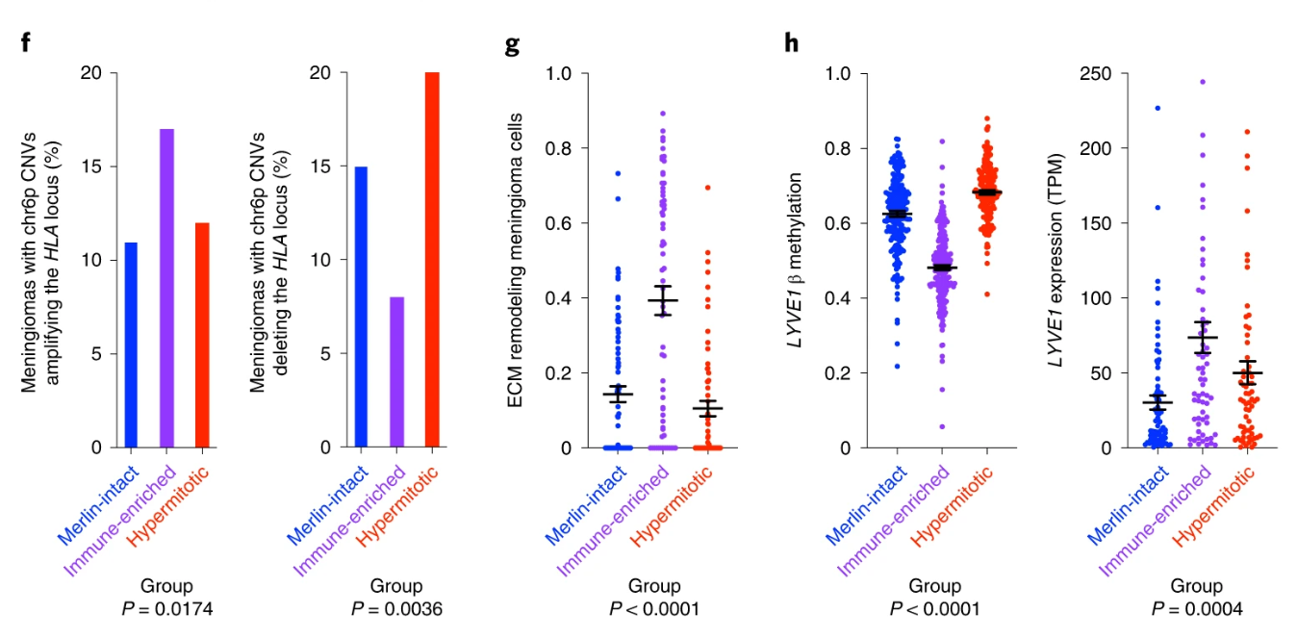
HLA gene locus
Amplification:
Merlin-intact (11%, n=21/192)
Immune enriched (17%, n=37/216)
Hypermitotic (12%, n=12/157)****
Should be 7.6%!!!
Present in 77% of immune enriched.

Slide 16
Hypermitotic meningioma
Ki-67- Cell division marker
FOXM1- Oncogene, marker for meningioma recurrence, drives immunity to cytotoxic therapies
CDKN2A/B- Tumor suppressor
Both are relatively uncommon within group

Slide 17
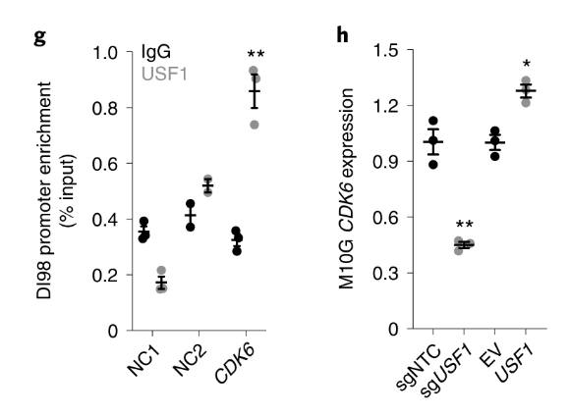
Hypermitotic common dysregulation
USF1 is a transcription factor that binds to CDK6 (proto-oncogene)
Enriched in 24% of hypermitotic, 0% of merlin intact
52 of 63 (83%) hypermitotic meningiomas displayed CDK2 deactivation, USF1 amplification, or FOXM1 increased expression.

Slide 18
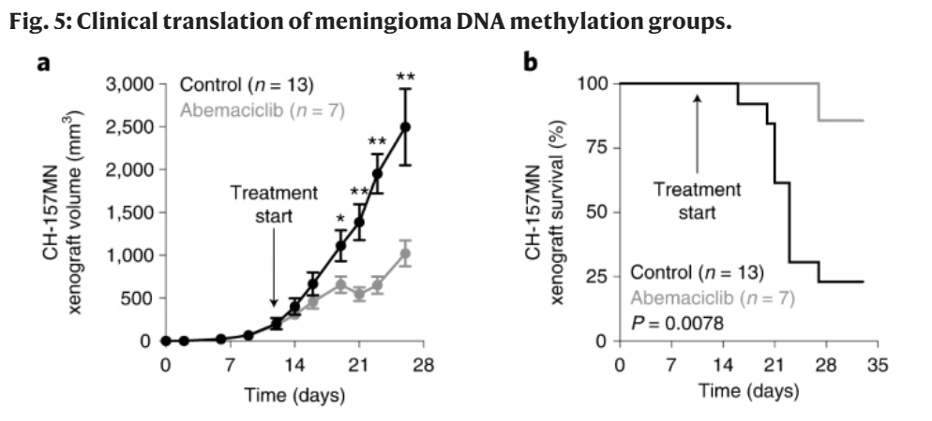
Therapeutic strategies
Meningiomas with worse prognosis outcomes are more resistant to cytotoxic therapies, yet more sensitive to cytostatic therapies.
CDK4/6 inhibitors (cell cycle inhibitors)
To find accurate clinically analogous results, an intracranial microenvironment was created
Heterogeneous environments increase resistances to therapies

Slide 20
Article Link
https://www.nature.com/articles/s41588-022-01061-8

