Slide 1
The genomic landscape of 2,023 colorectal cancers
Daniel Karimi Dehkordi
Notes:
Good morning, everyone. My name is Daniel, and today I’ll present The Genomic Landscape of 2,023 Colorectal Cancers, a study that provides groundbreaking insights into the somatic mutational landscape, driver genes, and molecular subgroups of colorectal cancer."

Slide 2
Presentation with more in depth slides:
Article

Slide 3
Introduction to Colorectal Cancer
Colorectal cancer (CRC) is a significant public health concern, ranking as the third most common malignancy worldwide. It is a leading cause of cancer-related deaths, primarily affecting the colon and rectum. The incidence of CRC varies globally, with higher rates observed in developed regions, which is often attributed to dietary and lifestyle factors.
Notes:
Colorectal cancer, or CRC, is a pressing global health issue. It is the third most common malignancy worldwide and a major cause of cancer-related deaths. This study investigates CRC's complexity by analyzing its genomic features and uncovering actionable insights.
The ongoing research into CRC not only enhances our understanding of its biological underpinnings but also drives innovation in treatment strategies. The comprehensive genomic profiling has implications for early detection, therapeutic interventions, and understanding resistance mechanisms to existing treatments. Moreover, CRC serves as a model for studying cancer development, progression, and the role of the tumor microenvironment, contributing broadly to the field of oncology.

Slide 4
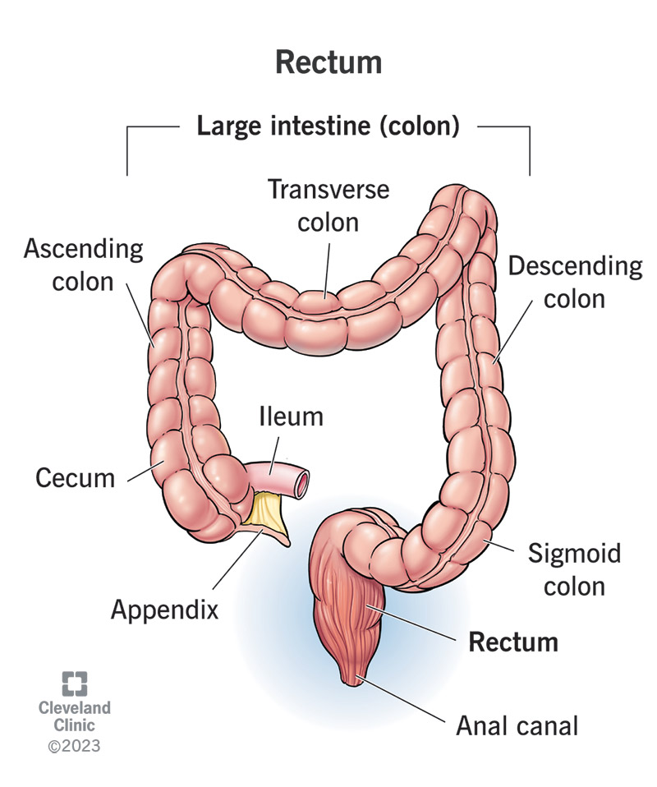
Study Objectives
Characterize the somatic mutational landscape of CRC.
Identify new CRC driver genes.
Define new molecular subgroups of CRC with distinct clinical implications.
Explore mutational profiles and potential etiological factors.
Identify actionable mutations for personalized medicine.
Analyze immune escape mechanisms in CRC.
Notes:
The study aims to:
Characterize the somatic mutational landscape of CRC.
Identify new CRC driver genes.
Define molecular subgroups with clinical implications.
Explore mutational profiles and potential etiological factors.
Identify actionable mutations for personalized medicine.
Examine immune escape mechanisms in CRC.

Slide 5
Next-Generation Sequencing (NGS)
NGS was used for whole-genome sequencing of 2,023 CRC samples.
They identified mutations including new CRC driver genes.
They categorized CRC into genomic subgroups with clinical relevance.
They enhanced personalized medicine by identifying actionable mutations.
Notes:
This study used NGS for whole-genome sequencing of 2,023 CRC samples. It identified novel driver genes, classified CRC into genomic subgroups, and contributed significantly to advancing personalized medicine.

Slide 6
Sample Size
CRC samples from the UK 100,000 Genomes Project.
Samples include primary carcinomas, metastases, and recurrent cancers.
Whole-genome sequencing performed on all samples.
Deep sequencing ensured high accuracy.
Large sample size (2,023) allowed robust analysis of CRC genomic diversity.
Notes:
The study included CRC samples from the UK 100,000 Genomes Project, encompassing primary, metastatic, and recurrent cancers. Deep sequencing ensured high accuracy, and the large sample size allowed a robust analysis of genomic diversity.

Slide 7
Whole-Genome Sequencing Results
Identified 250+ driver genes, many not previously linked to CRC.
Significant structural variants (SVs) discovered (deletions, amplifications, translocations).
CRCs classified into genomic stability subtypes (MSI, POL, MSS).
Actionable mutations linked to therapeutic targets.
Immune-escape mutations prevalent in hypermutant and MSS tumors.
Notes:
Whole-genome sequencing revealed over 250 driver genes, including many previously unassociated with CRC. It also uncovered structural variants and classified CRCs into genomic stability subtypes, providing therapeutic insights.

Slide 8
Driver Genes
Over 250 driver genes identified in CRC.
Includes genes involved in WNT, RAS-RAF-MEK-ERK, PI3K, TGFβ-BMP, and TP53 pathways.
Driver genes contribute to cancer progression and potential treatment targets.
Notes:
More than 250 driver genes were identified, including those in key pathways such as WNT, RAS-RAF-MEK-ERK, PI3K, TGFβ-BMP, and TP53. These findings are pivotal for understanding CRC progression and treatment opportunities.

Slide 9
Fig. 1 | Driver genes and structural variants in CRC. a, The most commonly mutated driver genes

Slide 10
Significance of New Driver Genes
Targeted Therapy Development: Enables creation of drugs to inhibit cancer-driving genes.
Personalized Medicine: Allows for tailored treatment based on individual genetic profiles.
Understanding Resistance: Identifies mechanisms of resistance to current therapies.
Prognostic Value: Provides insight into disease aggressiveness and patient prognosis.
Combination Therapies: Supports multi-targeted strategies to improve treatment outcomes.
Notes:
The discovery of new driver genes facilitates targeted therapy development, personalized treatment plans, and insights into resistance mechanisms. They also provide prognostic value and support the development of combination therapies.

Slide 11
Genomic Alterations
Single Nucleotide Variants (SNVs): Affect oncogenes and tumor suppressor genes, impacting pathways like WNT, RAS-RAF-MEK-ERK, and PI3K-AKT.
Insertions and Deletions (Indels): Common in mismatch repair genes, leading to microsatellite instability (MSI) and high mutation burden.
Copy Number Variations (CNVs): Duplications or deletions lead to overexpression of oncogenes or loss of tumor suppressor genes.
Structural Variants (SVs): Unbalanced inversions, translocations, and fusion genes disrupt gene function and contribute to cancer progression.
Notes:
The study identified various alterations:
Single Nucleotide Variants (SNVs),
Insertions and Deletions (Indels),
Copy Number Variations (CNVs),
Structural Variants (SVs). These changes disrupt gene function, contributing to tumor progression.

Slide 12
Mutation Signatures
Wide array of mutational signatures identified.
Signature SBS93 linked to exogenous mutagens.
Different CRC subtypes show distinct mutational profiles.
MSI tumors have a high mutation burden due to DNA repair deficiencies.
Notes:
The research uncovered distinct mutational signatures. Notably, SBS93 was linked to exogenous mutagens. Different CRC subtypes exhibited unique profiles, with MSI tumors showing a high mutation burden due to DNA repair deficiencies.

Slide 13
Immune-Escape Mechanisms
Immune-escape mutations found in hypermutant and MSS tumors.
Common changes in HLA gene copy numbers.
Mutations impair antigen processing and immune recognition.
Notes:
Immune escape mutations, particularly in hypermutant and MSS tumors, involved changes in HLA genes, impairing antigen processing and immune recognition. These findings inform immunotherapy strategies.

Slide 14
Molecular Subgroups
Microsatellite Instability-Positive (MSI):
High mutation burden due to mismatch repair deficiencies.
Associated with better prognosis and immunotherapy response.
Microsatellite-Stable (MSS):
Largest subgroup with more chromosomal stability.
Subdivided into genomic subgroups with distinct molecular features.
MSS Subgroups:
Genome Stable (GS): Fewer mutations, less chromosomal instability.
Chromosomal Instability (CIN): Significant chromosomal rearrangements and aneuploidy.
CpG Island Methylator Phenotype (CIMP): Extensive gene silencing through hypermethylation.
Notes:
CRC was categorized into:
Microsatellite Instability-Positive (MSI): High mutation burden, better prognosis, responsive to immunotherapy.
Microsatellite-Stable (MSS): Subdivided into Genome Stable, Chromosomal Instability, and CpG Island Methylator Phenotype groups. These subgroups enhance treatment precision.

Slide 15
Diet and Smoking Correlation
Mutational Signatures:
Diet: Linked to SBS93, associated with red/processed meats.
Smoking: Introduces mutations through PAHs and TSNAs.
Localized Effects: Different regions of the colon show distinct mutation profiles.
Influence on Prognosis: Specific mutations impact tumor behavior and treatment response.
Preventive Measures: Emphasize dietary changes and smoking cessation to reduce CRC risk.
Notes:
Mutational signatures linked CRC to environmental factors:
Diet, particularly red and processed meats, contributed to SBS93 mutations.
Smoking introduced mutations through PAHs and TSNAs. These insights emphasize preventive measures like dietary changes and smoking cessation.

Slide 16
Structural Variants
Deletions & Amplifications: Alter gene dosage, potentially activating oncogenes or inactivating tumor suppressors.
Inversions: Disrupt gene regulation and expression patterns.
Translocations: Create fusion genes with new oncogenic properties.
Complex Rearrangements: Lead to genomic instability, a hallmark of cancer.
Notes:
Structural variants such as deletions, amplifications, inversions, and translocations disrupt gene regulation and contribute to genomic instability. These variants provide opportunities for therapeutic targeting.

Slide 17
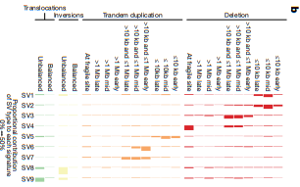
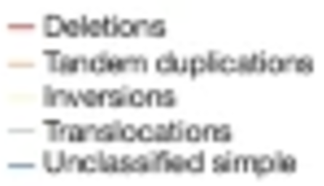
Fig. 1 | Driver genes and structural variants in CRC.b, Nine SV signatures by underlying SV type in MSS primary, MSI and POL CRCs (n = 1,898). Horizontal coloured bars represent the contribution of each SV type to each signature.

Slide 18
Clinical Implications
Targeted Therapy: Improved ability to develop drugs based on specific genetic profiles.
Precision Medicine: Tailored treatments that reduce side effects and enhance efficacy.
Diagnostics and Prognostics: Enhanced early detection and prediction of patient outcomes.
Immunotherapy: Better understanding of immune-escape mechanisms supports immunotherapy improvements.
Combination Therapies: Supports multi-targeted approaches to overcome resistance and improve outcomes.
Screening and Prevention: Genomic findings help identify high-risk individuals for targeted monitoring.
Notes:
Key clinical implications include:
Targeted therapies based on genetic profiles.
Precision medicine for tailored treatments.
Enhanced diagnostics and prognostics.
Advancements in immunotherapy and combination therapies.

Slide 19
Therapeutic Targets
Driver Genes and Pathways:
Mutations in key pathways like WNT, PI3K/AKT, and RAS-RAF-MEK-ERK offer therapeutic targets for inhibitors.
Structural Variants:
Fusion proteins from translocations offer new treatment opportunities.
Gene amplifications or deletions highlight targets for therapy or gene reactivation.
Molecular Subgroups:
MSI-High Tumors: Ideal candidates for immunotherapy due to their high mutation burden.
CIMP Status: Epigenetic therapies to reverse hypermethylation.
Immunotherapy Enhancements:
Use checkpoint inhibitors or cancer vaccines based on unique neoantigens identified through genomic profiling.
Combination Therapies: Multi-target strategies are essential to address complex genetic interactions and resistance mechanisms.
Notes:
Driver genes and pathways such as WNT and PI3K/AKT offer therapeutic targets. Structural variants, like fusion proteins, provide new opportunities. Molecular subgroups guide specific treatments, such as immunotherapy for MSI-high tumors.

Slide 20
Comparison with Previous Studies
Expanded list of driver genes beyond previous studies.
New molecular subgroups introduced for personalized treatment.
Detailed analysis of structural variants.
Environmental factors like diet and smoking linked to mutational signatures.
Supports precision medicine with actionable mutations.
Notes:
This study builds on prior research by expanding the list of CRC driver genes, introducing new molecular subgroups, and linking environmental factors to genomic alterations, advancing precision medicine.

Slide 21
Challenges and Limitations
Sample diversity and quality.
Genetic heterogeneity in CRC complicates mutation identification.
Translating genetic findings to clinical applications.
Technological biases in detecting complex variants.
Notes:
Challenges include sample diversity, genetic heterogeneity, and translating genetic findings into clinical applications. Technological biases also complicate the detection of complex variants.

Slide 22
Future Research Directions
Functional studies on new driver genes.
Drug development for new therapeutic targets.
Exploration of non-coding genomic regions in CRC.
Multi-omics data integration for comprehensive cancer research.

Slide 23
Conclusion
Enhanced Understanding of CRC: Provides a more detailed and nuanced understanding of CRC’s genetic complexity, guiding future research and clinical applications.
Pathway to Personalized Medicine: Expands opportunities for personalized treatment strategies based on unique genetic profiles.
Potential for Broader Cancer Research: The methodologies and findings from this study can be applied to other cancer types, promoting advances in the broader field of cancer research.
Notes:
In conclusion, this study advances our understanding of CRC’s genomic complexity, provides a foundation for personalized medicine, and offers methodologies applicable to other cancers

Slide 24
References
Cornish, A.J., Gruber, A.J., Kinnersley, B. et al. The genomic landscape of 2,023 colorectal cancers. Nature 633, 127–136 (2024). https://doi.org/10.1038/s41586-024-07747-9

