Slide 1
“Widespread position-dependent transcriptional regulatory sequences in Plants”
Authors: Yoav Voichek, Gabriela Hristova, Almudena Molla-Morales, Detlef Weigel & MAgnus Nordborg
Published: 12 September 2024
Vivi Nguyen- Bioinformatics

Slide 2
-Purpose-
This research investigates these position-dependent enhancers, focusing specifically on the sequences downstream of the TSS, and explores how they influence gene expression across multiple plant species
As well as grasping properties of cis-regulatory sequences in plants, using massively parallel reporter assays (MPRAs) to map the roles of these sequences

Slide 3
Key Points of this Study
01
02
03
04
05
06
GATC Motif as Key Regulatory Player
Plant Enhancers are Position-Dependent
Intro to eQTL
Future Outlook & Limitations
Cross- Species Consistency
Regulation Downstream of the TSS

Slide 4
Introducing eQTL
eQTL (expression Quantitative Trait Loci): Genomic regions where genetic variation affects gene expression.
Helps identify regulatory elements influencing gene activity.
On or Off gene
What is it?
Key Finding from Research
Downstream eQTL highlight unique transcriptional regulation in plants, distinct from animals.

Slide 5
Arabidopsis eQTL Analysis Findings
eQTL Enrichment
Chromatic & TF Involvement
Downstream eQTL regions were associated with histone enrichment (e.g., H3.1 and H3.3) and TF binding sites, confirming their role in transcription regulation.
Found a similar proportion of eQTL downstream of the TSS as upstream, challenging the traditional assumption that most regulatory elements are upstream.
mRNA Stability vs Transcription Regulation
Conserved Pattern Across Data Sets
Unlike in humans, where eQTL often correspond to mRNA stability regions, in Arabidopsis, eQTL downstream of the TSS appear to regulate transcription directly rather than mRNA stability.
The enrichment of eQTL downstream of the TSS was consistent across multiple Arabidopsis gene expression datasets.

Slide 6
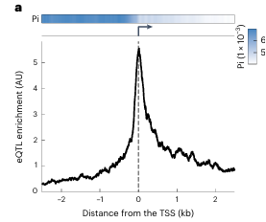
eQTL enrichment found downstream of TSS

Slide 7
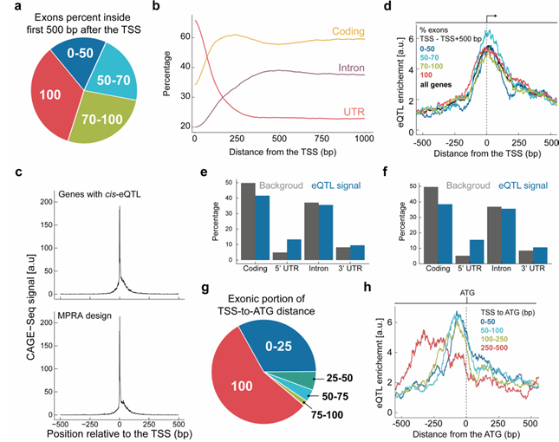
mRNA Stability vs Transcription Regulation
[Hypothesis]
If eQTL variants affect mRNA stability, they should be more frequent in exons than introns, as introns are removed by splicing.
Unlike human eQTL, Arabidopsis eQTL showed no preference for exons over introns.

Slide 8
mRNA Stability vs Transcription Regulation
eQTL were more frequent:
Just downstream of the TSS for genes with longer TSS-to-ATG distances (including 5′ UTRs and introns).
Just upstream of the TSS for genes with shorter TSS-to-ATG distances.

Slide 9
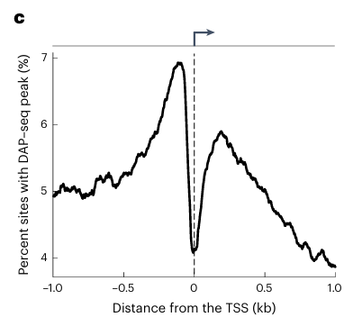
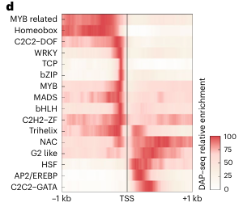
Chromatic & TF Involvement
DNA Affinity Purification Seq, In Vitro
In Vivo Immunoprecipitation

Slide 10
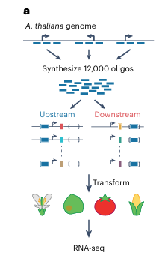
Massively Parallel Reporter Assay (MPRA)
Designed 12,000 160-bp DNA fragments from upstream and downstream regions of Arabidopsis transcription start sites (TSS).
Inserted fragments into reporter constructs with GFP genes for expression analysis.
Analyzed transcriptional activity using RNA sequencing across four plant species: Arabidopsis, tomato, maize, and Nicotiana benthamiana.

Slide 11
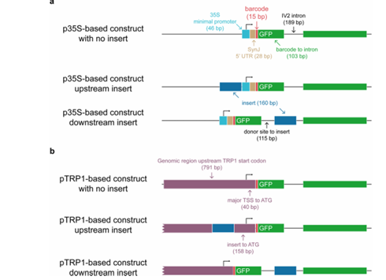
Continuation of MPRA..
2 different GFP reporter constructs utilized
46-bp Cauliflower Mosaic Virus (CaMV) 35s minimal promoter + short synthetic 5’UTR
700-bp Arabidopsis TRP1 including its 5’UTR
Study the effect of introns on gene expressions

Slide 12
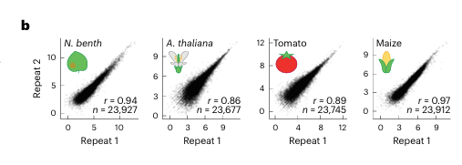
*Reproducibility was made sure throughout 3-4 repeated experiments
Continuation of MPRA…

Slide 13
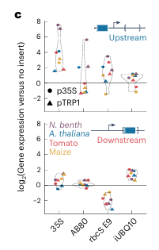
Role of IUB Q10 Enhancers in Results
Intronic sequences from the UBQ10 gene. Used as control to confirm the position-dependent of the plant
Fragments derived from IUBQ10 introns enhanced transcription more effectively when placed downstream of the TSS (inside the intron of the GFP reporter gene).
These sequences were less effective when positioned upstream, supporting the idea that intronic enhancers in plants are position-dependent.

Slide 14
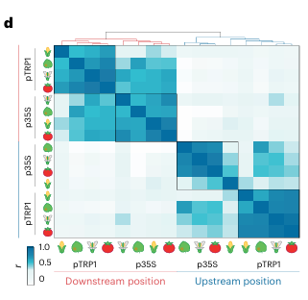
Position Dependent Enhancer Activity
Enhancer fragments showed similar activity across species, promoters, and host cell introduction methods.

Slide 15
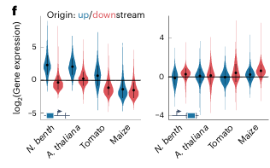
Impact of Original Genomic Location on Activity
In maize, fragments placed upstream often reduced reporter expression, regardless of their genomic origin.
Despite variations in absolute expression levels due to backbone or species, the relative activity of fragments at the same position was consistent across species.

Slide 16
Mutation and Position Analysis
Validation Techniques
Compared transcription rates via mRNA synthesis assays.
Tested fragment effects across different promoters, species, and transformation methods.
Systematic modification of fragments to assess transcriptional effects.
GATC motifs identified and studied for their role in enhancing transcription.

Slide 17
Introducing GATC Motif
GATC motif identified as a key regulatory element.
GATC is the core motif, often embedded in larger sequences (e.g., YVGATCBR, where Y = C/T, V = A/C/G, B = C/G/T, R = A/G).
Enhancers with GATC motifs downstream of the TSS increased gene expression in a dose-dependent manner.
The more GATC motifs present in a downstream region, the stronger the transcriptional enhancement.

Slide 18
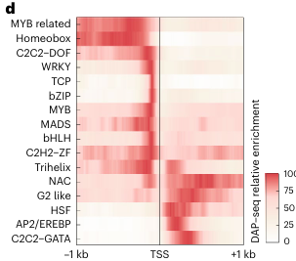
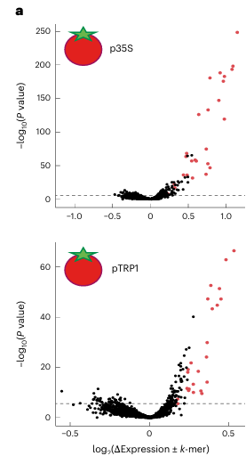
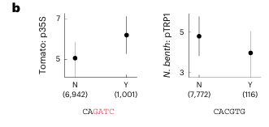
More 6-mers were associated with promoting expression than repressing it when located downstream of the TSS.
These 6-mers likely represent binding sites for TFs that regulate transcription in downstream regions.

Slide 19
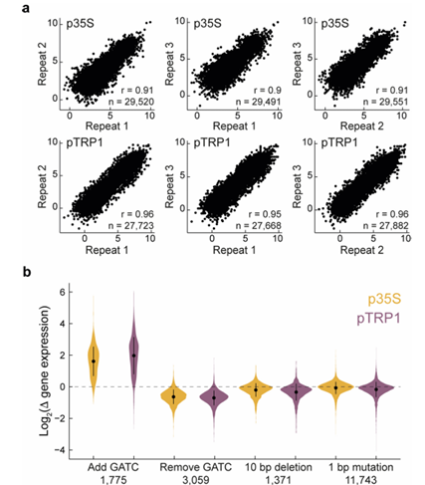
GATC Motif Effects
Synthesized 18,000 additional oligonucleotides, each a variant of fragments from the initial pool, and inserted them downstream of the TSS in two backbones.
Deleted, shuffled, or mutated the core GATC sequence to GATA.

Slide 20
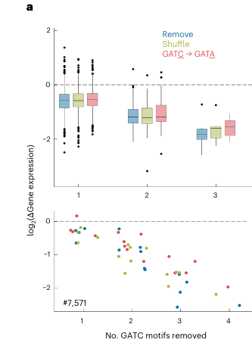
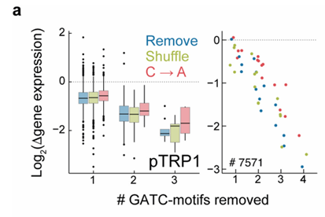
Focused on 841 fragments containing a GATC motif.
Removing or altering the GATC motif caused an average 50% reduction in gene expression, irrespective of mutation type.

Slide 21
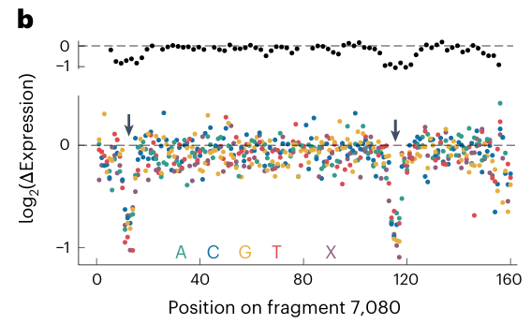
Altering the core 4 bp of the GATC motif consistently decreased activity, emphasizing strict sequence constraints.
Deep Mutational Scan
Conducted deep mutational scans on 13 downstream-derived fragments, generating 736 derivatives per fragment by:
Deleting sets of ten consecutive base pairs.
Mutating each nucleotide to its three alternatives or deleting it.

Slide 22
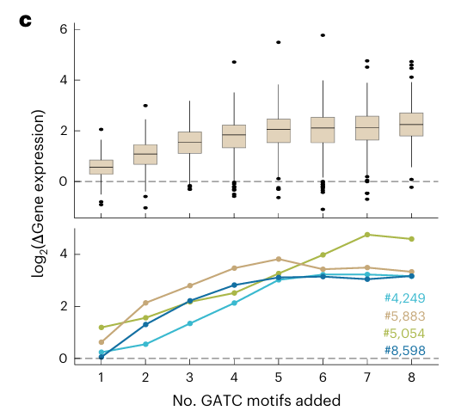
Testing GATC Sufficiency
Selected 221 fragments (166 downstream-derived, 55 upstream-derived) and incrementally added 1–8 GATC motifs.
Expression increased with each added GATC motif, even in upstream-derived fragments.
Observations
97% of fragments enhanced expression when at least 4 GATC motifs were added.
Highly active fragments saturated after one addition, while low-activity fragments remained unsaturated even after eight.

Slide 23
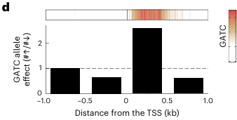
Natural Variation Analysis
GATC motifs downstream of the TSS, particularly within 500 bp, correlated with higher gene expression.
Consistent with synthetic MPRA results, highlighting the motif's role in transcriptional enhancement.

Slide 24
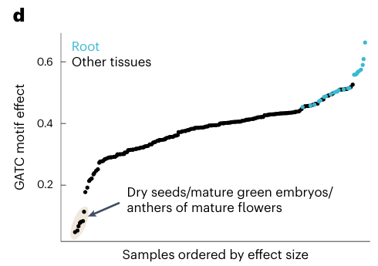
GATC Motifs Transcription Across Tissues
Findings moved from leaf cells to GATC’s impact on other tissues & stages
GATC motif activity fluctuate threefold across tissues and stages
Lowest effects was seen in seed developmental stages
Strongest effects observed in roots , in the meristem zone

Slide 25
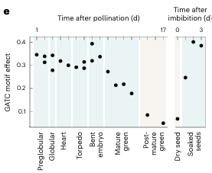

Slide 26
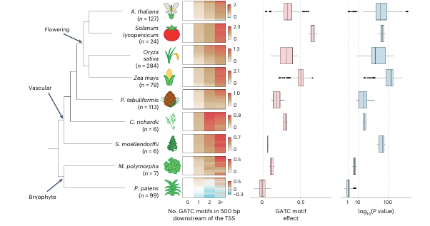
GATC with Vascular Plants

Slide 27
Limitations from this Study
1
2
3
4
5
Primarily leaf cells, limited on tissues & stages
TSS still remain unclear
Plant-specific genome packing
Non-GATC sequences
Vascular (fern) vs Nonvascular (mosses) Plants

Slide 28
-Future Outlook on this Research-
Evolutionary Insights
Mechanistic Studies
We can explore more how downstream regulatory mechanisms and motifs like GATC evolved across plant lineages
Investigate how plant-specific genome architecture influences regulatory element function near the TSS
Broader Applications
Unanswered Questions
Utilize GATC motif insights for crop improvement by engineering gene expression patterns in agricultural species
Determine the precise roles of GATC motifs in different tissues and environmental conditions

Slide 29
Thank You :)
REferences-_
1.Voichek, Y., Hristova, G., Mollá-Morales, A. et al. Widespread position-dependent transcriptional regulatory sequences in plants. Nat Genet 56, 2238–2246 (2024). https://doi.org/10.1038/s41588-024-01907-3
2. Gallegos, J. E. & Rose, A. B. An intron-derived motif strongly increases gene expression from transcribed sequences through a splicing independent mechanism in Arabidopsis thaliana. Sci. Rep. 9, 13777 (2019).

