Slide 1
Sub-1.4 cm³ capsule for detecting labile inflammatory biomarkers in situ
Presentation by: Thais Ortiz Rodriguez
Reference Article: https://doi.org/10.1038/s41586-023-06369-x
Authors: Inda-Webb, M.E., Jimenez, M., Liu, Q. et al.
Published in: Nature, Vol 620, 10 August 2023

Slide 2
Abstract
Short-lived molecules like nitric oxide and hydrogen sulfide in the gastrointestinal (GI) tract play important roles in signaling inflammation but are hard to detect due to their reactivity.
A tiny, ingestible device was developed that uses genetically engineered bacteria as biosensors to detect these molecules by emitting light in response to inflammation.
This light signal is then converted to a wireless message by electronic circuits in the device. Tested in animal models, the device fits into a capsule small enough to swallow and communicates wirelessly.
This technology could enable earlier diagnosis and better monitoring of conditions like inflammatory bowel disease (IBD), while also supporting remote, personalized patient care.

Slide 3
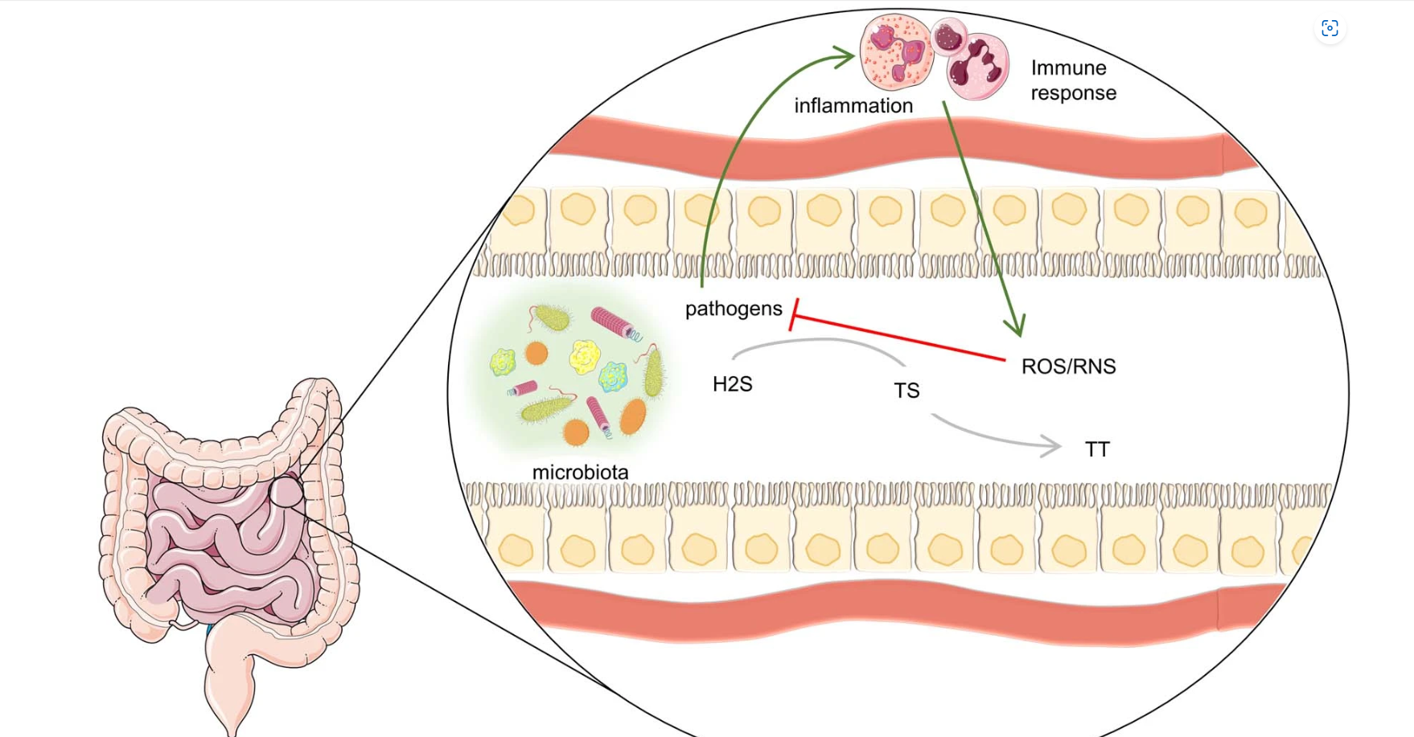
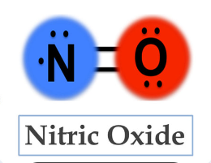
Introduction
Background on Gastrointestinal Inflammation:
Gastrointestinal (GI) inflammation is a common feature in diseases like Inflammatory Bowel Disease (IBD), and ulcerative colitis.
Inflammation in the GI tract can disrupt digestion, nutrient absorption, and immune function, often leading to chronic pain and discomfort.
Importance of Labile Biomarkers:
Labile biomarkers, like nitric oxide (NO) and reactive oxygen species (ROS), are produced during inflammatory responses. These molecules are indicators of active inflammation.
Detecting these biomarkers is crucial for understanding the severity and progression of GI diseases.
Challenges in Biomarker Detection:
Labile biomarkers are highly reactive and short-lived, meaning they degrade quickly and are difficult to measure accurately.

Slide 4
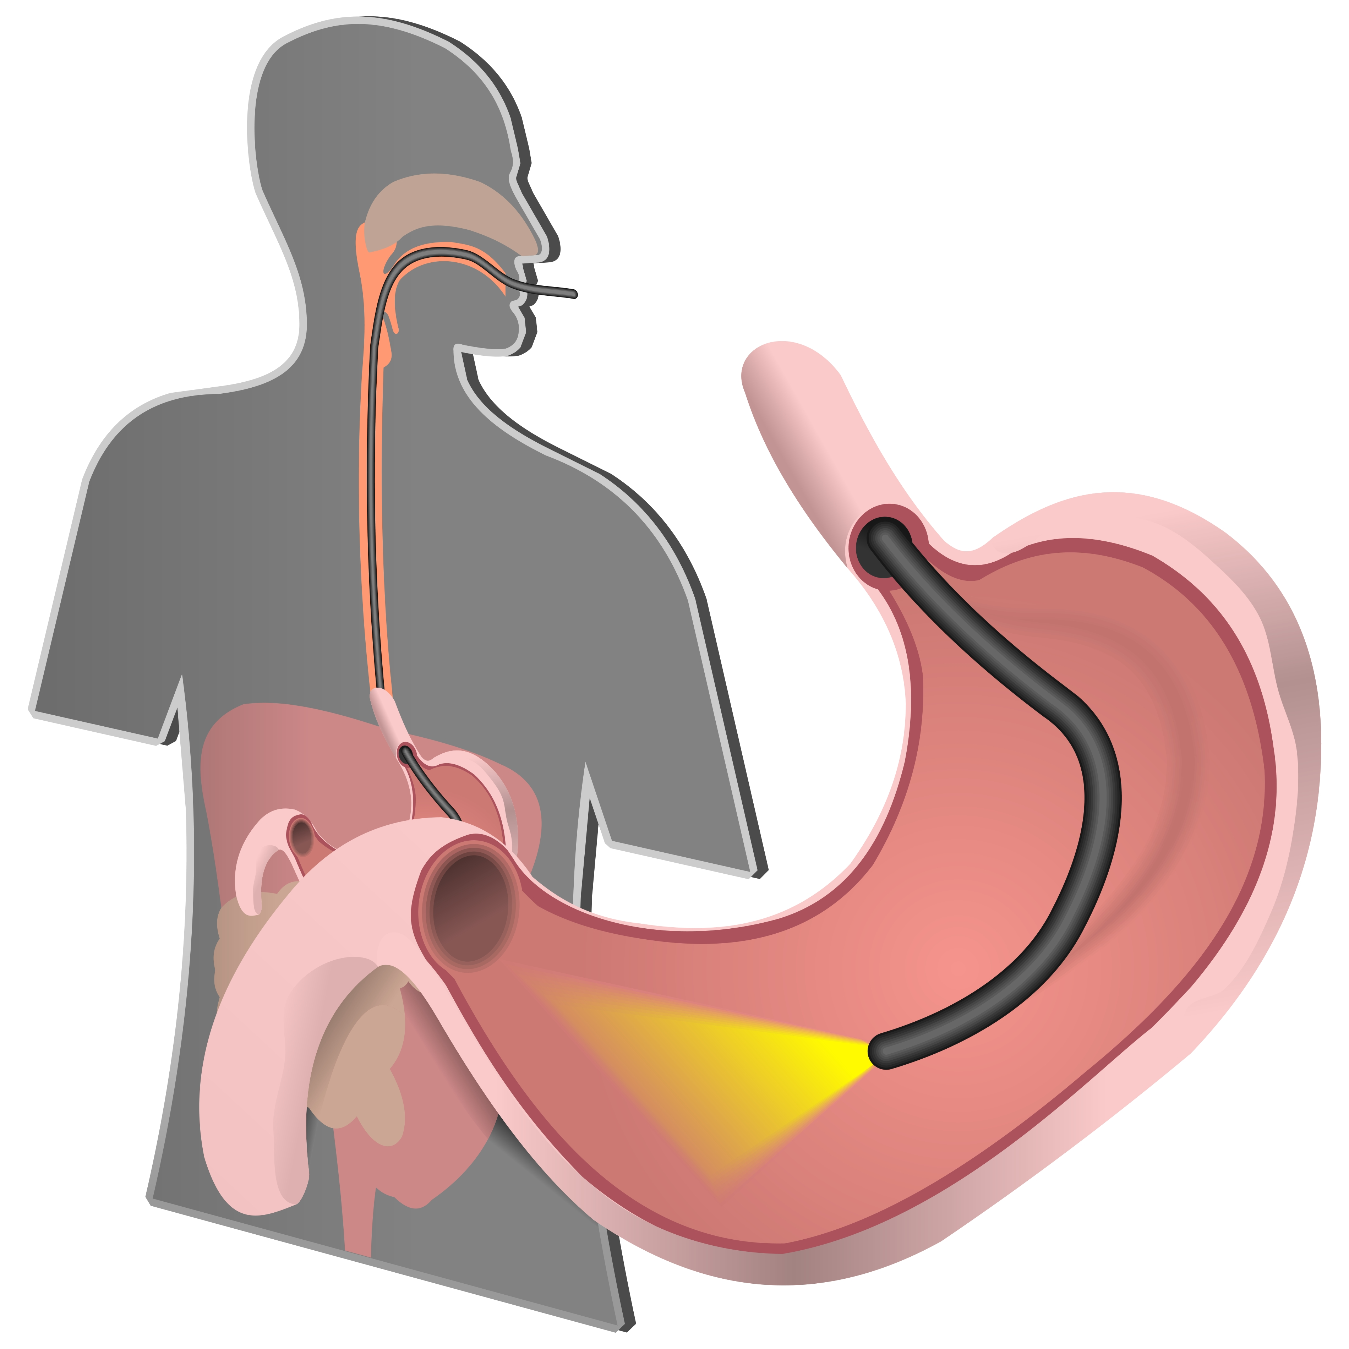
Research Motivation and objectives
Current Limitations in GI Inflammation Detection:
Endoscopy and stool analysis, are often invasive, uncomfortable, and provide only snapshot information.
These methods can miss critical, short-lived inflammation markers like nitric oxide (NO) and hydrogen sulfide (H₂S), which are key indicators of inflammatory conditions but degrade quickly in the body.
Research Objectives:
Goal: Develop a tiny, ingestible capsule that continuously detects inflammation-related biomarkers in the gastrointestinal tract in real-time.
Real-Time Monitoring: Allow for continuous, non-invasive tracking of disease progression, providing a fuller picture of inflammation levels over time.

Slide 5
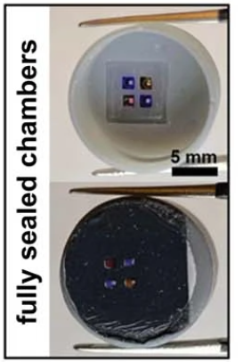
Device overview
Core Components:
Bacterial Biosensors:
The capsule contains genetically engineered E. coli Nissle 1917, a safe probiotic strain known for its stability in the GI tract.
These bacteria are modified to produce luminescence (light) when they detect specific inflammation markers, such as NO and H₂S.
Low-Power Electronics:
Photodetectors within the capsule sense the light emitted by the bacteria when biomarkers are detected
A custom-designed readout chip converts this luminescent response into an electronic signal.
Wireless transmission circuitry then sends this data to an external device, such as a smartphone or computer, for real-time monitoring by healthcare providers.
The device is a compact, 1.4 cubic centimeter (cm³) capsule designed for safe ingestion. Its small size is comparable to a soft gel capsule or a pea, making it easy to swallow and safe for use in the gastrointestinal tract.

Slide 6
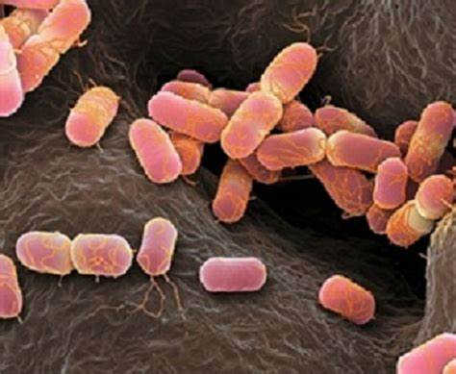
Bacterial biosensors: Why E. coli Nissle 1917?
E. coli Nissle 1917 is a non-pathogenic probiotic strain known for its beneficial properties and ability to survive in the GI environment without causing harm.
While some strains of E. coli (like E. coli O157) are associated with foodborne illnesses, Nissle 1917 is different. It is a benign strain used in probiotics and does not produce toxins.
16S rRNA sequencing used verify its identity and ensure no contamination with harmful strains.

Slide 7
Plasmid Construction and Circuit Characterization
Plasmid Construction
Method: Plasmids assembled using Gibson Assembly with PCR fragments and DNA from IDT gBlocks/Addgene (Supplementary Table 1).
Validation: Introduced into E. coli E. cloni 10G and confirmed via Sanger sequencing.
Circuit Testing
Culturing:
Aerobic: Incubated in Hi-Def Azure Media with inducers (e.g., H₂O₂, DETA-NO).
Anaerobic: Manipulated in a Coy chamber under N₂, H₂, and CO₂ gas mix.
Measurement: GFP expression evaluated via optical density (OD600) and flow cytometry.
Flow Cytometry Analysis
Process: Gated for single cells, excluding debris, using GFP fluorescence (FITC detector).
Software: Data analyzed with BD FACSDiva 9.0 and FlowJo.

Slide 8
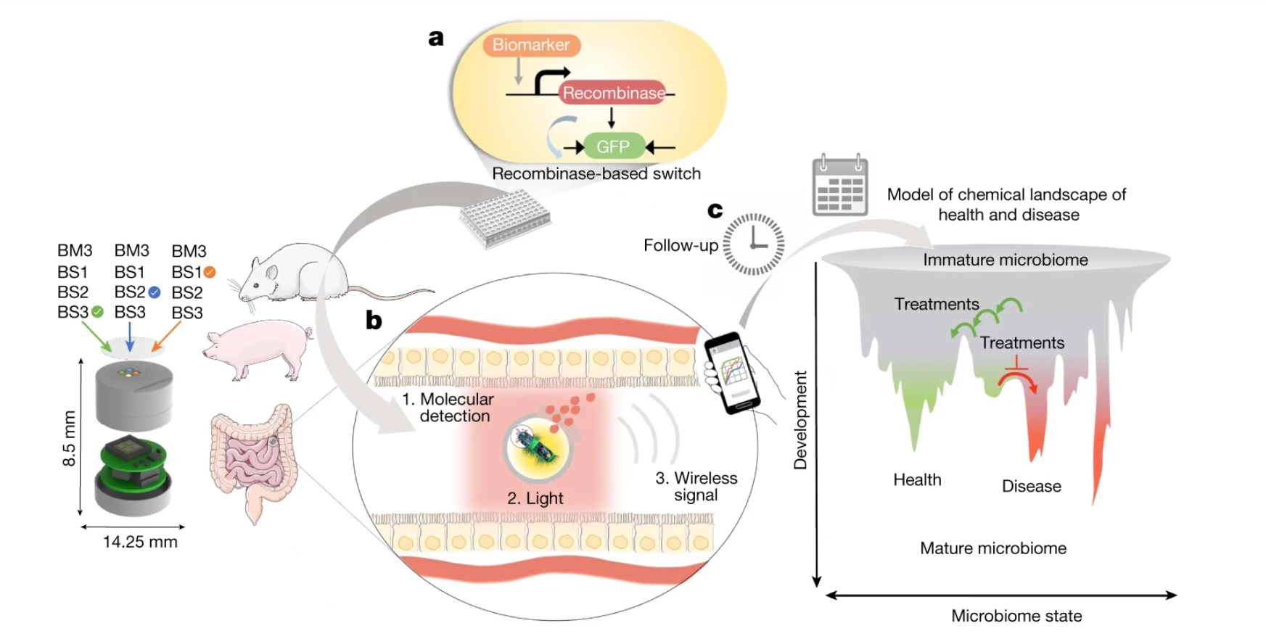
General platform for developing a miniaturized capsule for real-time detection of labile mediators of disease in the gut.
Engineered Bacteria and Device Design
Probiotic Engineering:
E. coli engineered to detect multiple biomarkers of Inflammatory Bowel Disease (IBD) using a recombinase-based genetic memory system.
Validated in animal models (mice and pigs) to ensure sensitivity and specificity to metabolites like nitric oxide (NO), hydrogen peroxide (H₂O₂), thiosulfate, and tetrathionate.
Capsule Design:
Dimensions: 8.5 mm height × 14.25 mm diameter.
Protects bacteria during passage through acidic environments, such as the stomach.
Miniaturized electronics interface with biosensing bacteria, capturing luminescent signals and converting them into wireless data.
Applications for Diagnosis and Monitoring
Immediate Follow-Up:
Enables remote detection of biomarkers after treatments or during disease progression.
Tracks response to therapies, such as anti-inflammatory drugs or dietary interventions.
Long-Term Gut Monitoring:
Monitors microbiome development from infancy to adulthood, observing shifts between healthy and diseased states.
Prevention and Treatment: Early detection of microbiome disturbances allows:
Preventive actions to resist unhealthy states (blocked red arrow).
Effective treatment plans to restore health (green arrows).

Slide 9
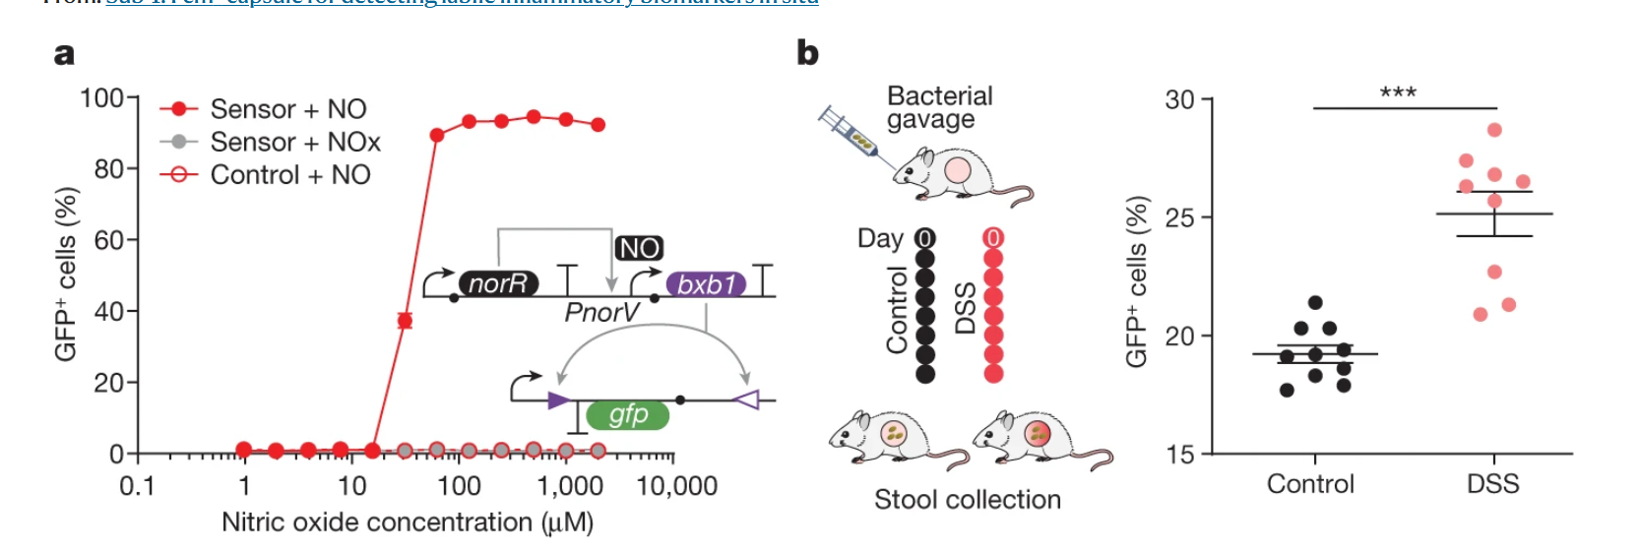
Validation of NO Biosensor in Mice
In Vitro NO Sensor Specificity
Mechanism:
NorR binds to the PnorV promoter in response to nitric oxide (NO), activating transcription of the bxb1 recombinase.
The recombinase flips the gfp expression cassette, leading to GFP production.
Results:
GFP expression increases with NO concentration (red curve).
The system is highly specific to NO; other reactive nitrogen species (RNS, or NOx) do not activate it (gray curve)
Analysis:
GFP-positive cells quantified via flow cytometry across NO concentrations.

Slide 10
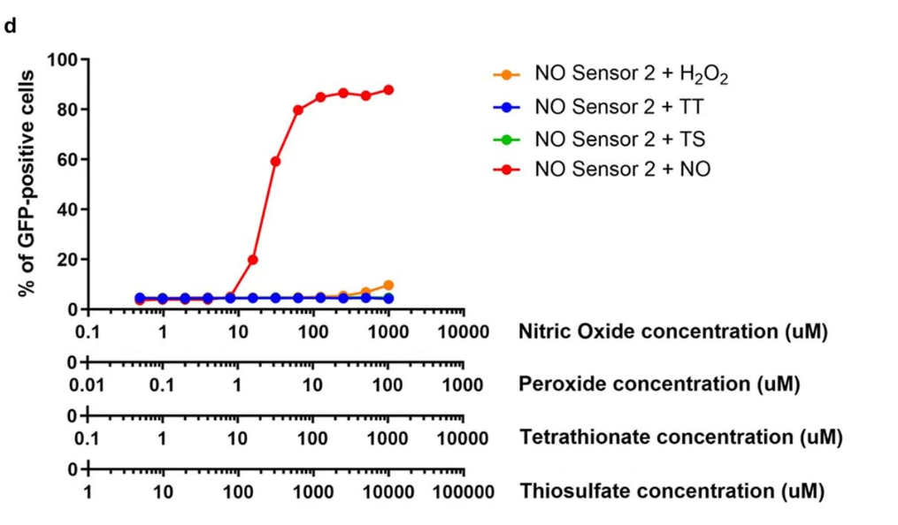
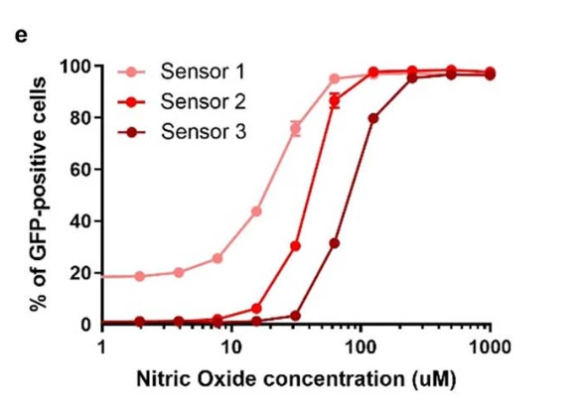
Validation and Sensitivity of NO Biosensors
Panel d: Cross-Reactivity of NO Sensor
The NO sensor 2 demonstrates high specificity to nitric oxide (NO), with GFP expression increasing significantly at higher NO concentrations.
Cross-reactivity tests show minimal GFP expression in response to other reactive species: hydrogen peroxide (H₂O₂), tetrathionate (TT), and thiosulfate (TS).
Results were obtained from flow cytometry, with n = 10,000 events per replicate.
Panel e: Sensitivity of NO Biosensors to Disease Stages
The three NO biosensors (Sensor 1, 2, 3) exhibit distinct GFP activation thresholds corresponding to specific NO concentrations:
Sensor 1: Detects low NO levels (~15 µM) associated with mild inflammation.
Sensor 2: Detects moderate NO levels (~30 µM).
Sensor 3: Detects high NO levels (~80 µM) indicative of severe inflammation.
Each point represents the mean GFP-positive percentage across three biological replicates.

Slide 11
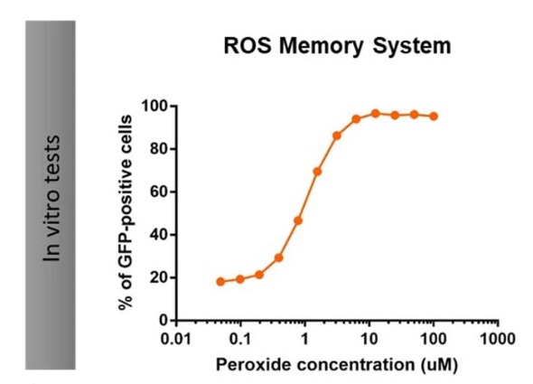
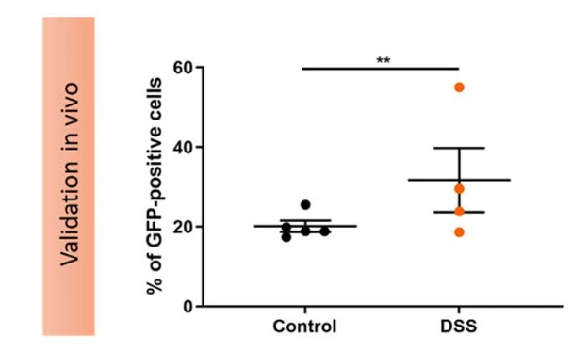
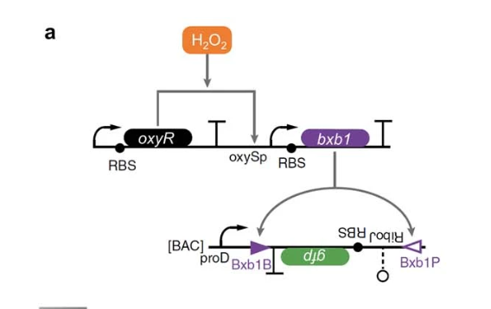
Validation of H2o2 ROS Memory System
Validation of ROS Sensor Circuit (H₂O₂ Detection):
The recombinant genetic circuit uses the OxyR transcription factor, which is oxidized and activated in the presence of hydrogen peroxide (H₂O₂). Activation of the oxySp promoter drives expression of the bxb1 recombinase, which flips the GFP expression cassette, enabling GFP production. This ROS memory system was validated in vitro to detect increasing peroxide concentrations.
Dose-Response Curve of ROS Memory System:
The graph shows the percentage of GFP-positive cells detected at varying concentrations of H₂O₂. GFP expression increases sharply as peroxide levels rise, confirming the specificity and sensitivity of the sensor. Data points represent mean values from three biological replicates, with error bars showing SEM
In Vivo Validation of ROS Memory System in Mice:
DSS-treated mice showed significantly higher percentages of GFP-positive cells compared to controls, confirming that the ROS sensor detects inflammation-associated H₂O₂ in the gut. Stool samples were collected and analyzed via flow cytometry 6 hours post-gavage.

Slide 12
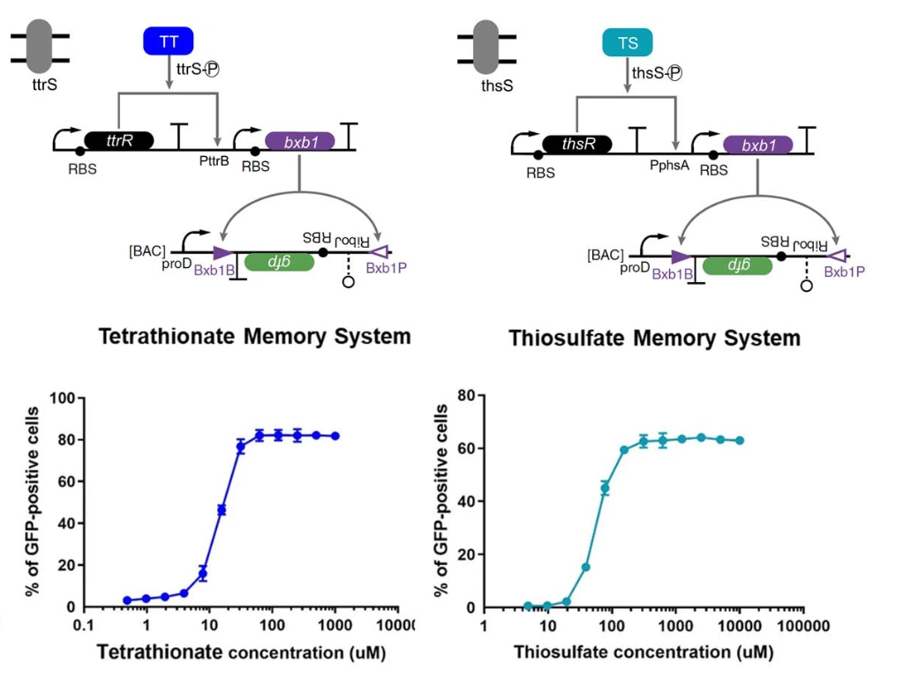
Validation of Tetrathionate and Thiosulfate Biosensors
a. Genetic Circuit Design:
The TT and TS sensors were designed to detect tetrathionate and thiosulfate in the gut environment.
The circuits use the bxb1 recombinase, which is activated upon target detection via transcription factors (TtrR and ThsR) regulated by specific promoters (PttrB and PphsA).
Recombinase-mediated flipping of the GFP expression cassette (flanked by attB and attP sites) results in GFP production as a readout.
Dose-Response Curves:
Tetrathionate Memory System: Shows increasing GFP-positive cells as tetrathionate concentration rises, with activation starting at ~10 µM and peaking at 100 µM.
Thiosulfate Memory System: Similar activation pattern observed, with a broader response range peaking at ~10,000 µM.
Data represent the mean of three biological replicates, with standard error of the mean (SEM) shown.

Slide 13
EXPERIMENTAL SET UP OF MICE EXPERIMENTS
Approval: Conducted under the Massachusetts Institute of Technology's Committee on Animal Care guidelines.
Subjects: Male C57BL/6J mice (8–10 weeks old, Jackson Labs).
Housing Conditions:
12/12 light cycle, 30–70% humidity, 21 ± 1 °C.
Acclimated for 1 week before experiments.
Bacterial Inoculation
Preparation:
E. coli Nissle 1917 cultured overnight, centrifuged, and resuspended in 20% sucrose.
Administration: 200 µl of culture (~10⁸ CFU) delivered via oral gavage.
Sample Collection and Processing
Faecal Sampling:
Collected 6 hours post-gavage, homogenized in PBS, and centrifuged to remove debris.
Culturing and Assay:
Supernatant cultured in media with antibiotics, incubated aerobically at 37 °C for 16–18 h, then analyzed via flow cytometry.
Media and Antibiotics:
Media supplemented with antibiotics (e.g., kanamycin, carbenicillin, chloramphenicol) for selective growth.

Slide 14
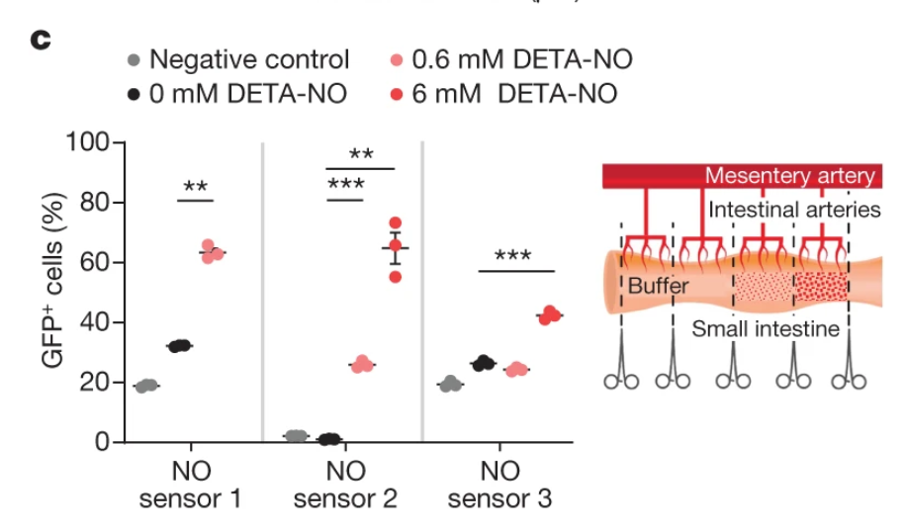
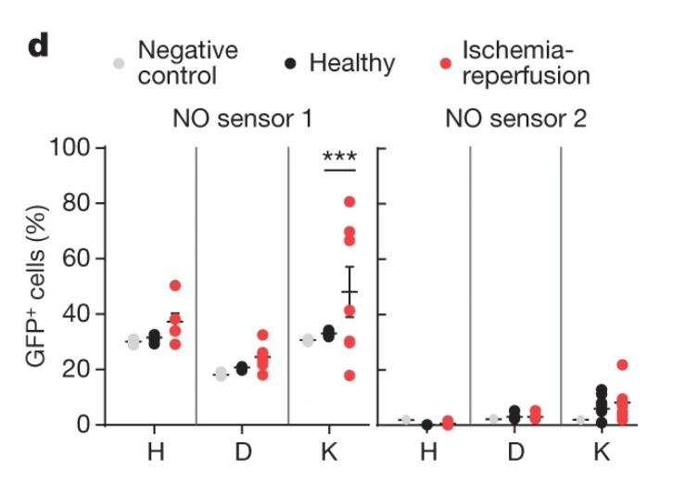
PIG no biosensor IN VIVO RESULTS
Response to DETA-NO in Intestinal Compartments:
Bacterial NO sensors 1, 2, and 3 were tested in pig intestines with separate compartments for control (negative or 0 mM DETA-NO) and treated conditions (0.6 mM and 6 mM DETA-NO).
Results showed significant GFP expression corresponding to NO concentrations, confirming that the sensors accurately detect NO at defined thresholds.
Ischaemia-Reperfusion Model of Inflammation:
Intestinal sections in pigs were subjected to ischaemia-reperfusion injury to induce inflammation.
NO Sensor 1 showed significantly higher GFP-positive cells in inflamed sections compared to healthy controls, validating its use in detecting inflammation-induced NO.

Slide 15
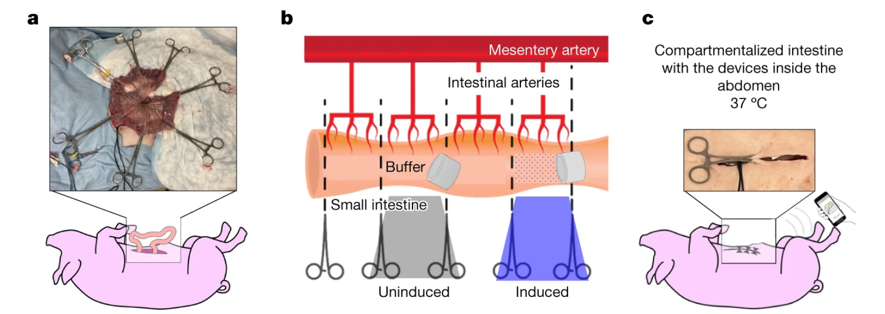
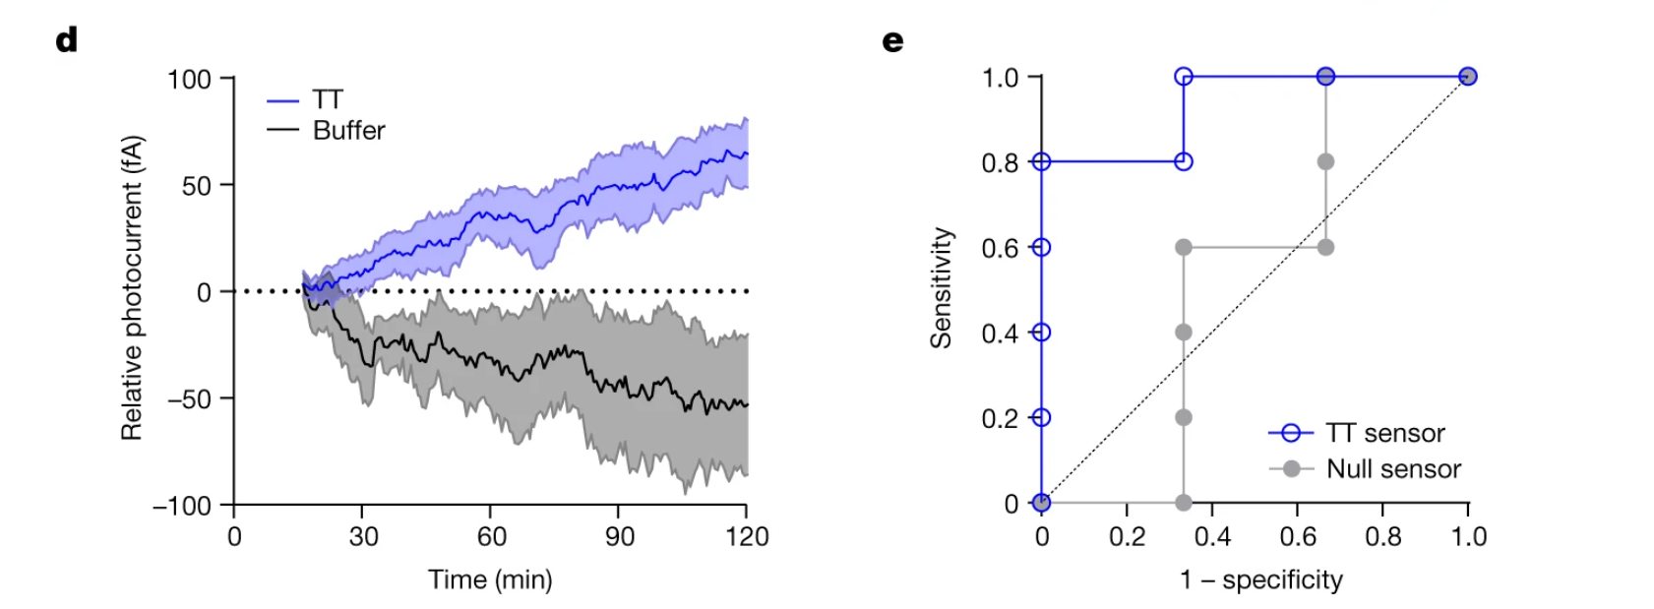
In Situ Validation of Tetrathionate Biosensor in Pigs
(a): Yorkshire pig intestinal compartmentalization. Devices containing bacterial biosensors were inserted into the lumen of the small intestine through a small incision, and the intestine was divided into test sections using clamps.
(b): Schematic of compartmentalization with test conditions: one compartment injected with tetrathionate (100 mM) as the experimental analyte and another with buffer as a control.
(c): Intestinal compartments were maintained inside the abdominal cavity at 37°C, and wireless signals from the biosensors were transmitted to an external receiver connected to a laptop or smartphone.
Kinetics of the Tetrathionate Sensor in Intestinal Compartments
The biosensor in the tetrathionate-treated compartment exhibited a distinct and increasing signal over time, compared to the minimal response in the buffer control compartment.
Results represent the mean of independent experiments across multiple pigs (n = 5 for tetrathionate; n = 3 for buffer).
Receiver Operating Characteristic (ROC) Curve for Tetrathionate Sensing
The ROC curve highlights the device's sensitivity and specificity in detecting tetrathionate after 60 minutes.
The tetrathionate sensor (blue) demonstrates high sensitivity, with a clear separation from the null sensor (gray), indicating robust and accurate detection.

Slide 16
PIG EXPERIMENTAL SET UP
Approval: Conducted under the Massachusetts Institute of Technology's Committee on Animal Care.
Subjects: Female Yorkshire pigs (50–95 kg), randomly selected and housed under conventional conditions.
Preparation:
Clear liquid diet for 24 h prior to experiments.
Morning feed withheld on the day of the experiment.
Procedure
Sedation: Telazol (5 mg kg⁻¹), xylazine (2 mg kg⁻¹), and atropine (0.04 mg kg⁻¹).
Jejunum Access: Midline laparotomy with lumen sectioned into test compartments using clamps.
Inflammation Model: Ischaemia-reperfusion injury induced via mesentery clamping for 2 h, followed by 1 h reperfusion.
Experimentation
Bacterial Studies:
Cultured bacteria injected into target sections or healthy sections with analytes (e.g., DETA–NO, H₂O₂).
Cells retrieved by flushing intestinal sections with PBS.
Capsule Testing:
Bacteria-loaded capsules inserted into intestinal sections.
Tetrathionate (100 mM) introduced, and data collected wirelessly via 915 MHz radio.
Devices manually retrieved post-experiment.
Control and Results:
Setup: Each pig (n=3) had two intestinal sections:
One with analyte injection.
One as a negative control.

Slide 17
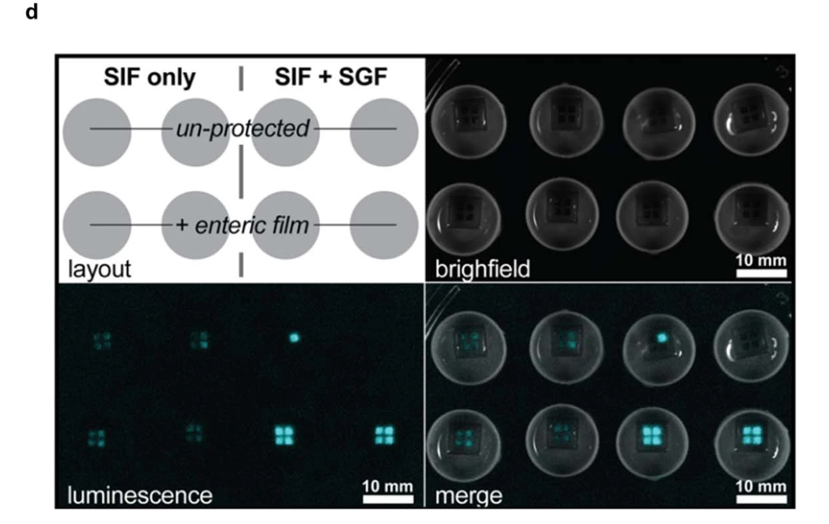
Effectiveness of Enteric Protection in Preserving Bacterial Viability and Luminescence
Panel c: Luminescence as a Measure of Viable Bacterial Signal
Encapsulated bacteria maintained luminescence levels above the limit of detection (LOD) after SIF-only and SGF+SIF treatments when protected by enteric film.
Unprotected capsules failed to sustain measurable luminescence after exposure to SGF+SIF.
Luminescence values were normalized to set the LOD = 1 for consistent analysis.
Panel d: Imaging of Luminescence
Brightfield and luminescence images were used to quantify bacterial viability.
Chambers with enteric-protected casings showed a consistent luminescent signal post-exposure, correlating with higher CFU values.
Images were quantified using BioRad ChemiDoc and ImageJ (FIJI).

Slide 18
Challenges and limitations
Power Consumption
Challenge: The capsule requires low power consumption to function continuously for real-time monitoring over extended periods.
Impact: Minimizing power use is critical for prolonged operation without significantly increasing the capsule’s size or compromising its functionality.
Solution: Optimization of electronic components and energy-efficient wireless communication systems is needed.
2. Durability
Challenge: The capsule must withstand the harsh conditions of the gastrointestinal (GI) tract, including:
Variability in pH (from stomach acid to intestinal fluid).
Digestive enzymes and mechanical forces during peristalsis.
Impact: Ensuring durability is essential for consistent performance during its transit through the GI tract.
Solution: Development of biocompatible and robust materials to protect the biosensors and electronic components.
Sequencing Challenges
Challenge: The engineered bacteria may mutate over time, potentially losing functionality or specificity.
Impact: Long-term reliability of the biosensors could be compromised, affecting the accuracy of biomarker detection.
Solution: Periodic genetic sequencing (e.g., Sanger or NGS) may be required to confirm the stability of the bacterial genetic circuits.

Slide 19
Future Directions and Applications
Expanding Biomarker Detection
Goal: Enhance the biosensor system to detect a broader range of biomarkers associated with gastrointestinal (GI) health, including:
Other inflammation-related molecules (e.g., cytokines).
Microbiome-derived metabolites relevant to diseases like cancer or metabolic disorders.
Approach: Integrate additional genetic circuits for multi-analyte detection within the same capsule.
Human Clinical Trials
Objective: Test the safety, reliability, and efficacy of the capsule in human subjects.
Focus Areas:
Validate capsule performance in diverse populations with conditions like inflammatory bowel disease (IBD).
Optimize capsule retrieval and data interpretation processes for real-world usage.

Slide 20
References:
Inda-Webb, M. E., et al. “Sub-1.4 Cm3 Capsule for Detecting Labile Inflammatory Biomarkers in Situ.” Nature News, Nature Publishing Group, 26 July 2023, www.nature.com/articles/s41586-023-06369-x#Sec22.
Oxidative Stress and Redox-Modulating Therapeutics in Inflammatory Bowel Disease: Trends in Molecular Medicine, www.cell.com/trends/molecular-medicine/fulltext/S1471-4914(20)30157-X. Accessed 18 Nov. 2024.

