Slide 1
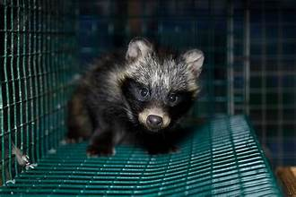
Fur Farming and Its Effects On Wildlife
Bryan Nguyen
Notes:
https://www.nature.com/articles/s41586-024-07901-3

Slide 2
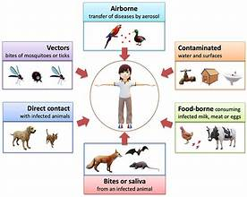
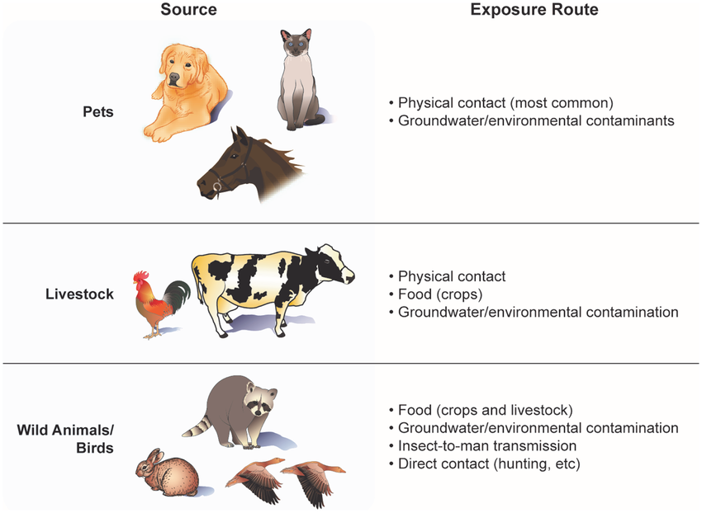
The Problem
Raccoon dogs, minks and muskrats are used for food and fur farming, but can also be spread dangerous pathogens to other species
This is called a zoonotic disease
There are dangers to fur farming such as zoonotic spillover of diseases to animals being farmed, wild animals, and even humans
Cases of respiratory coronavirus from dogs infecting raccoons
Cases of HKU5 coronavirus infected minks
Influenza A (H1N2, H5N6, and H6N2) infected the lungs of guinea pigs, minks and muskrats
Humans are also able to catch and spread the diseases of the animals while fur farming
Zoonotic diseases could ultimately lead to pandemics
Ex. COVID-19
Notes:
What is the problem of this study? We will be talking about zoonotic diseases, which are diseases that derive from animals such as raccoon dogs, minks and muskrats. These are all animals used for food or fur farming but can also carry dangerous pathogens that affect other species.
Examples of zoonotic spillovers are: respiratory coronavirus from dogs infecting raccoons, Pipistrellus bat HKU5 coronavirus infecting minks, and Influenza A infecting the respiratory systems of guinea pigs, minks and muskrats.
While these are examples of cases of zoonotic spillover between other fur animals, humans are susceptible as well which can lead to pandemics. Big example is COVID-19.

Slide 3
Why Fur Farming?
Fur farming is part of the economy of fashion and serves as a cultural importance in some countries
This results in international and domestic trade of animal furs
Stimulates the economy
Commonly fur farmed animals include: foxes, civets and minks
These animals are potential hosts for influenza A, SARS-CoV and SARS-CoV-2
Examples of countries that are main exporters of fur include: USA,Russia, Poland and China
While fashion may be the biggest market for fur farming, there are many other practical uses for it as well making it quite prevalent in the world’s economy
Notes:
So why fur farming specifically? Fur farming is used for fashion and is of cultural importance in some countries. Fur farming is an international trade or industry that may be a major stimulator for the economy of countries.
Most commonly farmed animals are foxes, civets and minks and these animals are reservoirs for influenza A and SARS-CoV.
The main exporters are the USA, Russia, and China. China being the country where this study will focus upon.
Fur farming may not only be used for fashion but for other uses as well, making it prevalent in the world's’ economy.

Slide 4
Methods of Sampling
Why China?
China is considered one of the largest producers and consumers of fur
While Denmark is the largest mink producer in the world, China is a close second
Species that are typically used for fur farming are silver foxes, arctic foxes, mink, and raccoon dogs
Regions: Hebei, Shandong, Heilongjiang, Liaoning
Dead, diseased samples were taken from the provinces and approved by Changchun Veterinary Research Institute
How were the samples stored?
Labels with animal information
Stored on dry ice to preserve samples
After transportation, lung and intestinal samples are taken out to be studied
To differentiate between samples and to determine their species, mitochondrial cytochrome B gene was sequenced
Notes:
As I said before, China will be the place where the sampling will occur. The reasons are that China is one of the largest producers and consumers of fur. Denmark is the largest producer but China is also a close second. I may have referred to some of these animals in the slide before this one but the animals most farmed in China are silver foxes, arctic foxes, minks, and raccoon dogs. Some of the primary regions that were sampled from are Hebei, Shandong, Heilongjiang, Liaoning.
Changchun Veterinary Research Institute validated the dead animals samples that were taken from these provinces.
These samples were stored with labels of general animal information and stored on dry ice for preservation. After transportation, the samples’ mitochondrial cytochrome B is sequenced to differentiate between them. While mitochondrial cytochrome B is generally conserved among species, it is variable enough to be used for differentiation.

Slide 5
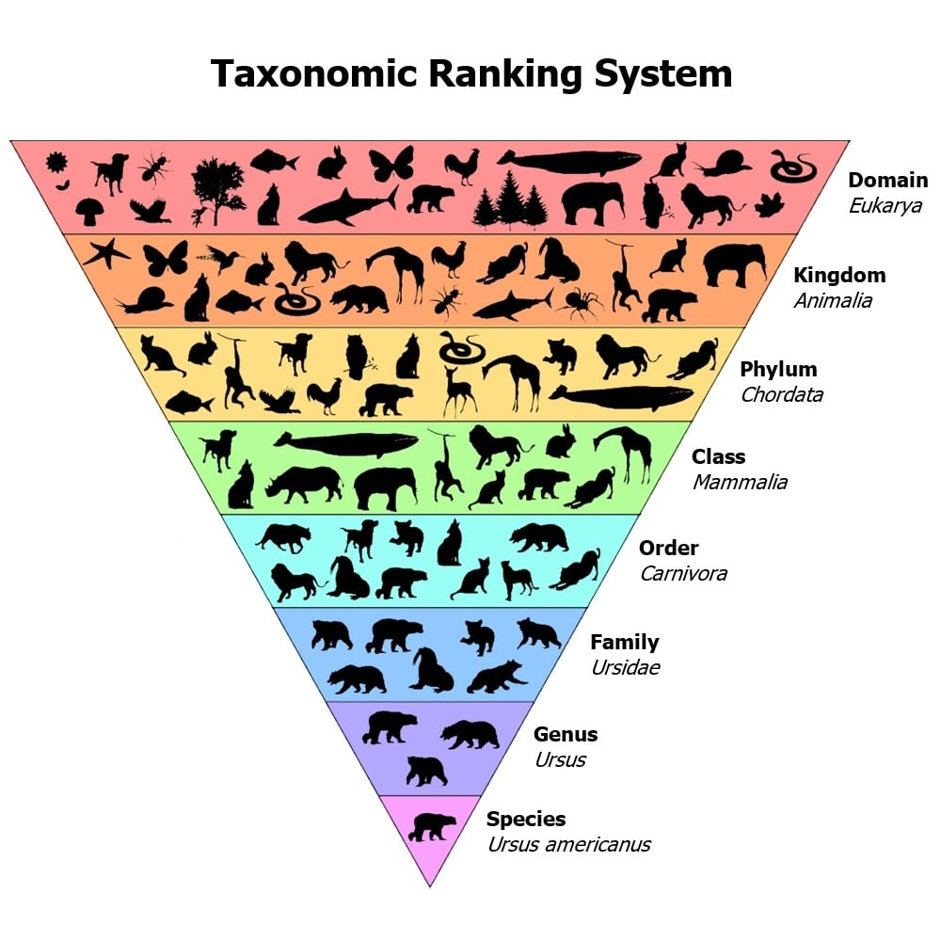
Identification of Potential Viruses
3 types of viruses with high emergence potential:
Zoonotic virus: virus that originates from animals and can be transmitted to humans
Cross-order virus: virus that spread across different orders
Novel potential risk virus: a newly emerging virus that was recently discovered
May be variants of a known virus
Notes:
There are three types of viruses that have high emergence potential: zoonotic, cross-order, and nove potential risk virus.
A zoonotic disease is a virus that has the ability to adapt to human hosts and ultimately cause outbreaks or pandemics.
A cross-order virus is self-explanatory in name and animals of the same kingdom/ domain are able to infect each other.
A novel potential risk virus is a virus that was recently discovered and has the potential of being dangerous due to it being unfamiliar.

Slide 6
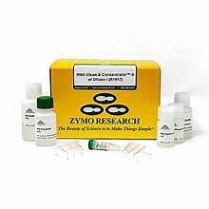
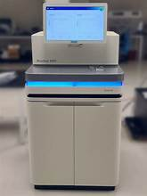
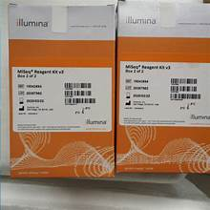
RNA extraction, library construction and sequencing tools
RNA was separated from lung and intestinal samples using the RNA Clean and Concentrator-5 kit from Zymo Research
Allows for pathogen identification
Separates RNA from DNA
rRNA is depleted using two different depletion kits: Ribo-Zero Plus rRNA depletion kit by Illumina and TIANSeq rRNA Depletion kit by TIANGEN Biotech
Removes excess RNA
Libraries are then constructed using TruSeq Stranded mRNA Total Library kit by Illumina and sequenced with Illumina NovaSeq 6000 platform (150 bp paired-end)
Notes:
Nextly, I will be talking about the tools used for this study. Lung and intestinal samples had their RNA extracted with RNA Clean and Concentrator-5 kit.
Since rRNA is the most abundant form of RNA, it must be depleted with Ribo-Zero Plus rRNA depletion kit and TIANSeq rRNA Depletion kit to decrease noise when sequencing.
A library is then constructed with TruSeq Stranded mRNA Total Library kit to allow the remaining RNA to be sequenced with Illumina NovaSeq 6000 platform.

Slide 7
Virus Identification and Data Processing
All sequenced reads were trimmed using Trimmomatic and were mapped to the SILVA database
Data was organized in a way to only obtain viral contigs that were only associated with vertebrates
Family and genus
Viruses that are similar to known ones were primarily studied
Species were assigned to viruses according to criteria set by International Committee on Taxonomy
Order, family, genus, species demarcation criteria
If there was a species with a non-definitive species demarcation criteria, 80% amino acid identity in RdRp or replicase to the virus was applied
Notes:
Unwanted portions of sequences are then trimmed with Trimmomatic and mapped to the SILVA database for cross-referencing.
Only viral contigs were then obtained to specifically focus on the family and genus of vertebrates.
Viruses that are similar to previously identified ones are studied. Species are assigned to viruses by demarcation criteria from the International Committee on Taxonomy. If there was a species with a non-definitive demarcation criteria, 80% amino acid identity in RdRp or the replicase complex would be used to demarcate them.

Slide 8
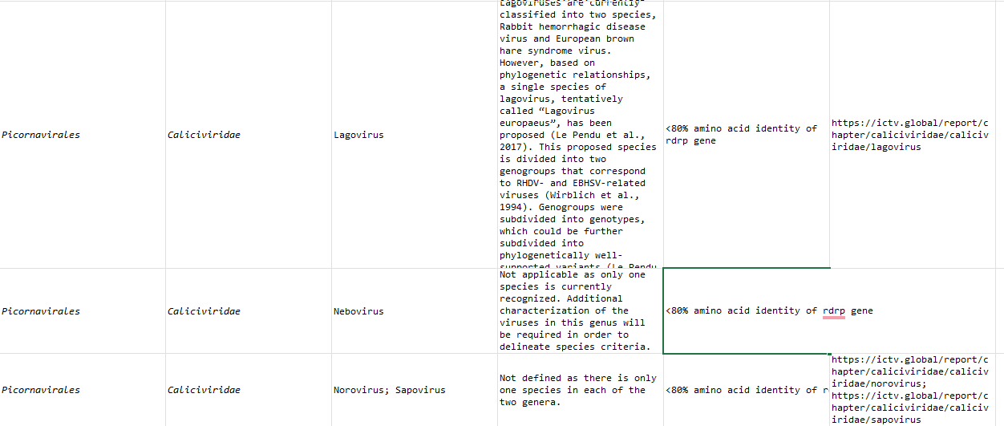
Notes:
How viruses were organized by order, family, genus, and demarcation criteria from the ICTV

Slide 9
Definitions and Steps of Building the Phylogenetic Tree
Hallmark proteins: conserved proteins that are used as markers to determine the evolutionary relationship between viruses
Hallmark proteins can be found in DNA or RNA viruses and help in the replication of viral genetic materials
Sequences from these proteins are obtained from different strains
Multiple sequence alignment: sequences of strains are aligned to detect for homologous segments
Recombination event: when genetic material is exchanged and form new viral genomes that are different from parent
reticulation
Most common in viruses with RdRp
Maximum likelihood tree inference: statistical method that allows researchers to select the tree that best represents sequence data
Helps observe relationships between viral strains, species and genotypes
Notes:
To understand how the phylogenetic tree is built, I will be talking about the definitions of key steps in the process. Hallmark proteins are conserved proteins that are used as markers to determine the evolutionary relationship between viruses. These proteins can be found in DNA or RNA viruses and help in the replication of them. The sequences from the hallmark proteins are also obtained from different strains.
Multiple sequence alignment is the alignment of strain sequences to find homology between them.
A recombination event is when new viral genomes, that are different from the parents’, are made from the exchange of genetic material between different RNA. RdRp (RNA-dependent RNA polymerase) is an enzyme that helps initiate recombination events in viruses.
The maximum likelihood tree inference is a statistical method that selects a tree the best represents the data the researchers may be looking for. It allows them to see the relationships between viral strains, species, and genotypes.

Slide 10
Phylogenetic Analyses (Tools)
Amino acid sequences of hallmark viral proteins used to estimate phylogenetic trees for the vertebrate viruses studied
Hallmark viral proteins: RdRp (RNA) and DNA polymerase
Amino acid sequences for each family were aligned with the L-INS-i algorithm in MAFFT and were trimmed with trimA1
Sequences were analyzed with MEGA11
Recombination analysis is done with Simplot and Splitstree 5
IQ-TREE was used to generate machine learning trees to create the best model of amino acid/nucleotide substitution
Helps find maximum likelihood tree inference
Notes:
Hallmark proteins like RdRp and DNA polymerase were used to estimate phylogenetic trees for the viruses studied.
Amino acid sequencing was performed with L-INS-i algorithm in MAFFT and then trimmed with trimA1. MEGA11 was used to look at the finished sequences.
Recombination analysis was done with Simplot and Splitstree 5.
Splitstree creates “splits” graphs that allow for the visualization of relationships between multiple sequences
Make network of evolutionary patterns, such as reticulation
Maximum likelihood trees were found with the program IQ-TREE.

Slide 11
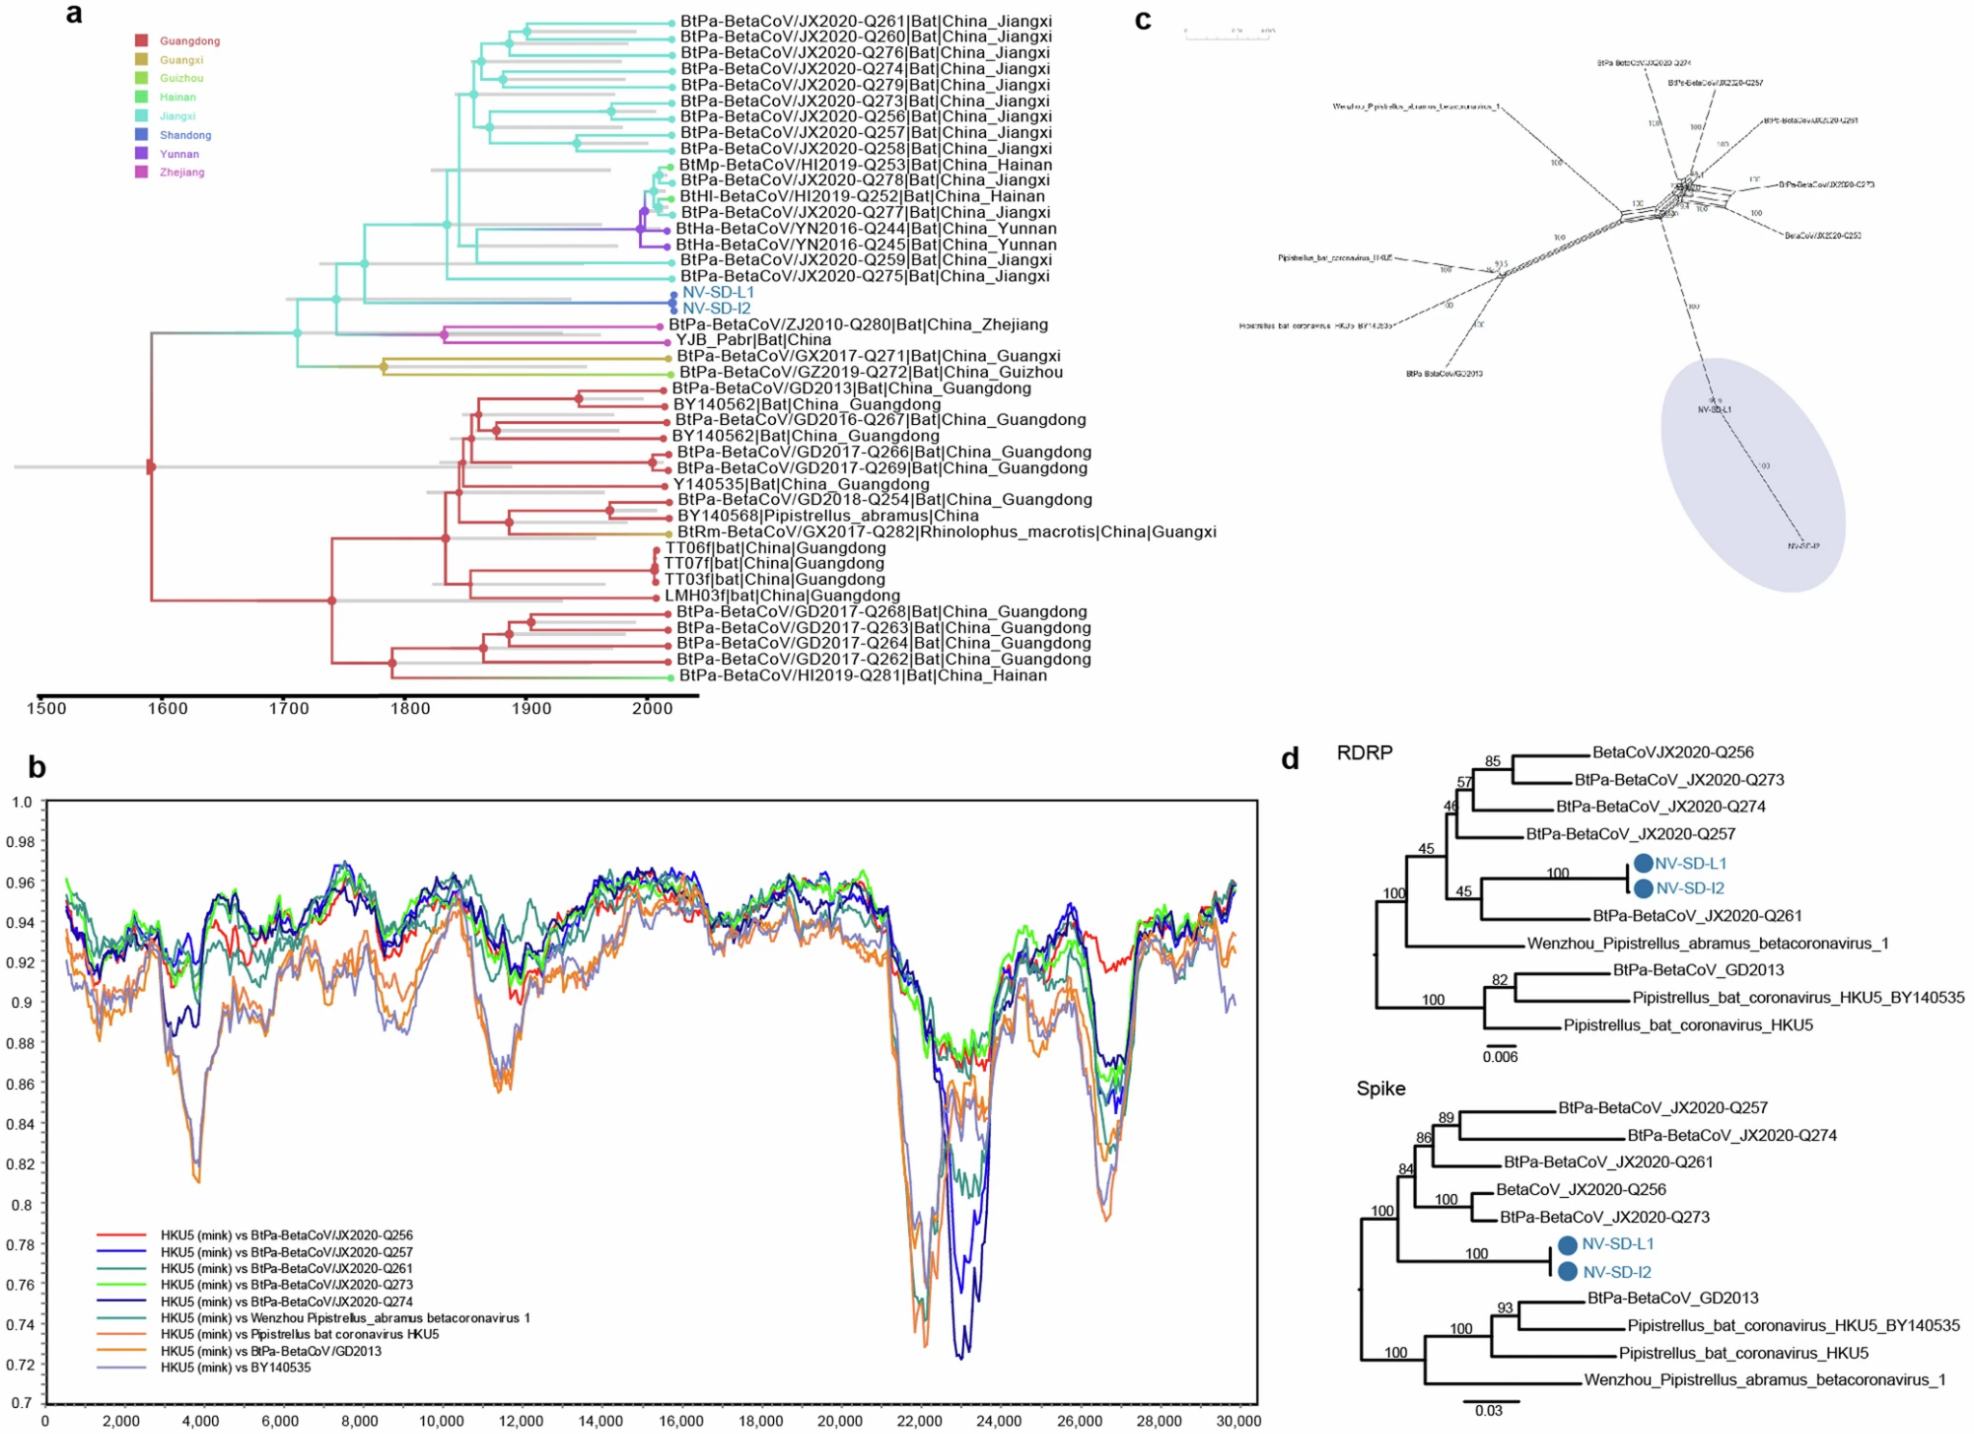
Phylogenetic Analyses of Mink Derived Coronavirus HKU5
Notes:
a.) phylogenetic tree on genome of mink-derived HKU5-like viruses
b.) Simplot to look for mink-derived HKU5-like sequences
c.) Neighbor net reconstruction using Splitstree5
d.) IQ-TREE used to estimate the most likely tree to occur from RdRp and S gene nucleotides

Slide 12
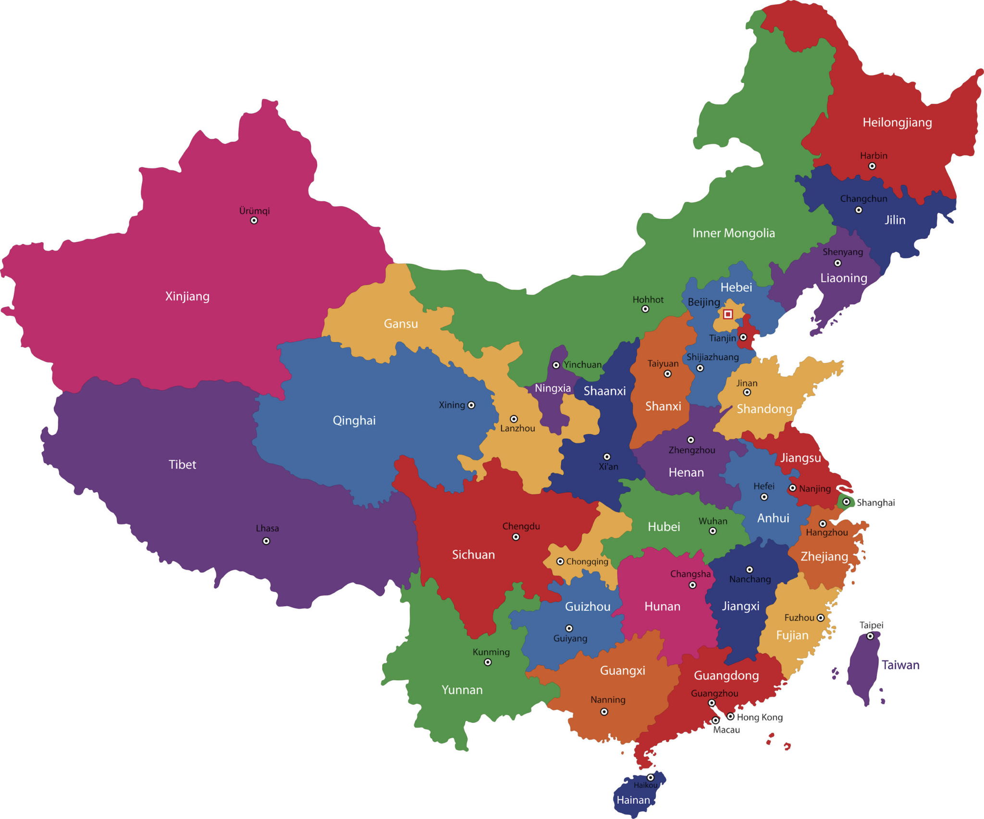
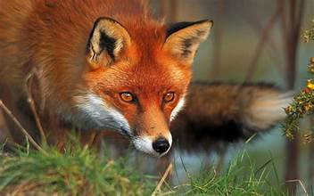
Sampling Groups
Samples were taken between farmed and wild fur animals across of China
412 non-wild and 49 animals wild
Animals samples were separated into two categories:
1. ‘Main’ farmed fur animals
Comprised of animals only used for fur:
Neogale vision (mink)
Vulpes vulpes (red fox)
Vulpes lagopus (arctic fox)
Nyctereutes procyonoides (raccoon dog)
164 total individuals sampled from 10 different provinces of China
2. Multipurpose farmed animals
Comprised of animals with other uses like food consumption:
Carnivora ( 34 individuals, 7 species)
Artiodactyla ( 34 individuals, 7 species)
Rodentia ( 157 individuals, 6 species)
Diprotodontia ( 3 individuals, 3 species)
Lagomorpha ( 69 individuals, 1 species)
297 total individuals and 24 species sampled from 25 provinces
Notes:
There were 412 non-wild and 49 wild animals sampled for this study.
There were separated into two groups: Main farmed animals and Multipurpose farmed animals.
The main farmed animals were only used for fur while multipurpose animals were used for other uses like consumption.
In the main farmed fur animal category, 164 samples came from 10 different provinces of China. Some of these animals being: minks, red foxes, arctic foxes, and raccoon dogs. These are the same animals listed before.
In the multipurpose farmed animal category, 297 samples came from 25 different provinces. Some of the animal orders listed above.

Slide 13
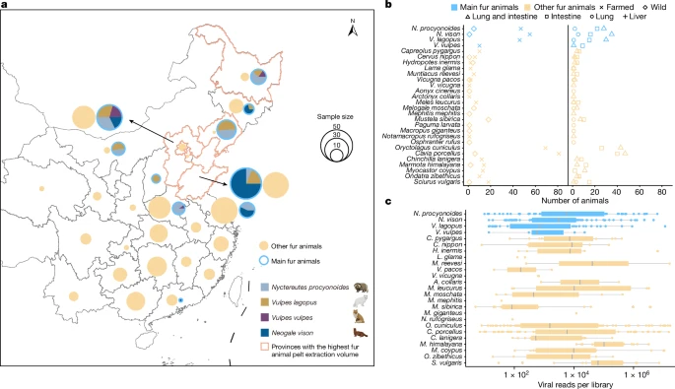
Geography of Samples
Fig. 1
Notes:
a.) size of pie represents sampling quantity
b.) are the counts of animals based on living condition and what organ the viral sample was obtained from
c.) viral read counts in each library of the different species. Box is the median, quartiles, and maximum and minimum values

Slide 14
Viromes
Only vertebrate-associated viruses were studied (viruses that have similar phylogenetic relationships with other viruses that are known to cause infection to vertebrates)
PCR was used to confirm 125 possible viruses
101 species of RNA virus
Ex. Arteriviridae, Coronaviridae, Pneumoviridae, and etc.
24 species of DNA virus
Ex. Anelloviridae, Adenoviridae, Circoviridae, and Parvoviridae
The most abundant viruses in the lungs were: Paramyxoviridae (RNA), Coronaviridae (RNA), and Caliciviridae (RNA)
The most abundant viruses in the intestines were: Coronaviridae (RNA), Sedoreoviridae (RNA), and Astroviridae (RNA)
All of the most abundant viruses in the lungs and intestines were RNA viruses
Rapidly mutate
Less stable than DNA
Evolve quickly
Notes:
As I said before, this study will focus on vertebrate-associated viruses. These are viruses that have similarity with other viruses that are known to infect vertebrates.
PCR is used to confirm 125 possible viruses. 101 species being RNA virus and 24 species being DNA virus. (Examples listed for reference)
While DNA viruses were found, the most abundant were RNA viruses found in the lungs and intestines. The reason for this being that RNA is less stable than DNA and subject to more mutation.

Slide 15
Viral Data
Of the 125 viruses recorded, 60% of the virus host ranges expanded
Ability to infect host cells increased
Average of 2-23 vertebrate-associated viruses seen in fur animals
Minks: 23 virus species (11 viral families)
Raccoon dogs: 19 virus species (14 viral families)
Guinea pigs: 20 virus species (11 viral families)
Arctic foxes: 13 virus species (6 viral families)
Raccoon dogs, minks and guinea pigs were very susceptible to co-infections (multiple infections from different viruses)
Another event of two co-infections occurring in rabbits with rabbit coronavirus HKU 14 and rabbit coronavirus 1
As suggested in slide prior slide, the most abundant virus in the intestine is Coronaviridae and most abundant in the lungs is Paramyxoviridae (Fig. 2 a)
The tissues of the fur animals were found with many different families of different viruses (Fig. 2 b)
One of the most diverse being S. vulgaris
C. nippon being the only one with a virus (Sedoreoviridae) found in liver
Notes:
Next I will just talk about general viral data. 60% of the 125 viruses recorded had their host ranges expanded, meaning their ability to affect hosts had increased.
2-23 viruses would generally be seen in the animals. Minks having 23 virus species, raccoon dogs with 19 species, guinea pigs with 20 species, and arctic foxes with 13 species.
Raccoon dogs, minks and guinea pigs were also susceptible to co-infections which meant that they were able to be infected with multiple viruses at the same time. Additionally, rabbits had a co-infection event with rabbit coronavirus HKU 14 and rabbit coronavirus 1.
Tissues of the fur animals were found to have many different families of different viruses.

Slide 16
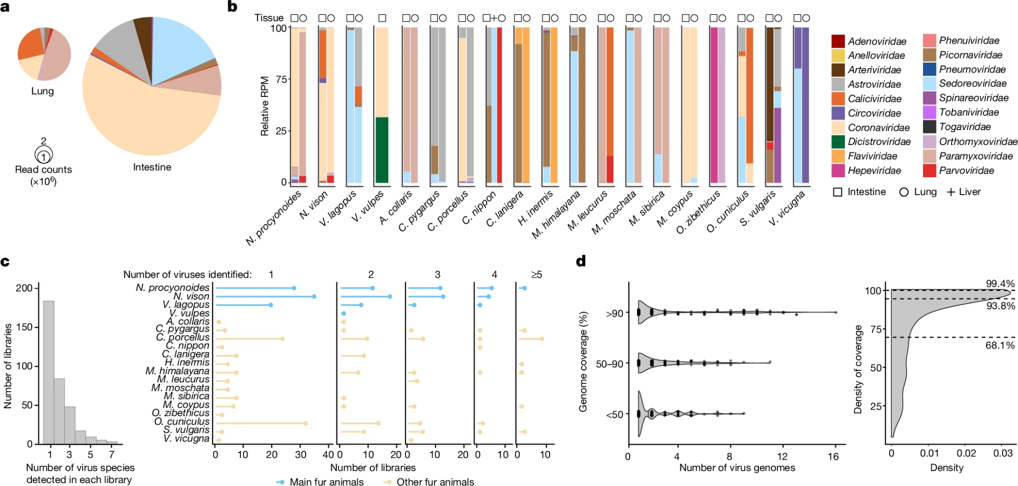
Viral Data cont.
Fig. 2
Notes:
a.) show the general amount of viral reads in lung and intestines
Coronaviridae being the most abundant in the intestines, and Paramyxoviridae being the most abundant in the lungs
b.) general viral abundance for different fur animals
S. vulgaris (Eurasian red squirrel) one of the most diverse, and M. coypus being one of the least diverse but with most Coronaviridae
c.) Left: shows number of virus species identified within each library, Right: number of libraries in different fur animals with either 1,2,3,4, or more than 5 virus species found
As more viruses identified, less viral libraries used for reference
d.) Left: genome coverage of viral sequences with distribution probabilities, Right: density plot showing distribution of assembly completeness
Shows uniformity and completeness of genome coverage

Slide 17
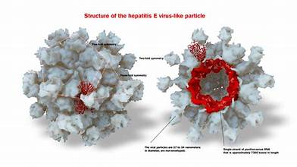
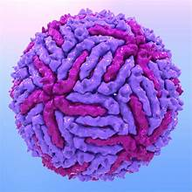
Cross-Species Transmission
Multiple viruses with the capability of infecting humans were found
Hepatitis E virus (HEV)
Japanese encephalitis virus (JEV)
Mammalian orthoreovirus (MRV)
All of these viruses have the capability of infecting humans because they came from viral sequences that exist in humans
Cross-species transmission between wild and farmed animals was also seen
Getah virus (GETV)
Coronaviruses
Influenza A
Multiple animals species would also be infected by the same virus because of their broad host spectrum
Canine distemper virus (CDV)
Most of the vertebrate-associated \diseases found already had evolutionary ties to current viruses being spread, but separate lineages of families were also seen like the Phenuiviridae family seen in Siberian weasels
Notes:
Specific viruses that were found to infect humans were: HEV, JEV, and MRV
This happens because they originally adapted from viral sequences that exist in humans
Examples of viruses that infected between wild and farmed animals were: Getah virus (GETV), Coronaviruses, and Influenza A
Canine distemper virus (CDV) had a broad host spectrum allowing it to infect a large range of animals
While most of the vertebrate viruses being studied had evolutionary ties to the viruses spread, more divergent lineages of virus families found like Phenuiviridae found in Siberian weasels.

Slide 18
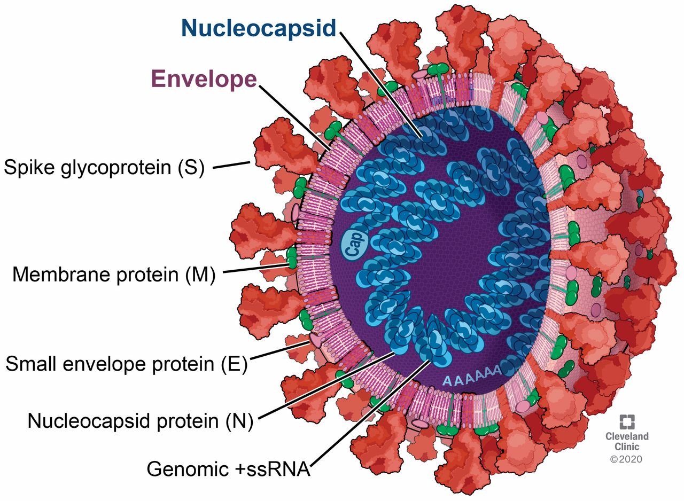
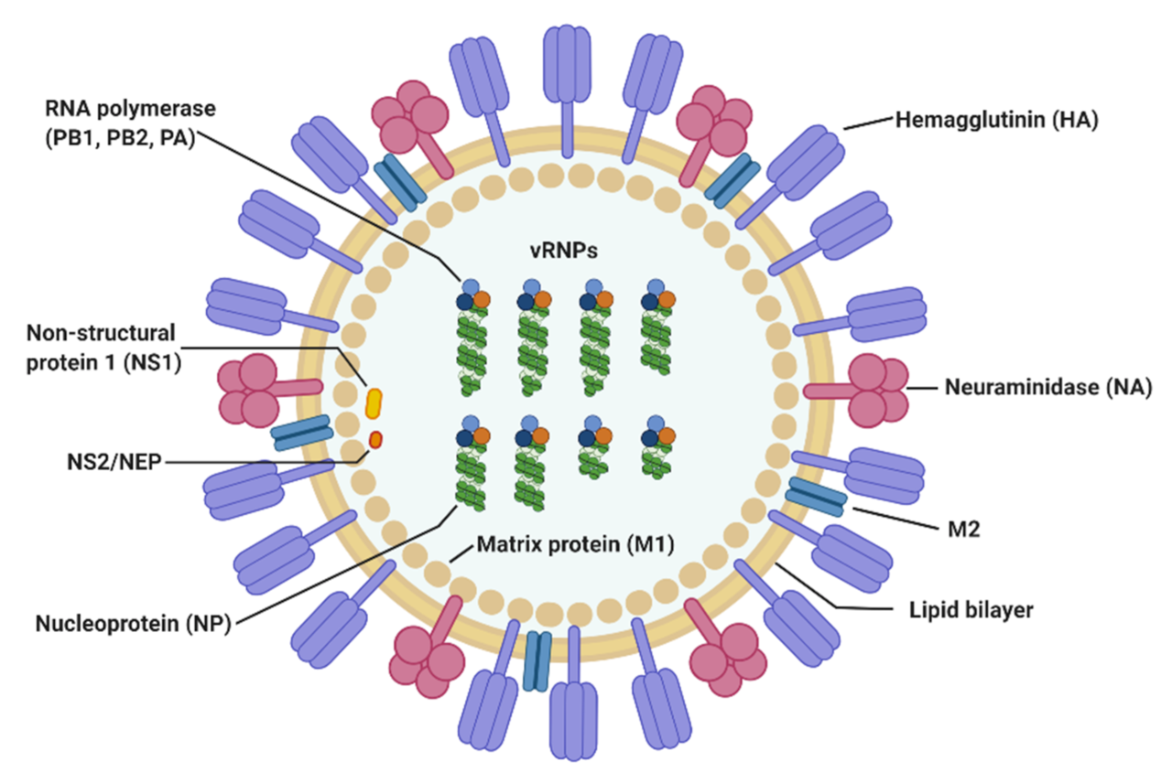
What is Pipistrellus bat coronavirus HKU5 and Influenza A?
Bat-CoV HKU5 is a positive-strand RNA virus
Discovered from the Japanese Pipistrellus bat in Hong Kong
Acts as a mRNA which allows it to be translated by host’s ribosomes
Related to MERS-CoV which is another type of coronavirus initiated from interspecies infection of humans and camels
Influenza A is a RNA virus
Originally causes infection of birds and other mammals but also causes the seasonal flu for humans
Commonly found in bats, pigs and dogs
Variations of IAV are classified through hemagglutinin and neuraminidase combinations
Notes:
The study focuses on two RNA viruses: Bat-CoV HKU 5 and Influenza A.
The bat coronavirus originated from the Japanese Pipistrellus bat in Hong Kong.
It spreads by acting as mRNA, allowing it to be translated by the host’s ribosomes.
It is also related to another virus, MERS-CoV which is between camels and humans.
Influenza A originated from birds and other mammals and causes the seasonal flu.
It is usually found in bats, pigs, and dogs.
It is subtype based on its hemagglutinin and neuraminidase
These allow for the entry and release/ spreading of virus

Slide 19
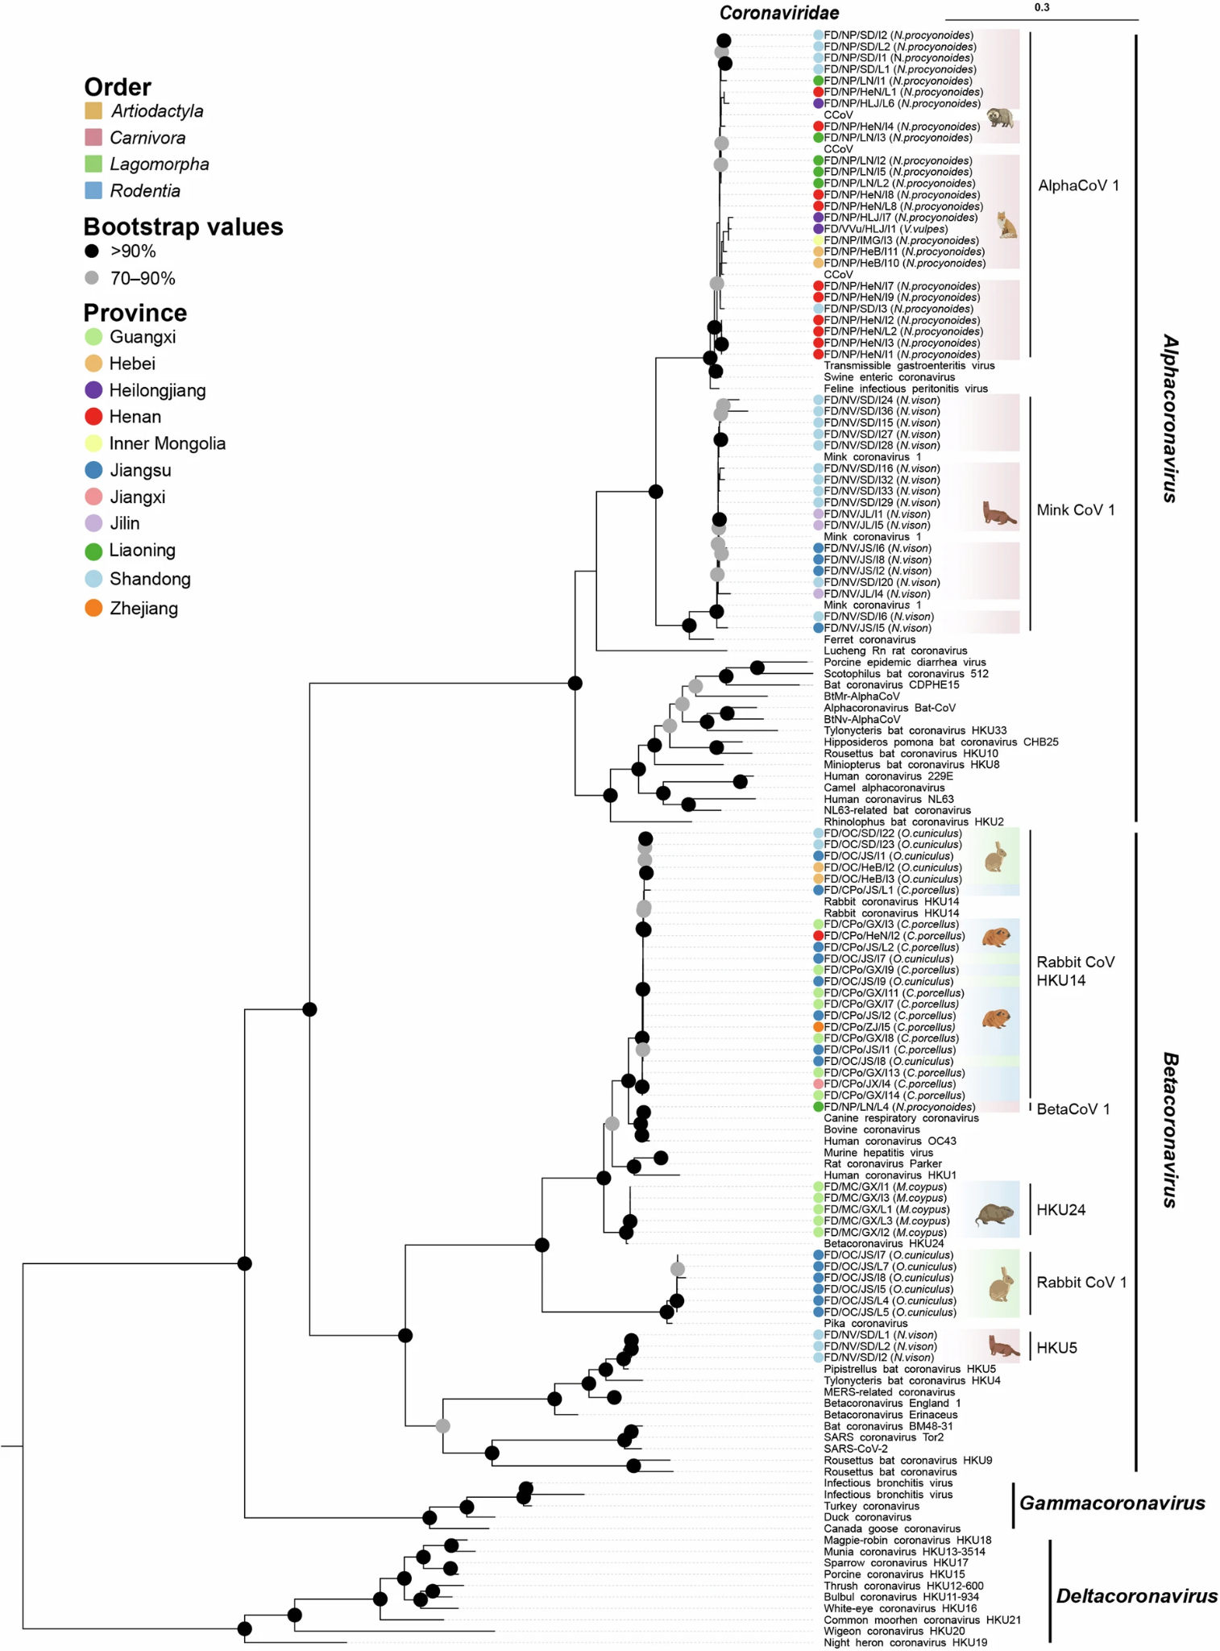
Coronavirus Findings
7 CoV species in 66 farmed animals
20 alpha-CoV 1 viruses in raccoon dogs and red foxes
Mink CoV 1 in 18 minks
1 beta-CoV 1 virus in raccoon dogs
Virus similar to Pipistrellus bat coronavirus HKU5 found in multiple minks
Before HKU5-like viruses only formed in bats
Recombination must have occurred to create diversity in host range
A novel coronavirus was found with a deletion mutation in the HE protein
Rabbit coronavirus 1
HE protein is a structural protein found in beta-coronaviruses
While there are high concentrations of CoV inside these dead animals, there is no clear answer for what caused the death of them
CoV abundance levels in 21 samples: 1.2 x 10⁴ - 4.9 x 10⁵ RPM
Notes:
There were 7 coronavirus species found in 66 of the farmed animals:
20 alphacoronavirus 1 viruses in raccoon dogs and red foxes
18 mink coronaviruses
1 betacoronavirus 1 virus in raccoon dogs
Viruses similar to the pipistrellus bat coronavirus were found in minks
Originally only found in bats so recombination event must have occurred for it to change its host range
A novel coronavirus, such as Rabbit coronavirus 1, was found with a deletion in the HE protein. This is a structural protein that aids in basic viral functions.
Coronavirus abundance levels of 1.2 x 10⁴ - 4.9 x 10⁵ RPM when viewing sequencing datasets
While coronavirus is detected in the dead samples, this is not a definitive answer for how they may have died
Note: Graphs shows different variants of coronavirus and the many strains found in different fur animals

Slide 20
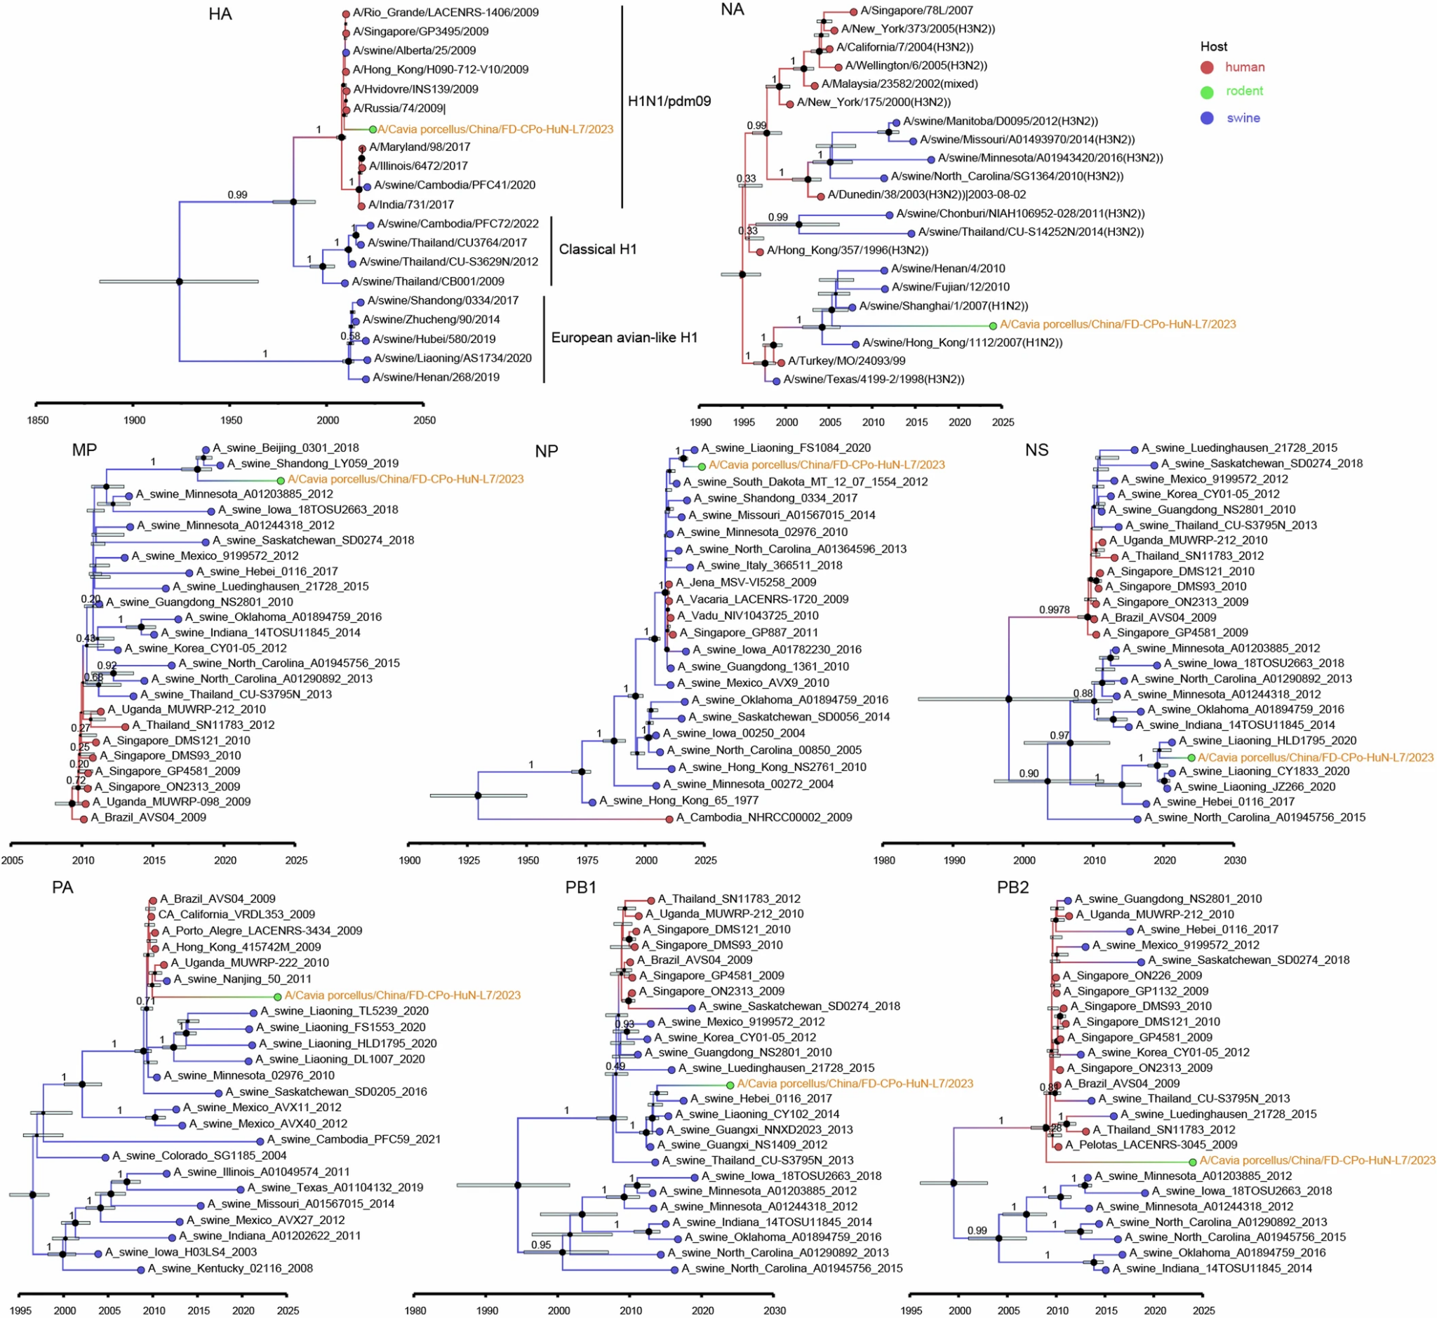
IAV (Influenza A virus) Findings
Two H5N6 viruses in minks, one H1N2 virus in guinea pigs and H6N2 virus in muskrats
H1N2 virus came from human H1N1 or swine virus
Indicates that H1N2 virus in guinea pigs must have had a reassortment event after being spread from humans
NS segment of H1N2 is related to human H1N1
H5N6 have highly pathogenic phenotypes
Similar sequence to avian and human viruses
H6N2 virus in muskrats is the first observation of this avian virus subtype seen in mammals
HA segment with 96.8% nucleotide identity to viruses from avians
NA segment with 97% nucleotide identity to viruses from avians
Notes:
Moving on the IAV findings, there were H5N6 viruses in minks, a H1N2 virus in guinea pigs, and a H6N2 virus in muskrats
The H1N1 must have had a reassortment event from humans to guinea pigs to make the new strain H1N2 found in this study.
The NS segment same in both influenzas
H5N6 is highly pathogenic and causes high mortality rates in infected animals
Has similarity with avian and human viruses which make it possible for cross-species transmission
H6N2 is the first observation of this avian virus subtype seen in mammals.
HA and NA segments having over 95% nucleotide similarity with avian viruses
While there is less genetic variability with H6N2, it has evolved to undergo only changes that would expand its host range.
Note: Graph shows phylogenetic analyses of guinea pig-derived Influenza A virus H1N2

Slide 21
Highly Emergent Virus Findings
Viruses that are high risk for cross-species infection were classified by how likely they are able to jump between animals to other species or vice versa
39 high-risk viruses
11 zoonotic diseases
15 cross-order viruses
13 high-risk novel viruses
The order Carnivora were infected with the most high-risk viruses
Coronavirus HKU5 (from Pipistrellus bat) and RbCoV HKU14 was found in Carnivora and Rodentia
Indicates high risk of emergence
Raccoon dogs (Carnivora): mean of 10 viruses
Minks (Carnivora): mean of 10 viruses
Guinea pigs (Rodentia): mean of 9 viruses
Shandong province had 19 potential high risk viruses
Notes:
Viruses that are considered highly emergent are classified by how likely they jump between animals to other species. There were 39 high-risk viruses identified: 11 being zoonotic, 15 being cross-order, 13 being high-risk novel viruses.
The Carnivora order was infected with the most high-risk viruses.
Pipistrellus bat coronavirus HKU 5 and rabbit coronavirus HKU 14 found in both Carnivora and Rodentia
This indicates high risk of emergence
Based on the number of highly emergent viruses they had:
Raccoon dogs with a mean of 10 viruses
Minks with a mean of 10
Guinea Pigs with a mean of 9
Shandong province having the most high potential viruses

Slide 22
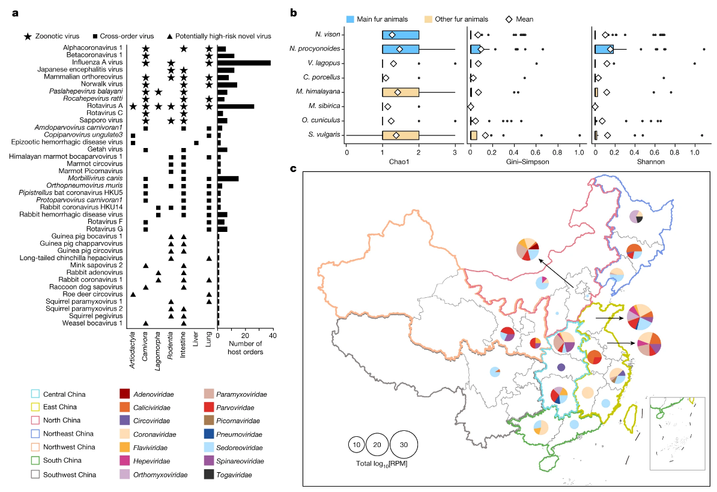
Fig. 3
a.)
Notes:
a.) host ranges of potentially high-risk viruses obtained from NCBI GenBank
b.) general diversity of viruses of different fur animals, bold line= median, hollow diamond= mean, box= quartile
N. procyonoides (raccoon dog) having the highest abundance of high-risk viruses
c.) shows the distribution of potentially high risk viruses in various Chinese provinces

Slide 23
Summary
Farmed fur animals are reservoirs for zoonotic viruses and which are used for fur farming
Diverse amount of coronaviruses and influenza viruses found
These viruses have the ability to expand their host range to spread across other orders and species
While Carnivora harbored the most viruses in this study, animals like guinea pigs (Rodentia) should be carefully surveyed because of the amount of high-diversity viruses contained within their samples

Slide 24
Limitations
Only dead animals were used, not live
Samples were not obtained specifically from each province out of choice but were obtained out of opportunity and sampling sizes were relatively small
This viral information cannot be applied to all of China
Study only focuses on respiratory and gastrointestinal systems, so viruses that were present in other tissues were not identified

Slide 25
Future Directions
Awareness and greater understanding of the types of zoonotic diseases that are spread from fur animals and the ability for these diseases to spread to other species
Understanding how disease is spread and setting precautions/ standards that may prevent cross-species infection in fur farming or other industries that deal with fur animals
Study other animals used in other industries like food
Study what mutations in RNA viruses lead to cross-species contamination

Slide 26
References
Zhao, J., Wan, W., Yu, K., Lemey, P., Pettersson, J. H.-O., Bi, Y., Lu, M., Li, X., Chen, Z., Zheng, M., Yan, G., Dai, J., Li, Y., Haerheng, A., He, N., Tu, C., Suchard, M. A., Holmes, E. C., He, W.-T., & Su, S. (2024, September 4). Farmed fur animals harbour viruses with zoonotic spillover potential. Nature News. https://www.nature.com/articles/s41586-024-07901-3

