Slide 1
CAR-NK Cell Antitumor Efficacy Enhanced by Genetic Engineering
Victoria DeFeo

Slide 2
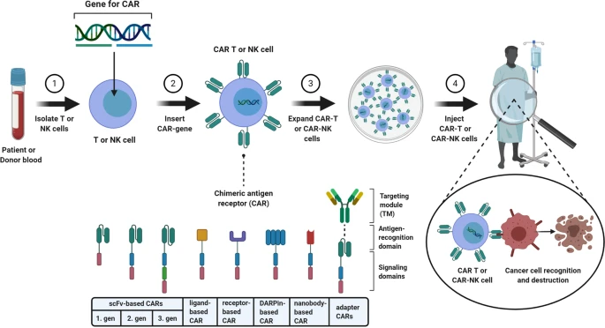
Why CAR-NK cell therapy?
Lower risk for toxicities
MHC-independent
Eliminate concern for gvhd
Allogenic NK sources
Trial success with blood cancers
1
Note. From “Current status and perspective of CAR-T and CAR-NK cell therapy trials in Germany” by N., Albinger, et al., 2021, Nature, Gene Therapy 28, 513-527, (https://www.nature.com/articles/s41434-021-00246-w#Fig1). Copyright 2021 by Springer Nature Limited

Slide 3
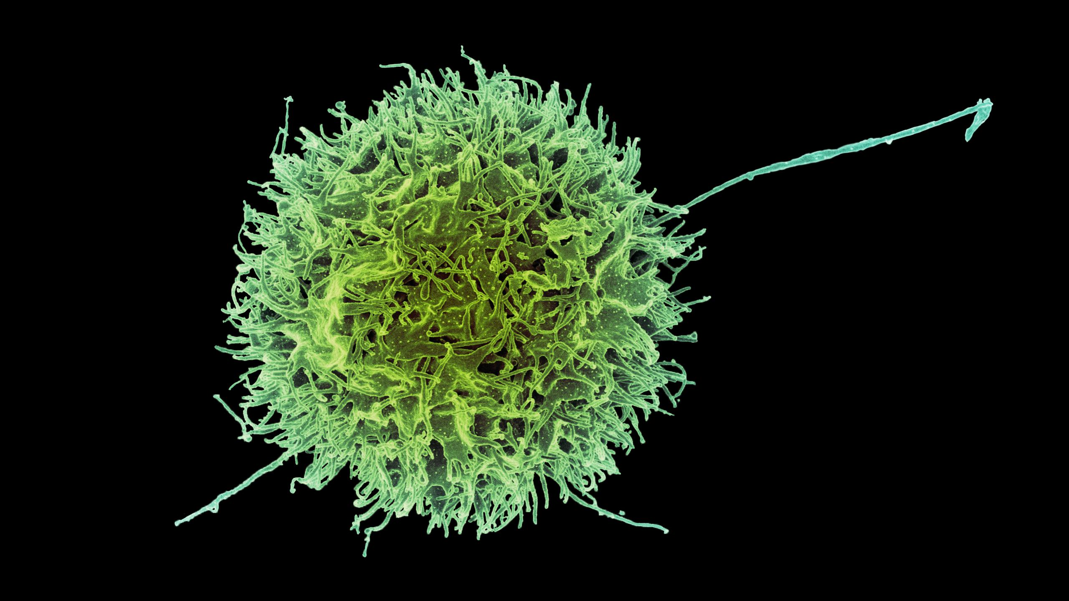
Overview of the experiment
functional map of TINK cells using in vivo AAV–SB-CRISPR screens in four solid tumor mouse models
single-cell transcriptomic landscapes of TINK cells by use of scRNA-seq

Slide 4
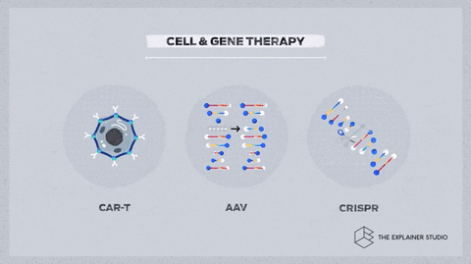
Adeno-associated virus – sleeping beauty-CRISPR system
AAV
Viral vector
SB transposon
CRSIPR
Delivery vehicle for SB
“jumping gene”
Allows stable integration
Selectively modifies DNA
(Animation Gene Therapy, 2021)

Slide 5
Design, Synthesis and Cloning of AAV–SB-Surf-v2 CRISPR Library
Protein and Gene Mapping: identification of 2,867 corresponding human genes and their mouse orthologs
Final Surf-v2 library included 56,911 on-target sgRNAs targeting 2,863 mouse genes

Slide 6
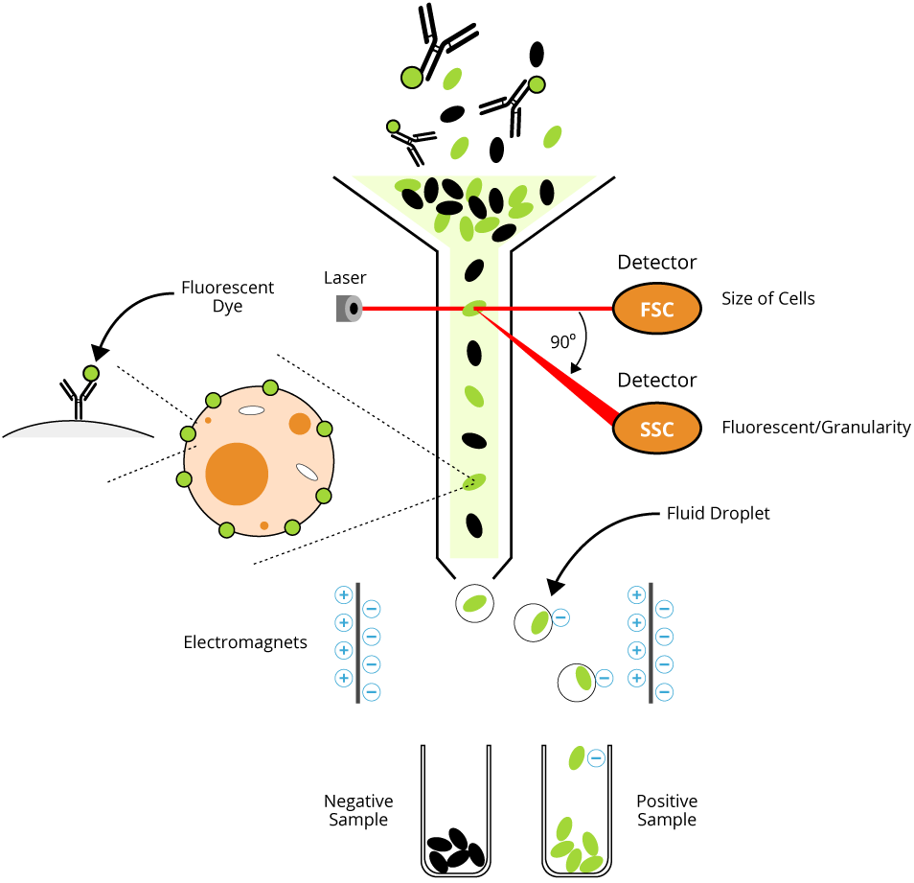
scRNA-seq of TINK Cells
NK cells were isolated from both spleens and tumors of mice
red blood cell lysis & fluorescence-activated cell sorting (FACS)
Used 10x Genomics protocol
Gene expression libraries sequenced on a Novaseq 4000 (Illumina)
amplify cDNA
(FACs Overview, 2024)

Slide 7
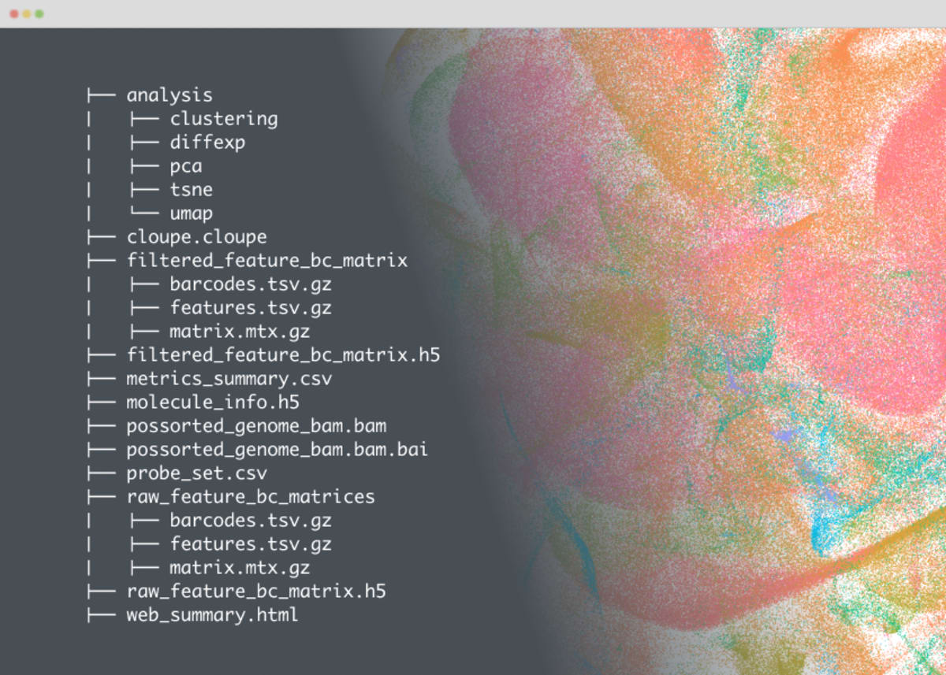
Single Cell Transcriptomics Data Processing
scRNA-seq data processed using the Cell Ranger pipeline
Louvain algorithm
Wilcoxon rank-sum analyses
Heat-map visualization of top DE genes

Slide 8
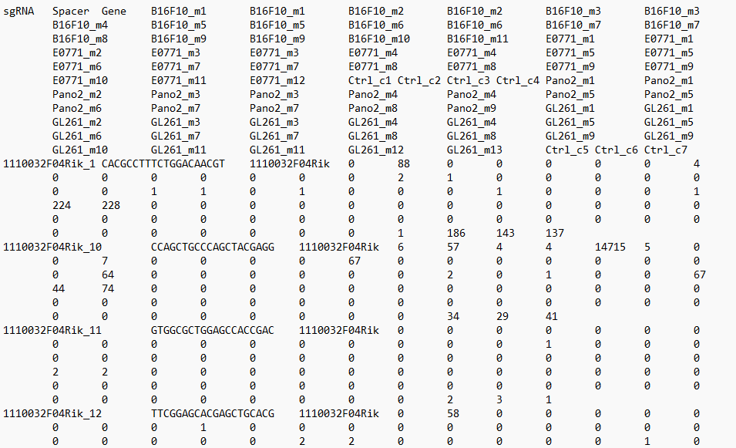
CRISPR KO Screen Data Analyses
Cutadapt used to demultiplex and trim raw sequencing data
Extracted spacers aligned to reference sgRNA library
Put into a count matrix for analyzing

Slide 9
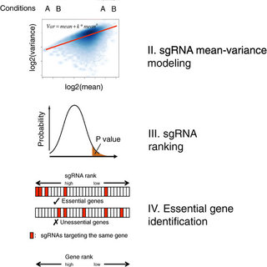
CRISPR KO Screen Data Analyses
Count matrix evaluated with MaGeCK-RRA
Integration of Datasets
ImmGen project comparison
Genetic checkpoint validation through screening and transcriptomic data integration
Note. From “MAGeCK enables robust identification of essential genes from genome-scale CRISPR/Cas9 knockout screens,” by W. Li et al., Genome Biol. 2014, https://doi.org/10.1186/s13059-014-0554-4. Copyright 2024 by Springer Nature.

Slide 10
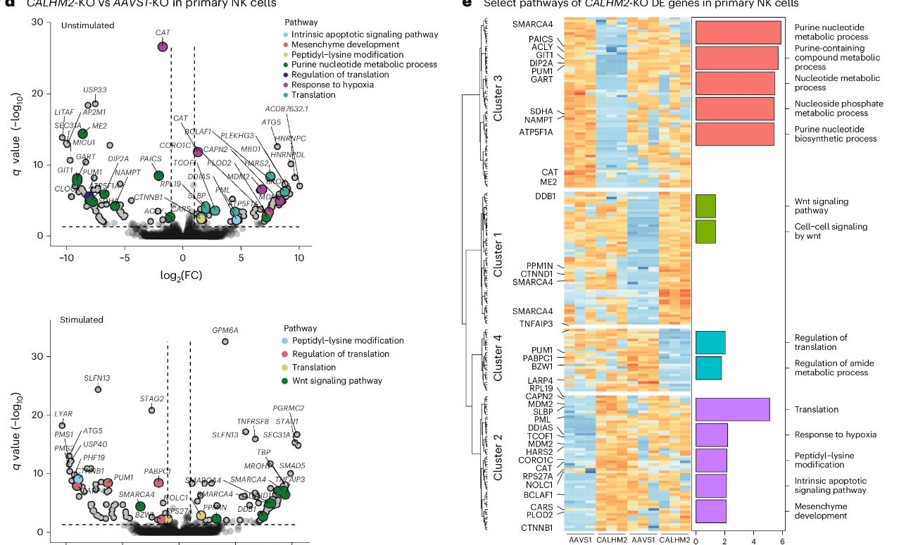
Meta-pathway Analyses
g:Profiler2 R package, focusing on significant Gene Ontology (GO) terms
More than two significant GO terms identified -> clustered
Leiden clustering to optimize
Chose the five most significant pathways to visualize as network plots

Slide 11
In Vivo CRISPR Screens
Screened four tumor models: breast cancer, glioblastoma, melanoma, and pancreatic cancer
Analyzed with MAGeCK-RRA
Significant hits: Plxna1, Sort1, and Calhm2
Hits aligned with data from ImmGen project
C
Note. From “In vivo AAV–SB-CRISPR screens of tumor-infiltrating primary NK cells identify genetic checkpoints of CAR-NK therapy,” by L. Peng. et al, 2024, Nature Biotechnology, (https://doi.org/10.1038/s41587-024-02282-4) . Copyright 2024 by Springer Nature Limited

Slide 12
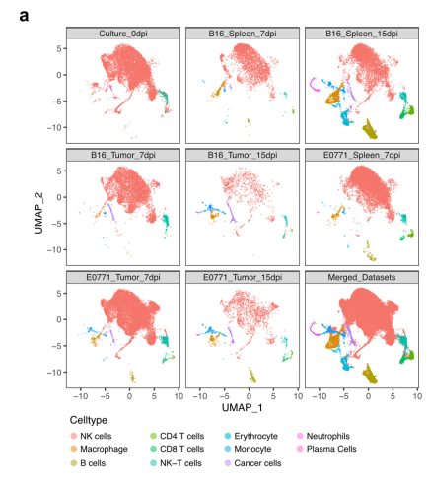
Single-cell Transcriptomics of TINK Cells
Conducted scRNA-seq of TINK cells from B16F10 and E0771 tumor models in B6 mice
Isolated NK cells from tumors and spleens at 7 and 15 days post-injection using FACS
10x Genomics platform
Sequenced pretransfer donor NK cells as control for baseline comparisons.
Note. From “In vivo AAV–SB-CRISPR screens of tumor-infiltrating primary NK cells identify genetic checkpoints of CAR-NK therapy,” by L. Peng. et al, 2024, Nature Biotechnology, (https://doi.org/10.1038/s41587-024-02282-4) . Copyright 2024 by Springer Nature Limited

Slide 13
Single-cell Transcriptomics of TINK Cells
Data integrated and visualized using UMAP
Characterized NK cell subsets to create global
functional maps in tumor microenvironment
Identified:
NK T cells (Ncr1+Cd3e+)
ILC1 cells (Ncr1+Rora+Gpr183+Cxcr6+)
Nine NK cell groups, including:
Mature NK (mNK)
Tissue-resident NK (trNK)
Proliferative NK (NK5)
Note. From “In vivo AAV–SB-CRISPR screens of tumor-infiltrating primary NK cells identify genetic checkpoints of CAR-NK therapy,” by L. Peng. et al, 2024, Nature Biotechnology, (https://doi.org/10.1038/s41587-024-02282-4) . Copyright 2024 by Springer Nature Limited

Slide 14
Single-cell Transcriptomics of TINK Cells
Explored tumor infiltration across all NK cell populations using DE analysis
More mNK cells observed in the spleen than in tumors, despite TINK comprising ~20% mNK cells

Slide 15
CALHM2 The Convergent Hit
Amplified NK cell functions in mouse primary NK cells, human primary NK cells and CAR-NK cells
Expression was predominantly found in splenic NK subsets and significantly reduced in TINK cells
Suggests potential role in regulating NK cell activity in the tumor microenvironment
Note. From “In vivo AAV–SB-CRISPR screens of tumor-infiltrating primary NK cells identify genetic checkpoints of CAR-NK therapy,” by L. Peng. et al, 2024, Nature Biotechnology, (https://doi.org/10.1038/s41587-024-02282-4) . Copyright 2024 by Springer Nature Limited

Slide 16
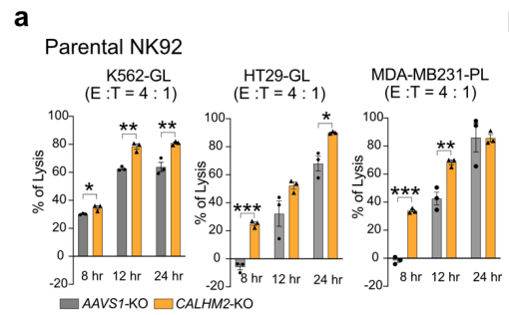
CALHM2 KO Enhanced CAR-NK92 Antitumor Function
Generated CALHM2-mutant NK92 cells by Cas9 gRNA RNP electroporation
Increased cytotoxicity against multiple cancer cell lines
K562 (leukemia)
HT29 (solid tumor)
MDA-MB231 (solid tumor)
Proliferation unaffected
Note. From “In vivo AAV–SB-CRISPR screens of tumor-infiltrating primary NK cells identify genetic checkpoints of CAR-NK therapy,” by L. Peng. et al, 2024, Nature Biotechnology, (https://doi.org/10.1038/s41587-024-02282-4) . Copyright 2024 by Springer Nature Limited

Slide 17
CALHM2 KO Enhanced CAR-NK92 Antitumor Function
Increased CAR-NK Infiltration
21-28 days post tumor implantation
Enhanced Cytotoxicity
Against HER2+ cancer cell lines in coculture assays
Note. From “In vivo AAV–SB-CRISPR screens of tumor-infiltrating primary NK cells identify genetic checkpoints of CAR-NK therapy,” by L. Peng. et al, 2024, Nature Biotechnology, (https://doi.org/10.1038/s41587-024-02282-4) . Copyright 2024 by Springer Nature Limited

Slide 18
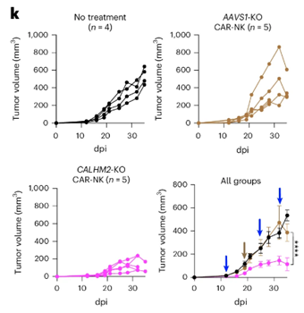
CALHM2 KO Enhanced CAR-NK92 Antitumor Function
Potent In Vivo Antitumor Efficacy
CALHM2-KO anti-HER2-CAR-NK92-hIL-2 cells in solid tumor model

Slide 19
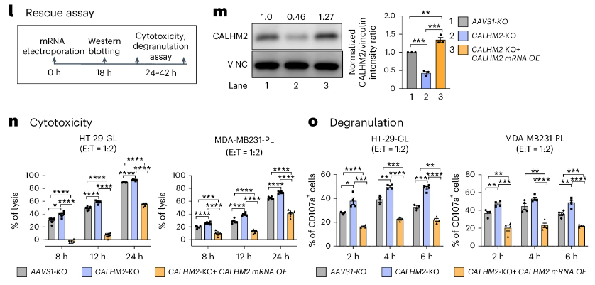
CALHM2 Transgene Rescued CALHM2-KO Phenotypes
Note. From “In vivo AAV–SB-CRISPR screens of tumor-infiltrating primary NK cells identify genetic checkpoints of CAR-NK therapy,” by L. Peng. et al, 2024, Nature Biotechnology, (https://doi.org/10.1038/s41587-024-02282-4) . Copyright 2024 by Springer Nature Limited
Reintroduced the CALHM2 gene into CALHM2-KO anti-HER2-CAR-hIL-2-NK92 cells
CALHM2 overexpression significantly decreased cancer-killing capability of CALHM2-KO NK cells against HT29 and MDA-MB-231 cancer lines
Overexpression lowered CD107a production in response to cancer cells

Slide 20
CALHM2 KO Enhanced Human Primary NK Cell Functions
Note. From “In vivo AAV–SB-CRISPR screens of tumor-infiltrating primary NK cells identify genetic checkpoints of CAR-NK therapy,” by L. Peng. et al, 2024, Nature Biotechnology, (https://doi.org/10.1038/s41587-024-02282-4) . Copyright 2024 by Springer Nature Limited
Enhanced cytotoxicity across three distinct healthy donors
Elevated production of CD107a when stimulated with cancer cells
Enhanced secretion of effector cytokines, such as interferon-γ and tumor necrosis factor-α observed

Slide 21
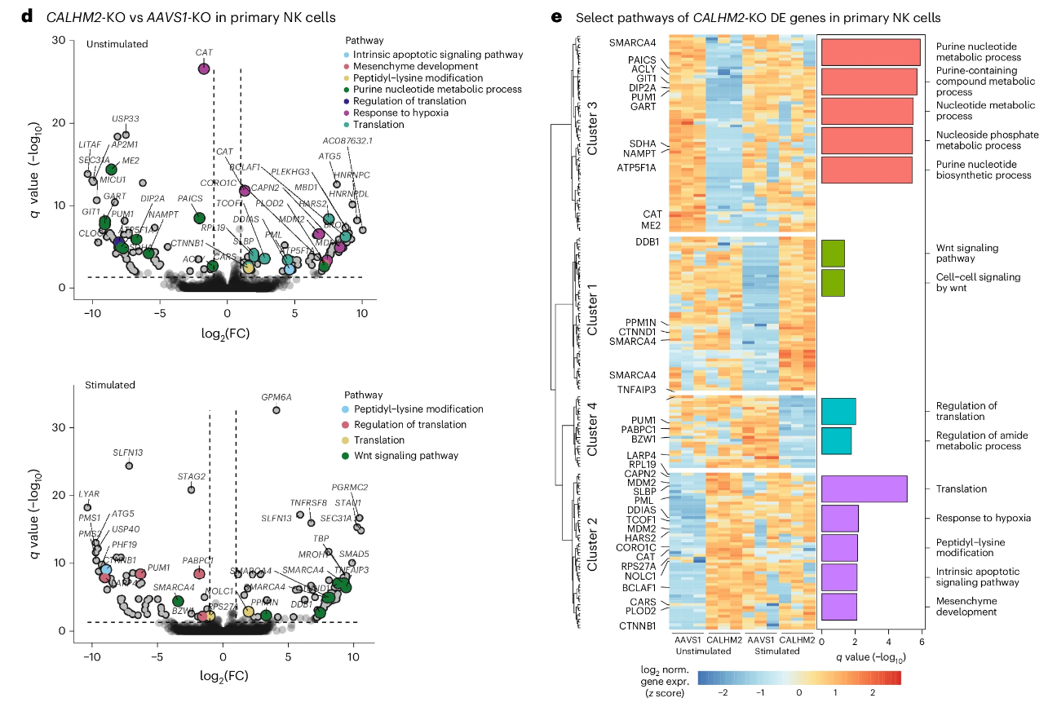
CALHM2 KO Alters Multiple Pathways in Human Primary NK cells
Bulk mRNA-seq analysis identified
98 upregulated and 96 downregulated genes in resting cells
114 upregulated and 60 downregulated genes after stimulation
Note. From “In vivo AAV–SB-CRISPR screens of tumor-infiltrating primary NK cells identify genetic checkpoints of CAR-NK therapy,” by L. Peng. et al, 2024, Nature Biotechnology, (https://doi.org/10.1038/s41587-024-02282-4) . Copyright 2024 by Springer Nature Limited

Slide 22
Outcome of Experiment
Systematically identified genes that suppress NK cell function through
AAV–SB-CRISPR KO screens in mouse primary NK cells
scRNA-seq to analyze TINK cell subpopulations
Potential of targeting endogenous genetic suppressors like CALHM2 to develop more effective NK cell-based therapies for cancer treatment
CALHM2 KO:
Significantly enhanced the cytotoxicity, degranulation, cytokine production, and tumor infiltration of primary NK cells and CAR-NK cells
Improved the efficacy of anti-HER2-CAR-NK92 cells against solid tumors
.

Slide 23
The Future
CAR-NK cells are emerging as promising candidates for cancer immunotherapies
manufactured as allogeneic
similar efficacy to CAR-T cell therapies but with significantly lower toxicity
Function is often limited by endogenous genetic suppressors, necessitating modifications to enhance their potency against cancer
Current strategies to boost NK cell function include overexpressing cytokines (e.g., IL-15) and knocking out negative regulators

Slide 24
References
Albinger, N., Hartmann, J. & Ullrich, E. (2021), Current status and perspective of CAR-T and CAR-NK cell therapy trials in Germany. Gene Ther 28, 514. https://doi.org/10.1038/s41434-021-00246-w
2. The Explainer Studio (2021). Animation Gene Therapy [Photograph]. The Explainer Studio. https://giphy.com/gifs/ExplainerStudio- animation-explainer-explainerstudio-BEEf7qJ3LNS3NMxNcP
3. Peng, L., Renauer, P.A., Sferruzza, G. et al. (2024), In vivo AAV–SB- CRISPR screens of tumor-infiltrating primary NK cells identify genetic checkpoints of CAR-NK therapy. Nat Biotechnol. https://doi.org/10.1038/s41587-024-02282-4
4. Li, W., Xu, H., Xiao, T. et al. (2014), MAGeCK enables robust identification of essential genes from genome-scale CRISPR/Cas9 knockout screens. Genome Biol 15, 554. https://doi.org/10.1186/s13059-014-0554-4
5. B. (2024). FACs Overview [Photograph]. BosterBio. https://www.bosterbio.com/protocol-and-troubleshooting/flow-cytometry-principle

