Slide 1
Positive Selection CRISPR Screens Reveal A Druggable Pocket In An Oligosaccharyltransferase Required For Inflammatory Signaling To NF-κb
Lampson Et al., April 2024
Presented By: Rithvik Rajkumar

Slide 2
Relevant Introductory Concepts
Glycosylation
Lentiviruses
CRISPR-Cas9
B-Cell (NF-kB) Signal Transduction Pathway

Slide 3
Relevant Introductory Concepts, Expanded
Glycosylation
Lentiviruses
The process by which a carbohydrate attaches to a macromolecule, generally either a protein and lipid.
Glycosylation is typically responsible for protein modulation, corrective folding, and expression.
A specific genus of (RNA) retrovirus, that is generally associated with either chronic or deadly disorders, such as HIV.
Lentiviruses can be modified and inserted, in a manner similar to other developed retroviruses, to induce effects into the patient.

Slide 4
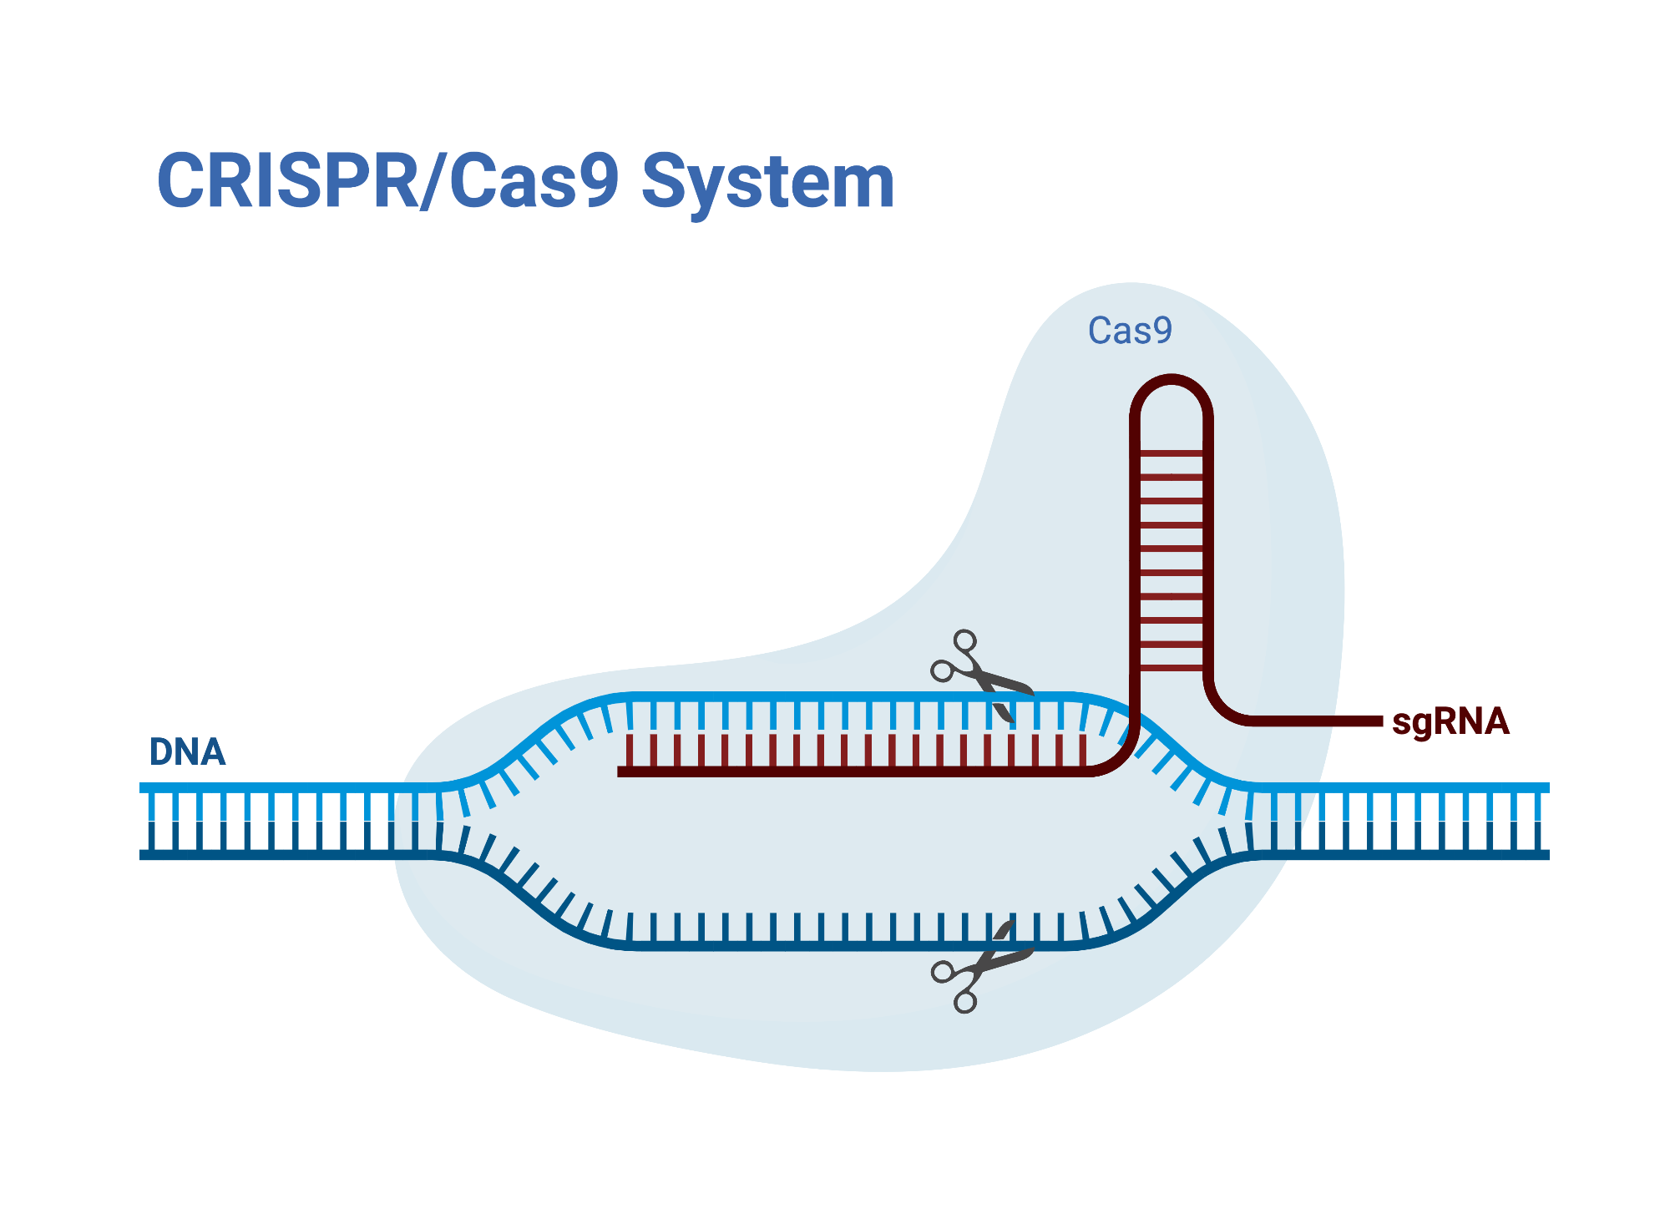
Relevant Introductory Concepts, Expanded
CRISPR-Cas9
A Gene Editing technique that allows the altering of DNA, using the CRISPR sequence & Cas9 enzyme derived from bacteria/archaea.
In this paper, it serves multiple purposes, but for now, know that it can modify Lentiviruses.

Slide 5
B-Cell (NF-kB) Signal Transduction Pathway
A complex cascade of two pathways that plays a critical role in the development, survival, and activation of B lymphocytes.
NF-kB: Nuclear Factor kappa B, a family of transcription receptor proteins, which control DNA transcription, as well as cytokine production and secretion.
Overactivation of NF-κB is known to cause many known diseases, such as Sepsis, Cancer (with a leaning towards lymphoma), and autoimmune diseases, such as celiac and arthritis.
There are pharmaceutical drugs that are in the business of targeting the NF-κB pathway, common examples including Tyrosine Kinase Inhibitors, various steroid hormones and NSAIDs.

Slide 6
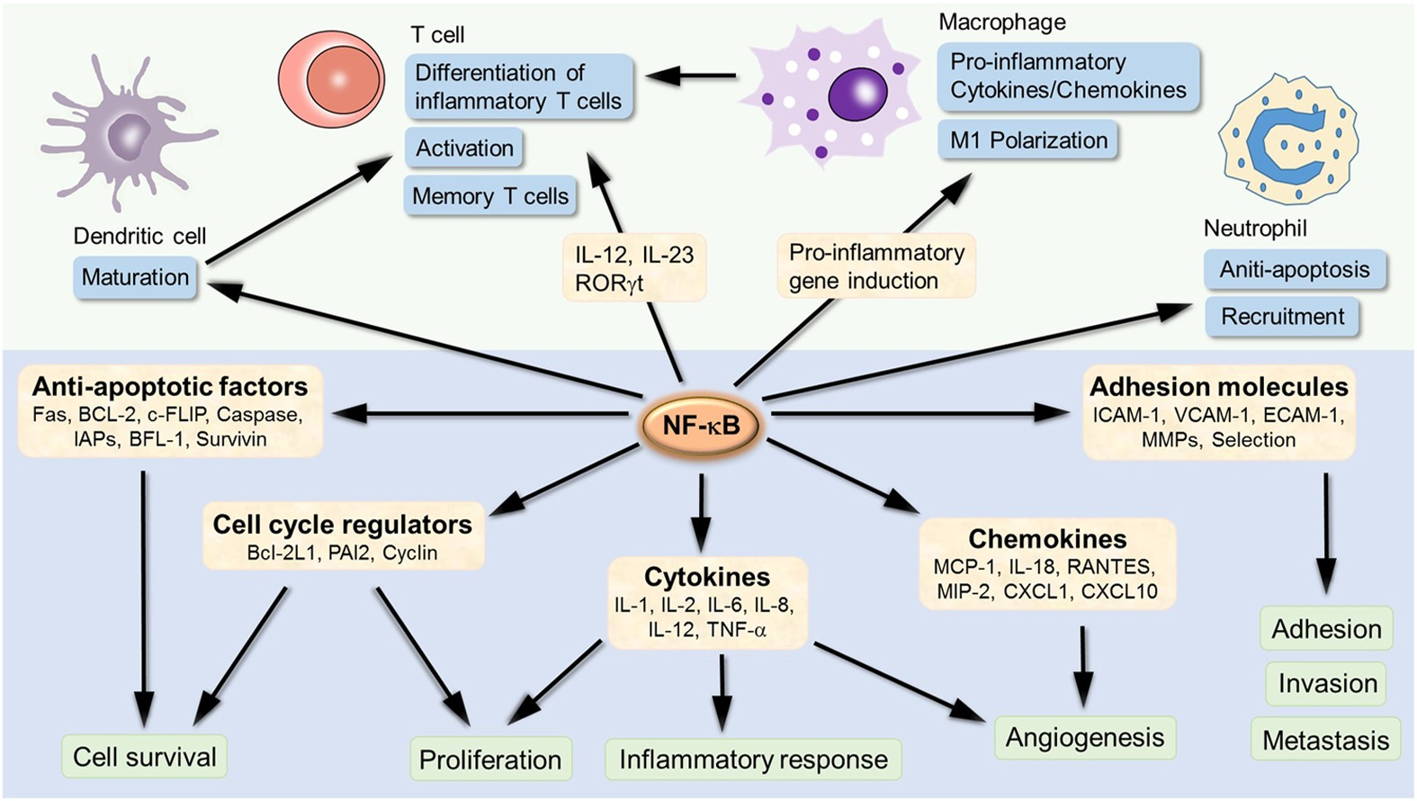

Slide 7
Research Goals
To determine genes and/or targets, through which inhibition or activation would affect the NF-κB Signal Transduction Pathway, or locations along the pathway.
To determine the side effects of inactivation or overactivation of the NF-κB Signal Transduction Pathway, in regards to each specific drug/gene target, using a variety of testing techniques.

Slide 8
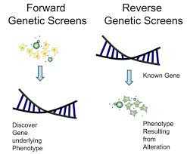
Forward and Reverse Screening
Most previous research in this field was done using Reverse Genetic Screens, which are susceptible to confusion if the gene encodes for a perturbant which can cause general loss of function in cells (I.E. major system shutdown).
This can cause difficulty in identifying specific pathway regulators.
So, instead, the researchers decided to complete a CRISPR-based Forward Genetic Screen, which effectively uncovers all genes that originate from the stimulus.
In this case, from the NF-kB signaling pathway. EX: Lipopolysaccharide (LPS), an activator.

Slide 9
Dual Reporter Systems, Excitation and Inhibition
The researchers deigned to create a “Dual Reporter System”, controlling both a Modified Suicide Gene, and GFP (Green Fluorescent Protein), which in turn allows the screen to be used to identify drugs/proteins that affect the NF-kB pathway signaling.
This system allows for the identification of perturbants (disruptors) that either inhibit or activate NF-κB signaling by measuring the expression of DCK (Deoxycytidine Kinase) and GFP in response to NF-κB activity.
To clarify, this study aims to identify genes which both excite and inhibit the pathway, and identify methods through which drugs which can affect said genes.

Slide 10
Dual Reporter Systems, Via Lentiviruses
Said Dual-Reporter System was created via a mammalian Lentivirus, which encodes for the previous mentioned modified suicide gene (programs for deoxycytidine kinase), and GFP.
The system works by converting bromovinyl deoxyuridine (BVdU, a nucleoside, and which is particularly active in cells which have significant activity of the NF-κB pathway, into a toxin.
Additionally, lentiviruses were also used to establish stable and consistent cell lines for the experiments to come.

Slide 11
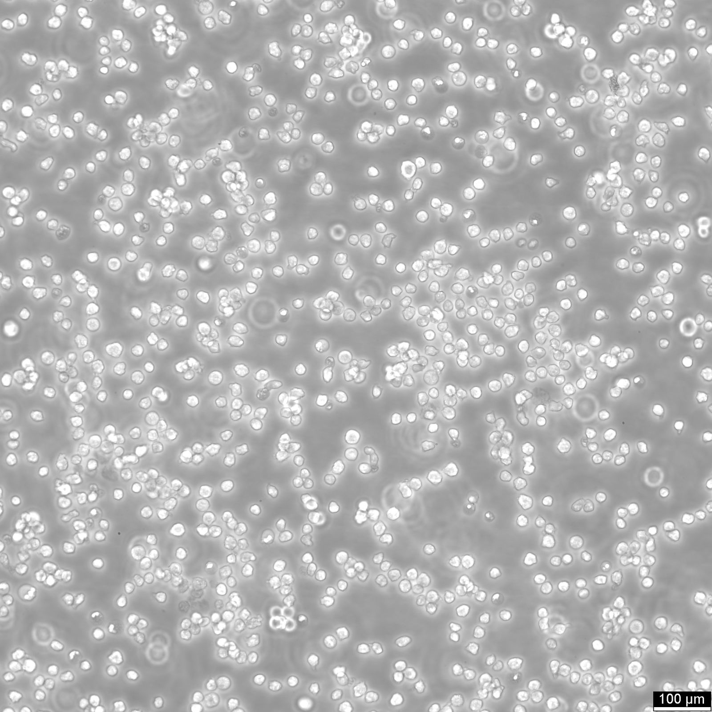
NF-kB Signal Transduction Pathway, Introduction
After conversion of BVdU into a toxin, by Deoxycytidine Kinase, the NF-κB-DCK reporter is then introduced into NALM-6 Leukemia Cells.
The NALM-6 cell line is a reliable model that has been used by various studies, and has been verified to be accurate in representing the biology of B-Cell precursors in-vivo.
Notes:
Relatively Expensive, with a singular Cryovial going for about $400 USD

Slide 12
NF-kB Signal Transduction Pathway, Expanded
Using Tumor necrosis factor, Alpha-Induced Protein 3 (TNFAIP3), a known endogenous NF-κB inhibitor through insertion by CRISPR-Cas9, researchers were able to dramatically increase the strength of the GFP response (fluorescence), when cells were stimulated using LPS.
The results of this confirmed that the Reporter System was correctly linked with the NF-kB pathway, as when a key mediator of the pathway, MYD88, was inactivated, it resulted in the negation of LPS-derived activation.
In a later test, the researchers mixed two groups of cells—one which produced MYD88 sgRNA, and another producing a control sgRNA and blue fluorescent protein (BFP). After treating the mixed cells with LPS and BVdU, those cells with MYD88 inactivation were significantly amplified, suggesting that loss of NF-κB activity increased cell survival, while in the presence of BVdU.

Slide 13
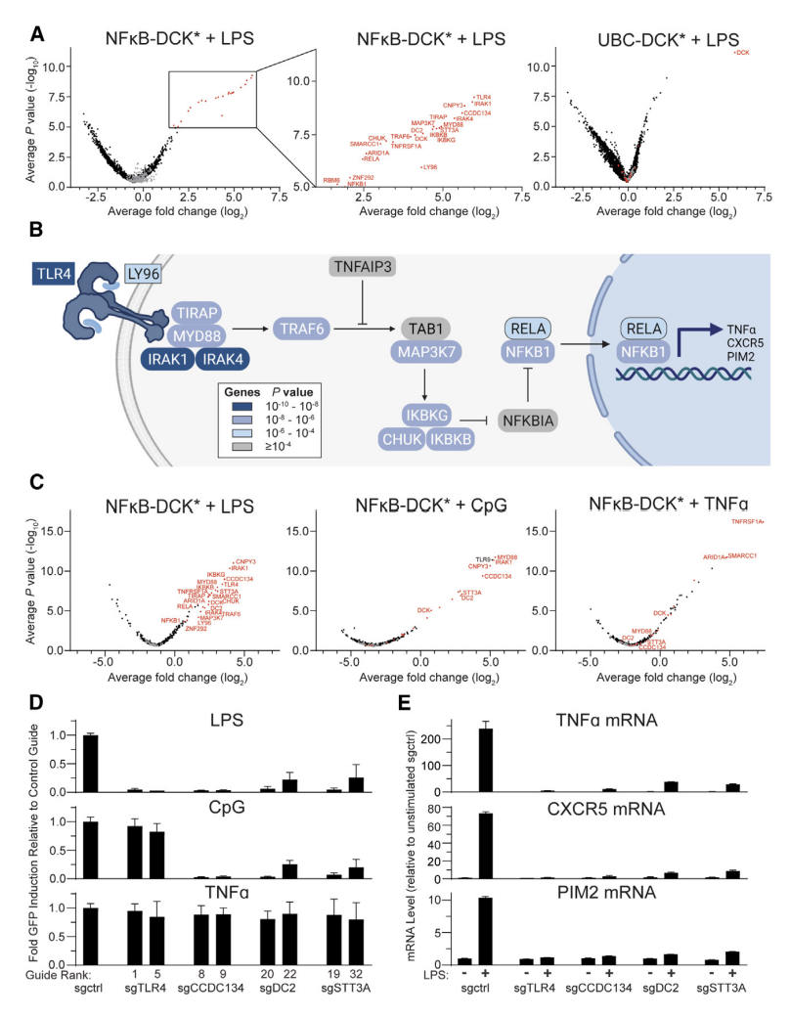
Note:
UBC refers to human ubiquitin C, which is used as a promoter in the dual reporter system.
It serves as a control to compare against the NF-κB promoter
Notes:
Explain each, list that d and e, are not entirely relevant?

Slide 14
NF-kB Pathway, Biological Techniques
Researchers used a whole-genome sgRNA library, which targets almost 20,000 genes, in TNFAIP3 knockout NF-κB-DCK cells.
Said Cells were treated with LPS & BVdU to identify cells that had lost NF-κB activity. Those that were positively selected were identified based on increased levels of sgRNA through Next-Generation Sequencing (NGS).
NGS is a modern method that allows the sequencing of millions of small fragments of DNA simultaneously, in this case, allowing for whole genome sequencing and single gene testing.

Slide 15
Identification of Genes Required by NF-kB Pathway
The most positively screened “Hit” was Toll-Like Receptor 4, while other genes in the NF-κB pathway generally ranking much lower.
It should be noted that there seemed to be a correlation between proximity to TLR4, and how highly genes ranked, and those further downstream, even if essential for cell-sustaining, ranked lower the further out they were.
One of the highest ranking hits was the STT3A, a catalytic subunit of Oligiosaccharyltransferase A (OST-A). STT3A is typically responsible for N-glycosylation, and is usually essential for TLR4 signaling.
Whenever STT3A was inactivated, NF-kB activation by LPS was shown to be significantly diminished.
It should be noted that STT3B, the complementary subunit of STT3A, did not score on the screen, and by itself, does not affect TLR4 receptors or NF-kB signaling.

Slide 16
NF-kB Pathway, Biological Techniques, Expanded
Loss of STT3A was shown to decrease TLR4 cell surface expression, which was confirmed via through two methods.
Flow Cytometry: A laser based lab test, that allows for the testing of multiple parameters (chemical and physical), for tens of thousands of particles at a time.
A derivative of Flow cytometry, called Fluorescence-activated cell sorting (FACS) was used, which allows for the physical separation of cells into distinct populations
Immunoblotting (Western Blotting): A technique that separated proteins, based on size, charge, etc. It generally uses mass amounts of antibodies which bind to antigens found on cell walls, and those that bind are then visualized via chromogenic methods or luminescence.

Slide 17
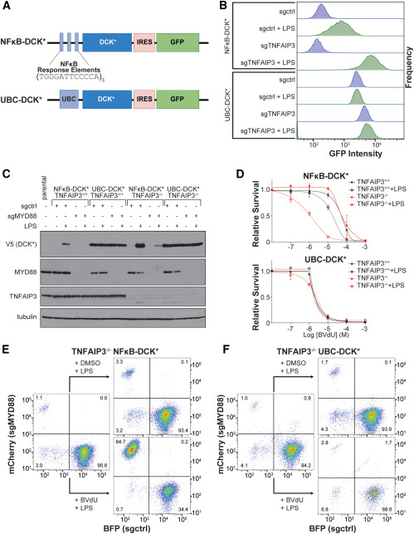
Note:
IRES stands for internal ribosomal entry site, which is a sequence that allows for the initiation of translation.
Notes:
B is Fluorescence Activated Cell Sorting, C is an immunoblot (we will discuss in a later slide), D is a Kill Curve Graph, E and F are FACS-based visualized competition arrays.

Slide 18
Oligosaccharyltransferase-A & B
OST-A is responsible for the catalyzation of N-glycosylation of certain sequons, in which N-Glycans attach to acceptor proteins.
OST-B on the other hand catalyzes those skipped over by OST-A, a post translational mechanism, that works like a cleanup crew.
After CRISPR-induced knockout of STT3A, the reintroduction of standard STT3A restored TLR4 glycosylation in cells.
This realization led researchers to identify that STT3A is the catalytic subunit of OST-A.

Slide 19
Identified Inhibitors
NGI-1 is inhibitor of both OST-A and OST-B, whose function is to bind to the titular Conserved Pocked in STT3A, which results in the disruptions of glycosylation, by altering the binding of the substrate LLO (Listeriolysin O), causing the enzyme to become inactive.
NGI-235 is a selective inhibitor, only acting on the STT3A subunit of OST-A, inhibiting TLR4 glycosylation, and cell surface connection.
NGI - 235 only inhibited the glycosylation of STT3A-dependent substrates (ex: prosaposin) but not STT3B-specific substrates (ex: ERGFP).
This specificity, may allow for less collateral damage as a result of dysregulation of the NF-κB signaling, especially as the TLR4 receptor is widely used.

Slide 20
Limitations Addressed
It is not yet proven that STT3A is necessary for regulation of TLR4 and NF-kB signaling in-vivo, as the inhibitors NGI 1 & 235 are not yet suitable for animal-based research.
Although the structural differences are known between the inhibitors, the researchers were unable to pinpoint why exactly the latter showed signs of isoform selectivity.
While CRISPR technology is highly specific, off-target gene editing can still occur. This could potentially lead to unintended consequences or false positives, where other genes indirectly influence NF-κB signaling due to unintended modifications.
Identifying a druggable pocket does not mean that an applicable drug will be easy to design. There are likely more structural/biochemical challenges, that will need to be addressed.

Slide 21
Future Potential, and Further Research
All of the collected information in this study leads the researchers to the conclusion that STT3A-specific inhibitors like NGI-235 could be more broader effective, and with less potential toxicity. This particular article helps sets the foundation for the development of selective inhibitors targeting OST-A, in the future, particularly for those diseases involving NF-κB dysregulation.
Further research, as indicated by the authors will aim to identify, and subsequently minimize the Off-Target effects of insertion or deletion of the STT3A specific inhibitor NGI-1.

Slide 22
References, Citations
Main Article:
Lampson, B. L., Ramίrez, A. S., Baro, M., He, L., Hegde, M., Koduri, V., Pfaff, J. L., Hanna, R. E., Kowal, J., Shirole, N. H., He, Y., Doench, J. G., Contessa, J. N., Locher, K. P., & Kaelin, W. G. (2024). Positive selection CRISPR screens reveal a druggable pocket in an oligosaccharyltransferase required for inflammatory signaling to NF-κB. Cell, 187(9), 2209-2223.e16. https://doi.org/10.1016/j.cell.2024.03.022
‌Supplementary Sources
What is CRISPR-Cas9?. Your Genome. (n.d.). https://www.yourgenome.org/theme/what-is-crispr-cas9/
Kramer, D. K. (n.d.). Western blotting (immunoblot): Gel electrophoresis for proteins, ELISA Kits & Proteins for Life Science Research, https://www.antibodies-online.com/resources/17/1224/western-blotting-immunoblot-gel-electrophoresis-for-proteins/
Chong, G. (2024). We don’t need no inflammation. Nature Chemical Biology, 20(6), 657–657. https://doi.org/10.1038/s41589-024-01646-w

