Slide 1
CRISPR screens decode cancer cell pathways that trigger γδ T cell detection
Mamedov, M.R., Vedova, S., Freimer, J.W. et al. CRISPR screens decode cancer cell pathways that trigger γδ T cell detection. Nature 621, 188–195 (2023).

Slide 2
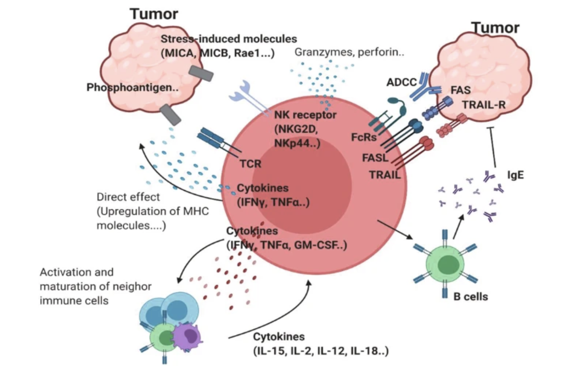
γδ T Cells
Activation occurs when stress-induced molecules and phosphoantigens engage their receptors.
Activation promotes antitumor responses
γδ T cell also promote B cells to produce IgE, which also has antitumor effects.
Source: Park, J.H., Lee, H.K. Function of γδ T cells in tumor immunology and their application to cancer therapy. Exp Mol Med 53, 318–327 (2021). https://doi.org/10.1038/s12276-021-00576-0

Slide 3
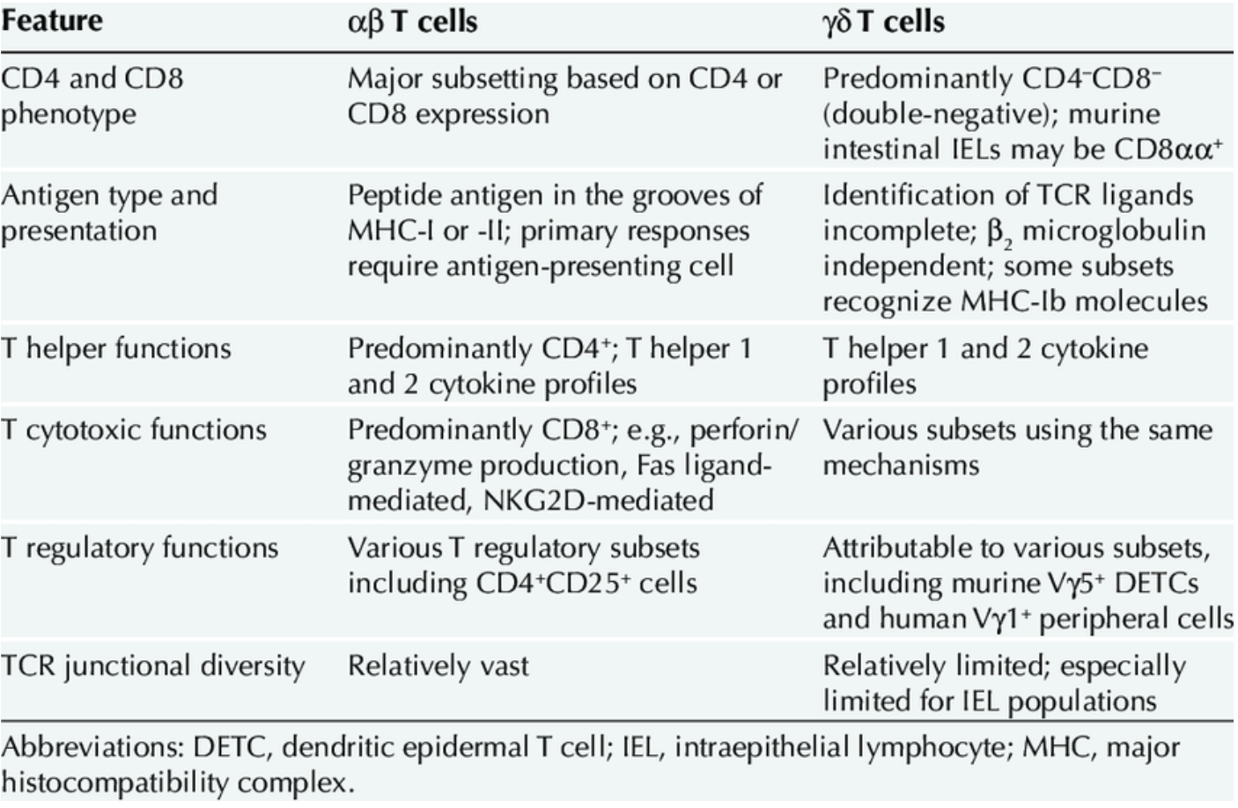
γδ T Cells vs. αβ T Cells
Source: Girardi, Michael. (2006). Girardi MImmunosurveillance and immunoregulation by γδ T cells. J Invest Dermatol 126:25-31. The Journal of investigative dermatology. 126. 25-31. 10.1038/sj.jid.5700003.

Slide 4
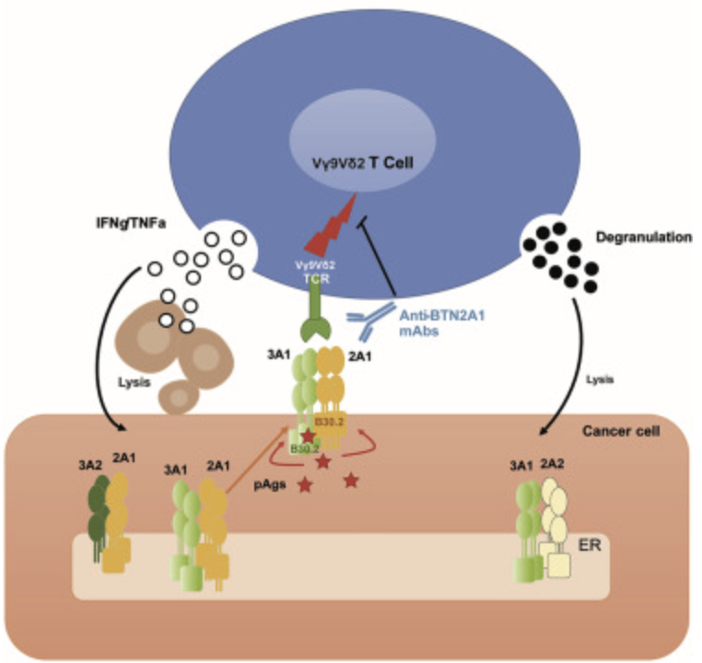
Vγ9Vδ2 T Cells
Most dominant subset of γδ T cells in humans.
Recognizes the BTN2A1-BTN3A1 complex.
Detects phosphoantigens produced by the mevalonate pathway.
Source: Cano, Carla E., et al. "BTN2A1, an Immune Checkpoint Targeting Vγ9Vδ2 T Cell Cytotoxicity Against Malignant Cells." *Cell Reports*, vol. 36, no. 2, 2021, 109359. [ScienceDirect](https://doi.org/10.1016/j.celrep.2021.109359).

Slide 5
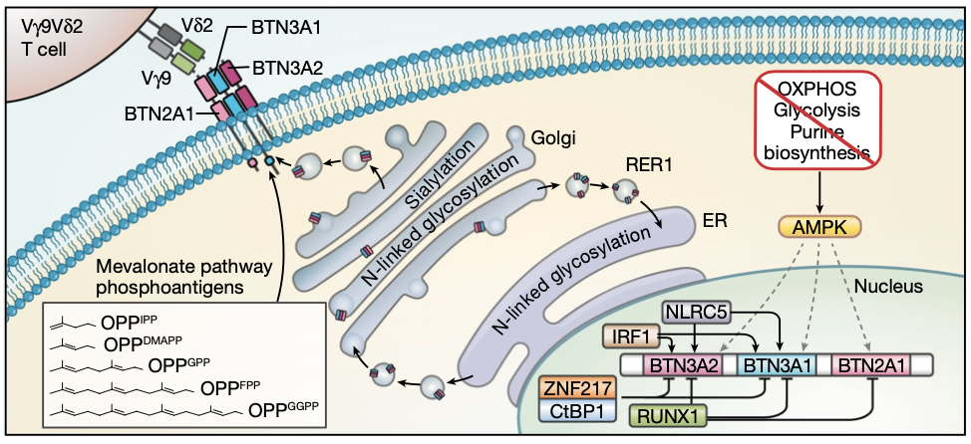
Phosphoantigens and Tumor Detection

Slide 6
BTN2A1-BTN3A1 Complex: Central to Tumor Recognition
Cell-surface proteins that form a complex in stressed/transformed cells
Activated by phosphoantigens.
BTN3A1 activates to allow BTN2A1 to engage with the Vγ9Vδ2 TCR
“Stress signal”
Flagged for immune attack
BTN3A1 expression higher in cancer cells

Slide 7
Metabolic Pathways Affecting Tumor Detection
Oxidative Phosphorylation (OXPHOS)
ATP generation
High energy demand of cancer cells leads to disruption and metabolic stress
Purine Metabolism
Proliferation of cancer cells leads to upregulation
BTN3A upregulated due to stresses
Phosphoantigens produced by these pathways then activate BTN3A

Slide 8
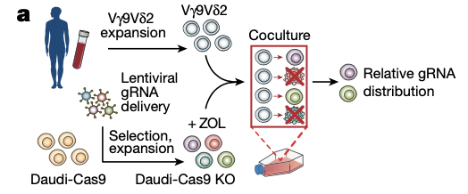
Experimental Design
Knockout (KO) Daudi cancer cells co cultured with expanded Vγ9Vδ2 T cells
Cells treated with zoledronate
Boosts phosphoantigen levels
Measure survival of Daudi cells to determine impact of each gene knockout

Slide 9
Experimental Design
Daudi-Cas9 cells edited with genome-wide KO CRISPR library
3 replicates of each cell pool
Populations sorted, pellets frozen and used to generate sequence libraries
Library sequenced by NovaSew 6000 S4 PE150 kit from Illumina
Two-step PCR used ro index gDNA samples for NGS

Slide 10
Experimental Design
MAGeCK test command
Indentify differentially enriched sgRNA targets
Correlation AnalyzeR used to determine BTN3A1 expression correlations by ARCH4 repository
sgRNA plasmids used for arrayed validation studies
Daudi-CAS9 NLRCS KOs genotyping by Sanger sequencing
Amplified analysis by Sanger sequencing and KO efficiency through indel tracking by decomposition algorithm

Slide 11
CRISPR Screens to Decode γδ T Cell Pathways
Purpose:
Identify which genes in cancer cells affect γδ T cell recognition and killing
Screening:
Genome-wide CRISPR knockouts created in Daudi cancer cells
Outcome:
See which knocked out genes increase or decrease the susceptibility of cancer cells to Vγ9Vδ2

Slide 12
CRISPR Screens to Decode γδ T Cell Pathways
Data Processing
Gene-set enrichment analysis
Identifies significant pathways
Tools and software
MAGeCK
CRISPR Screen data analysis
Impact of each knockout on cell survival and γδ T cell killing

Slide 13
Initial Findings
Through screening, several metabolic and immune regulatory pathways were identified that affect γδ T cell interaction
Butyrophilin Complex
BTN2A1, BTN3A1, BTN3A2
Mevalonate pathway
ACAT2, HMGCR
FDPS, GGPS1
ZOL transporter
SLC37A3
Transactivator of BTN3A1-3 genes
NLRC5
Surface proteins
ICAM1

Slide 14
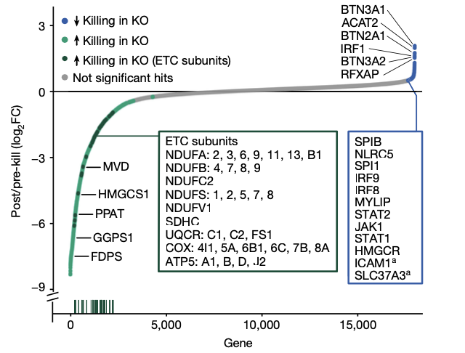
Initial Findings

Slide 15
Gene Set Enrichment Analysis
Pathways enriched:
OXPHOS, TCA cycle, purine metabolism
Metabolic importance:
Maintenance of ATP balance
BTN3A expression
Significance:
Metabolic pathway KO can lead to increased γδ T cell sensitivity

Slide 16
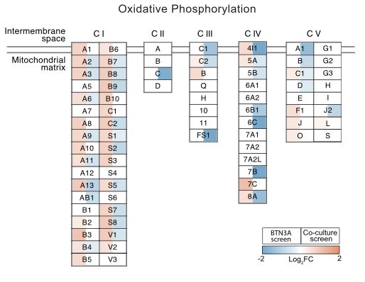
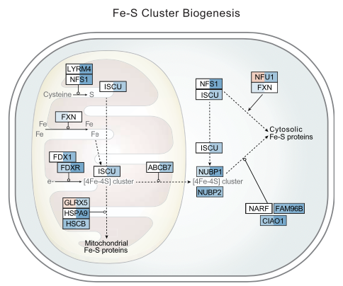
Gene Set Enrichment Analysis

Slide 17
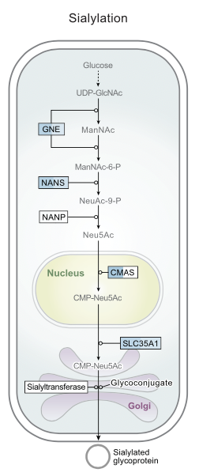
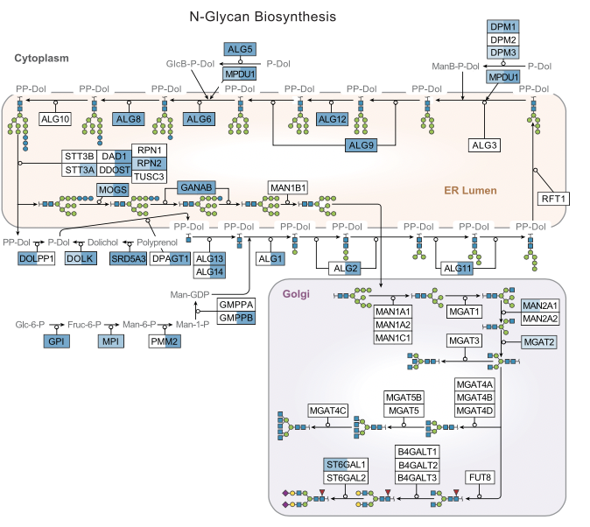
Gene Set Enrichment Analysis

Slide 18
Mechanisms of BTN3A Regulation
IRF1 and NLRC5 crucial for transcription of BTN3A genes
IRF1 binds to BTN3A1 and BTN3A2 promoter regions
BTN3A undergoes glycosylation and sialylation modifications
Reduction in these increase BTN3A surface levels
RER1 protein controls transport of BTN3A to plasma membrane

Slide 19
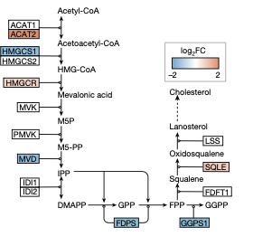
Mevalonate Pathway
Prosophoantigen production
Significance:
Increased activity in many cancers due to increased energy needs
Enhanced γδ T cell engagement
Genes affected
HMGCR, ACAT2

Slide 20
Purine Biosynthesis Pathway (KEGG)
Essential for ATP Production
Influence on BTN3A levels
Genes
PPAT, IMPDH1
Implication
Interruption of pathway affects the energy states of cancer cells
Enhances detection by γδ T cells

Slide 21
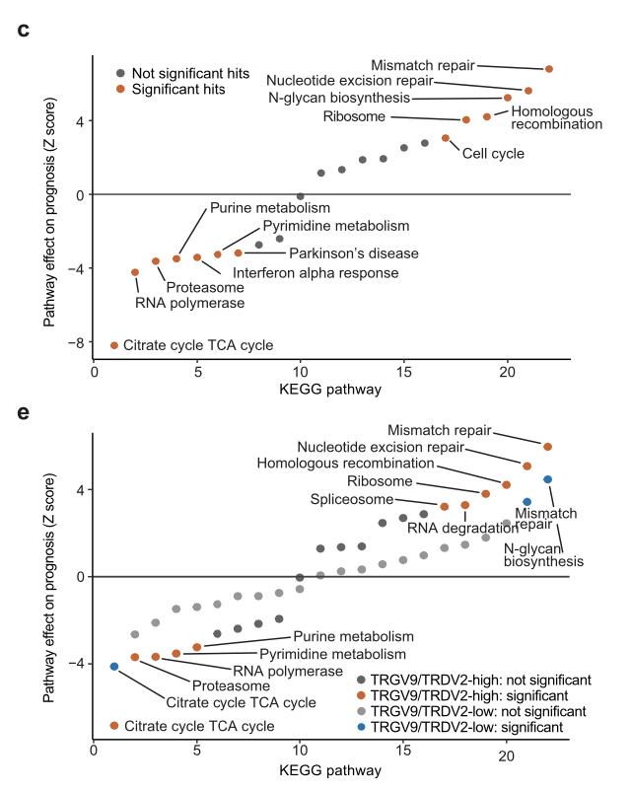
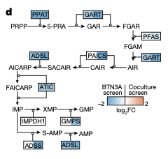
Purine Biosynthesis Pathway (KEGG)

Slide 22
Glycosylation and Sialylation Pathways
Glycosylation and sialylation modifies BTN3A
Decreased N-linked glycosylation and sialylation
Increase BTN3A surface staining
Genes
CMAS
High importance in detection enhancement

Slide 23
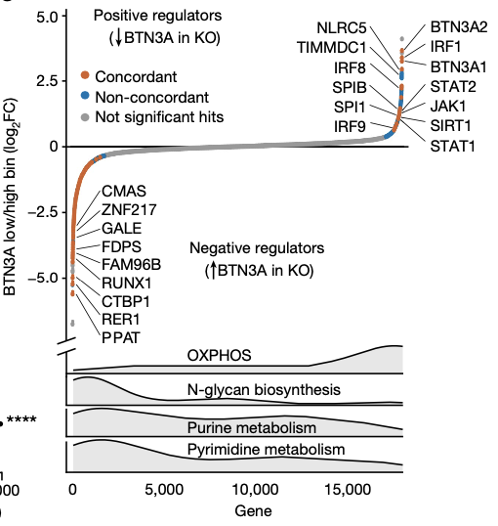
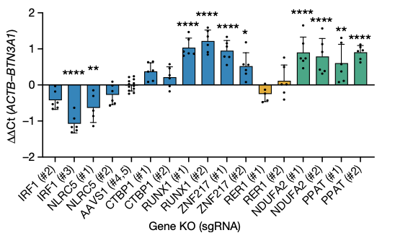
Surface Expression Data

Slide 24
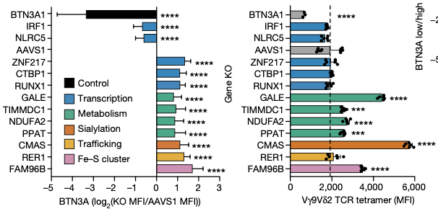
Surface Expression Data

Slide 25
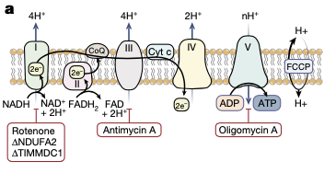
AMPK Activation
AMP-Activated Protein Kinase
Sensor for cellular energy levels
Metabolic stress increases expression of BTN3A1 and BTN2A1
Small-molecule AMPK activators can mimic the stress response
Cancer cells are then more susceptible to γδ T cell mediated killing

Slide 26
AMPK Activation and BTN3A regulation
Glucose levels increased, BTN3A surface expression increased in OXPHOS KOs
Inhibition of ATP synthase or uncoupling ATP synthesis lead to highest BTN3A expression
AMPK required for proper BTN3A induction in stressed cells

Slide 27
AMPK Activation

Slide 28
AMPK Activation

Slide 29
Patient Data
Gene signature scores in correlation with survival in cancer patients
Measured across 33 cancer types
Strongest correlation in low-grade glioma
High γδ T cell gene signatures correspond with longer survival

Slide 30
Key Findings
AMPK activation significantly improves BTN3A-mediated γδ T cell killing
Experiments in patient derived cancer organoids confirm CRISPR screen findings
Treatment with AMPK activators (pamidronate,AICAR, C991)
AMPK agonist treatment of 34T increased TEG001 susceptibility
Highly reactive Vγ9Vδ2 clone

Slide 31
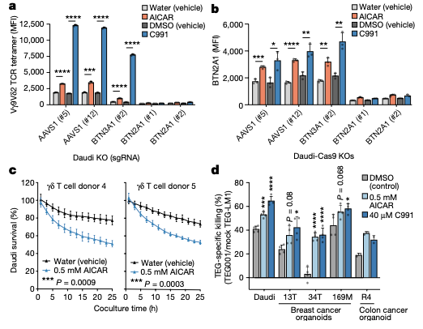
Key Findings

Slide 32
Clinical Relevance
Cancer Therapy
γδ T cell pathways leveraging to improve immunotherapy
AMPK activators used for enhanced γδ T cell action
Versatile potential
Independent function

Slide 33
Future in γδ T Cell Research
AMPK Activators
Bioengineering
Predictive Modeling
Expand to other cancer types

Slide 34
Conclusion
γδ T cells - a promising tool
Discovery of key regulatory pathways
Impact of metabolic stress
Implications for immunotherapy

Slide 35
Sources
¹Park, J.H., Lee, H.K. Function of γδ T cells in tumor immunology and their application to cancer therapy. Exp Mol Med 53, 318–327 (2021). https://doi.org/10.1038/s12276-021-00576-0
²Girardi, Michael. (2006). Girardi MImmunosurveillance and immunoregulation by T cells. J Invest Dermatol 126:25-31. The Journal of investigative dermatology. 126. 25-31. 10.1038/sj.jid.5700003.
³ Cano, Carla E., et al. "BTN2A1, an Immune Checkpoint Targeting Vγ9Vδ2 T Cell Cytotoxicity Against Malignant Cells." *Cell Reports*, vol. 36, no. 2, 2021, 109359. [ScienceDirect](https://doi.org/10.1016/j.celrep.2021.109359).

