Slide 1
Fit Time
EEL 6788 Project Presentation
Presented By: Lauren Ball
April 27, 2011

Slide 2
Topics
Background
Description
System Architecture
Sensor Processing
Future Work
My Experience and Hurdles
Demo

Slide 3
Background
Smartphone Capabilities
Massive Deployment
Many Sensors (3G, WiFi, GPS, Camera, Microphone, etc)
Fit Time
Looks to provide motivation for the gym type of workout
Often choose other workout options.
Leverages competition/guilt to inspire users
Requires minimal user interaction
Working out
User has the option to interact as much as desired

Slide 4
Fit Time Android App
Accelerometer data is used to determine the number of Reps or Steps performed by the user for each gym visit.
When the user leaves the gym the Rep and Step numbers for the user are sent to the “server”
When the user is in the Idle mode, the sensor data is not sampled

Slide 5
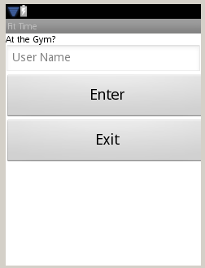
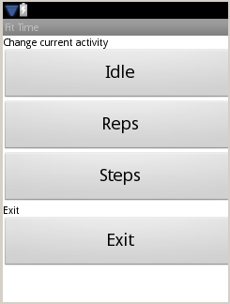
Fit Time Android App Layout
Login Page
In Gym Page
Note: Demo will show Actual Screen

Slide 6
Email Monitor
“Server” Function
fittimelauren@gmail.com
Unprotected email account
Share password with users
Users can monitor access to see who is logging gym activities
Either while at gym if curious. For instance, if you see your friend leave the gym.
Or via email notifications from the “server”

Slide 7
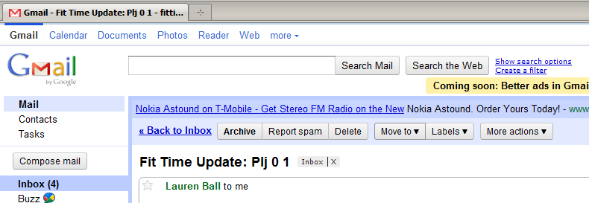
Server Layout

Slide 8
Steps vs Reps Applications
Example Steps Applications
Treadmill Running
Stair stepper
Elliptical Machine
Example Reps Applications
Arm Machines

Slide 9
Future Enhancements
Have a Real Server
Have user query server at login time to possibly display other users status on Gym Screen
Make user interface more appealing
Separate out to more events than Steps and Reps to allow more optimization of detections
Allow user to select placement of sensor

Slide 10
Hurdles/My Experience
Lots of examples available, but sometimes it was hard to find specific small things.
I found when things get weird, reboot pc and phone!
I have been operating on private networks mostly lately and when I started I was thinking I could run my server without a dynamic IP (clear oversight). This impacted deployment.
Disconnected debugging was interesting. For instance, no breakpoints.

Slide 11
Demo

