Slide 1
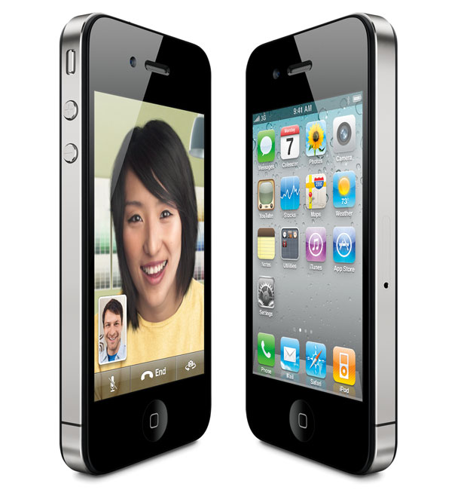
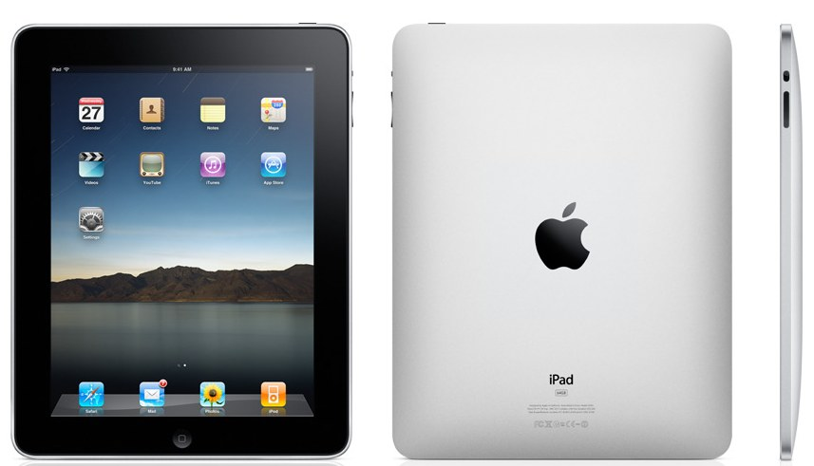
PhotoSwap
Albert Park & Brandon Ochs

Slide 2
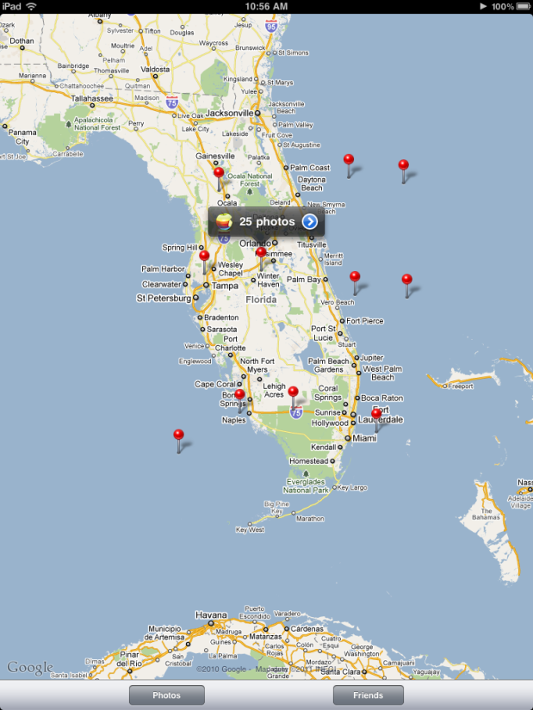
What is PhotoSwap?
Social networking platform for iOS
Users share images with each other
Extract sensor data embedded in
the image or directly from the GPS

Slide 3
Architecture

Slide 4
Database Handler
Connects to local database
Uses SQLite which is an embedded database
Tailored for use in small scale applications

Slide 5
Upload Handler
Sends requests to remote server
Uses ASIHTTPRequest library
Requests can be sent synchronously, asynchronously, or queued
Mimic HTML page by creating an HTTP post tag on the phone

Slide 6
Map Handler
Uses pins to display photos
Pin locations and thumbnails stored locally
Amount of pins is relative depending
on the level of zoom

Slide 7
Friend Handler
Friends associated with unique id for comments and photos
Common look and feel
Swipe to delete
Search box
Jump to alphabetized headers

Slide 8
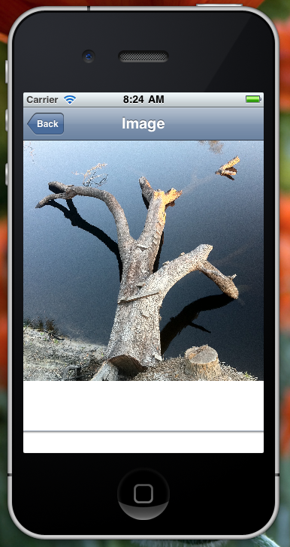
Comment Handler
Lets users comment through clicking on a map pin
Images can be downloaded to the
phone from this screen

Slide 9
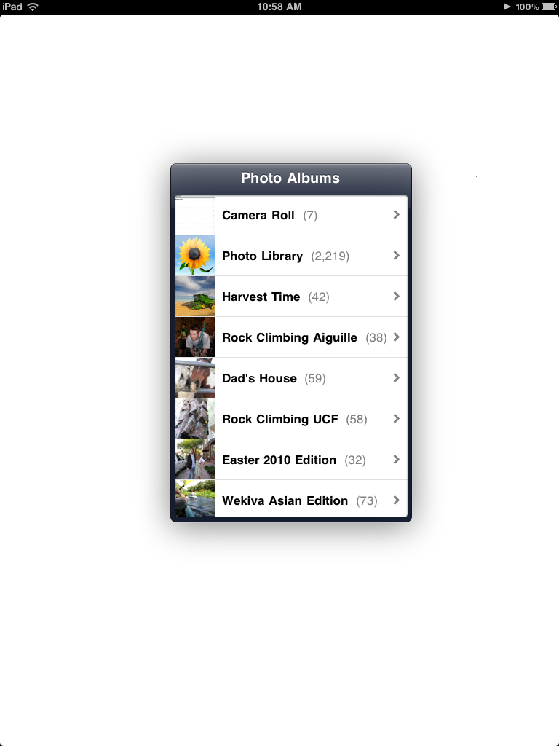
Image Handler
Browse through camera roll and photo albums
Uploads current GPS location
Used for bad/missing EXIF data

Slide 10
Synchronization Handler
Updates local database from the server in the background
Reduces the network overhead
Reduces time it takes to check for updates manually

Slide 11
Server Uploading
Remote LAMP server
EXIF data is extracted with PHP
Stored in a MYSQL database
Images available through links

Slide 12
Server Downloading
Requests for data are initialized on the phone in a queue
Server builds XML files and sends to phone
XML parser on iPhone extracts data and populates database

Slide 13
EXIF GPS Data
Stored in jpeg as decimals/xx, minutes/yy, seconds/zz
Need to convert to decimal
N,S: 90 to -90
E,W: 180 to -180

Slide 14
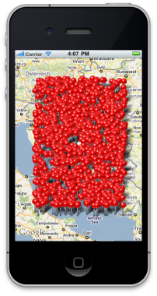
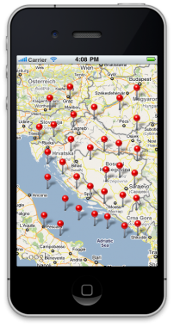
Problems we had to overcome…
Map pins can get cluttered
Don’t place pin on map if there is one near it already!

Slide 15
Problems we had to overcome…
Originally used a Python process that continually monitored an upload directory
PHP was better because it was reactive
Apache, MySQL, PHP server hosts are common!

Slide 16
Problems we had to overcome…
Communicating with the server
Can’t just do a MySQL query from the iPhone
Created an XML reader class to read data from server

Slide 17
Future Work!
Animate pins moving as the user zooms
Allow for geotagging for incorrect pins
Extract additional EXIF data?

