Slide 1
VTrack
Arvind Thiagarajan, Lenin Ravindranath, Katrina LaCurts, Sivan Toledo, Jakob Eriksson, Hari Balakrishnan, Samuel Madden, "VTrack: Accurate, Energy-Aware Road Traffic Delay Estimation Using Mobile Phones, In Proc. 14th ACM SenSys, November 2009.
Presented By: Lauren Ball
March 2, 2011

Slide 2
Background
Road Traffic Problem
Results
Causes inefficiency
Fuel Waste
Frustration (not measuring this here ☺)
Trends
More cars on road (1B now and projected to double)
More time wasted in traffic (4.2B Hrs in 2007 and increasing)
Smartphone Capabilities
Massive Deployment
GPS , WiFi, and Cellular Triangulation Capabilities

Slide 3
Previous Work
Real-time traffic information can alleviate congestion with information
Collected Travel Time
Collected Vehicle Flow Densities
Alleviation Methods
Informing drivers of “Hotspots” to avoid
Traffic aware routing
Combining historic and real-time information
Update traffic light control
Plan infrastructure improvements
Update toll scheme
Dominant Data Source Commercial Fleets
End user travel times would be more realistic

Slide 4
What is VTrack?
MIT CSAIL, Tel-Aviv Univ, and Univ Illinois Chicago
Goal
Accurate, Energy-Aware Road Traffic Delay Estimation Using Mobile Phones
GPS Limitations
“Urban Canyon” outages
Pocket outage
Power Hungry
Key Challenges
Energy Consumption
Need to find optimal Sample Rate
Sensor Unreliability
GPS Outages
WiFi and Cellular Triangulation aren’t Precise

Slide 5
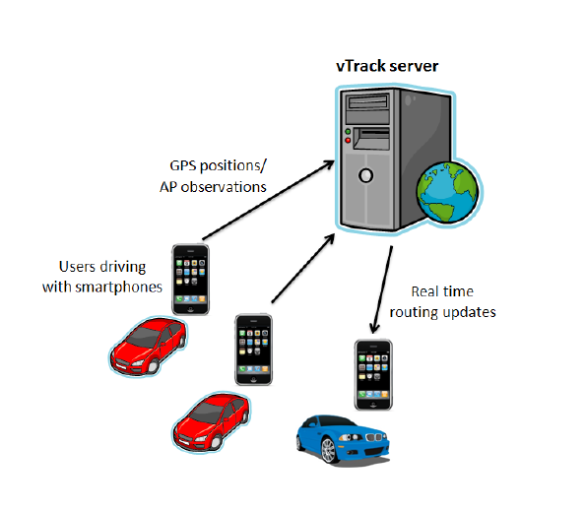
System Architecture
Users with smartphones
Run VTrack reporting application
Report position data periodically to the server

Slide 6
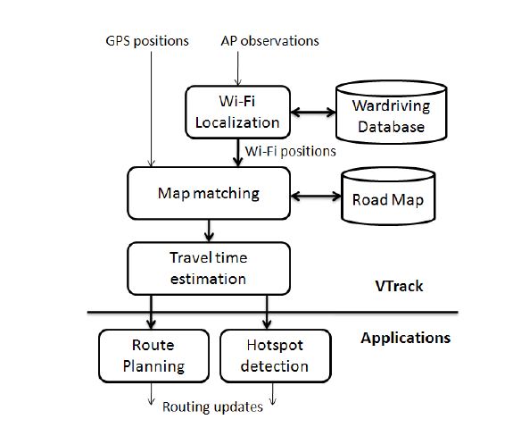
VTrack Server
Server algorithm components
Map-matcher
Travel-time estimator
If GPS not available
Access point (AP) observations are used
AP observations converted to position estimates
Done via the wardriving database where APs have been in previous drives

Slide 7
VTrack Application Support
“Hotspot” Reporter
Senses Traffic Anomalies
Reports Segments with Rate << Speed Limit
Optimized for low miss rate
Optimized for false positive
Route Planner
Plans Least Time path
Uses individual segment estimated from VTrack
Note: Rerouting available real-time

Slide 8
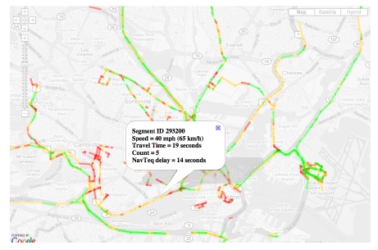
VTrack Website
Users have access
Users can view current traffic delays
Users can receive route planning updates

Slide 9
Server Algorithm Constraints
Accurate
Errors 10% -15% OK
Correlates to 3-5 minutes on a 30 minute drive
Efficient enough to use real-time data
Existing map-matching use A*-type
Prohibitively expensive
Hard to optimize
Energy Efficient
Meet accuracy goals
Maximize battery life

Slide 10
Server Challenges
Map matching with errors
Not yet characterized with GPS Outages
Not yet characterized with noisy data
Time estimation is difficult (even with accurate trajectories)
Source data noisy
Difficult to determine best route
Difficult to point a travel time to a segment
Localization accuracy is at odds with energy consumption
GPS more accurate but more power hungry
GPS takes up to 20x more power than WiFi
WiFi only available where Aps available

Slide 11
VTrack Map Matching
Input: A sequence of noisy/sparse position data
Output: A sequence of road segments
Essential for travel time estimation
Steps
1. Samples are pre-processed to remove outliers.
Outliers are classified as those > 200mph from last reading.
2. Outages
Simple interpolations used
3. Viterbi decoding over Hidden Markov Model (HMM) to estimate the route driven
4. Bad zone removal
low confidence matches

Slide 12
Time Estimation Errors
Main source is inaccuracy of the map-matched output
Two reasons
Outages during transitions
Cannot determine if delay is from
Leaving segment
Entereing segment
Noisy positions samples
Incosistancies when the sample is at the end of a short segment and it’s the only sample in the segment
Note: Though small segment estimates were sometimes inaccurate, the total path results, were accurate!

Slide 13
VTrack Deployment Plan
Extensive Evaluation of Collection Results
Large Dataset
~800 Hrs of Commuter Data
Deployed on 25 vehicles
Deployment Method
iPhone 3G
Embedded in-car computers with GPS and WiFi
Looking for
Sensor(s) Used
Sampling Frequency

Slide 14
VTrack Deployment Truth Data
Traditionally a hard problem finding ground truth data, previous approaches
Additional test drive data
Costly
GPS samples as ground truth
Fails in regions with GPS Errors and dropouts
Note: Ground truth is impossible

Slide 15
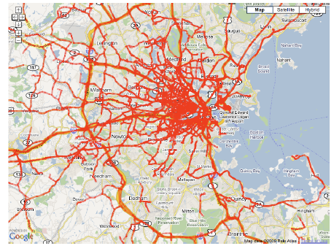
VTrack Deployment Coverage
Initial collection of 2998 drives from the 25 cars with GPS and WiFi sensors
Urban Area
Simultaneous GPS and WiFi location estimates
WiFi locations via centroid calculations of Aps

Slide 16
Findings
HMM-based map matching
robust to noise
Error < 10%
when only WiFi
With 40m Gaussian noise
Travel Times via only WiFi are accurate even though individual paths are not
Travel Times via only WiFi cannot detect hotspots
Due to outages
If WiFi available
Detection > 80%
False Alarm < 5%
GPS available and accurate, periodic sampling helps with both

Slide 17
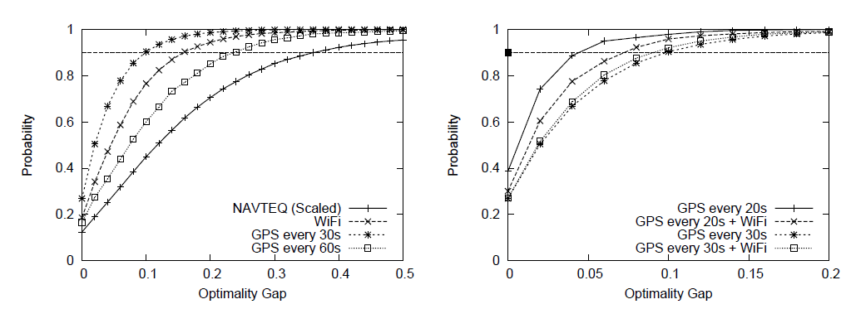
Optimality Gap Metric
GPS vs WiFi vs NAVTEQ GPS vs Hybrid GPS + WiFi

Slide 18
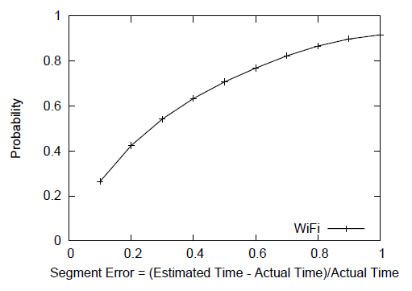
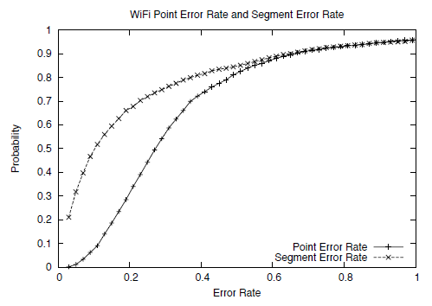
Segment vs Map Matching

Slide 19
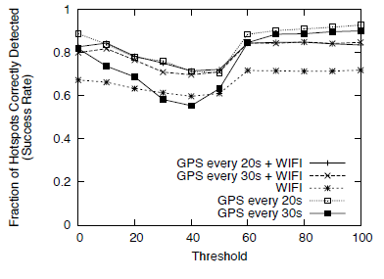
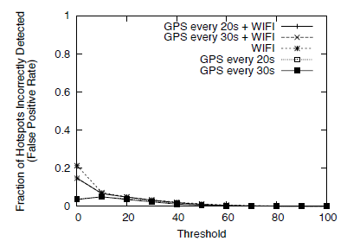
Hotspot Detection Success
Hotspot Detection False Alarms
Threshold = observed segment time - predicted

Slide 20
Out of Scope
Privacy

Slide 21
Conclusions
The approach minimizes energy consumption using inaccurate position sensors
The approach obtains accurate travel time estimates from the inaccurate positions
Significant noise was handled

Slide 22
Future Work
Online, adaptive algorithm
Dynamically selects the best sensor to sample
Accounting for available energy, uncertainty of node position, and trajectory
Looking to improve the quality of the algorithms to predict future times on segments
Using historic times
Using sparse amounts

Slide 23
References
[1] The mobile millenium project. http://traffic.berkeley.edu.
[2] Navteq. http://navteq.com/about/data.html.
[3] The peir project. http://peir.cens.ucla.edu.
[4] Bureau of Transportation Statistics. http://www.bts.gov.
[5] The CarTel project. http://cartel.csail.mit.edu/.
[6] Y. chung Cheng, Y. Chawathe, A. Lamarca, and J. Krumm. Accuracy
characterization for metropolitan-scale wi-fi localization. In In
Proceedings of Mobisys 2005, pages 233–245, 2005.
[7] C. Claudel and A. Bayen. Guaranteed bounds for traffic flow
parameters estimation using mixed lagrangian-eulerian sensing. In
Allerton Conference on Communication, Control, and Computing,
2008.
[8] C. Claudel, A. Hofleitner, N. Mignerey, and A. Bayen. Guaranteed
bounds on highway travel times using probe and fixed data. In 88th
TRB Annual Meeting Compendium of Papers, 2009.
[9] D. F.V. Gps accuracy: Lies, damn lies, and statistics. 1998.
[10] S. Gaonkar, J. Li, R. R. Choudhury, L. Cox, and A. Schmidt.
Micro-blog: sharing and querying content through mobile phones and
social participation. In MobiSys, pages 174–186, 2008.
[11] M. Gruteser and D. Grunwald. Anonymous usage of location-based
services through spatial and temporal cloaking. In ACM MobiSys, 2003.
[12] M. Gruteser and B. Hoh. On the anonymity of periodic location
samples. In Pervasive, 2005.
[13] B. Hoh, M. Gruteser, R. Herring, J. Ban, D. Work, J.-C. Herrera, A. M.
Bayen, M. Annavaram, and Q. Jacobson. Virtual trip lines for
distributed privacy-preserving traffic monitoring. In MobiSys ’08:
Proceeding of the 6th international conference on Mobile systems,
applications, and services, 2008.
[14] B. Hoh, M. Gruteser, H. Xiong, and A. Alrabady. Enhancing security
and privacy in trafc-monitoring systems. IEEE Pervasive Computing,
5(4):38–46, 2006.
[15] B. Hoh, M. Gruteser, H. Xiong, and A. Alrabady. Preserving privacy in
GPS traces via uncertainty-aware path cloaking. In ACM CCS, 2007.
[16] B. Hull, V. Bychkovsky, Y. Zhang, K. Chen, M. Goraczko, E. Shih,
H. Balakrishnan, and S. Madden. CarTel: A Distributed Mobile Sensor
Computing System. In Proc. ACM SenSys, Nov. 2006.
[17] B. Hummel. Map matching for vehicle guidance. In Dynamic and
Mobile GIS: Investigating Space and Time. CRC Press: Florida, 2006.
[18] Inrix home page. http://www.inrix.com/.
[19] J. Krumm. Inference attacks on location tracks. In Pervasive, 2007.
[20] J. Krumm, J. Letchner, and E. Horvitz. Map matching with travel time
constraints. In SAE World Congress, 2007.
[21] P. Mohan, V. N. Padmanabhan, and R. Ramjee. Nericell: rich
monitoring of road and traffic conditions using mobile smartphones. In
SenSys ’08: Proceedings of the 6th ACM conference on Embedded
network sensor systems, 2008.
[22] D. Sperling and D. Gordon. Two Billion Cars: Driving Toward
Sustainability. Oxford University Press, 2009.
[23] L. Sweeney. k-anonymity: A model for protecting privacy, 2002.
[24] A. J. Viterbi. Error bounds for convolutional codes and an
asymptotically optimum decoding algorithm. In IEEE Transactions on
Information Theory, 1967.
[25] J. Yoon, B. Noble, and M. Liu. Surface Street Traffic Estimation. In
MobiSys, 2007.

Slide 24
My Thoughts
Energy Constraint??
If in car plugged in phone
Not true for mass transit if that should be included
Obviously still have the GPS Outage issue
Mass Transit Buses?
False Stops

Slide 25
Questions??

