Slide 1


Junit with

Slide 2
Unit Testing
Procedural Programming
  Functions
Object Oriented Programming
  Classes, Interfaces, Functions
White Box Testing!
If there is a change, testing will notify if it is erroneus

Slide 3
Junit
Unit Testing Library in Java
https://github.com/junit-team/junit4/wiki/Download-and-Install
  With Maven
  With Nothing☺ (Download the jar files, specify them as library, use it)
Write @Test before each method

Slide 4
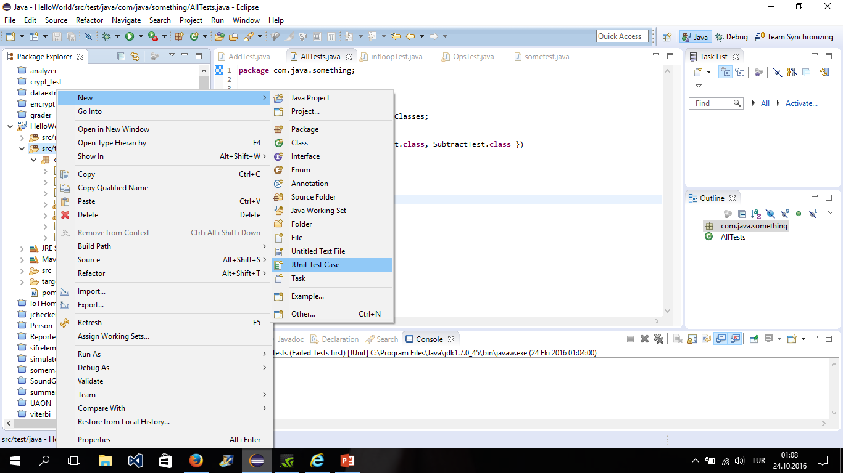

Slide 5
Before After
//execute before test
@Before
public void before() {
System.out.println("in before");
}
//execute after test
@After
public void after() {
System.out.println("in after");
}
Executed before each test in class

Slide 6
Before After Class
//execute before test
@BeforeClass
public void before() {
System.out.println("in before");
}
//execute after test
@AfterClass
public void after() {
System.out.println("in after");
}
Executed before only
once

Slide 7
fail()
Nice command to fail your test automatically
Why do we need that?
If exception is thrown, we may need to fail!

Slide 8
assertEquals
@Test
public void addTest(){
Calculator c=new Calculator();
int output=c.add(3, 4);
assertEquals(7,output);
}

Slide 9
Timeout Test
@Test (timeout = 2000)
public void infloopTest(){
Calculator c=new Calculator();
c.infloop();
}
It creates an error not failure!

Slide 10
assert(Not)Null
@Test
public void getDoubleTest(){
Calculator c=new Calculator();
Double d=c.getDouble(-1);
//if null then success else failure
assertNull(d);
}

Slide 11
assertTrue/False
Public void someTest(){
String str=«Someval»;
boolean check=Calculator.getLengthEqualZero(str);
assertTrue(check);
}

Slide 12
assert(Not)Same
int num1=4;
int num2=4
assertSame(num1,num2);
//they will be same
//Check if two object references not point to the same object
assertNotSame(num1,num2);
== is used for comparison whereas assertEquals() uses equals(Obj)

Slide 13
TestSuite
Create a collection of tests and run them together
Right Click on the package of test and New>Other> Test Suite
Select the tests to be added to that test Suite

Slide 14
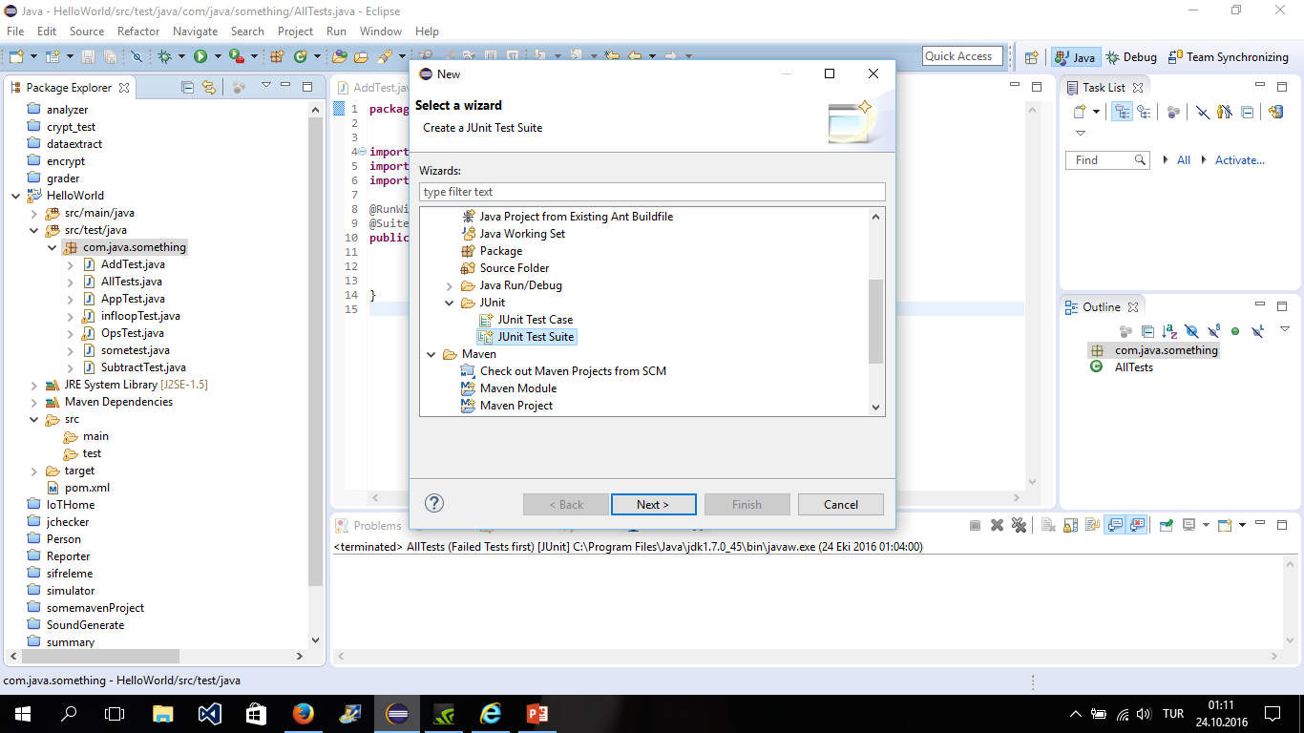

Slide 15
package com.java.something;
import org.junit.runner.RunWith;
import org.junit.runners.Suite;
import org.junit.runners.Suite.SuiteClasses;
@RunWith(Suite.class)
@SuiteClasses({ AddTest.class,OpsTest.class, SubtractTest.class })
public class AllTests {
}

Slide 16

Results as a report?
You can get XML report
Or write some code to parse them
import org.junit.runner.JUnitCore;
import org.junit.runner.Result;
import org.junit.runner.notification.Failure;
public class TestRunner2 {
public static void main(String[] args) {
Result result = JUnitCore.runClasses(TestAssertions.class);
for (Failure failure : result.getFailures()) {
System.out.println(failure.toString());
}
System.out.println(result.wasSuccessful());
}
}
Resource: https://www.tutorialspoint.com/junit/junit_quick_guide.htm

Slide 17
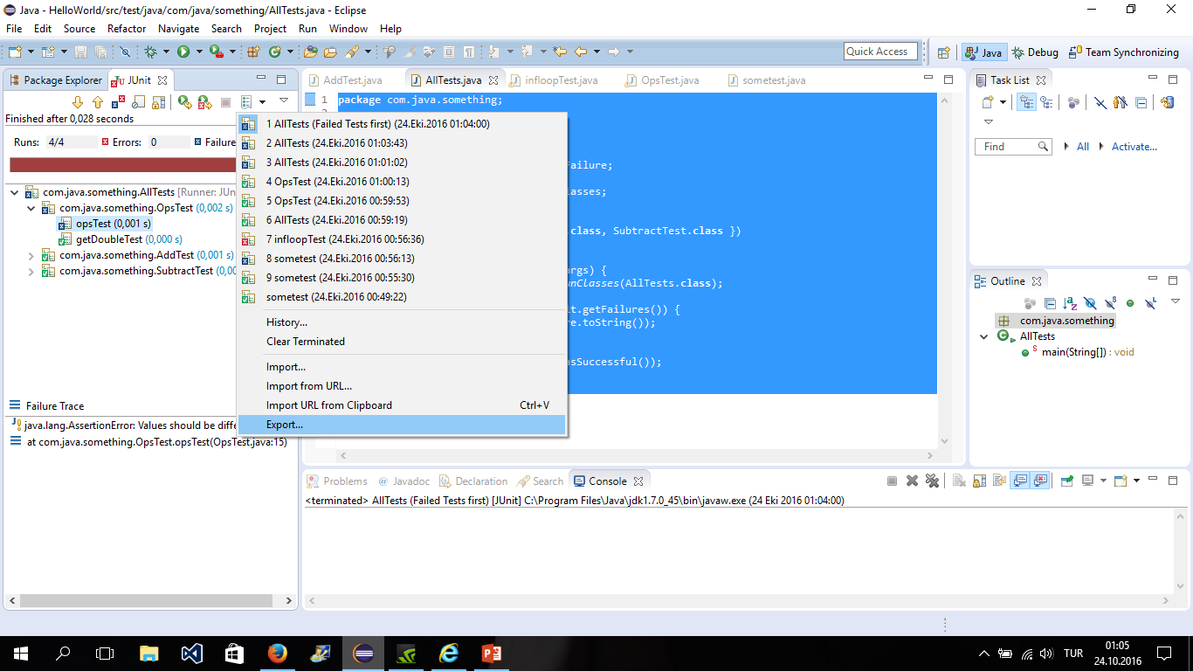

Slide 18

Demo Time!
See this link for a quick code examples
https://www.tutorialspoint.com/junit/junit_using_assertion.htm
Code and these slides are in the QR Code or in the link below
https://app.box.com/s/smyhc0i2nqgn8b63i4rsu2rlftd6p4ec
Prepared by:
Salih Safa BACANLI
bacanli@knights.ucf.edu

