Slide 1
COP 4331 Recitation #1

Slide 2
COP 4331 Recitation #1
Kia Manoochehri
kiam@knights.ucf.edu

Slide 3
Unified Modeling Language
Use Case Diagrams

Slide 4
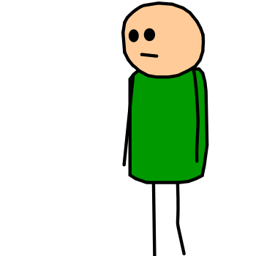
Use Case Diagram
Describes the relationship between “actors” and use cases
An actor is something that interacts with the system
Actors

Slide 5
Use Case Diagram
A use case represents some action that takes place within the system
Login

Slide 6
Use Case Diagram
Additionally:
A large box denotes the system boundary
A line between an actor and use case denotes that the actor participates in the use case

Slide 7
Use Case Diagram
<<include>>
A use case includes the functionality described in the previous one.
Represented by a directed arrow having a dotted shaft, labeled with <<include>>
Pay Fines
Check Fines
<<include>>

Slide 8
Use Case Diagram
<<extend>>
A use case may include the functionality described in another use case
Find Item
Borrow Item
<<extend>>

Slide 9
