Slide 1
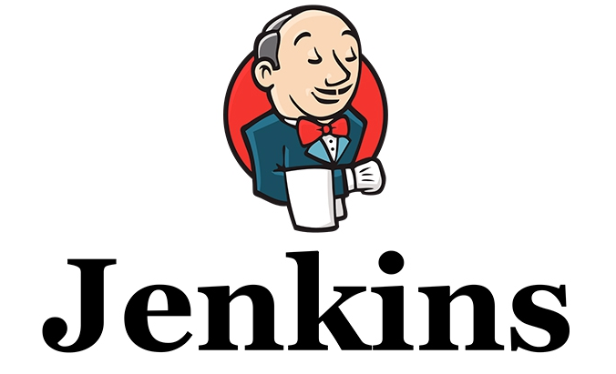

Slide 2

Trends like agile development and continuous integration speak to the modern enterprise’s need to build software hyper-efficiently
Jenkins: a highly popular open source tool for managing the software development process.
  from source code management to delivering code to production
  a continuous integration (CI) and continuous delivery (CD) solution.
    CI: merge code from individual developers into a project multiple times per day and test continuously.
    CD: a step further to ensure that all merged code is always in a production-ready state.

Slide 3
Why CI server:
  Developer might forgot to run the test
  Might take too long to run the test
  We might need to test in various environment
    Different architecture
      32/64 bit intel, PowerPC
    Different platforms
      Windows, linux, etc.

Slide 4
"production-ready":
  it runs
  it satisfies the project requirements
  it's stable
  it's maintainable
    correct defects or their cause, repair or replace faulty components without having to replace still working parts
  it's scalable
  it's documented
  Etc.

Slide 5
An open source automation server.
  Accelerate the software development process through automation.
  Manage and control development lifecycle processes of all kinds,
    build
    document
    test
    deployment
    static analysis
    etc.

Slide 6
watch for any code changes
  SVN, Git, etc.
Automatically do a build
  Ant, Maven, Make etc.
Jenkins offer over 1,000 plugins that allow Jenkins to integrate with almost any popular technology
  https://wiki.jenkins-ci.org/display/JENKINS/Plugins

Slide 7
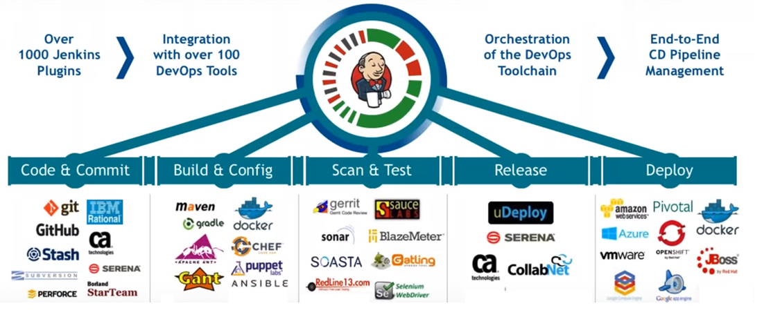

Slide 8
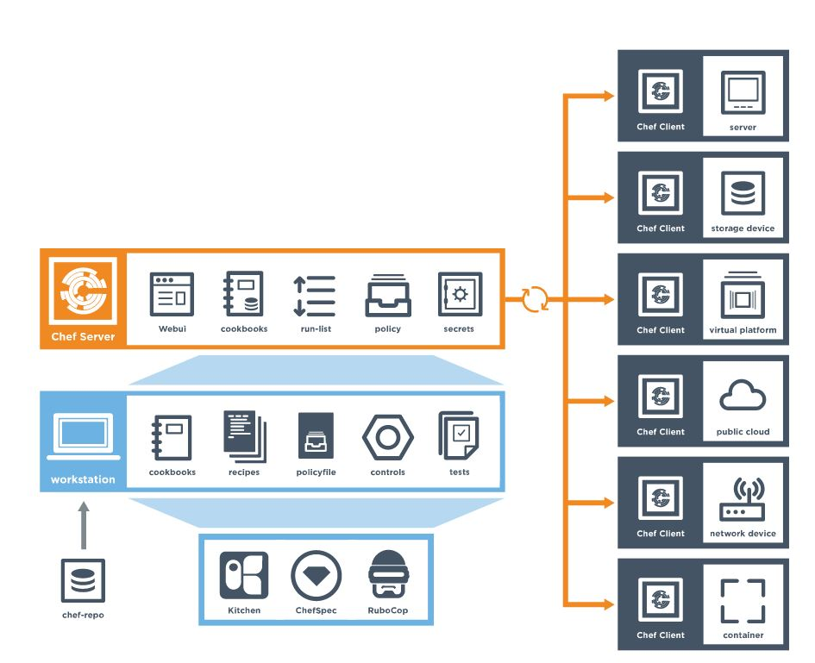


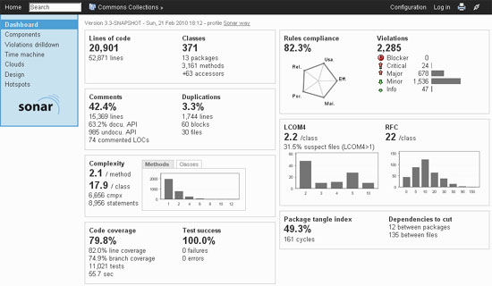

Slide 9
Without Jenkins
  Commit code
  Project manager should ask programmer for latest version
  Programmer asks tester to put the files on the dev server
  Test the programmer and show to the project manager
With Jenkins
  Writing the code and committing it.
  5 minutes later the code is on dev environment without anyone having to do anything.
  The project manager can look at the dev environment knowing it has the latest work.
  When something breaks you can look at the dev environment to check the latest version.
  When the project manager is happy with the build on dev, they click a button to deploy it to staging.

Slide 10
Automated testing
  Scheduling building
Notification:
  email notification for a build project.
Reporting
  Reporting plugins such as Junit
Code Analysis
  Code Analysis plugin. The various plugins can be found at https://wiki.jenkins-ci.org/display/JENKINS/Static+Code+Analysis+Plugins
Distributed Builds
  Jenkins slave machines

Slide 11
Automated Deployment
  plugins available to transfer the build files after a successful build to the respective application/web server
Metrics & Trends
  plugin available to calculate the following metrics for all of the builds once installed
    Mean Time To Failure (MTTF)
    Mean Time To Recovery (MTTR)
    Standard Deviation of Build Times
Server Maintenance
  Shutdown, Restart, reload the configuration, Backup
Security:
  having the ability to setup users and their relevant permissions on the Jenkins instance
Remote Testing
  tests can be run on remote slave machines via the master slave

Slide 12
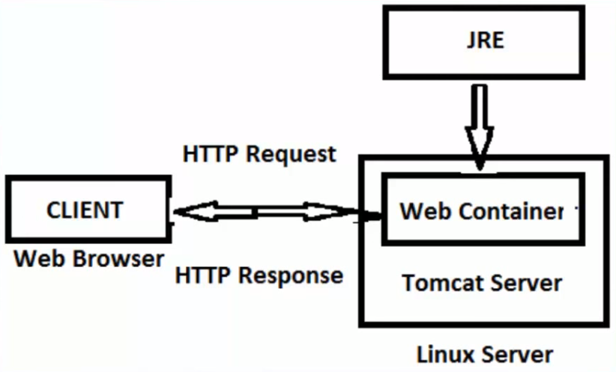

Slide 13
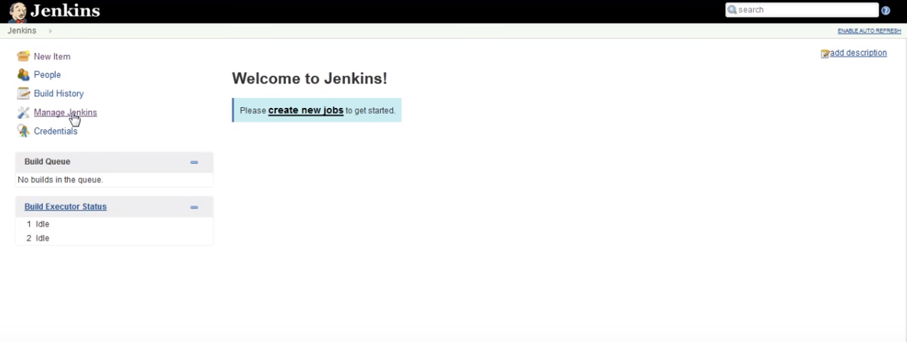
Go to https://jenkins.io/index.html
  Click on latest and greatest

Slide 14
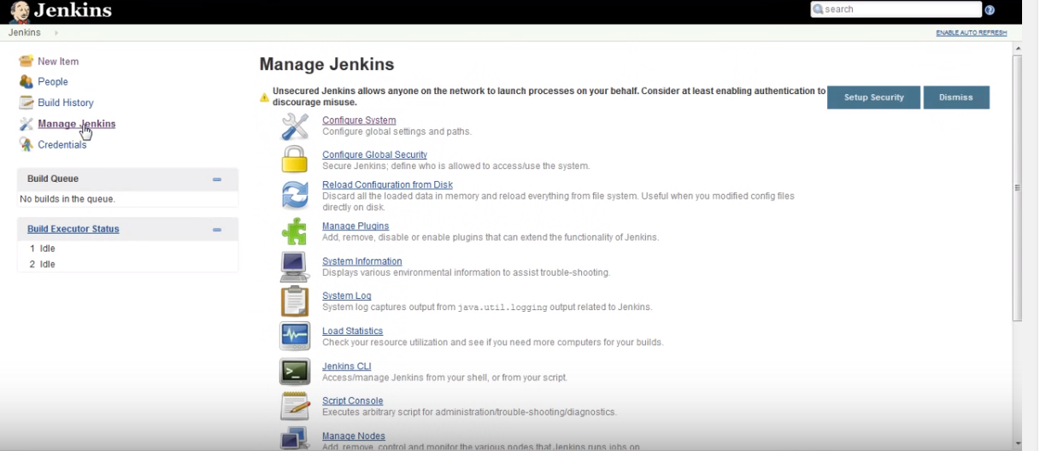

Slide 15
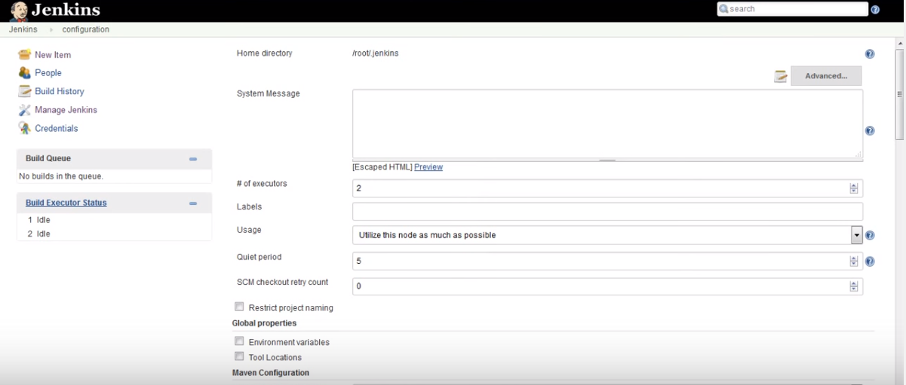

Slide 16
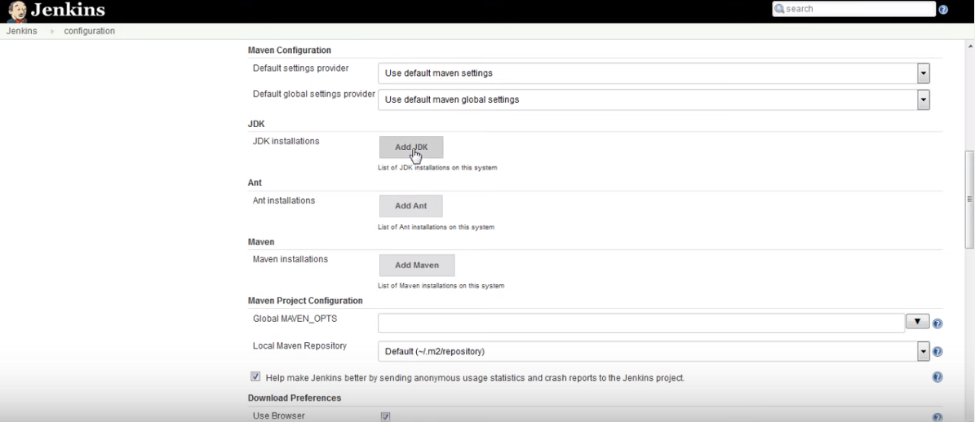

Slide 17
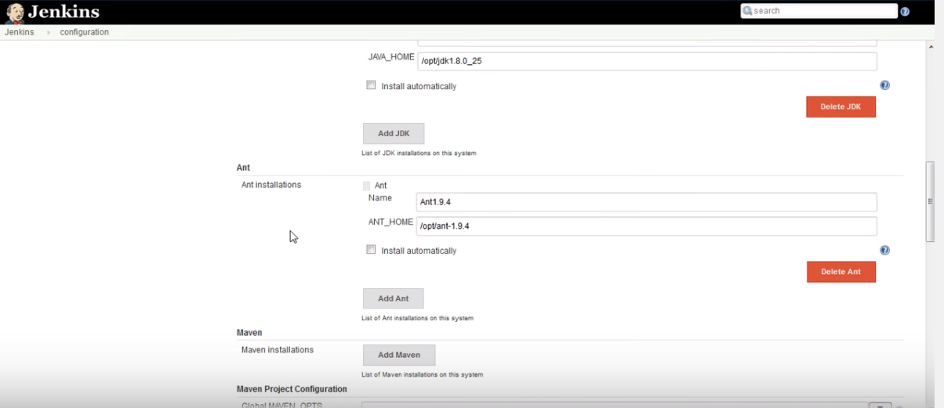

Slide 18
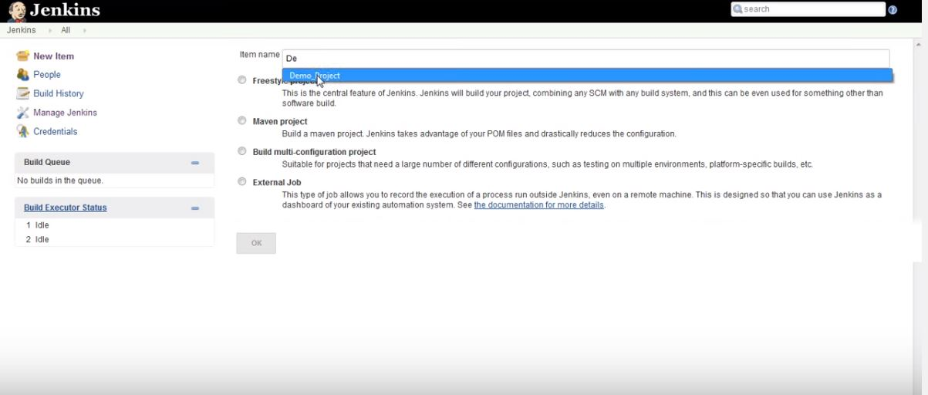

Slide 19
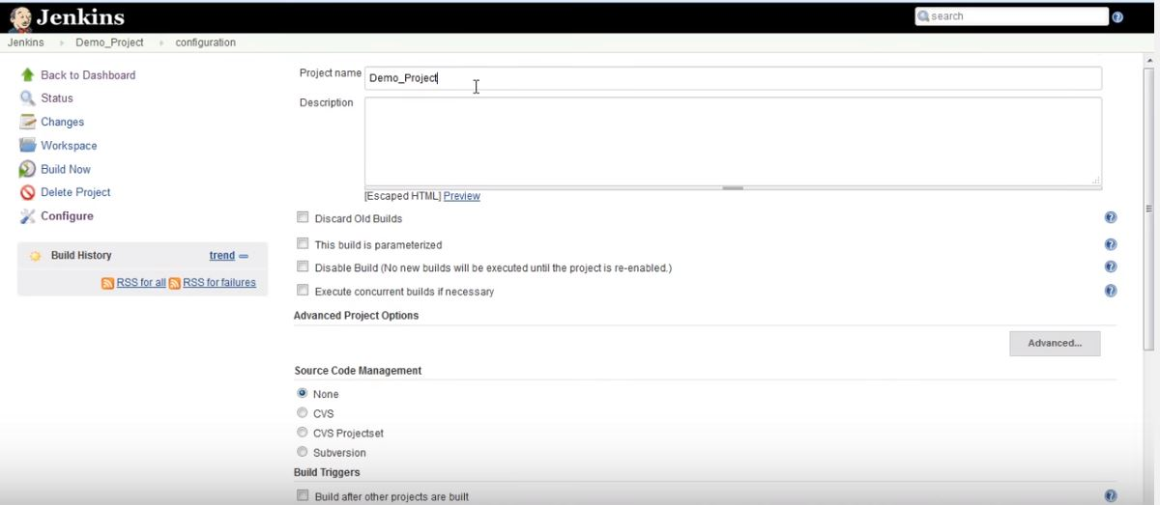

Slide 20
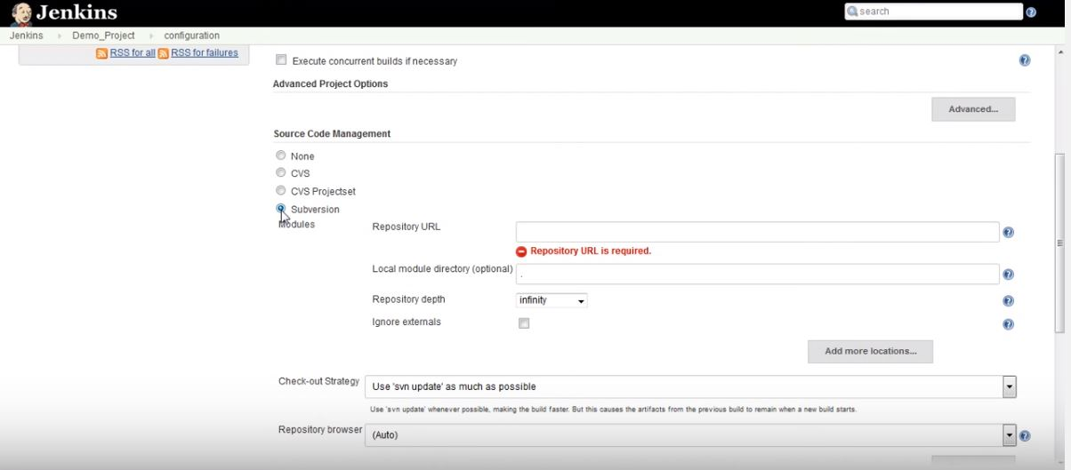

Slide 21
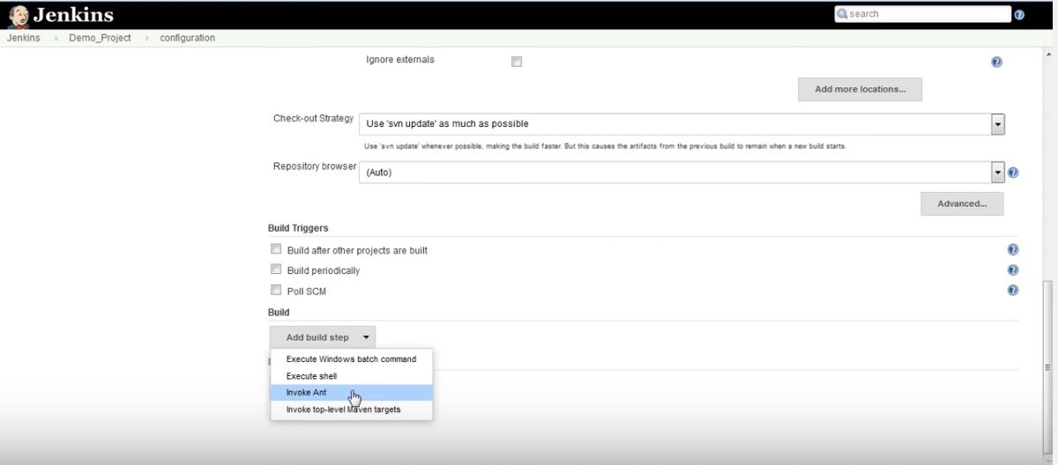

Slide 22
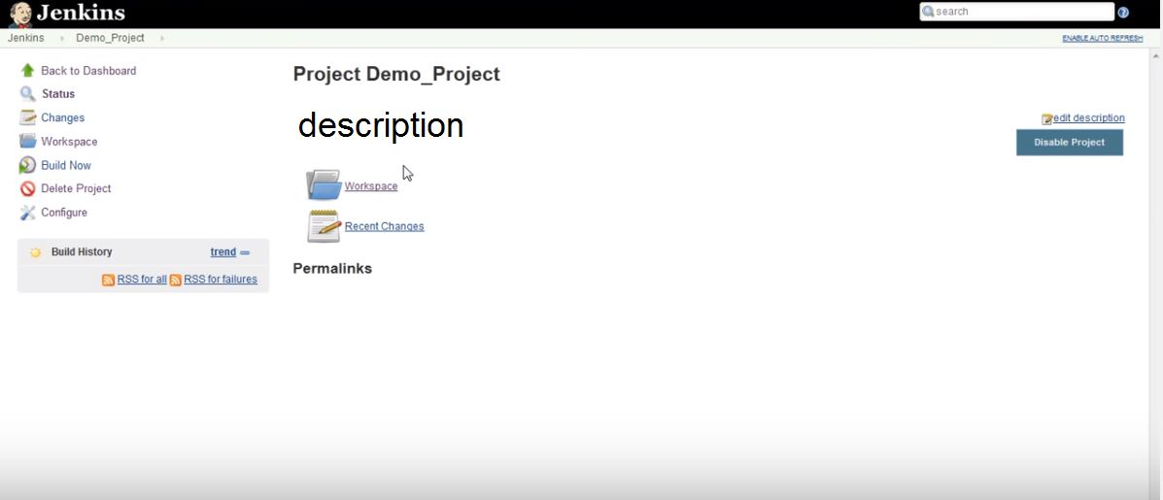

Slide 23
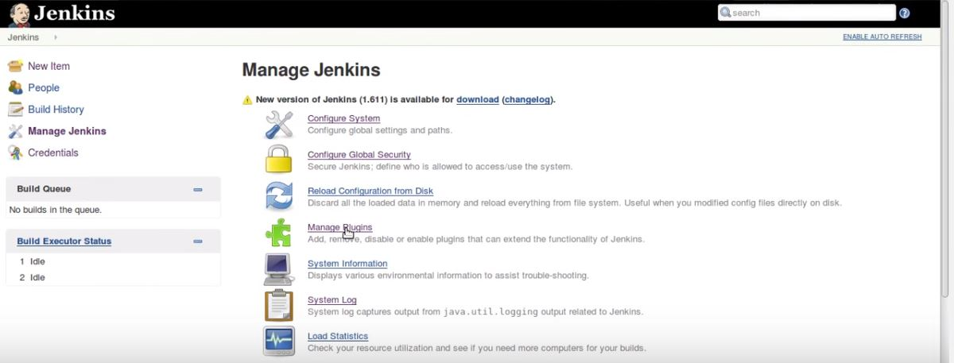

Slide 24
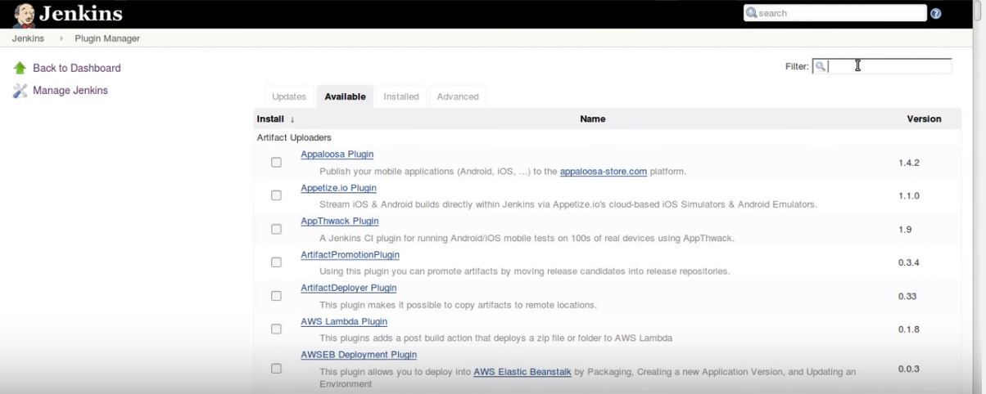

Slide 25
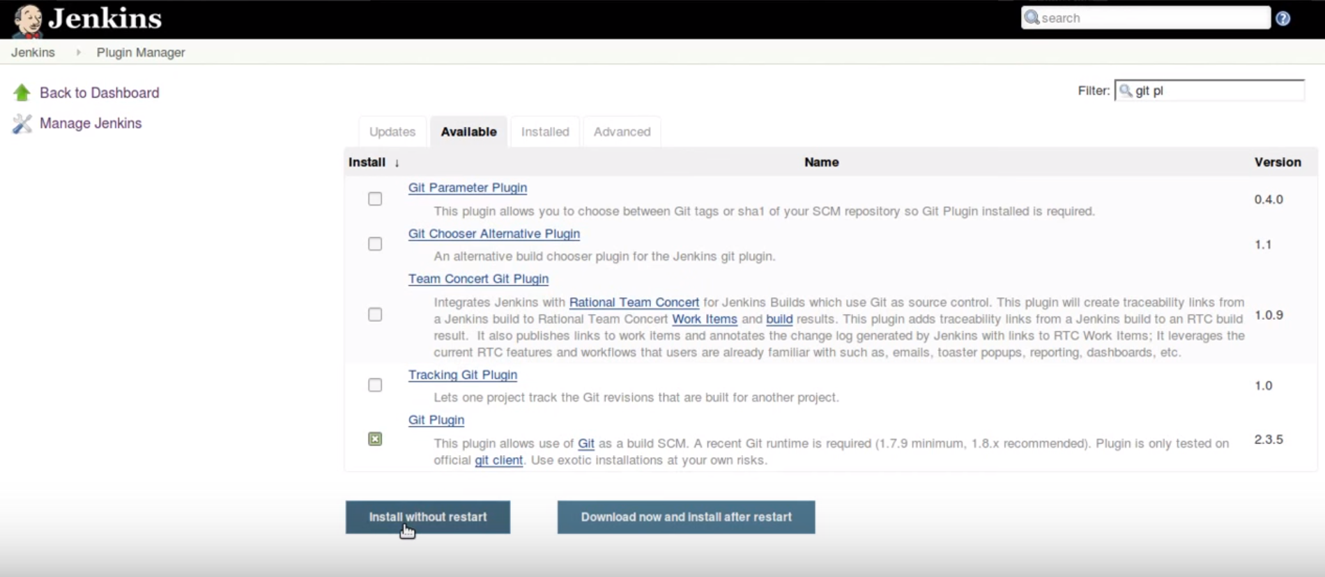

Slide 26
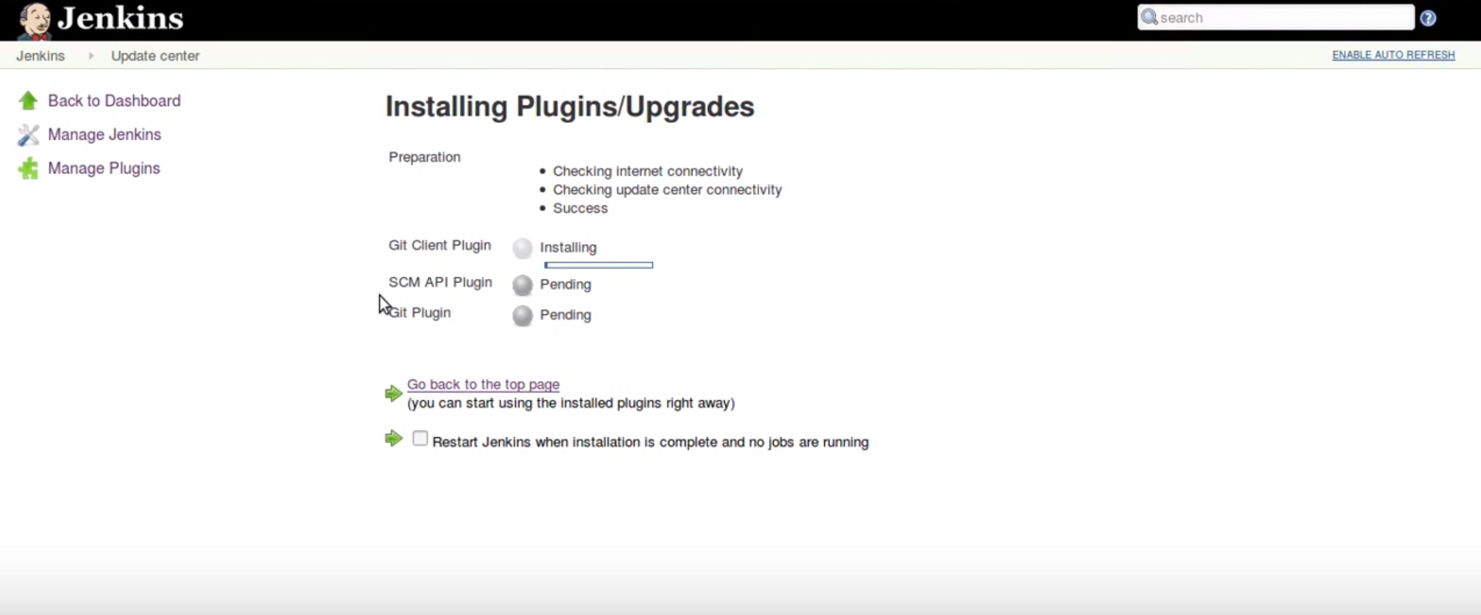

Slide 27
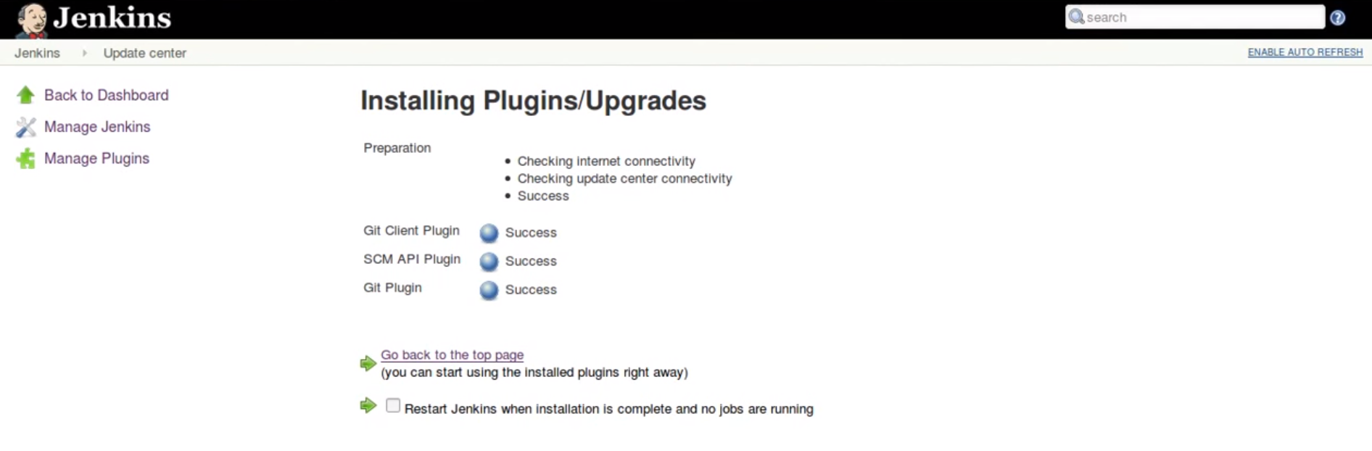
Do not forget to restart after installing plugins.

Slide 28
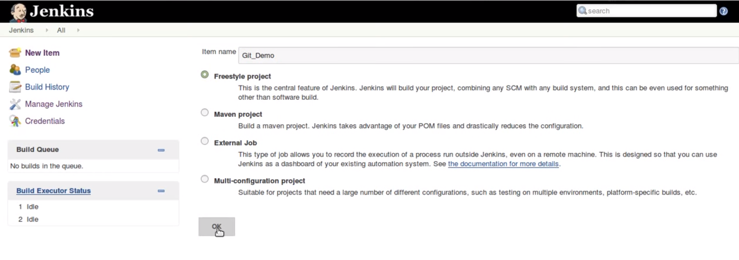

Slide 29
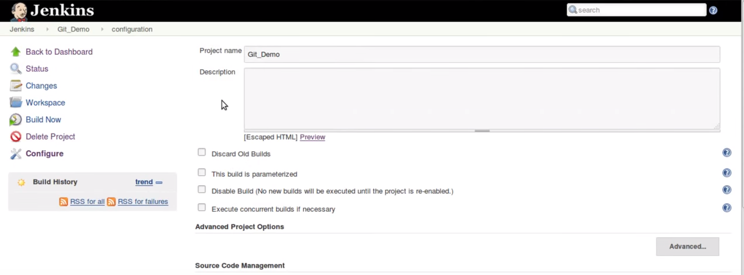
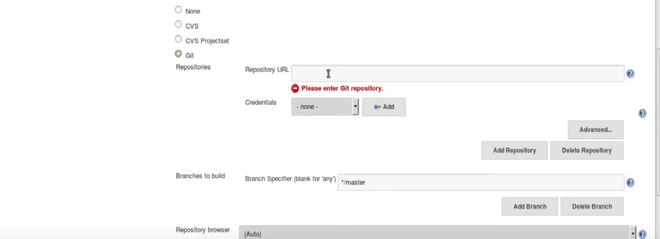

Slide 30
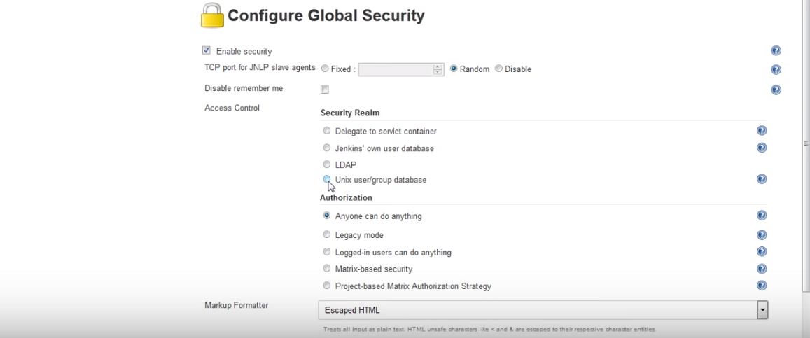

Slide 31
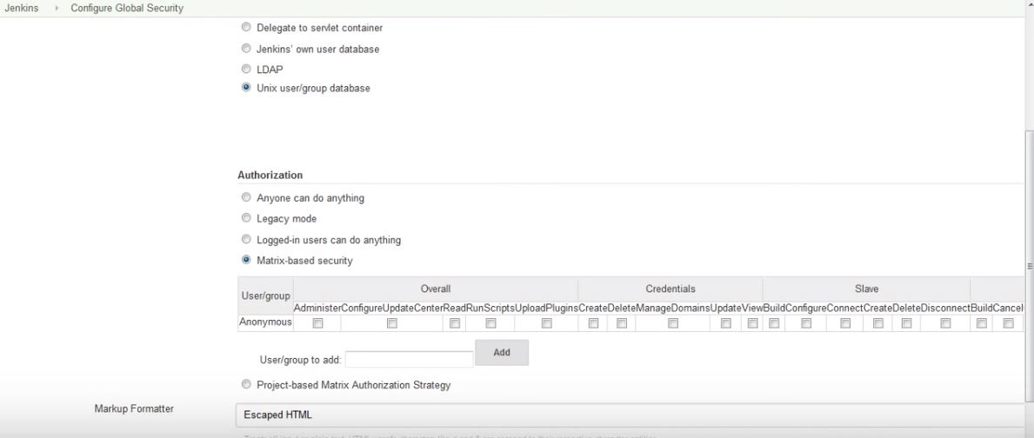

Slide 32
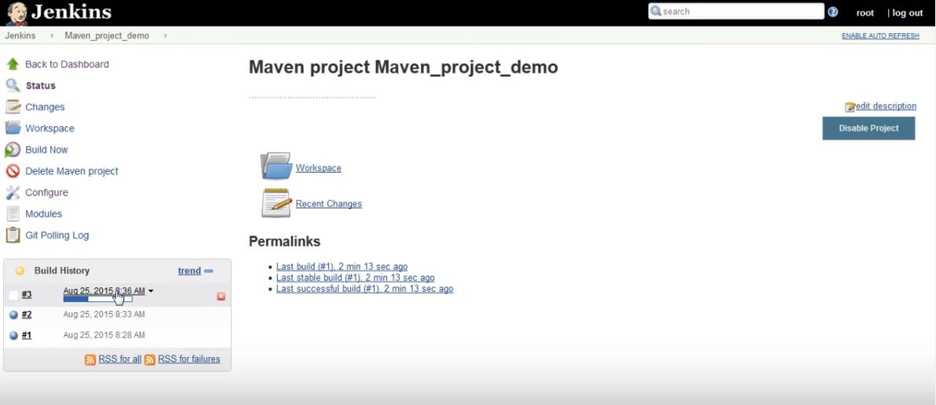

Slide 33
References
http://www.tutorialspoint.com/jenkins/
https://wiki.jenkins-ci.org/display/JENKINS/Beginners+Guide+to+Contributing
http://www.infoworld.com/article/3046038/application-development/why-jenkins-is-becoming-the-engine-of-devops.html
http://www.specialmoves.com/research-and-development/articles/jenkins-and-continuous-integration.html
https://www.youtube.com/watch?v=XY-ZB3FRnxw
https://www.youtube.com/watch?v=EOp2VVRHrKQ

Slide 34

hajiakhoond@knights.ucf.esu

