Slide 1


Slide 2

Outline
  Introduction
  Programming in eclipse
  Debugging in eclipse
  GitHub and eclipse
  UML and eclipse

Slide 3
What is that?
  a Java-based open source platform
  an integrated development environment (IDE)
For:
  developing Java applications
  developing applications in:
    Ada, ABAP, C, C++,COBOL, D, Fortran, Haskell, JavaScript, Julia, Lasso, Lua, NATURAL, Perl, PHP, Prolog, Python, R, Ruby, Rust, Scala, Clojure, Groovy, Scheme, and Erlang
  developing documents with LaTeX

Slide 4
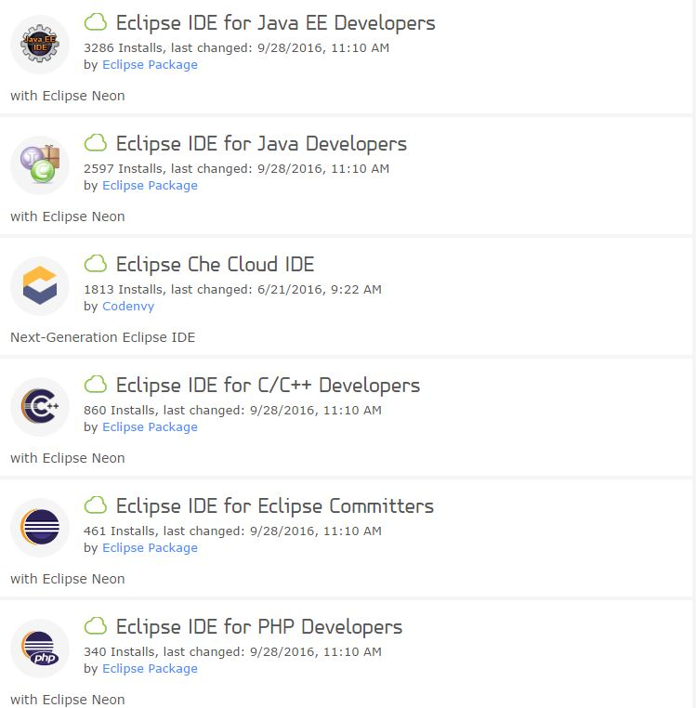
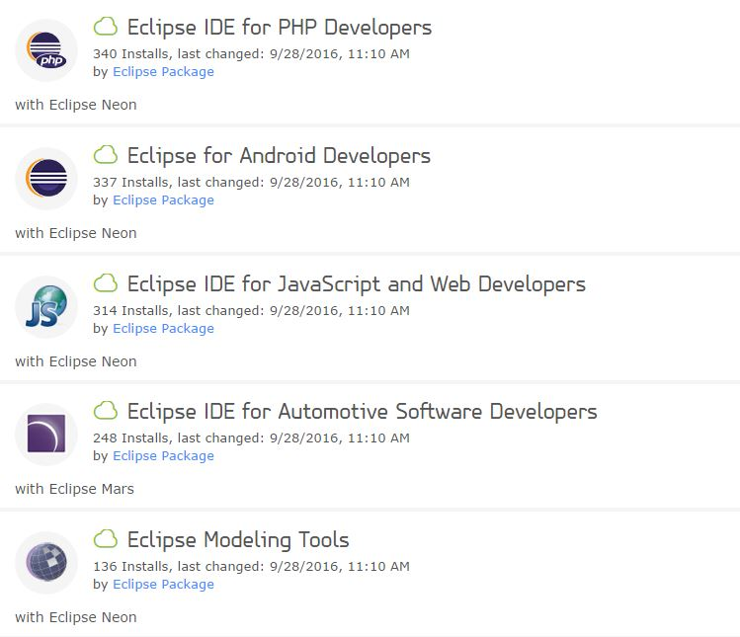
How to install?
  Install JDK (Java Development Kit)
  Go to //eclipse.org/downloads/
  unzip

Slide 5
How to create a project?
  File menu -> New -> Java Project
  In the “New Java Project”
    Enter Project name
    Check “default location”
    Check the JDK version
    Finish

Slide 6
How to create a program?
  Right click on project name in “Package Explorer” -> New -> Class
  In the dialog
    Enter name
    Check “public static void main(String[] args)” box
    Finish
  In the created class write your program

Slide 7
Debugging in eclipse
  Double click on the left side of the desired line
  Right click on the class name -> debug as -> java application

Slide 8
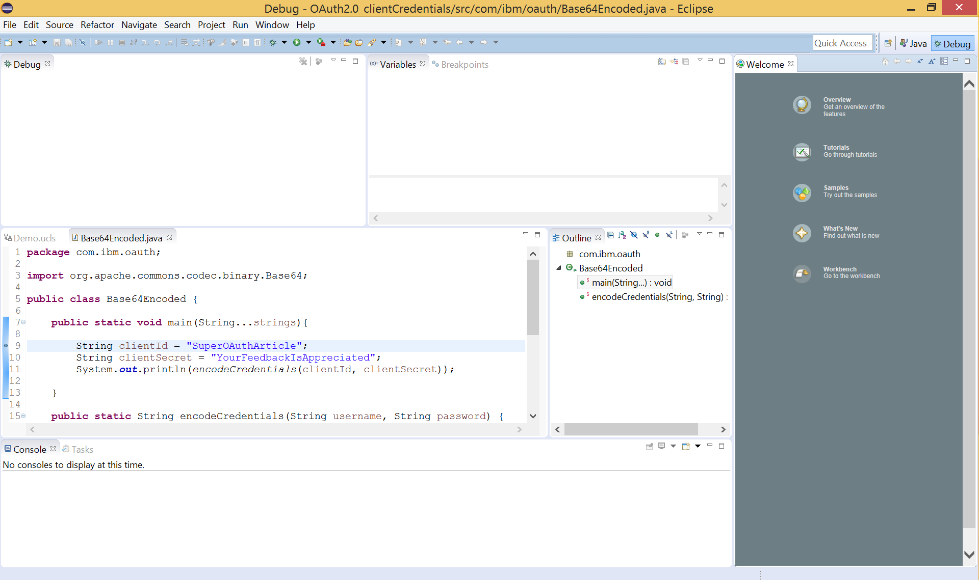
Debug view

Slide 9
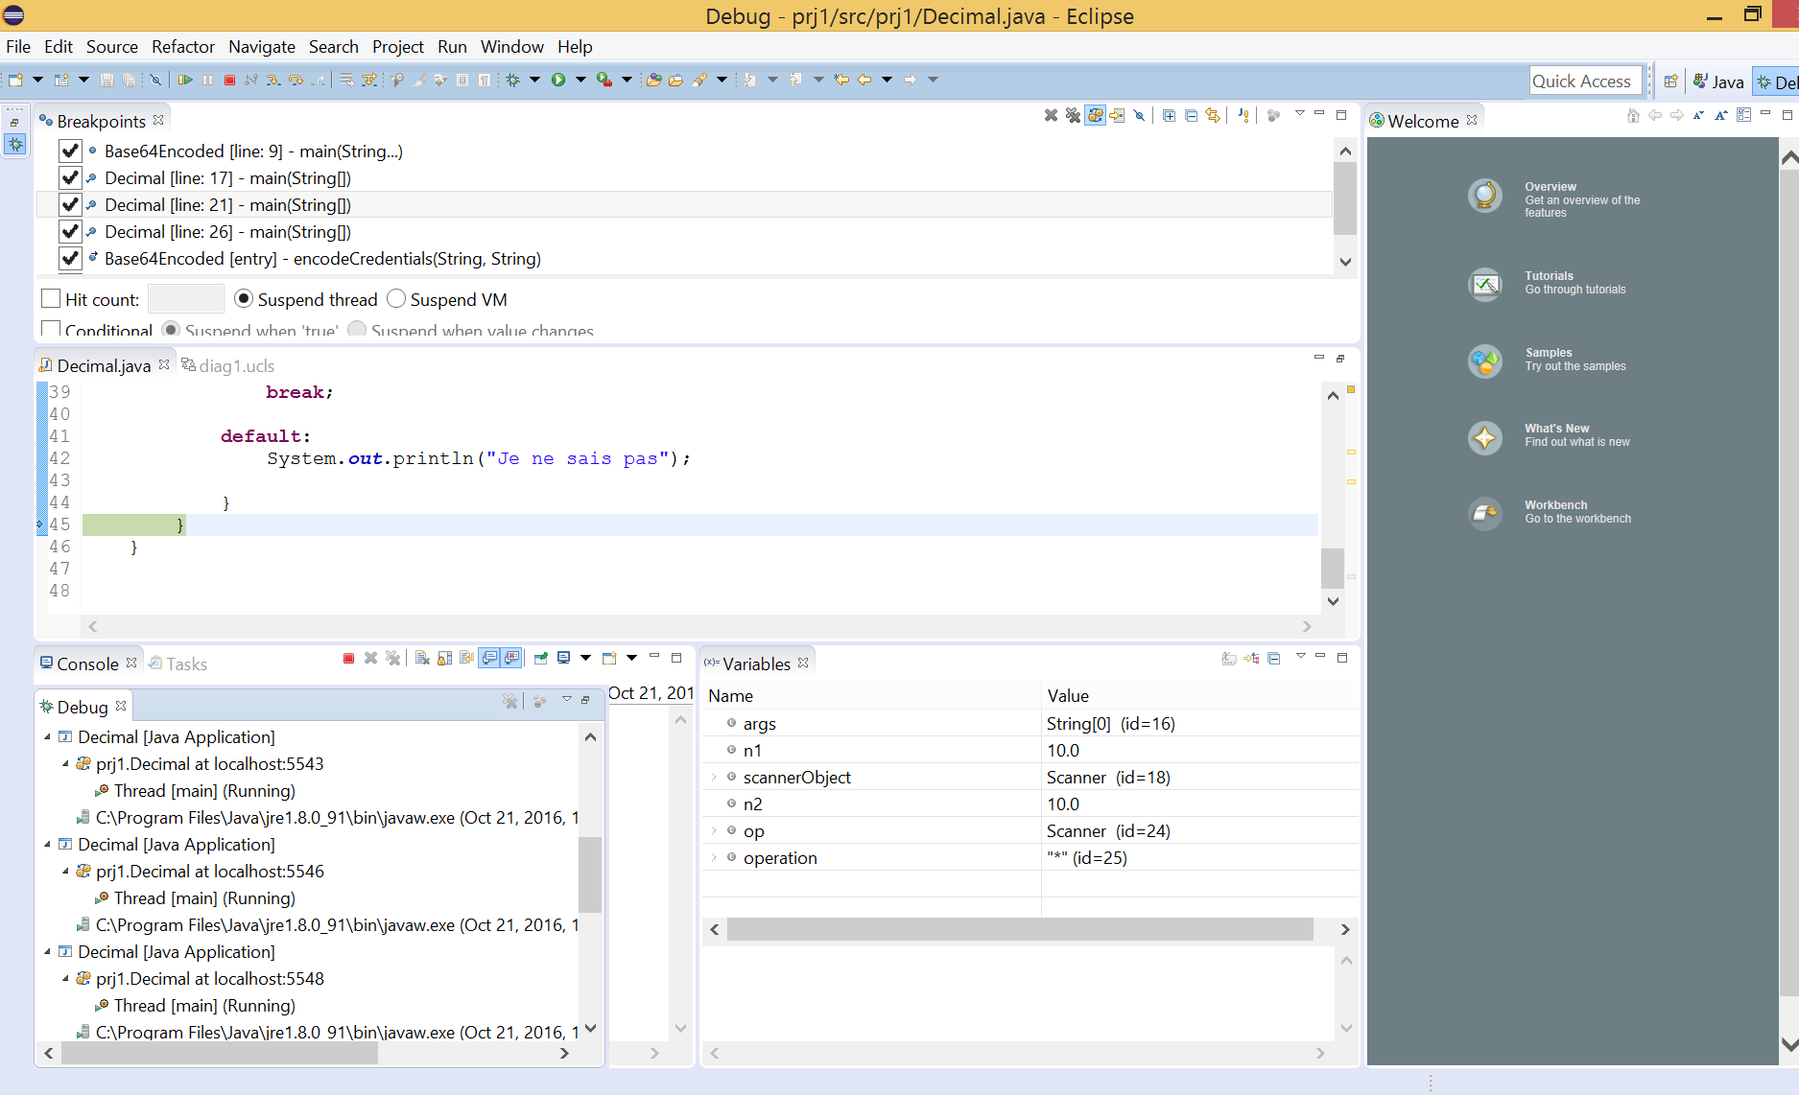

Slide 10
You can easily pull projects from Git into eclipse
  File -> Import -> Git -> Projects from Git
  Next -> Clone URI
  Enter URI -> Next -> … ->Finish

Slide 11
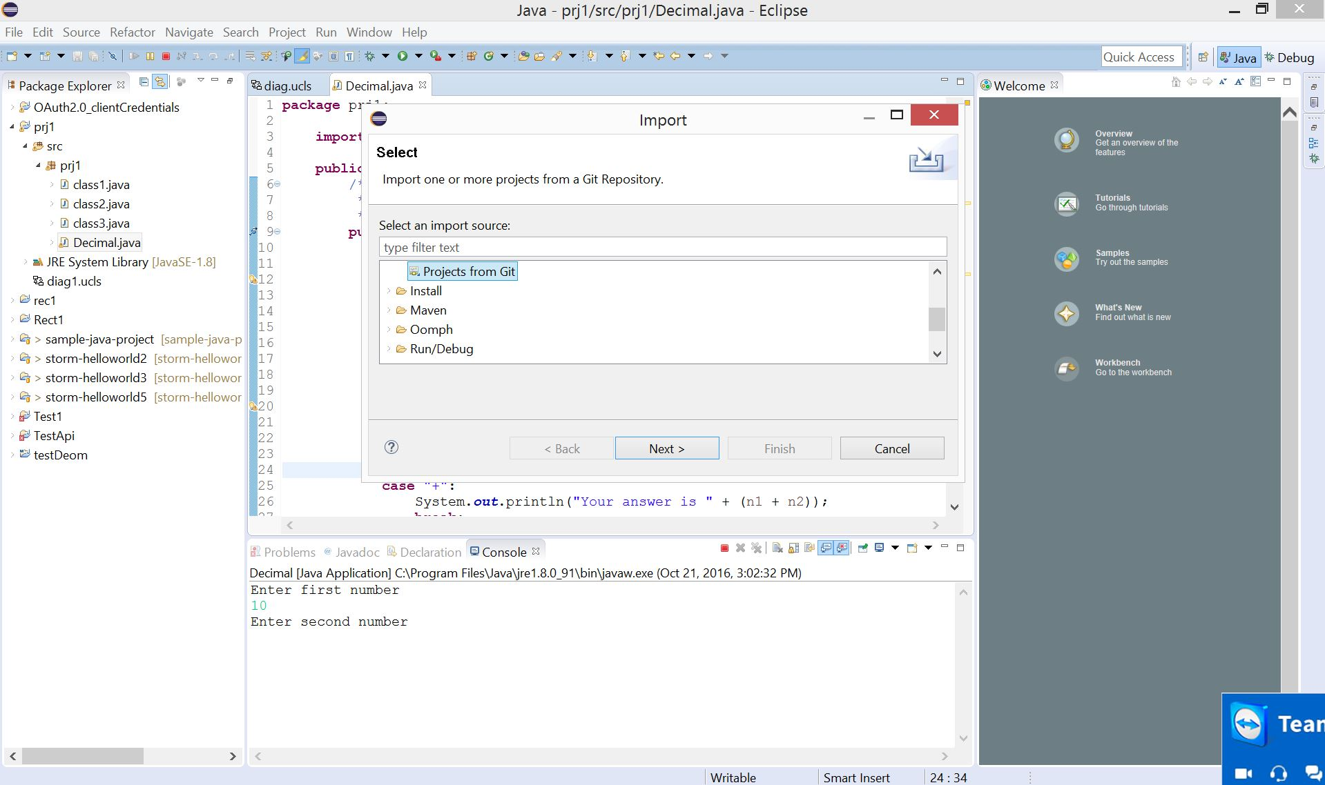

Slide 12
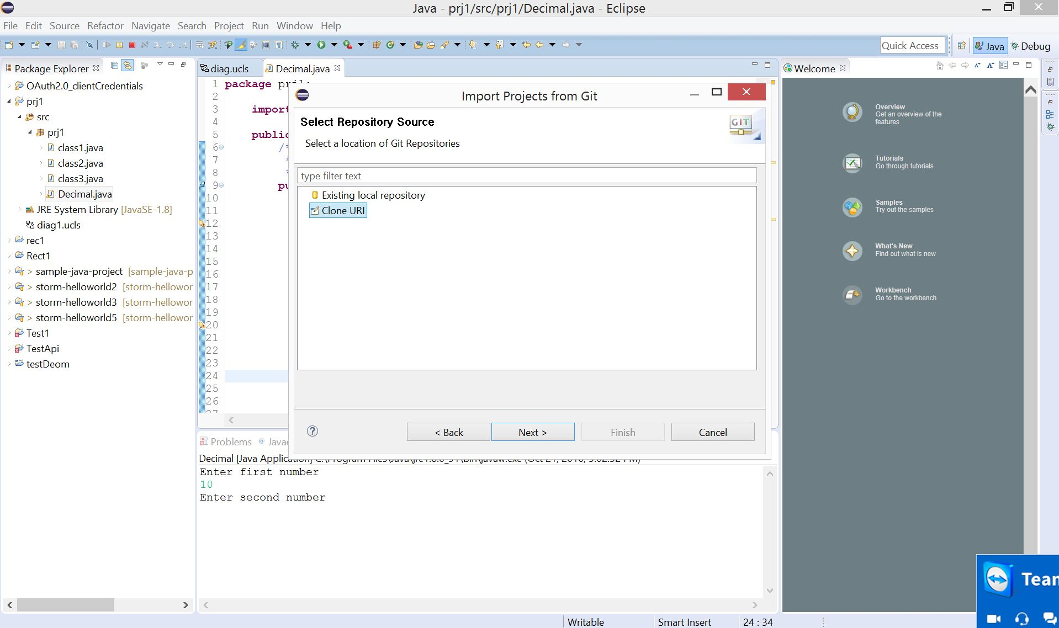

Slide 13
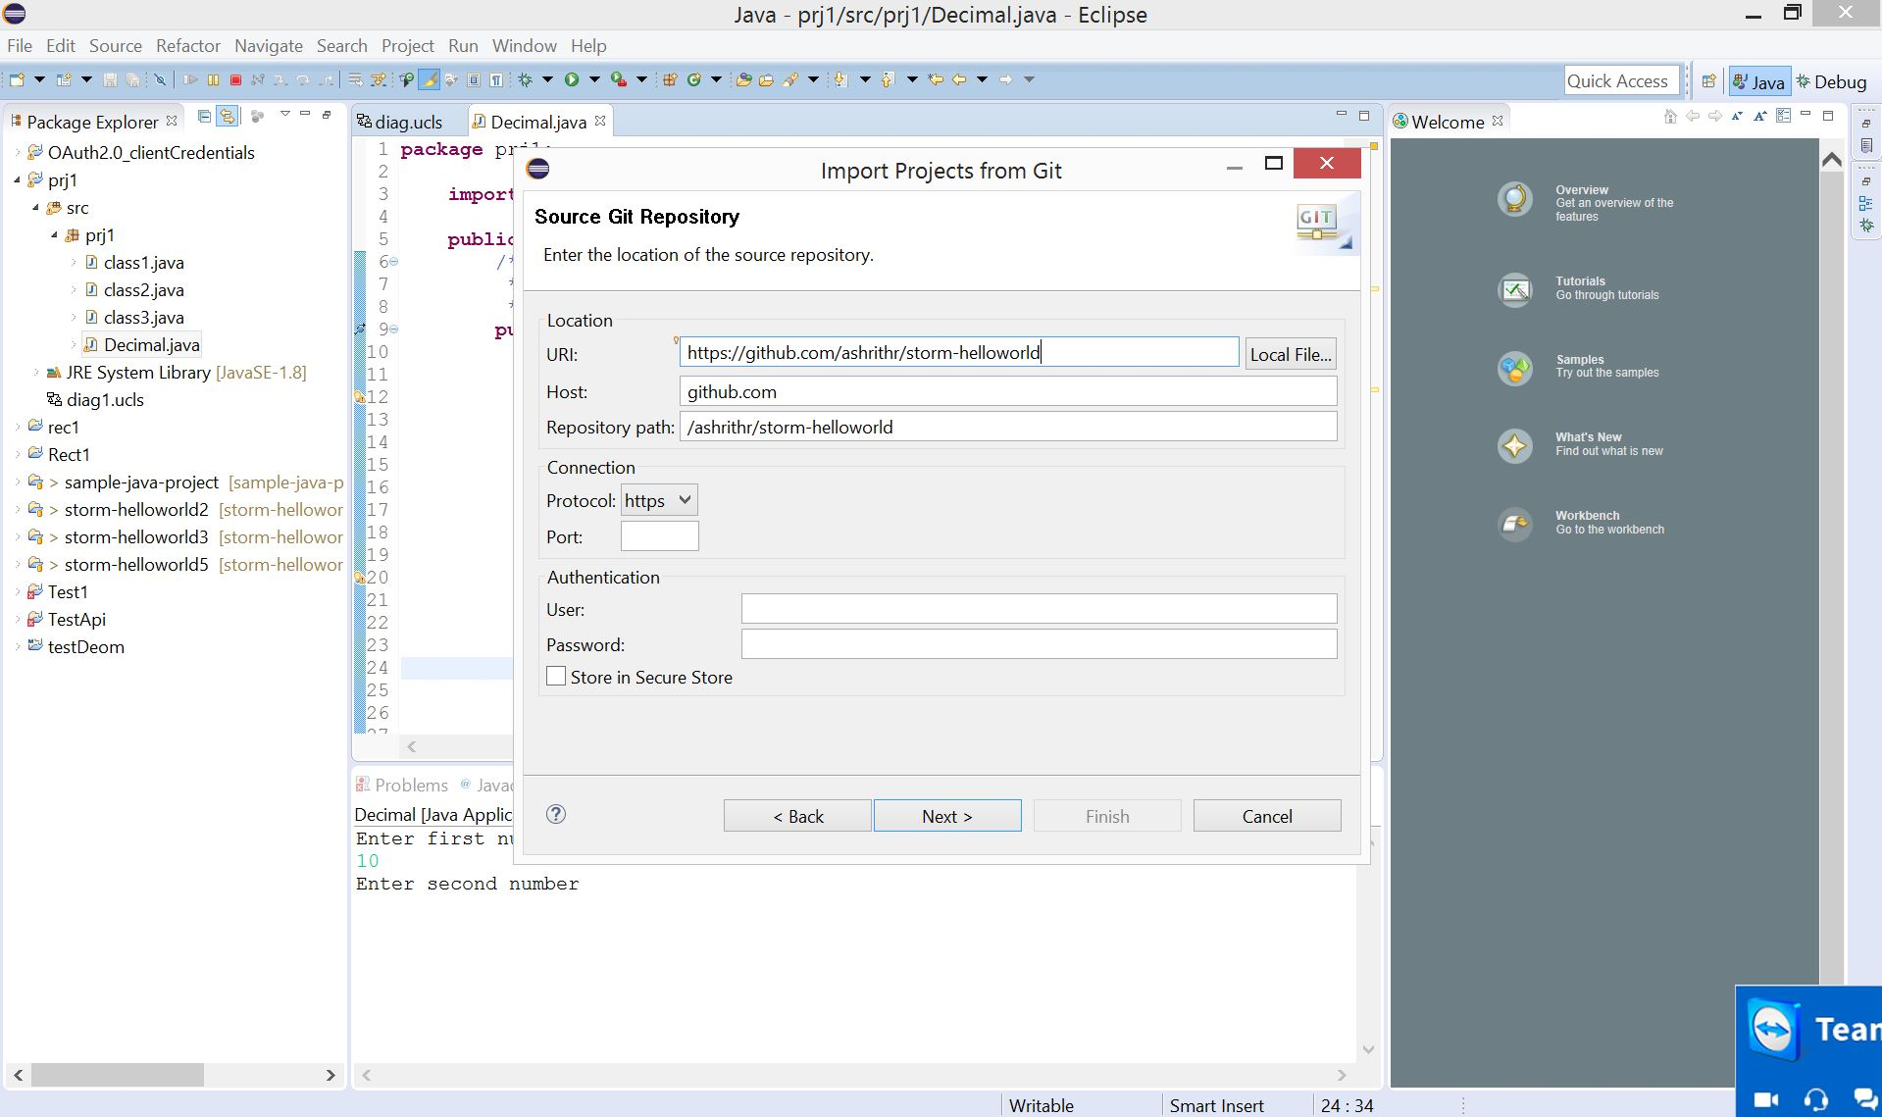

Slide 14
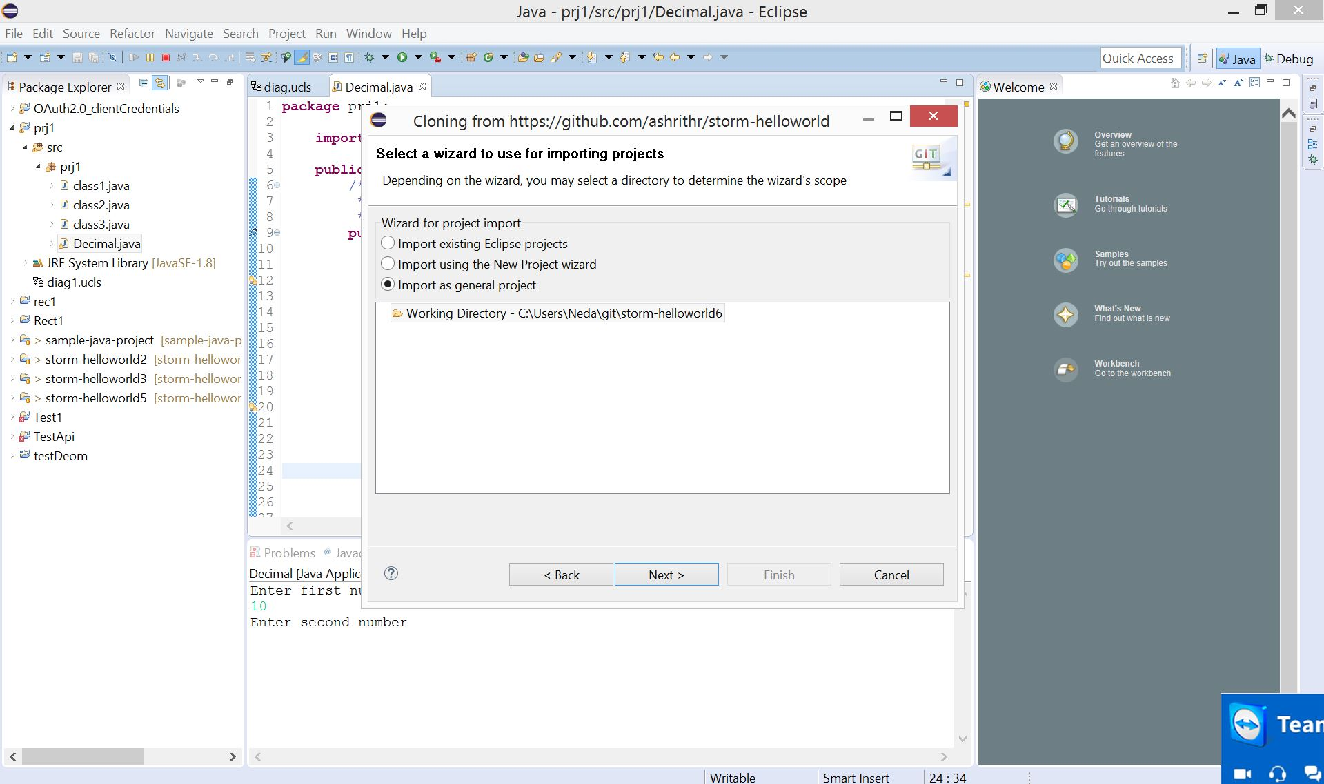

Slide 15
UML in eclipse
  Automatically convert java code into UML
How to Install:
  Go to “Help” tab -> install new software
  Type “http://www.objectaid.com/update” in “work with”
  Restart eclipse
  Right click on the project name -> New -> Other -> Class diagram
  Copy and Paste all the classes into the empty file
  YES! Class diagram is generated!

Slide 16
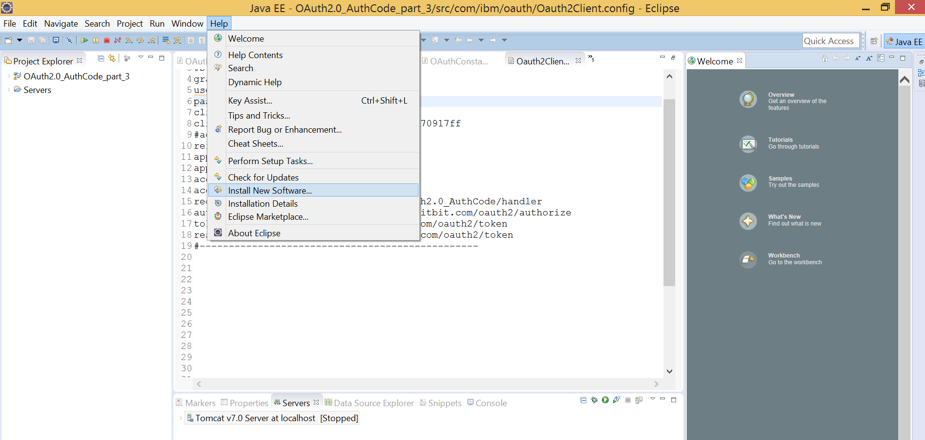

Slide 17
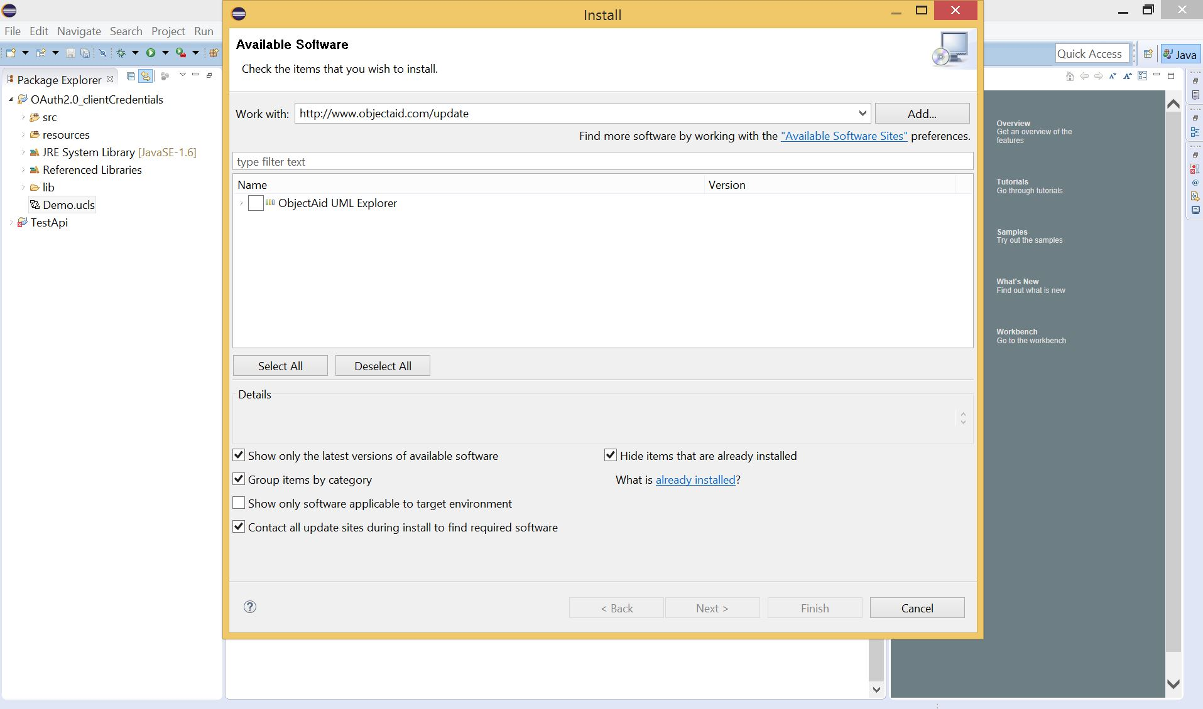

Slide 18
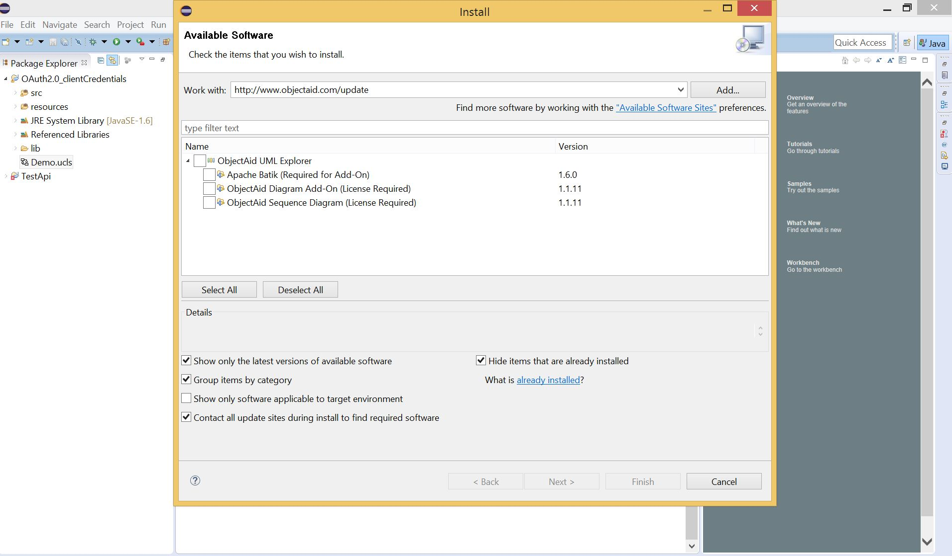
Select class diagram. Since I already installed it, it is not in my list!

Slide 19
Select next ->next
Accept agreement!
Restart

Slide 20
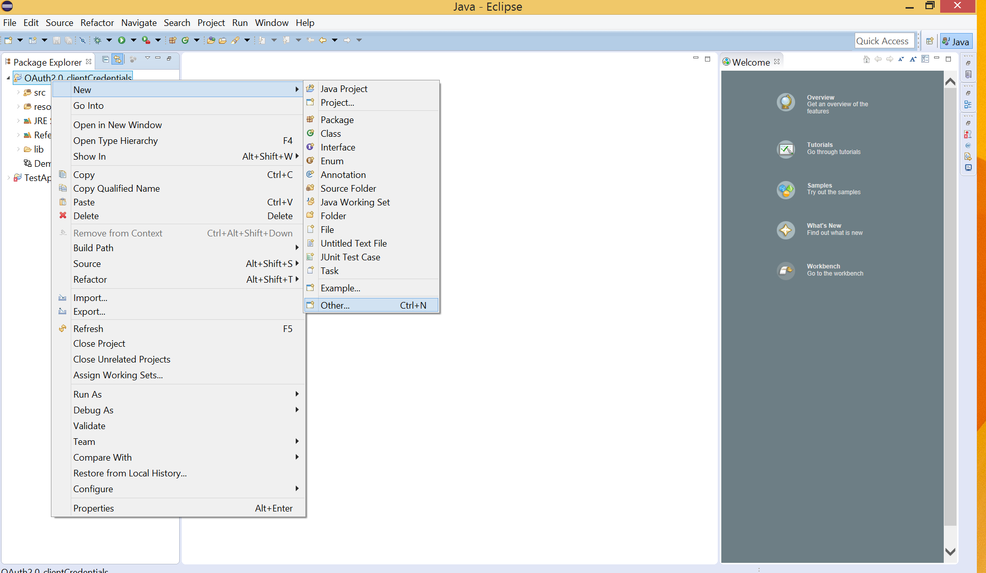

Slide 21
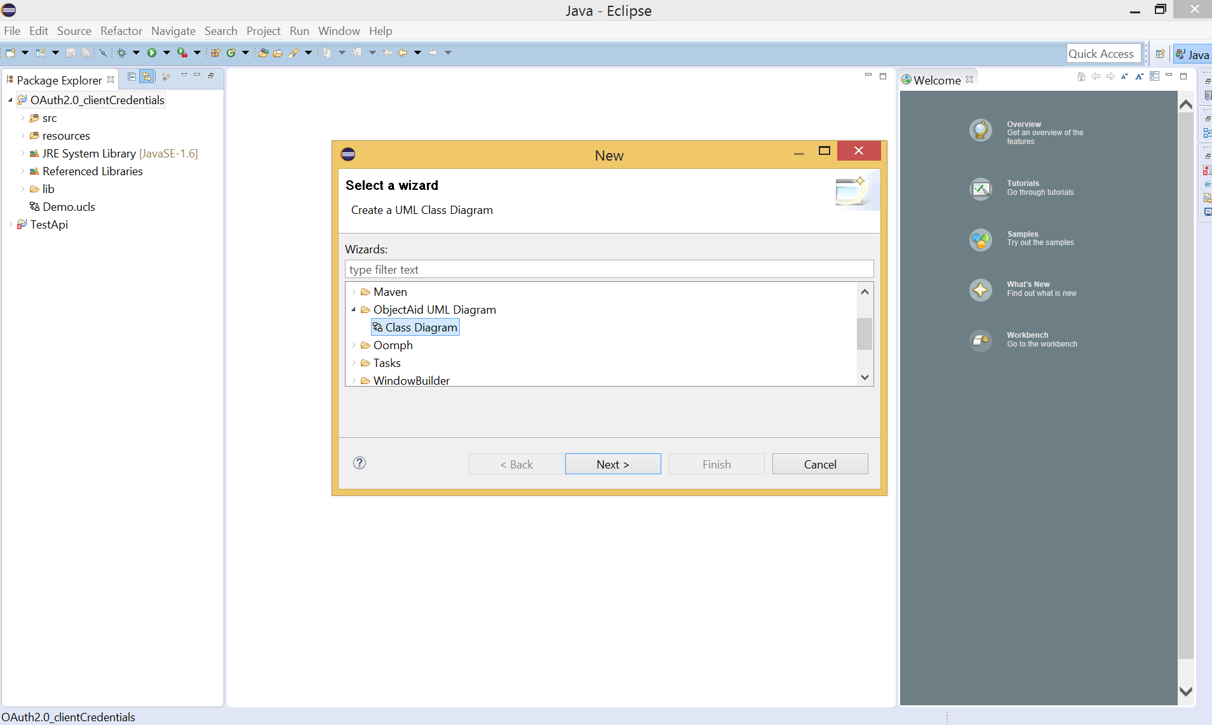

Slide 22
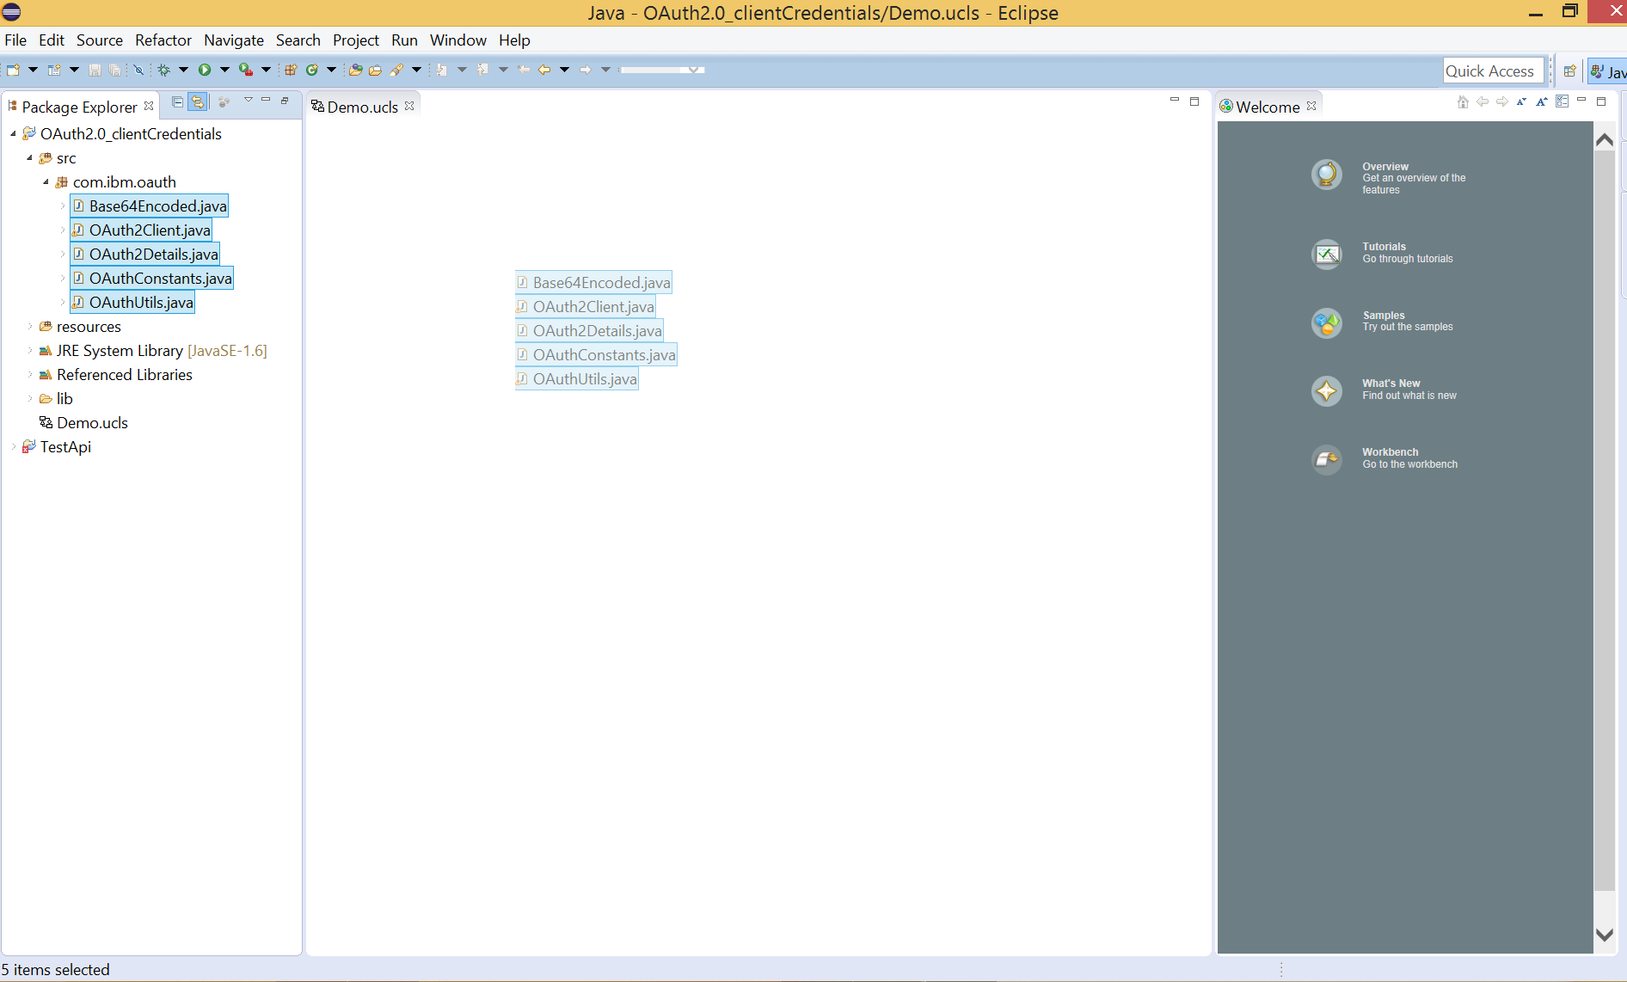

Slide 23
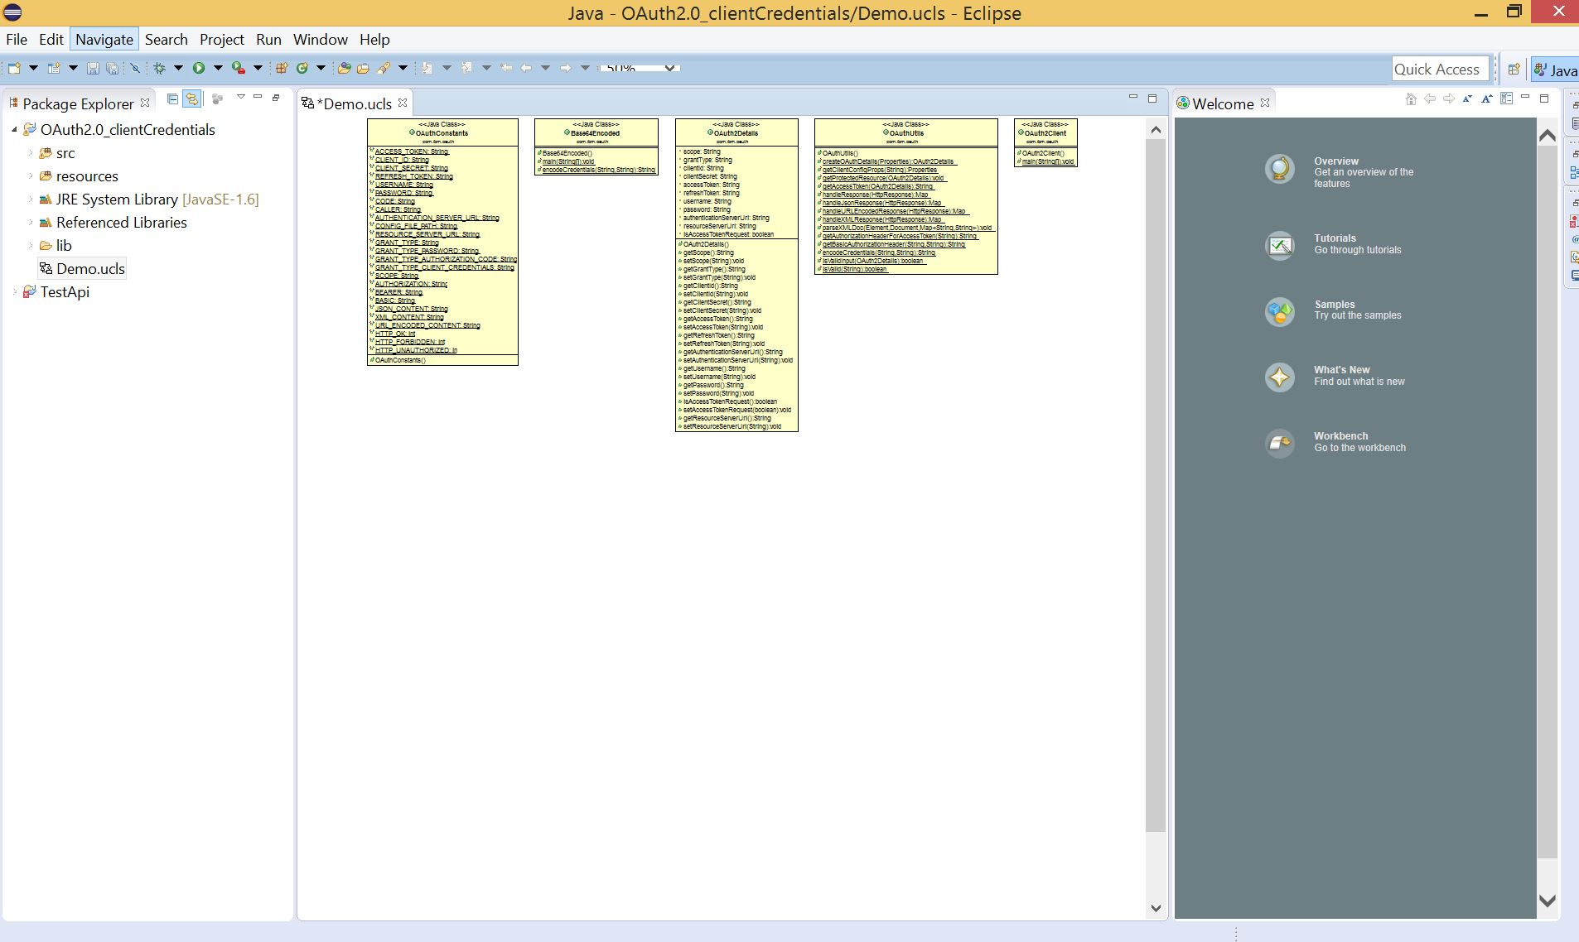

Slide 24
Optional Homework
Please consider the following items seriously
  Relationship between classes (aggregation, composition, inheritance, etc.)
  Variable names
  Return type of the methods
  Design patterns
Read Chapter 6 carefully.

Slide 25
https://www.ntu.edu.sg/home/ehchua/programming/howto/EclipseJava_HowTo.html
http://www.objectaid.com/download
https://www.youtube.com/watch?v=_Z3eIy5nRgQ

Slide 26

Neda Hajiakhoond Bidoki
hajiakhoond@knights.ucf.edu

