Slide 1
COP 4331 Recitation #2
Department of Electrical Engineering and Computer Science
University of Central Florida
Fall 2016

Slide 2
Unified Modeling Language
Class & Sequence Diagrams

Slide 3
Class Diagram
Each class is divided into three components:

Slide 4
Class Diagram
Each class is divided into three components:
Class Name

Slide 5
Class Diagram
Each class is divided into three components:
Class Name
Attributes

Slide 6
Class Diagram
Each class is divided into three components:
Class Name
Attributes
Attributes can be:
+ Public
- Private
# Protected

Slide 7
Class Diagram
Each class is divided into three components:
Class Name
Attributes
Operations

Slide 8
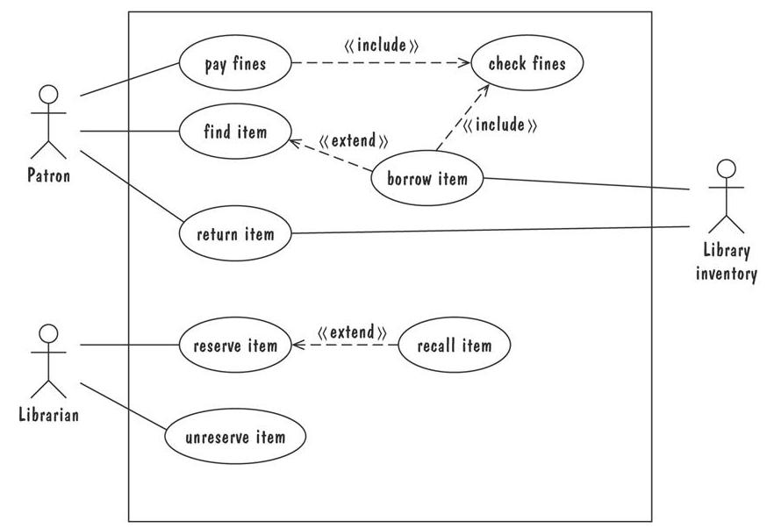
Class Diagram example:

Slide 9
Class Diagram example:
Patron

Slide 10
Class Diagram example:
Patron
# ID_Number : integer
+Name : String
- Fines : double

Slide 11
Class Diagram example:
Patron
# ID_Number : integer
+Name : String
- Fines : double
checkFines()
payFines()

Slide 12
Class Diagram
Class diagrams also contain information regarding the relationship between them
  Association
  Dependency
  Generalization

Slide 13
Class Diagram
Association: A link indicating that two classes need to communicate with one another
Student
Professor

Slide 14
Class Diagram
Association: A link indicating that two classes need to communicate with one another
  Multiplicity: Every professor has 1 or more students
Student
Professor
[1…*]

Slide 15
Class Diagram
Association: A link indicating that two classes need to communicate with one another
  Multiplicity: Every professor has 1 or more students
  Role Names: Students learn from Professors
Student
teaches
learns from
Professor

Slide 16
Class Diagram
Aggregation: “has a” association. Each part exists outside of the whole
    Shown by using an empty diamond
Wheel
Car
Engine
The head of arrow should point something bigger than the bottom

Slide 17
Wheel
Car
Engine
public class Engine {
. . .
}
public class Car {
private Engine engineV6;
private Wheel[] wheels;
public Car(Engine engine, Wheel[] wheels){
engineV6 = engine;
this.wheels=wheels;
}
. . .
}
Car does not manage lifetime of Engine. If car gets destroyed, wheel still stays active.

Slide 18
Class Diagram
Composition: demonstrates strong ownership, the part cannot exist without the whole and vice versa
    Shown by using a filled diamond
Arm
Person
Leg
The head of arrow should point something bigger than the bottom

Slide 19
Arm
Person
Leg
public class Arm
{
. . .
}
public class Person
{
Arm leftarm = new Arm();
.......
}
Person manages the lifetime of Arm.
Arm is created in Person Class.

Slide 20
Class Diagram
Dependency relationship:
  Is a semantic relationship between classes because the functionality of one depends on the other
Calendar
addEvent(p: Party)
Party

Slide 21
Class Diagram
Generalization: connection between a subclass and a superclass
People
Student
Professor

Slide 22
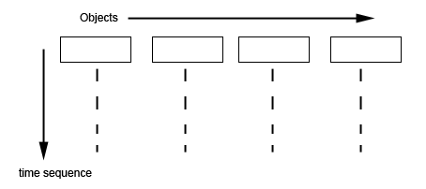
Sequence Diagram
Sequence diagrams emphasis the time ordering of messages
  Objects create the “object life line”
  Active objects are shown in a time period

Slide 23
SSD vs SD
System Sequence Diagrams interaction between System and the actors whereas
Sequence Diagram shows interaction between components of the system

Slide 24
Sequence Diagram
lifeline
Messages
Guards
Combined fragments (alternatives, options, and loops)

Slide 25
Sequence Diagram
Messages are shown by a horizontal line between life lines
  May include a condition
Customer
Bank
withdraw money

Slide 26
Sequence Diagram
A return message is a response from the object
Customer
Bank
withdraw money
money

Slide 27
Sequence Diagram
Arrow with open head: Asynchronous message
The sender does not wait for the receiver to finish processing the message, it continues immediately.
Customer
Bank
withdraw money
money
ThankYou

Slide 28
Sequence Diagram
The end of an object life line is demonstrated by an X. That means the object is destroyed.
Bank

Slide 29
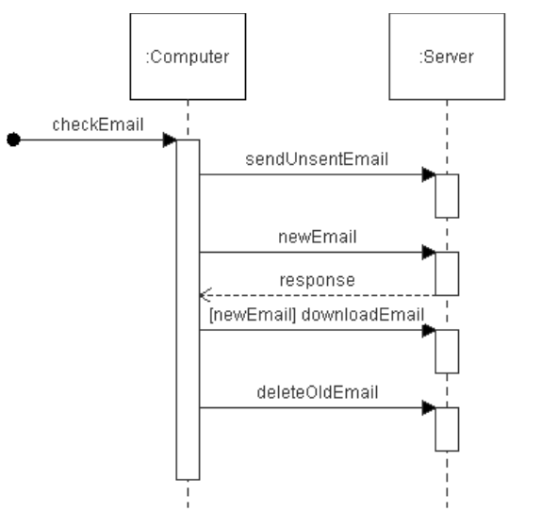
Unknown or unrelated source
is Returned Value

Slide 30
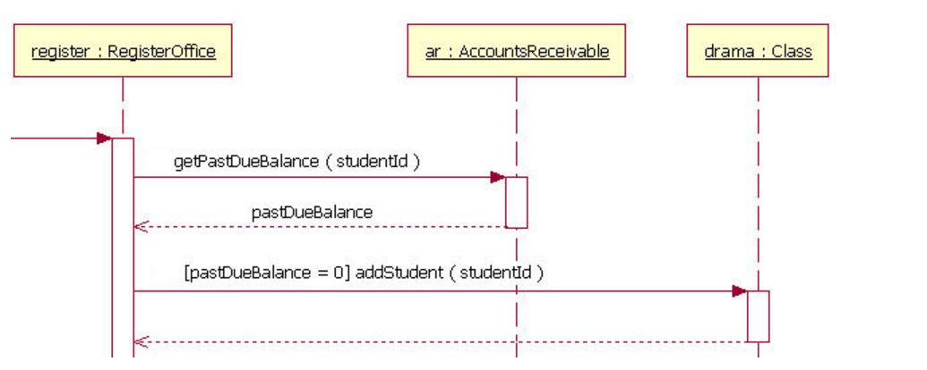
Guards
when a condition must be met for a message to be sent to the object
  (sometime the object name is underlined which refers to a specific instance of that object)

Slide 31
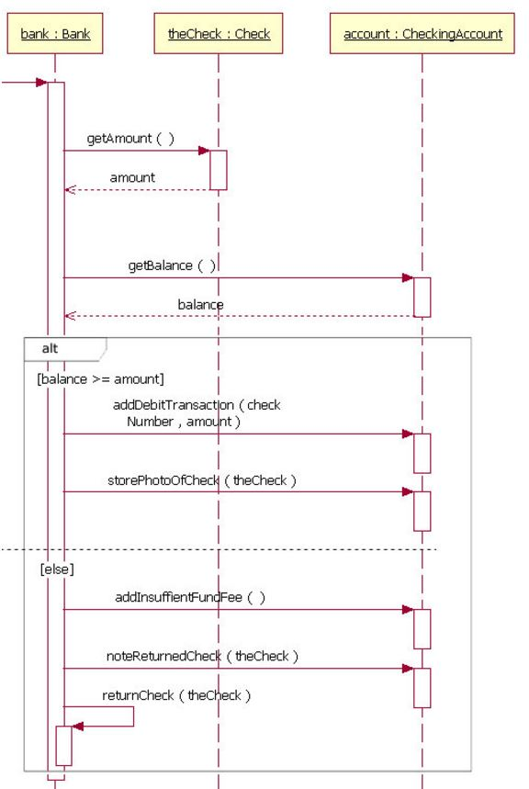
If condition
Condition
  Above the message line

Slide 32
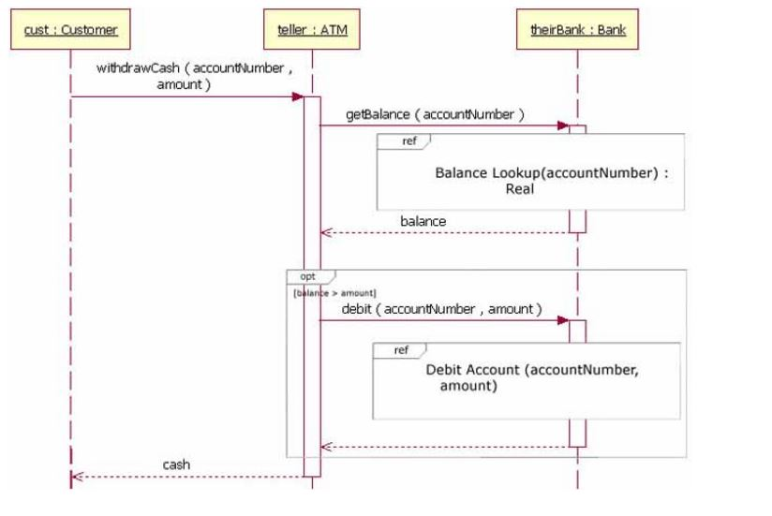
Nesting of Frames

Slide 33
References
Shari Lawrence Pfleeger and Joanne M. Atlee, "Software Engineering: Theory and Practice", 4th Edition, Prentice Hall, 2010.
Prepared/modified by
Kia Manoochehri
  kiam@knights.ucf.edu
Gurkan Solmaz
  gsolmaz@knights.ucf.edu
Salih Safa Bacanli
  bacanli@knights.ucf.edu
Neda Hajikahoond
  hajiakhoond@knights.ucf.edu

